Slide 1
Risk factors: the case of CEI, the effect on expected returns and its relationship with Market factor
Edoardo Anfelli
Thaddeus Da Silva Correa

Slide 2
Summary of topics
Statistical Significance and Fit of the Regression Model on Excess Returns & Residuals Analysis
Significance of the CEI Risk Premium
Expected Yearly Excess Return for AAA, BBB, CCC, and our suggested Portfolios (5 examples)
Adjusting CEI Risk Premium for Market Risk: Is It Biased?

Slide 3
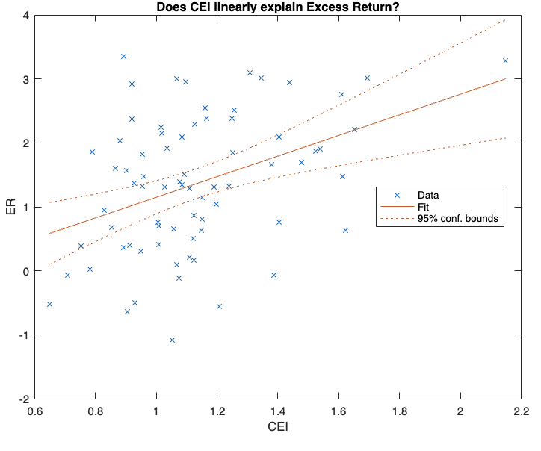
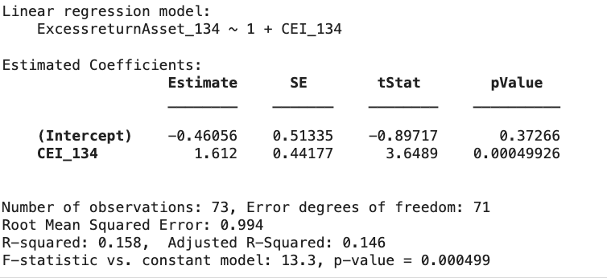
Statistical Significance and Fit of the Regression Model on Excess Returns & Residuals Analysis
Significance of Regressors:
The independent variable CEI_134 is statistically significant (p-value = 0.0005), meaning it has a meaningful impact on the dependent variable ExcessreturnAsset_134.
The intercept is not significant, which is not unusual.
Regression Fit:
The R-squared (0.158) indicates that the model explains only 15.8% of the variation in the excess return of the asset, suggesting a low fit.
The Adjusted R-squared (0.146) confirms that the overall model fit is still weak even after accounting for model complexity.
The RMSE (0.994) shows that the model's predictions have relatively large errors, indicating the model does not predict the excess return very precisely.

Slide 4
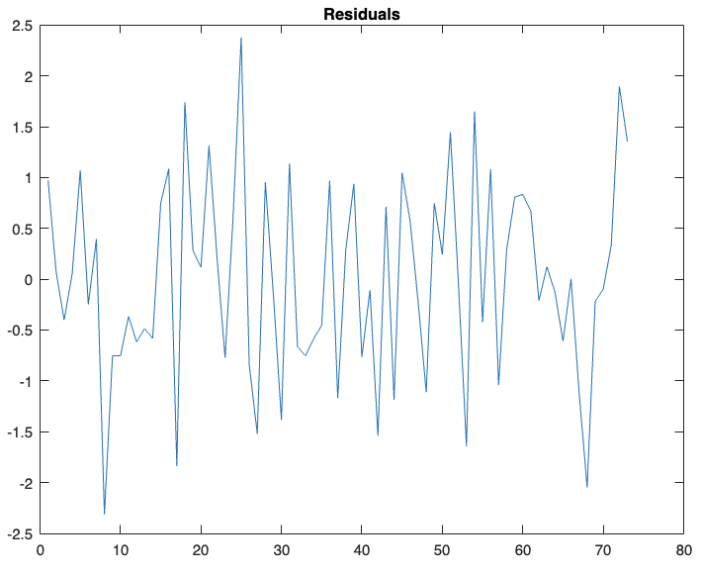
Residuals
Heteroskedasticity
Breusch-Pagan Test Statistic of 0.30982
p-value of 0.57779
Our model does not show signs of heteroscedasticity, as the p-value is high, and the Breusch-Pagan test statistic is low. This implies that the assumption of homoscedasticity (constant variance of the residuals) holds, which is ideal for the validity of the regression model’s results.
In summary:
The model’s residuals are likely homoscedastic, meaning their variance is constant and does not systematically change with the values of the independent variables.
We can proceed confidently with the results of your regression analysis without worrying about heteroscedasticity affecting your conclusions.

Slide 5
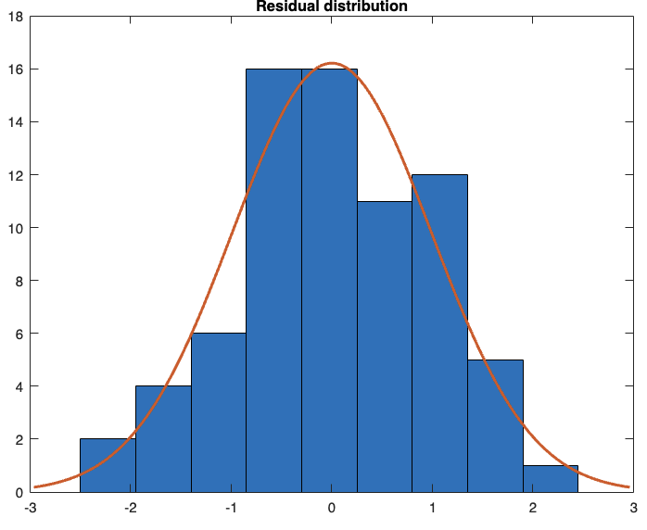
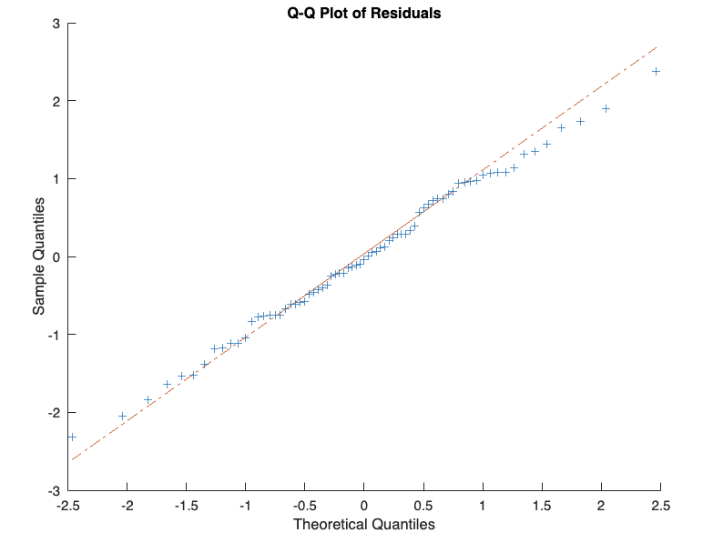
Residuals
Normality
QQ Plot
The closer the points are to the line, the more they are distributed as Normal, in this case, they are really close to.
JB Test
High p-value:
A p-value of 0.5 or higher indicates that the residuals do not deviate significantly from a normal distribution.
he null hypothesis of the JB test is that the residuals are normally distributed. Since the p-value is large, you fail to reject the null hypothesis, meaning the residuals likely follow a normal distribution.
K-S Test
A high p-value (in our case 0.98884) means that there is no evidence to reject the null hypothesis, which assumes that the residuals follow a normal distribution.
In other words, your data are very likely to follow a normal distribution since the K-S test did not find any significant deviation from normality.
Is a good sign for our model. It suggests that the assumption of normally distributed residuals holds, making our statistical inferences from the model more reliable.

Slide 6
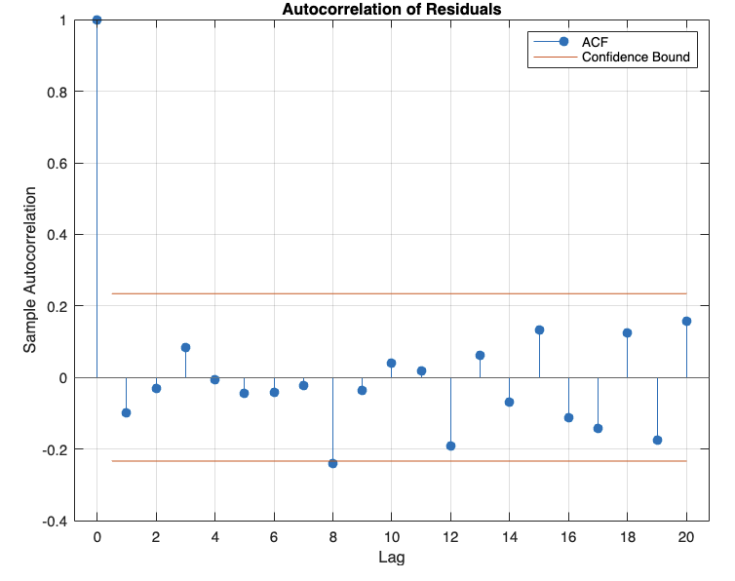
Residuals
Autocorrelation
Low mean autocorrelation (0.0196): This small value suggests that there is almost no correlation between the residuals at different time lags. In practical terms, the residuals from our model appear to be largely independent of each other.
Independence of residuals: When residuals are independent (or nearly so), it means that each residual is not influenced by the previous or future values. This is a desirable property in many models, as it indicates that the model has captured most of the structure in the data, leaving only random noise.
Interpretation:
No significant autocorrelation: The low autocorrelation suggests that there is no persistent pattern in the residuals that would indicate autocorrelated errors. This means that the model does not suffer from autocorrelation, which is often a sign that the model is well-specified in capturing the underlying relationships between the variables.
Model validation: Since our residuals are nearly independent, we can confidently interpret the results of your regression model. The absence of autocorrelation indicates that our model has successfully accounted for temporal relationships, and the residuals are behaving like white noise, which is the ideal scenario.

Slide 7
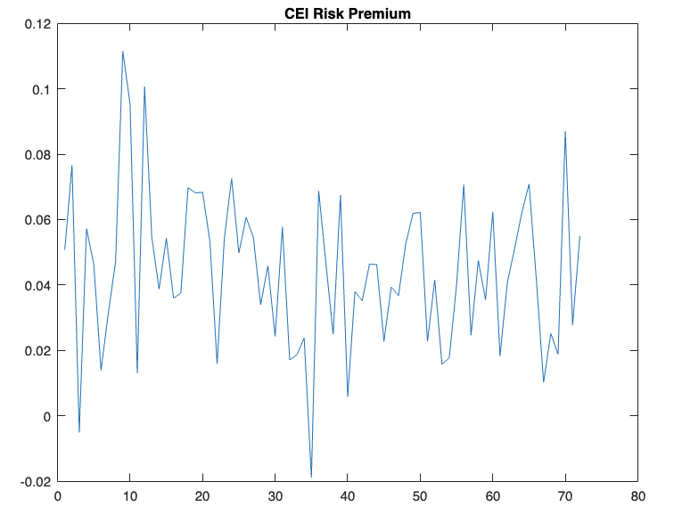
CEI RP
Key Findings
Given that your Augmented Dickey-Fuller (ADF) test p-value is 0.00355:
It’s a stationary time serie
This stationarity implies that the statistical properties of the series, such as mean and variance, are constant over time, making it suitable for further statistical analysis.
T-statistic: 15.5563
P-value: 0.0000
Alpha Level: min(1;1/73 (≈ 0.0137)) so 0.01

Slide 8
Assets’ Performance
AAA
Relatively low mean return (0.2%) and low risk (standard deviation of 1.2%).
Positive skewness (0.1999) means there are occasional positive outliers in the returns.
Kurtosis of 3.3538 suggests the return distribution has slightly heavier tails than a normal distribution, meaning it may occasionally have extreme returns.
BBB
Negative mean return (-8.16%), meaning it consistently underperforms.
Standard deviation (3.36%) is higher than AAA, indicating more variability in returns.
Negative skewness (-0.1999) implies downside risk—the left tail of the distribution is heavier, indicating more frequent or extreme negative returns.
Similar kurtosis to AAA, but with a more substantial downside.
CCC
Pprovides the highest mean return (5.93%) but also has the highest standard deviation (4.33%), implying greater risk.
Positive skewness (0.1999) suggests occasional large positive returns, and kurtosis (3.3538) implies the presence of occasional extreme returns in both directions, but primarily on the upside.

Slide 9
Assets’ Performance
AAA
• AAA has a relatively low mean return (0.2%) and low risk (standard deviation of 1.2%).
• The positive skewness (0.1999) means there are occasional positive outliers in the returns.
• The kurtosis of 3.3538 suggests the return distribution has slightly heavier tails than a normal distribution, meaning it may occasionally have extreme returns.
BBB
• BBB has a negative mean return (-8.16%), meaning it consistently underperforms.
• The standard deviation (3.36%) is higher than AAA, indicating more variability in returns.
• Negative skewness (-0.1999) implies downside risk—the left tail of the distribution is heavier, indicating more frequent or extreme negative returns.
• Similar kurtosis to AAA, but with a more substantial downside.
CCC
• CCC provides the highest mean return (5.93%) but also has the highest standard deviation (4.33%), implying greater risk.
• Positive skewness (0.1999) suggests occasional large positive returns, and kurtosis (3.3538) implies the presence of occasional extreme returns in both directions, but primarily on the upside.
• AAA: If AAA has a low beta with respect to the CEI, this implies that AAA is less sensitive to changes in carbon emissions and may be more environmentally resilient. This could explain why it has a positive weight in most portfolios, especially for conservative investors seeking lower risk and exposure to CEI.
• BBB: If BBB has a negative beta, its negative return and negative weight in most portfolios suggest it might be more exposed to carbon-intensive industries or other risks related to CEI. Investors are likely shorting BBB to hedge against risks associated with carbon emissions.
• CCC: If CCC has a high beta, it is more sensitive to carbon risk. The fact that CCC has higher returns but higher risk means that investors expecting high returns may accept its exposure to CEI risks. It is weighted more heavily in the riskier portfolios.

Slide 10
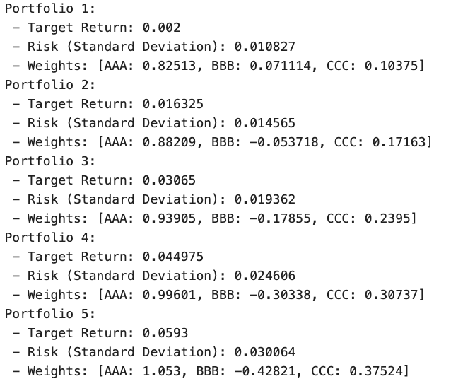
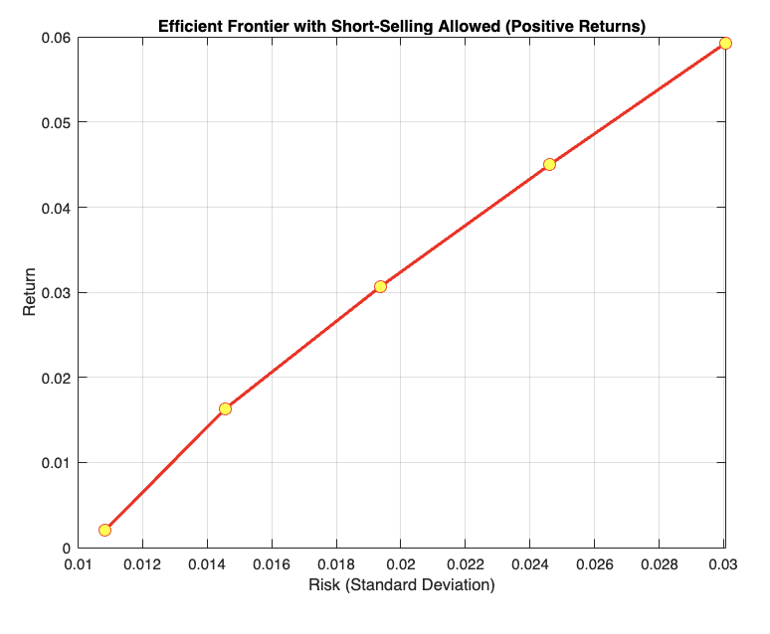
crecimiento máximo

Slide 11
AAA’s consistent positive weighting in all portfolios indicates that it is low CEI risk, making it attractive to both conservative and risk-seeking investors.
BBB consistently has negative weight due to its negative return and high sensitivity to CEI risk, making it a good candidate for shorting.
CCC offers the highest returns but also the highest CEI exposure and risk, making it more suitable for investors with higher risk tolerance who expect to benefit from industries exposed to carbon risk.
This strategy aligns with investors’ views on the environmental impact of carbon emissions, with portfolios offering different levels of exposure to CEI based on risk-return preferences.

Slide 12
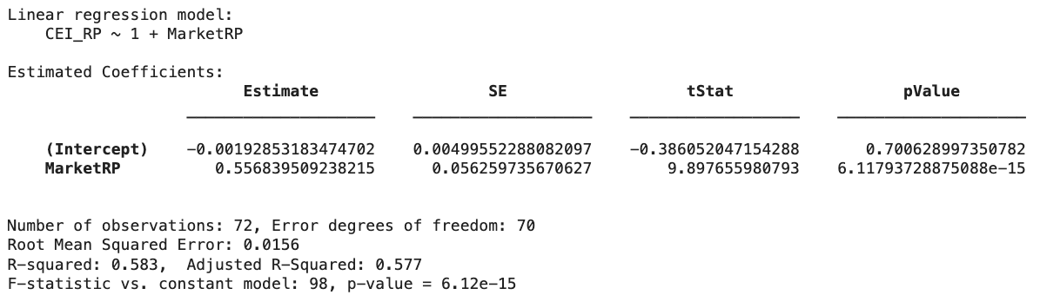
Adjusting CEI Risk Premium for Market Risk: Is It Biased?
Correlation Analysis:
0.763703490165299
p value of 6.117937288749957e-15
Interpretation:
The strong positive correlation and significant p-value suggest that the CEI risk premium and the market risk premium are closely related. Specifically:
A significant portion of the variation in the CEI risk premium is explained by the market risk premium.
The large difference between the non-adjusted CEI premium (0.0440) and the adjusted CEI premium (-7.71e-19) is explained by the fact that once market risk is accounted for, there is almost no independent effect of the CEI premium.
Conclusion:
CEI and Market Risk are Strongly Correlated: The correlation of 0.7637 shows that the CEI risk premium is heavily influenced by market risk.
CEI Premium is Mostly Explained by Market Risk: most of the CEI premium was driven by market risk.
Regression Analysis
Market risk premium (MarketRP) has a strong and statistically significant impact on the CEI risk premium (CEI_RP). The coefficient for MarketRP (0.5568) is significant, with a very small p-value, indicating that market movements strongly influence the CEI premium.
Intercept is not significant: The intercept term is not significantly different from zero, meaning that when the market risk premium is zero, the CEI risk premium is also likely to be near zero.
Model fit: The model explains a significant portion of the variation in CEI_RP (R-squared = 0.583), indicating that the market risk premium is a key driver of CEI_RP.

Slide 13
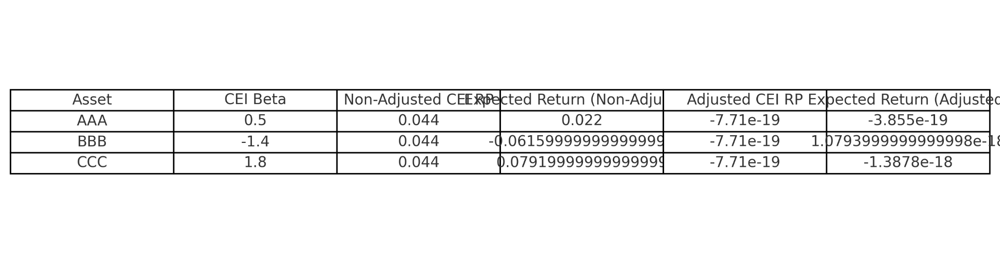
This strong link suggests that much of what was initially considered CEI risk is actually driven by market risk.
The next step might be to focus on the adjusted CEI risk premium, which isolates the part of the CEI premium that is independent of market risk.
Market Risk Explains Most of the CEI Premium: The strong correlation and significant regression results suggest that most of the variation in the CEI risk premium can be attributed to market risk.
Initial CEI Premium Was Biased: The initial non-adjusted CEI premium was likely overstated because it failed to account for the relationship with market risk.
Adjusted CEI Risk Premium (as mean of residuals):
The adjusted CEI mean is extremely close to zero (-7.71e-19),the previous was 0.440.
It suggests that after accounting for market risk, the CEI risk premium has very little to no effect.
This implies that any effect the CEI premium initially
seemed to have was mostly absorbed by the market risk.

