Slide 1
EVALUATING ASSETS’ PERFORMANCE
How does Berkshire Hathaway perform compared to index ETFs?
And in an equally weighted portfolio?
Ricards Bulavs
Aigars Hardijs Karulis
Eduardo Anfelli
Thaddeus da Silva Correa

Slide 2
Summary
Invesco QQQ Trust (QQQ):
Type: Total replication (cash) ETF directly holding assets of the Nasdaq 100 Index.
Benchmark: Nasdaq 100 Index (top 100 non-financial companies listed on Nasdaq).
Total Expense Ratio (TER): 0.30%.
Vanguard Total World Stock ETF (VT):
Type: Total replication (cash) ETF aiming to replicate the FTSE Global All-Cap Index.
Benchmark: SPDR S&P 500 ETF Trust (SPY).
Total Expense Ratio (TER): 0.07%.
SPDR S&P 500 ETF Trust (SPY):
Type: Total replication (cash) ETF fully replicating the S&P 500 Index.
Benchmark: S&P 500 Index (directly tracked).
Total Expense Ratio (TER): 0.09%.
Berkshire Hathaway Inc. (BRK-B):
Benchmark: SPY (S&P 500), due to substantial overlap with large-cap U.S. stocks.
This analysis focuses on the performance evaluation of three Cash Exchange-Traded Funds (ETFs)—Invesco QQQ Trust (QQQ), Vanguard Total World Stock ETF (VT), and SPDR S&P 500 ETF Trust (SPY)—as well as Berkshire Hathaway Inc. (BRK-B). The evaluation period spans from July 1, 2008, to July 1, 2024, with a total of 192 monthly observations.

Slide 3
Question 1
Portfolio Weights
Lowest-Risk Portfolio Weights:
QQQ: 2.0191
VT: -1.0000
SPY: -0.0191
Medium-Risk Portfolio Weights:
QQQ: 2.4115
VT: -1.0000
SPY: -0.4115
Highest-Risk Portfolio Weights:
QQQ: 3
VT: -1
SPY: -1
Download monthly data from January 2000 to July 2024 of three ETFs investing in stocks, Berkshire Hathaway Inc. (BRK-B) stock price, and the relevant risk-free rate. Describe the first, second, and third portfolio's investment strategy. Compute all measures of portfolio performance evaluation analysis (see Performance Measures below) for the portfolios and BRK-B. Compare across portfolios and to BRK-B.

Slide 4
OUR 3 PORTFOLIOS PERFORMANCE (SR>0)
p(S)=min(0.01;1/192 = 0.00520) so 0.00520
Portfolio 1 (Lowest-Risk):
Mean Excess Return: 0.0114
Standard Deviation: 0.0713
Sharpe Ratio: 0.1600
P-value: 0.0139
Treynor's Ratio (RT): 0.0231
Jensen's Alpha (α): 0.0136
Information Ratio (IR): 0.2661
Information Ratio Benchmark (IRB): 0.3102
M2 Measure (M2): 0.0186
Portfolio 2 (Medium-Risk):
Mean Excess Return: 0.0134
Standard Deviation: 0.0777
Sharpe Ratio: 0.1720
P-value: 0.0091
Treynor's Ratio (RT): 0.0314
Jensen's Alpha (α): 0.0153
Information Ratio (IR): 0.2599
Information Ratio Benchmark (IRB):
0.3036
M2 Measure (M2): 0.0192
Portfolio 3 (Highest-Risk):
Mean Excess Return: 0.0163
Standard Deviation: 0.0881
Sharpe Ratio: 0.1852
P-value: 0.0055
Treynor's Ratio (RT): 0.0473
Jensen's Alpha (α): 0.0179
Information Ratio (IR): 0.2531
Information Ratio Benchmark (IRB)
: 0.2946
- M2 Measure (M2): 0.0198

Slide 5
BRKB
• Sharpe Ratio: 0.0010, indicating almost no excess return per unit of risk.
• Sharpe Ratio T-Statistic: 0.0140, with a p-value of 0.4944, suggesting no statistical significance.
• Beta (relative to SP500): 0.6617, implying lower sensitivity to market movements compared to the overall market.
• Jensen’s Alpha (α): 0.0030, indicating a small positive outperformance relative to expected returns based on its beta.
• Information Ratio (IR): 0.0662, showing limited ability to generate excess return relative to benchmark volatility.
• Information Ratio Benchmark (IRB): 0.0994, indicating slightly better performance relative to tracking error.
• M2 Measure (M2): 0.0105, indicating positive but modest risk-adjusted performance when compared to a market benchmark.
The extremely low Treynor’s Ratio for Berkshire Hathaway (8.28e-05) indicates that the stock provides very little return relative to the level of market risk (beta), suggesting poor compensation for the risk taken.

Slide 6
3. Sharpe Ratio:
BRK-B's Sharpe Ratio is extremely low (0.0010), suggesting that the risk-adjusted return is not favorable, especially compared to the three portfolios.
All three portfolios have higher Sharpe Ratios, with Portfolio 3 having the highest (0.1852). This indicates that, despite higher risk, these portfolios provide better compensation per unit of risk compared to BRK-B.
1. Risk and Volatility:
BRK-B has the lowest standard deviation (0.0541), indicating the least volatility among all assets, which implies a more stable return profile.
All three portfolios have higher volatility, with Portfolio 3 being the most volatile (0.0881). This increased risk is reflected in their composition, especially considering the heavy exposure to QQQ.
4. Treynor's Ratio (RT):
BRK-B has a lower Treynor's Ratio(0.0010), implying a lower return per unit of market risk compared to the portfolios.
Portfolio 3 exhibits the highest Treynor's Ratio (0.0473), showing the best performance relative to its market exposure, which reflects a better return generation per unit of systematic risk.
2. Average Returns
The mean excess return for BRK-B is very low (0.000055) compared to all three portfolios, indicating that BRK-B has delivered relatively smaller returns above the risk-free rate.
Mean Excess Return:
Portfolios 1, 2, and 3 have progressively increasing returns, with Portfolio 3 showing the highest mean excess return (0.0163), especially due to the large weighting in QQQ.

Slide 7
5.Jensen's Alpha (α)
Jensen's Alpha for BRK-B (0.0030) is positive, indicating some ability to generate returns above the benchmark.
However, all three portfolios have higher Jensen's Alpha values, with Portfolio 3 again leading at 0.0179. This suggests the portfolios have been more effective in outperforming the benchmark relative to their risk..
7.M2 Measure:
The M2 measure for BRK-B is 0.0105, which is lower compared to all three portfolios.
Portfolio 3, with the highest M2 measure of 0.0198, delivers the best risk-adjusted return when normalized to the risk of the benchmark, suggesting superior performance relative to the risk taken.
6. Information Ratio and IRB:
BRK-B's Information Ratio (0.0662) is lower compared to the portfolios, meaning that the excess returns relative to the benchmark are less efficient when considering tracking error.
Portfolios 1, 2, and 3 all have significantly higher Information Ratios and IRBs, with Portfolio 1 leading in IRB (0.3102). This suggests that these portfolios provide better risk-adjusted outperformance relative to the benchmark compared to BRK-B.

Slide 8
CONCLUSION
Berkshire Hathaway has demonstrated a much more conservative risk profile, with a significantly lower standard deviation, but this has come at the cost of lower excess returns and poorer risk-adjusted performance metrics compared to the three constructed portfolios.
Portfolios 1, 2, and 3 have progressively increasing returns and risk, with Portfolio 3 showing the highest return and best performance across most risk-adjusted metrics (Sharpe, Treynor, Jensen's Alpha)
Portfolio 3, which is the most aggressive, outperforms BRK-B significantly in terms of risk-adjusted returns, indicating that an investor willing to take on more risk could achieve better returns compared to Berkshire Hathaway's more conservative strategy.
However, the negative weights (implying short positions) in VT and SPY for all three portfolios indicate a higher-risk strategy that is not suitable for all investors, especially those with lower risk tolerance like those favoring Berkshire Hathaway's more stable and diversified approach.

Slide 9
Question 2
2. Create an equally weighted portfolio ( same using the four assets (weight 1/4 to all). Analyze performance results. Compare the relative performance of this portfolio to the other four and BRK-B.

Slide 10
EQUALLY WEIGHTED PORTFOLIO
4. Negative Mean Return: The mean return of -0.00073 shows that, on average, the portfolio underperformed the risk-free rate.
5. Higher Kurtosis and Negative Skewness: The portfolio distribution has negative skewness (-0.5092) and higher kurtosis (3.7666), suggesting a tendency toward occasional extreme negative returns.
6. Non-Normal Distribution: The JB P-value (0.0081) indicates the return distribution deviates significantly from normality.
1. Negative Treynor’s and Sharpe Ratios: Both the Treynor’s Ratio (-0.0008) and Sharpe Ratio (-0.0153) are negative, indicating that the equally weighted portfolio did not generate positive risk-adjusted returns.
2. Slight Positive Jensen’s Alpha: Jensen’s Alpha (0.0033) suggests the portfolio outperformed its expected return based on beta, albeit slightly.
3. Moderate Information Ratios: The IR (0.2291) and IRB (0.2609) show that the portfolio managed to deliver some excess return relative to benchmark volatility.

Slide 11
EQUALLY WEIGHTED PORTFOLIO
Key Takeaways:
The equally weighted portfolio has shown underwhelming risk-adjusted performance, as highlighted by the negative Sharpe and Treynor Ratios.
Its small positive Alpha and M² suggest there is limited outperformance, but not enough to suggest that the portfolio is significantly beating the market or the benchmark.
Mean Return: -0.00073, indicating a slight negative average excess return over the evaluation period.
Standard Deviation (STD): 0.0477, implying moderate risk/volatility.
Skewness: -0.5092, indicating a slight left-skew in returns distribution (more negative returns).
Kurtosis: 3.7666, showing slightly more peakedness compared to a normal distribution, suggesting occasional extreme returns.
JB P-value: 0.0081, indicating the data does not follow a normal distribution at a 1% significance level.

Slide 12
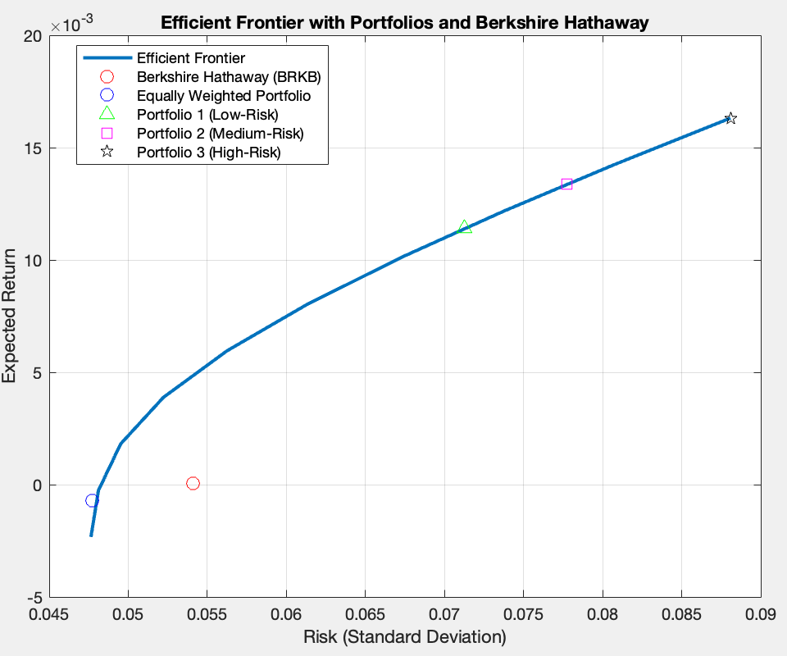

Slide 13
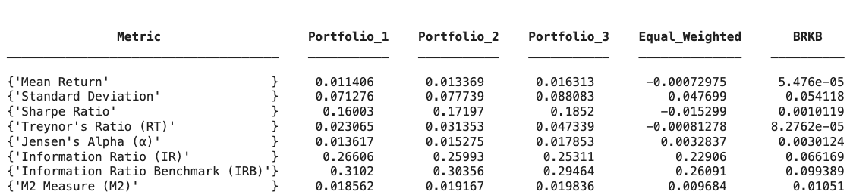

Slide 14
thanks!

