Slide 1

Lecture 13: Monte Carlo method and plotting

Slide 2

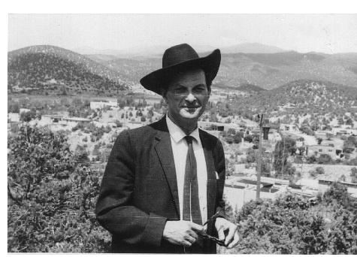
Monte Carlo method
Developed by Stanislaw Ulam

Slide 3
Monte Carlo Method
Key Idea:
Use repeated simulation of a random process to compute a non-random quantity
You have already used it !

Slide 4
Example: Modeling a game of dice
A casino plays a game of dice. If the dice hits one, the casino wins. Otherwise the player wins.
How much should the house wager against a player who wagers $12?
This is a deterministic question
What is the wager that will give an expected win of zero.
Notes:
12*1/6 –x*5/6 = 0
12/5

Slide 5
Monte Carlo Simulation
Code can be found here: http://bit.ly/12aEWdH

Slide 6
It’s not just for probabilistic processes
Deterministic algorithms can sometimes have simpler Monte Carlo analogs
N=1000
NC=0.0
x=-1.0
for i in xrange(2*N):
y=-1.0
for j in xrange(2*N):
if x*x+y*y<1:
NC=NC+1
y=y+1.0/N
x=x+1.0/N
print NC/(N*N)

Slide 7
Monte Carlo Version
n = 5000000
count = 0
for t in xrange(0,n):
x = rr.random()
y = rr.random()
if x*x + y*y < 1.0:
count += 1
print 4* (float(count) / n)
Code with plots can be found here: http://bit.ly/XbdLeE

Slide 8
More about random
It’s a Pseudo random number generator
Given a seed x produces a sequence of numbers that ‘look’ random
random.seed(x) initializes the seed
Given the same seed you will get the same sequence
Try it!
If you run the code above many times, you will get the same sequence of numbers
If you change the seed you get a different sequence
import random
random.seed(10)
for t in xrange(0, 5):
print random.random()

Slide 9
Plotting
import pylab
Basic logic
Create named figures
Add lines and points to them
show them on the screen or save them to a file
Notes:
savefig(‘abc’

Slide 10
Main Plotting Routines
pylab.figure(name)
Switch to a new figure
(or to a previously used figure with that name)
pylab.plot(lx, ly)
Plot a set of points
lx is a list of x coordinates
ly is a list of y coordinates
alternative pylab.plot(ly)
lx is then equal to range(0, len(ly))
pylab.show()
shows the plot in a window
stops the execution until the window is closed

Slide 11
More on plot
You can use named parameters to pass properties
pylab.plot(lx, ly, porperty=val, ...)
Ex.
pylab.plot([1,2,3], [3,2,1], color='r', marker='*', markersize=20, linewidth=6.0)

Slide 12
More pylab properties
pylab.xlabel(labelstring)
label of the x axis
pylab.ylabel(labelstring)
label of the y axis
pylab.title(titlestring)
title of the plot
pylab.axis([xlow, xhigh, ylow, yhigh])
range for the x and y axis

Slide 13
To learn more
More documentation on available properties can be found here:
http://matplotlib.org/users/pyplot_tutorial.html
Note they import matplotlib.pyplot instead of pylab
for our purposes, they are the same thing.

