Slide 1

Lecture 14’: Exceptions

Slide 2
Basic idea
try:
try block
except ExceptionType1, e1:
...
except ExceptionType2, e2:
...
If try block does not raise an exception
except blocks are ignored
If try block raises an exception
block of code for matching exception type executes
if no matching type, exception is raised by the try block to the caller
statements after try block won’t execute in this case

Slide 3
Examples
Try the two examples from class:
http://bit.ly/10ziYvV
http://bit.ly/Z4dMP0
We also have a challenge example
http://bit.ly/YVbgxB
illustrates how you can use your own classes as exceptions
illustrates how expressions of different type can be handled selectively
can you determine what the program will print?

Slide 4
Real Lecture 15: Monty Hall Problem, Distributions, [confidence intervals and levels, standard error](for next time)

Slide 5

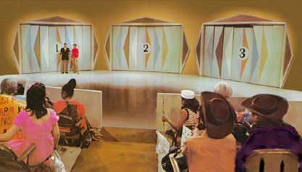
Monty Hall Problem
Notes:
Steve Selvin wrote a letter to the American Statistician in 1975
In 1990 the same problem was restated in the form shown above in a letter to Marilyn vos Savant's Ask Marilyn column in Parade.
Of the letters from the general public, 92% were against her answer, and of the letters from universities, 65% were against her answer. Overall, nine out of ten readers completely disagreed with her answer.

Slide 6
Problem Statement
Goat
Goat
Car
There are three doors
two have goats, one has a car
On the first stage, you pick a door
In the second stage, Monty Hall opens a door with a goat
a different door from the one you picked
What should you do next?
you can stay with your original choice
you can randomly pick one of the two remaining doors
you can switch from the door you had picked to the other closed door

Slide 7
Trying it in Code
http://bit.ly/12lJiep
Something to remember:
Mod operator a % b
computes the reminder of dividing a / b
allows you to ‘wrap around’
1 % 3 = 1
2 % 3 = 2
3 % 3 = 0
4 % 3 = 1
5 % 3 = 2
...
helpful when computing ‘the other door’
an alternative approach is to use ‘if’ for the different cases

Slide 8
Distributions
Assign a probability to sets of possible outcomes of a random variable (or in our case an experiment)
For experiments that produce integer or boolean values it’s easier to talk about the probability of each discrete value
For experiments that produce real numbers, the probability of any real number will usually be zero
You need to talk about the probability of a neighborhood around a value

Slide 9
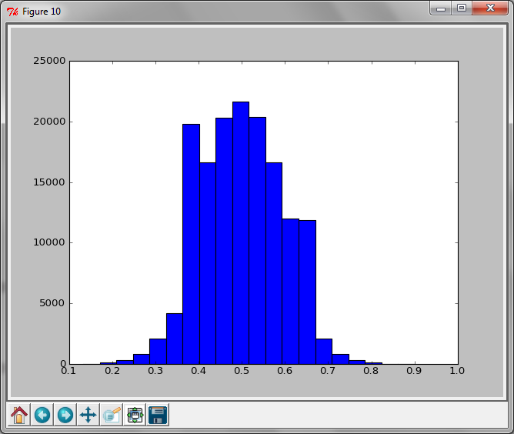
Plotting Histograms
pylab.hist(vals, bins=x)
Example:
plot of the outcome of the MontyHall Simulation for the random strategy for 150k simulations

Slide 10
to be continued...

Slide 11
Normal Distributions
Completely Specified by two parameters
Mean and standard deviation
They fall off exponentially
gives them nice explanatory power
Notes:
Variance = expected value of mean-value squared
STDev = sqrt(var)
68% 1 std dev
95.4% 2 std dev
.2% more than 3

Slide 13
Monte Carlo Method
Key Idea:
Use repeated simulation of a random process to compute a non-random quantity
You have already used it !

Slide 14
Example: Modeling a game of dice
A casino plays a game of dice. If the dice hits one, the casino wins. Otherwise the player wins.
How much should the house wager against a player who wagers $12?
This is a deterministic question
What is the wager that will give an expected win of zero.
Notes:
12*1/6 –x*5/6 = 0
12/5

Slide 15
Monte Carlo Simulation
Code can be found here: http://bit.ly/12aEWdH

Slide 16
It’s not just for probabilistic processes
Deterministic algorithms can sometimes have simpler Monte Carlo analogs
N=1000
NC=0.0
x=-1.0
for i in xrange(2*N):
y=-1.0
for j in xrange(2*N):
if x*x+y*y<1:
NC=NC+1
y=y+1.0/N
x=x+1.0/N
print NC/(N*N)

Slide 17
Monte Carlo Version
n = 5000000
count = 0
for t in xrange(0,n):
x = rr.random()
y = rr.random()
if x*x + y*y < 1.0:
count += 1
print 4* (float(count) / n)
Code with plots can be found here: http://bit.ly/XbdLeE

Slide 18
More about random
It’s a Pseudo random number generator
Given a seed x produces a sequence of numbers that ‘look’ random
random.seed(x) initializes the seed
Given the same seed you will get the same sequence
Try it!
If you run the code above many times, you will get the same sequence of numbers
If you change the seed you get a different sequence
import random
random.seed(10)
for t in xrange(0, 5):
print random.random()

Slide 19
Plotting
import pylab
Basic logic
Create named figures
Add lines and points to them
show them on the screen or save them to a file
Notes:
savefig(‘abc’

Slide 20
Main Plotting Routines
pylab.figure(name)
Switch to a new figure
(or to a previously used figure with that name)
pylab.plot(lx, ly)
Plot a set of points
lx is a list of x coordinates
ly is a list of y coordinates
alternative pylab.plot(ly)
lx is then equal to range(0, len(ly))
pylab.show()
shows the plot in a window
stops the execution until the window is closed

Slide 21
More on plot
You can use named parameters to pass properties
pylab.plot(lx, ly, porperty=val, ...)
Ex.
pylab.plot([1,2,3], [3,2,1], color='r', marker='*', markersize=20, linewidth=6.0)

Slide 22
More pylab properties
pylab.xlabel(labelstring)
label of the x axis
pylab.ylabel(labelstring)
label of the y axis
pylab.title(titlestring)
title of the plot
pylab.axis([xlow, xhigh, ylow, yhigh])
range for the x and y axis

Slide 23
To learn more
More documentation on available properties can be found here:
http://matplotlib.org/users/pyplot_tutorial.html
Note they import matplotlib.pyplot instead of pylab
for our purposes, they are the same thing.

