Slide 1

Real Lecture 16: Distributions, Standard deviation , Confidence intervals and levels

Slide 2
Distributions
Assign a probability to sets of possible outcomes of a random variable (or in our case an experiment)
For experiments that produce integer or boolean values it’s easier to talk about the probability of each discrete value
For experiments that produce real numbers, the probability of any real number will usually be zero
You need to talk about the probability of a neighborhood around a value

Slide 3
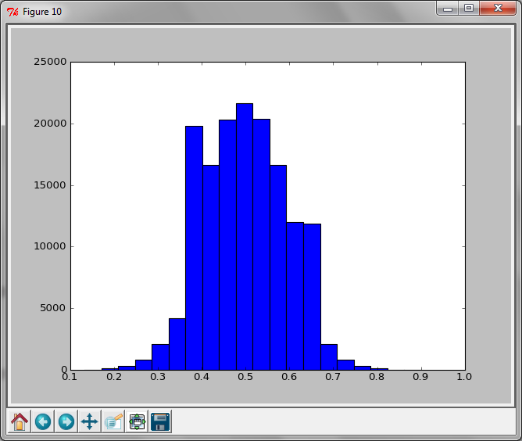
Plotting Histograms
pylab.hist(vals, bins=x)
Example:
plot of the outcome of the MontyHall Simulation for the random strategy for 150k simulations

Slide 4
Uniform Distribution
That’s what random.random() provides
All values within some domain have equal probability
All sets of values of the same size have equal probability

Slide 5
Exponential Distributions
Can model time until some random event happens
assuming the probability of the event is independent of time
memoryless property
succinctly described by the half life

Slide 6
Normal Distributions
Completely Specified by two parameters
Mean and standard deviation
They fall off exponentially
gives them nice predictive power
Sums of independent variables from uniform distributions give this kind of distribution
Notes:
Variance = expected value of mean-value squared
STDev = sqrt(var)
var = [(Ex-x)^2]
68% 1 std dev
95.4% 2 std dev
.2% more than 3

Slide 7

Standard deviation
$\sqrt{E[{\left(E\left[x\right]−x\right)}^{2}]}$
Provides an estimate of how far values are from the mean

Slide 8
Confidence intervals
What is the probability that a result falls within a given range
Easy to compute for normal distributions
68% are less than 1 std dev away
95.4% are less than 2 std dev away
.2% more than 3 std dev away

Slide 9
Back to Monty Hall example

Slide 10
Accuracy vs. Precision
Accuracy: How far is your mean from the true mean
Precision: How close together are your values

