Slide 1

Lecture 2: Introduction to Variables and Control Flow
Armando Solar-Lezama

Slide 2
Course Policies
Grading
Problem sets: 25% Quiz I: 15% (March 7) Quiz II: 20% (April 11) (Changed from lecture) Final: 35% Participation: 5%

Slide 3
MITx page up
https://mit.edx.org/courses/MITx/6.00/MIT_2013_Spring/about
Lot’s of resources to help you with the material in the course!

Slide 4

A simple computer
Just a (really big) table that stores values at different addresses
Ex: Make mem(1) equal to the lowest multiple of 5 $≥$ mem(2)
Random Access Memory (RAM)
CPU
Memory
Write 0 to mem(1)
if not mem(1) $<$mem(2) go to 5.
Write mem(1) + 5 to mem(1)
go back to 2.
done
1 | 55
2 | 23
3 | 13
4 | 44
... | ...
123456 | 77
123457 | 109874
... | ...
Understands a very small number of instructions including
reads and updates to memory
basic arithmetic among memory locations
conditional jumps to other instructions

Slide 5
A simple computer
Just a (really big) table that stores values at different addresses
Ex: Make mem(1) equal to the lowest multiple of 5 $≥$ mem(2)
Random Access Memory (RAM)
CPU
Memory
Write 0 to mem(1)
if not mem(1) $<$mem(2) go to 5.
Write mem(1) + 5 to mem(1)
go back to 2.
done
1 | 55
2 | 23
3 | 13
4 | 44
... | ...
123456 | 77
123457 | 109874
... | ...
Programming at this level is hard!!
Understands a very small number of instructions including
reads and updates to memory
basic arithmetic among memory locations
conditional jumps to other instructions

Slide 6

Programming at this level is hard!!
If you only have one big memory, it’s hard to remember where you put what.
It takes thousands of instructions to do even relatively simple things. This would be a lot of code to write.
Random Access Memory (RAM)
CPU
Memory
Write 0 to mem(1)
if not mem(1) $<$mem(2) go to 5.
Write mem(1) + 5 to mem(1)
go back to 2.
done
1 | 55
2 | 23
3 | 13
4 | 44
... | ...
123456 | 77
123457 | 109874
... | ...
Write 0 to mem(1)
if not mem(1) $<$mem(2) go to 5.
Write mem(1) + 5 to mem(1)
go back to 2.
done
It’s hard to reason about code that jumps all over the place.
It’s also hard to keep track of what the values in memory mean.

Slide 7
Programming at this level is hard!!
If you only have one big memory, it’s hard to remember where you put what.
Random Access Memory (RAM)
CPU
Memory
Write 0 to mem(1)
if not mem(1) $<$mem(2) go to 5.
Write mem(1) + 5 to mem(1)
go back to 2.
done
1 | 55
2 | 23
3 | 13
4 | 44
... | ...
123456 | 77
123457 | 109874
... | ...
Solution: Have as many memories as you want with meaningful names to help you remember what they are for.

Slide 8

Programming languages to the rescue
If you only have one big memory, it’s hard to remember where you put what.
CPU
bound
Write 0 to value
if not value $<$bound go to 5.
Write value + 5 to value
go back to 2.
done
23
value
23
Solution: Have as many memories as you want with meaningful names to help you remember what they are for.

Slide 9
Programming languages to the rescue
CPU
bound
Write 0 to value
if not value $<$bound go to 5.
Write value + 5 to value
go back to 2.
done
23
value
23
It’s also hard to keep track of what the values in memory mean.

Slide 10
Programming languages to the rescue
Solution: Keep a tag with each value that lets the program know how to interpret it.
message (str)
D
O
N
E
68
79
78
69
CPU
bound (int)
Write 0 to value
if not value $<$bound go to 5.
Write value + 5 to value
go back to 2.
done
23
value (int)
23
It’s also hard to keep track of what the values in memory mean.

Slide 11
Programming languages to the rescue
It takes thousands of instructions to do even relatively simple things. This would be a lot of code to write.
message (str)
D
O
N
E
68
79
78
69
CPU
bound (int)
Write 0 to value
if not value $<$bound go to 5.
Write value + 5 to value
go back to 2.
done
23
value (int)
23
Solution: Package complex sequences of instructions under easy-to-use procedures with intuitive names.

Slide 12

Programming languages to the rescue
It takes thousands of instructions to do even relatively simple things.
message (str)
D
O
N
E
68
79
78
69
CPU
bound (int)
Write 0 to value
if not value $<$bound go to 5.
Write value + 5 to value
go back to 2.
print( message )
23
value (int)
23
Solution: Package complex sequences of instructions under easy-to-use procedures with intuitive names.

Slide 13
Programming languages to the rescue
message (str)
D
O
N
E
68
79
78
69
CPU
bound (int)
Write 0 to value
if not value $<$bound go to 5.
Write value + 5 to value
go back to 2.
print( message )
23
value (int)
23
It’s hard to reason about code that jumps all over the place.
Solution: Provide high-level control constructs

Slide 14

Programming languages to the rescue
message (str)
D
O
N
E
68
79
78
69
CPU
bound (int)
Write 0 to value
while (value $<$bound):
Write value + 5 to value
print( message )
23
value (int)
23
It’s hard to reason about code that jumps all over the place.
Solution: Provide high-level control constructs

Slide 15
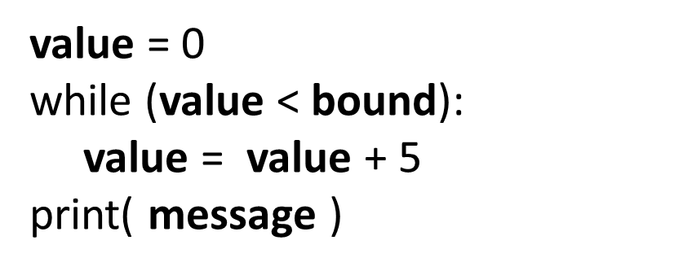
Programming languages to the rescue
CPU
Write 0 to value
while (value $<$bound):
Write value + 5 to value
print( message )
This is what the program looks like in python
value = 0
while (value < bound):
value = value + 5
print( message )

Slide 16
Key points
A variable is a name for a piece of memory
assignment changes what that memory contains.
Lines are executed in sequence
while repeats its body until the condition is satisfied
message (str)
D
O
N
E
bound (int)
23
value (int)
23

Slide 17
Running the examples
You will need to install python.
Follow the Getting Started Guide from Pset 0
http://bit.ly/UFhXVo
If you want to use the animations you need to install matplotlib and numpy as well
Instructions are also in the Getting Started Guide
Finally, if you want to use the simpleplot trajectory drawing you will need to have the simpleplot.py file in the same directory as your file
http://bit.ly/YWyCoo

Slide 18
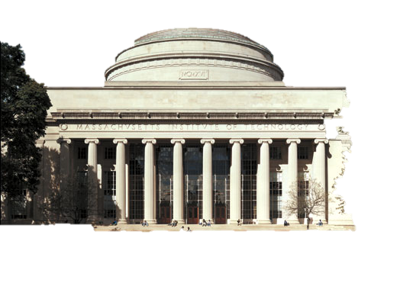
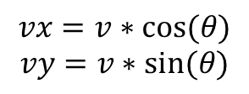
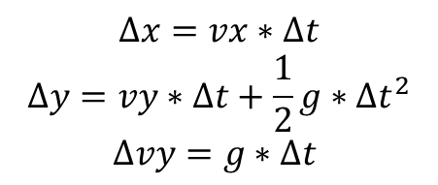
Angry Nerds
$$Δx=vx∗Δt$$
$$Δy=vy∗Δt+\frac{1}{2}g∗Δt^{2}$$
$$Δvy=g∗Δt$$
(x,y)
$$vx=v∗cos⁡(θ)$$
$$vy=v∗sin⁡(θ)$$
vy
vx
Notes:
import math
import simpleplot as sp
g = -9.8
dt = 0.01;
x = 0.1
y = 0.1
v = 25.0
ang = 30.0
vx = v*math.cos((ang/ 180.0) * math.pi)
vy = v*math.sin((ang/ 180.0) * math.pi)
while y > 0.0:
x = x + vx*dt
y = y + vy*dt + g*dt*dt/2
vy = vy + g*dt
sp.plotTrajectory((x,y))
sp.doAnimation()

Slide 19
Code
import math
import simpleplot as sp
g = -9.8
dt = 0.01;
x = 0.1
y = 0.1
v = 25.0
ang = 30.0
vx = v*math.cos((ang/ 180.0) * math.pi)
vy = v*math.sin((ang/ 180.0) * math.pi)
while y > 0.0:
x = x + vx*dt
y = y + vy*dt + g*dt*dt/2
vy = vy + g*dt
sp.plotTrajectory((x,y))
print x
sp.doAnimation()

Slide 20
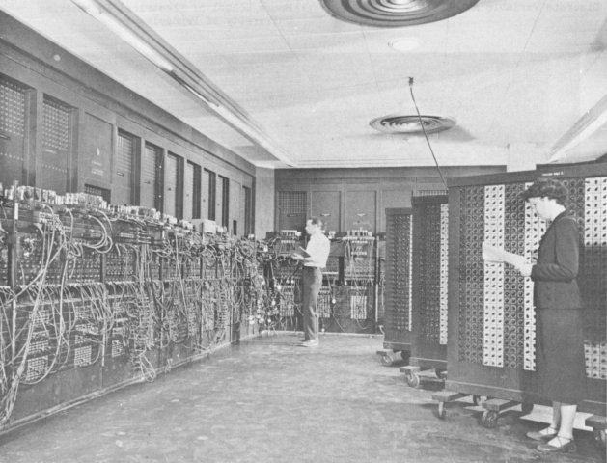
Programming in the old days
Image from http://www.columbia.edu/cu/computinghistory/eniac8.jpg

