Slide 1

Real Lecture 20: Hierarchical and K-means Clustering

Slide 2
Clustering
Goal:
Identify groups of related points in a dataset
points in each group are more similar to each other than to points in other groups
Examples
market segmentation
recommendation systems
Natural language processing

Slide 3
Hierarchical Clustering
Results in a Tree of Clusters
Make every point a cluster
while(#clusters > 1):
pick the two closest clusters
merge them

Slide 4
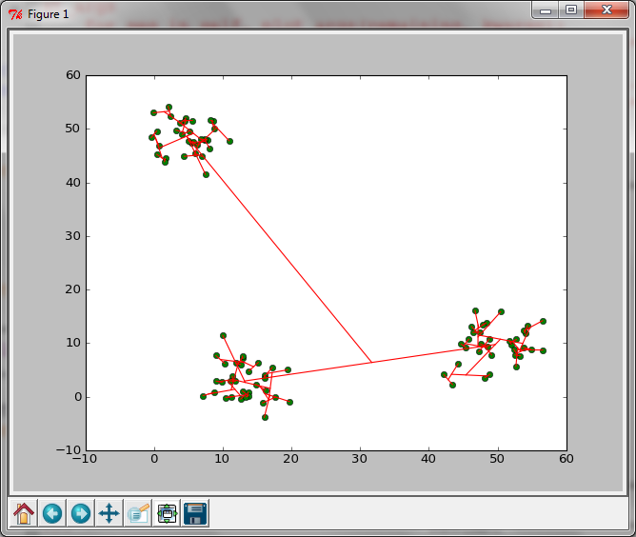
Example printed from code

Slide 5
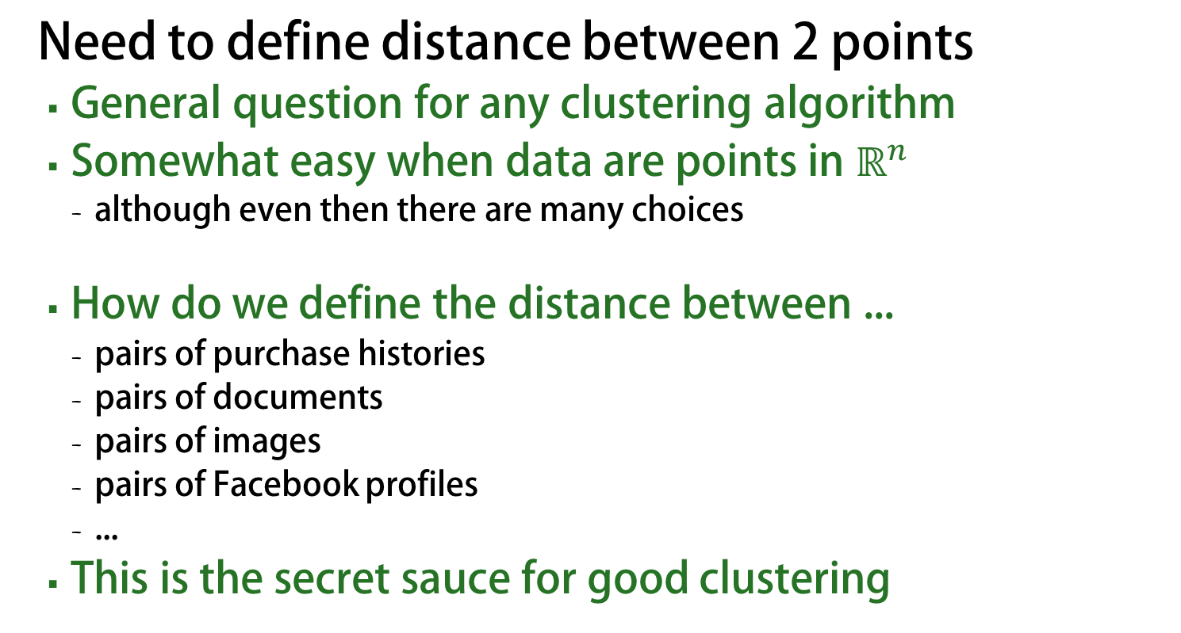
What do we mean by closest
Need to define distance between 2 points
General question for any clustering algorithm
Somewhat easy when data are points in $ℝ^{n}$
although even then there are many choices
How do we define the distance between ...
pairs of purchase histories
pairs of documents
pairs of images
pairs of Facebook profiles
...
This is the secret sauce for good clustering

Slide 6
What do we mean by closest
What is the distance between two clusters?
this question is more specific to hierarchical clustering
some choices:
distance between the means
distance between the closest points
distance between the farthest points
each of these choices may lead you astray in some situations

Slide 7
Aside: List Comprehensions
Simple shorthand notation for building lists
syntax: [ expr for var in list]
Shorthand for
rv = []
for var in list:
rv.append(expr)

Slide 8
Hierarchical Clustering
Pros:
Helpful when number of clusters is unknown
Can help uncover structure in the data
Cons:
No theoretical guarantees

Slide 9
K-means clustering
Divide a set of points into exactly K clusters
minimize the sum-of-squares of the distances to the mean for each cluster
naïve algorithm is exponential
iterative algorithm is fast and effective in practice
but it’s not guaranteed to converge to the right result

Slide 10
k-means clustering algorithm
X =set of k points to represent the partitions
while(not converged):
-partition the points by assigning each data point to the closest point in X
-update the representative points X to correspond to the mean of each partition
What if one of the partitions is empty?
reassign that representative to a new random point.

Slide 11
