Slide 1

Real Lecture 22: More Clusters more Graphs

Slide 2
Parenthesis on Clusters
Code to cluster all the data can be found here:
http://bit.ly/10nQ54Q
The code requires the code for clustering (http://bit.ly/15cApcE) and for reading the data (http://bit.ly/ZCwSQg) to both be in the same folder
Resulting clusters can be found here:
http://bit.ly/10F0V5A
Feel free to play with the code and experiment with the effect of different distance metrics

Slide 3
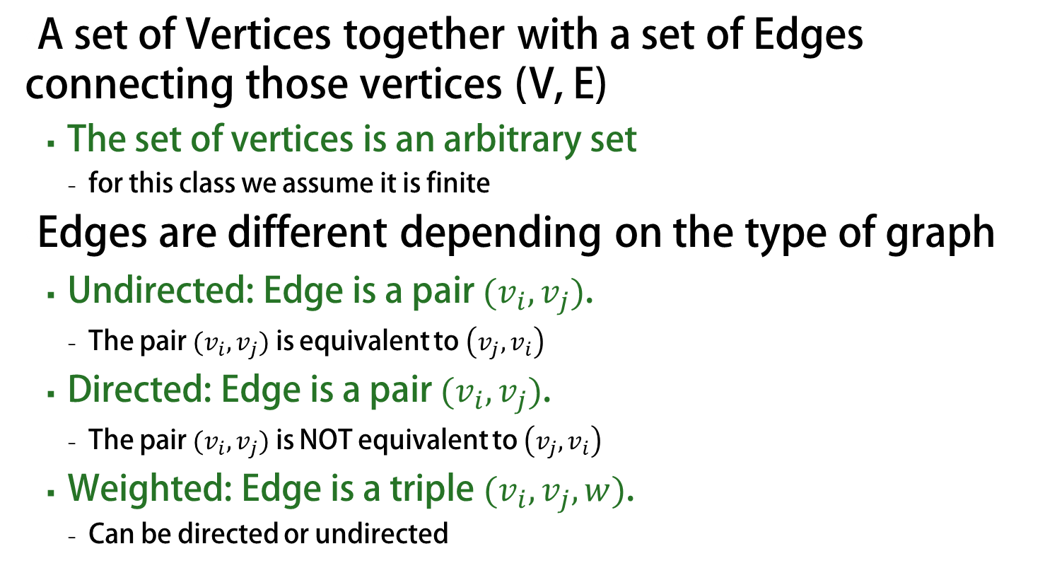
What is a graph
A set of Vertices together with a set of Edges connecting those vertices (V, E)
The set of vertices is an arbitrary set
for this class we assume it is finite
Edges are different depending on the type of graph
Undirected: Edge is a pair $(v_{i}, v_{j})$.
The pair $(v_{i},v_{j})$ is equivalent to $\left(v_{j}, v_{i}\right)$
Directed: Edge is a pair $(v_{i}, v_{j})$.
The pair $(v_{i},v_{j})$ is NOT equivalent to $\left(v_{j}, v_{i}\right)$
Weighted: Edge is a triple $(v_{i}, v_{j}, w)$.
Can be directed or undirected

Slide 4

Example 1: Undirected
Example 1: Undirected
Vertices $\left\{n_{1}, n_{2}, n_{3}, n_{4}\right\}$
Edges $\left\{\left(n_{1}, n_{2}\right), \left(n_{3}, n_{1}\right), \left(n_{1}, n_{4}\right), \left(n_{2},n_{4}\right), \left(n_{1}, n_{1}\right), (n_{3}, n_{4})\right\}$
All nodes are reachable from each other

Slide 5

Example 2: Directed
Example 2: Directed
Vertices $\left\{n_{1}, n_{2}, n_{3}, n_{4}\right\}$
Edges $\left\{\left(n_{1}, n_{2}\right), \left(n_{3}, n_{1}\right),\left(n_{1}, n_{4}\right),\left(n_{2},n_{4}\right), \left(n_{1}, n_{1}\right), (n_{3},n_{4})\right\}$
There is no path from n4 to n1 for example
Shortest path from n3 to n4 takes one edge

Slide 6

Example 3: Weighted Directed
Example 3: Weighted Directed
Vertices $\left\{n_{1}, n_{2}, n_{3}, n_{4}\right\}$
Edges $\left\{\left(n_{1}, n_{2}, 2\right), \left(n_{3}, n_{1}, 2\right),\left(n_{1}, n_{4}, 3\right),\left(n_{2},n_{4},9 \right), \left(n_{1}, n_{1},5\right), (n_{3},n_{4},7)\right\}$
Shortest path from n3 to n4 is not the one-edge path, but the path that goes through n1
Shortest path between any two nodes will never go through a loop

Slide 7


Example 2: Weighted Directed
Example 2: Weighted Directed
Vertices $\left\{n_{1}, n_{2}, n_{3}, n_{4}\right\}$
Edges $\left\{\left(n_{1}, n_{2}, 2\right), \left(n_{3}, n_{1}, 2\right),\left(n_{1}, n_{4}, 3\right),\left(n_{2},n_{4},9 \right), \left(n_{1}, n_{1},−1\right), (n_{3},n_{4},7)\right\}$
Shortest path is now undefined for many nodes (it is $−∞$)
For any path that goes through n1, you can get a shorter path by going around n1 one more time.

Slide 8
Representing Graphs
Representation 1: Set based representation
Many important operations are expensive
Representation 2: Object oriented
Node object contains list of neighboring nodes
List of neighbors contains references pointing to nodes
Representation 3: Matrix
Very inefficient for sparse matrices
Representation 4: Implicit
Graph represented as a function
Sometimes the only mechanism that works when the graph is too big for any other representation

Slide 9
dot: Graph Visualization Language
Very simple syntax:
digraph name{
v1 -> v2[label=“something”];
v2->v3;
}
You can find many visualizers on the web
GraphViz is probably the most popular one
http://www.graphviz.org/
There is a simple web viewer here: http://sandbox.kidstrythisathome.com/erdos/
but it only supports a small number of nodes and edges if you want to play with this, it’s better to download the stand alone version

Slide 10
Key algorithmic questions
Is there a path between two nodes?
What is the shortest path between two nodes?
Can we order the nodes in a graph so all nodes come before their successors in the graph?
Notes:
More in 6.006

