Slide 1

Real Lecture 23: More Graphs: DFS, BFS and shortest paths

Slide 2
Search in a Graph
Basic search algorithm
def reachableNodes(origin, graph, empty):
S = empty #collection of pending nodes
V = set({}) #set of visited nodes
S.add(origin)
V.add(origin)
while not S.empty():
n = S.pop()
print str(n)
for edge in graph.edgesOf(n):
dest = edge.getDestination()
if dest not in V:
V.add(dest)
S.add(dest)
return V

Slide 3
Breath First Search
Keep the collection of nodes to visit as a FIFO queue
class Fifo(Collection):
def __init__(self):
self.lst = []
def add(self, x):
self.lst.append(x)
def empty(self):
return len(self.lst)==0
def pop(self):
return self.lst.pop(0)
data = cl.getDataPoints('responses2.csv')
(g,nodes) = cg.getGraphFromData(data)
reachableNodes(nodes[0], g, Fifo())

Slide 4
Depth First Search
Keep the collection of nodes to visit as a LIFO stack
class Lifo(Collection):
def __init__(self):
self.lst = []
def add(self, x):
self.lst.append(x)
def empty(self):
return len(self.lst)==0
def pop(self):
return self.lst.pop()
data = cl.getDataPoints('responses2.csv')
(g,nodes) = cg.getGraphFromData(data)
reachableNodes(nodes[0], g, Fifo())

Slide 5
Shortest path
For an unweighted graph
BFS will find the shortest path
Argument:
Every element in the wait queue was reached through the shortest path
At the entry point of the outer loop, the length of the path to any unvisited element is greater than or equal to the length of the path to any element in the wait queue
We can prove this by induction!
The property is preserved because the FIFO queue ensures that we always pick the ‘nearest’ node to visit next

Slide 6
Shortest path
What if the graph has weights?
The same idea as BFS, but we can no longer assume that the head of the FIFO queue is the nearest node
We need to keep a distance estimate for each node in the collection of nodes to visit and visit the one with the smallest distance
This is called Dijkstra’s algorithm

Slide 7
The Code
The search code for the graph can be found here: http://bit.ly/13GQvXz
The code to build the graph from the class data is here: http://bit.ly/YxpBR7
The graph definition itself is here: http://bit.ly/11ocFRp
You will also need the definition of the data itself from here: http://bit.ly/ZCwSQg
Remember all the files must be in the same folder

Slide 8
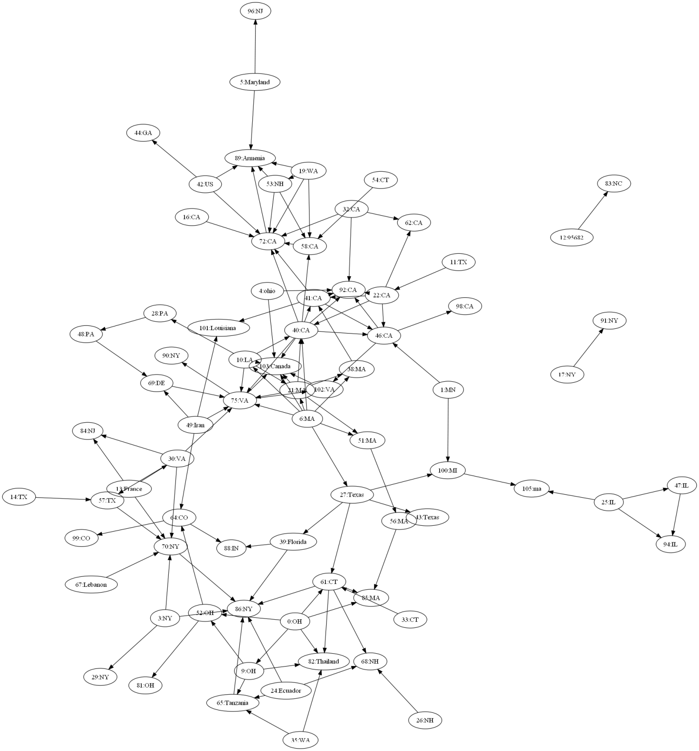

Slide 9


