Slide 1

Lecture 3: More control flow, Functions, bisection methods
Armando Solar-Lezama

Slide 2
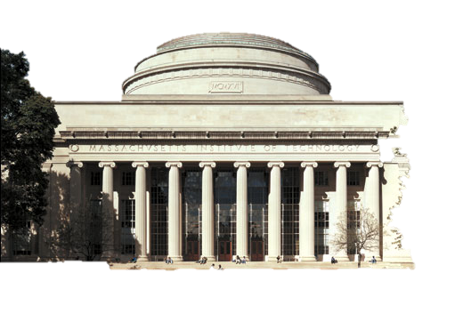
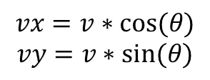
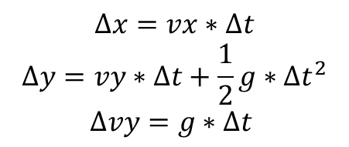
Angry Nerds
$$Δx=vx∗Δt$$
$$Δy=vy∗Δt+\frac{1}{2}g∗Δt^{2}$$
$$Δvy=g∗Δt$$
(x,y)
$$vx=v∗cos⁡(θ)$$
$$vy=v∗sin⁡(θ)$$
vy
vx
Notes:
import math
import simpleplot as sp
g = -9.8
dt = 0.01;
x = 0.1
y = 0.1
v = 25.0
ang = 30.0
vx = v*math.cos((ang/ 180.0) * math.pi)
vy = v*math.sin((ang/ 180.0) * math.pi)
while y > 0.0:
x = x + vx*dt
y = y + vy*dt + g*dt*dt/2
vy = vy + g*dt
sp.plotTrajectory((x,y))
sp.doAnimation()

Slide 3
Code
import math
import simpleplot as sp
g = -9.8
dt = 0.01;
x = 0.1
y = 0.1
v = 25.0
ang = 30.0
vx = v*math.cos((ang/ 180.0) * math.pi)
vy = v*math.sin((ang/ 180.0) * math.pi)
while y > 0.0:
x = x + vx*dt
y = y + vy*dt + g*dt*dt/2
vy = vy + g*dt
sp.plotTrajectory((x,y))
print x
sp.doAnimation()

Slide 4
Control flow
if cond :
t-body
else:
e-body
after-the-loop
while cond :
body
after-the-loop

Slide 5
Making the nerd bounce
y=0
Notes:
Start with one bounce, scale vy;
bounce = 0
while (bounce < 15):
x = x + vx*dt
y = y + vy*dt + g*dt*dt/2
vy = vy + g*dt
sp.plotTrajectory((x,y))
if(y < 0.0):
bounce = bounce + 1
vy = -vy*0.5

Slide 6
Almost Correct solutions
if y == 0.0:
vy = -vy*0.5
Problem: Unlikely that y will be exactly 0.0
y=0

Slide 7
Almost correct solutions
if y < 0.0:
vy = -vy*0.5
Problem: After the bounce, velocity may not be enough to get past zero
y=0
Notes:
Start with one bounce, scale vy;
bounce = 0
while (bounce < 15):
x = x + vx*dt
y = y + vy*dt + g*dt*dt/2
vy = vy + g*dt
sp.plotTrajectory((x,y))
if(y < 0.0):
bounce = bounce + 1
vy = -vy*0.5

Slide 8
Correct Solution
import math
import simpleplot as sp
g = -9.8
dt = 0.01;
x = 0.1
y = 0.1
v = 25.0
ang = 30.0
vx = v*math.cos((ang/ 180.0) * math.pi)
vy = v*math.sin((ang/ 180.0) * math.pi)
bounce = 0
while (bounce < 15):
x = x + vx*dt
y = y + vy*dt + g*dt*dt/2
vy = vy + g*dt
sp.plotTrajectory((x,y))
if(y < 0.0 and vy < 0.0):
bounce = bounce + 1
vy = -vy*0.5
print x
sp.doAnimation()

Slide 9
Functions
Give you a way to package functionality
def fname(param1, param2, ...):
body
return value

Slide 10
Example: function for conversions
def degToRad(deg):
return (deg / 180.0) * math.pi
Notes:
import simpleplot as sp
import math
def degToRad(deg):
return (deg / 180.0) * math.pi
g = -9.8
dt = 0.01
x = 0.1
y = 0.1
v = 25.0
ang = 30.0
vx = v*math.cos(degToRad(ang))
vy = v*math.sin(degToRad(ang))
bounce = 0
while (bounce < 15):
x = x + vx*dt
y = y + vy*dt + g*dt*dt/2
vy = vy + g*dt
sp.plotTrajectory((x,y))
if(y < 0.0 and vy < 0):
bounce = bounce + 1
vy = -vy*0.5
sp.doAnimation()
print x

Slide 11
import simpleplot as sp
import math
def degToRad(deg):
return (deg / 180.0) * math.pi
g = -9.8
dt = 0.01
x = 0.1
y = 0.1
v = 25.0
ang = 30.0
vx = v*math.cos(degToRad(ang))
vy = v*math.sin(degToRad(ang))
bounce = 0
while (bounce < 15):
x = x + vx*dt
y = y + vy*dt + g*dt*dt/2
vy = vy + g*dt
sp.plotTrajectory((x,y))
if(y < 0.0 and vy < 0):
bounce = bounce + 1
vy = -vy*0.5
sp.doAnimation()
print x

Slide 12
Guess and Check Algorithms

Slide 13
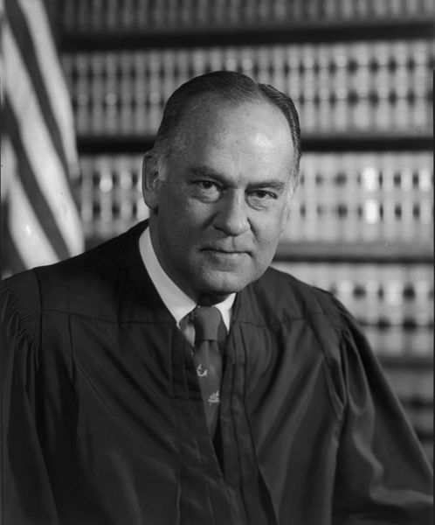
I know it when I see it
I shall not today attempt further to define the kinds of material I understand to be embraced within that shorthand description ["hard-core pornography"]; and perhaps I could never succeed in intelligibly doing so. But I know it when I see it, and the motion picture involved in this case is not that.
—Justice Potter Stewart, Jacobellis v. Ohio (1964)
Source: Wikipedia.
Notes:
regarding possible obscenity in The Lovers.

Slide 14
Guess and Check Algorithms
For any problem where the answer is easy to check
Very general and powerful
Also very slow!
Unless you can guess answers in a smart way
while ( answer is not correct):
guess a new answer
check if it is correct

Slide 15
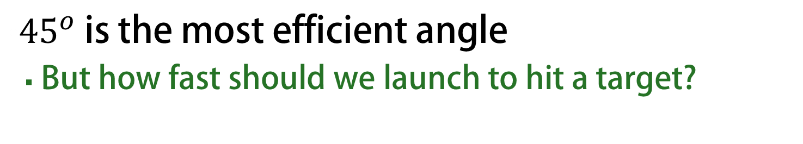
Hitting the target
${45}^{o}$ is the most efficient angle
But how fast should we launch to hit a target?
(x,y)

Slide 16
Code for hitting the target
goal = 100.0
testV = 0.0
land = 0.0
count = 0
while land < goal:
testV = testV + 1.0
land = nerdFinalPos(45, testV)
count = count + 1
print "testV = " + str(testV) + " land=" + str(land)
print count
Code: http://bit.ly/12JcNcV
Notes:
import simpleplot as sp
import math
g = -9.8
dt = 0.01
def degToRad(deg):
return (deg / 180.0) * math.pi
def landingPos(ang, v):
x = 0.1
y = 0.1
vx = v*math.cos(degToRad(ang))
vy = v*math.sin(degToRad(ang))
bounce = 0
while (bounce < 2):
x = x + vx*dt
y = y + vy*dt + g*dt*dt/2
vy = vy + g*dt
sp.plotTrajectory((x,y))
if(y < 0.0 and vy < 0):
bounce = bounce + 1
vy = -vy*0.5
return x
landing = 0.0
testV = 0.0
while landing < 100.0:
testV = testV + 2.0
landing = landingPos(50.0, testV)
print testV;
sp.doAnimation()

Slide 17
Bisection Search
Very effective when the function is monotonic
Reduce the search time from linear to logarithmic

Slide 18
Angry Nerds with bisection search
low = 0.0
high = 500.0
mid = (low+high)/2.0
landing = nerdFinalPos(45.0, mid)
while abs(landing - goal)>0.01:
if(landing < goal):
low = mid
else:
high = mid
mid = (low+high)/2.0
landing = nerdFinalPos(45.0, mid)
print "low=" + str(low) + " h=" + str(high) + " m= " + str(mid) + " land = " + str(landing)
Code: http://bit.ly/VStfka
Notes:
import simpleplot as sp
import math
g = -9.8
dt = 0.01
def degToRad(deg):
return (deg / 180.0) * math.pi
def landingPos(ang, v):
x = 0.1
y = 0.1
vx = v*math.cos(degToRad(ang))
vy = v*math.sin(degToRad(ang))
bounce = 0
while (bounce < 2):
x = x + vx*dt
y = y + vy*dt + g*dt*dt/2
vy = vy + g*dt
# sp.plotTrajectory((x,y))
if(y < 0.0 and vy < 0):
bounce = bounce + 1
vy = -vy*0.5
return x
low = 0.0
high = 500.0
target = 500.0
print landingPos(50.0, high)
mid = (low+high)/2.0
landing = landingPos(50.0, mid)
while abs(landing - target)>0.01:
if(landing < target):
low = mid
else:
high = mid
mid = (low+high)/2.0
landing = landingPos(50.0, mid)
print "low=" + str(low) + " high=" + str(high) + " mid = " + str(mid) + " landing = " + str(landing)
# sp.doAnimation()

