Slide 1

Lecture 9: Testing and Debugging
Armando Solar-Lezama

Slide 2
Testing and debugging
How do you know your code is correct?
Black box testing
White box testing or Glass box testing
So it’s not correct; how do you fix it?
Debugging with asserts
Debugging with the scientific method
Print

Slide 3
Problem: Break a word into syllables
Simple algorithm
not entirely accurate, but simple and effective
Specification
Introduce a break halfway between any two vowels that have one or more consonants between them
VCCV -> VC-CV
No break required if there is no consonant between vowels
If there is an odd number of consonants, break before the middle consonant
VCV -> V-CV
VCCCV -> VC-CCV
if the algorithm breaks ‘sh’ or ‘th’ keep the ‘h’ next to the ‘s’ or ‘t’

Slide 4
Black box testing
Create test cases without looking at the code
focus on corner cases in the specification
Some corner cases
Cases the specification says should be handled differently
Word with multiple vowels together
Word with even and odd number of consonants
Word with ‘sh’ or ‘th’
Corner cases in terms of size of the input
Single letter words
Empty words
Word without consonants
Word with one vowel
Word with no vowels

Slide 5
Some testing terms
Test first programming
Create the test before writing the code
Helps you think about corner cases in the specification
Regression testing
Have an automated test suite that you can run as you develop
When you find a bug, add a test that exposes it to the test suite
Helps you find if you are reintroducing errors you have fixed before.

Slide 6
Some test cases for syllable()
Code can be found here:
Take function as a parameter
def tester(fun):
out = fun('cooperate')
print out
if(out != ['coo', 'pe', 'ra', 'te']):
print "ERROR!!"
return False
return True
Automatically check for error; return false
If no error return true

Slide 7
Syllable Breaking Algorithm
Two phases
buildSyllable
keep adding letters to the current syllable
transition to next phase when you find a vowel
findNextVowel
find next vowel so you can find the midpoint between last and next vowel
if next vowel is right next to the last vowel, just make that the last vowel
if the midpoint breaks a ‘th’ or ‘sh’ increment it by one.
once you find the next vowel,
push letters between vowel and midpoint into the current syllable
add it to the list
start a new word with the remaining letters
C
V
C
C
C
V
V
t
h
V
C
C
C
V
C

Slide 8
Syllable Breaking Algorithm
State
buildSyllable(word, result, csyll, cpos, size)
keep adding letters to the current syllable
transition to next phase when you find a vowel
findNextVowel(word, result, csyll, lastVowel, cpos, size)
find next vowel so you can find the midpoint between last and next vowel
if next vowel is right next to the last vowel, just make that the last vowel
if the midpoint breaks a ‘th’ or ‘sh’ increment it by one.
once you find the next vowel,
push letters between vowel and midpoint into the current syllable
add it to the list
start a new word with the remaining letters
C
V
C
C
C
V
V
t
h
V
C
C
C
V
C

Slide 9
Recursive Structure
Find the correct algorithm at:
http://bit.ly/WtSrO0
To run the tester, download the tester here:
http://bit.ly/WtStWn
Place the tester and algorithm in the same folder
Run the tester

Slide 10
Debugging with the scientific method
Make a hypothesis
Design an experiment to try to invalidate hypothesis
if you invalidate it, make a new hypothesis and repeat
if you don’t invalidate it, try another experiment
When you are confident you have found the bug fix it
but not before that!
This is just a fancy way to say
“be systematic and don’t go around making arbitrary changes to your code until you know what you are doing”
Notes:
bug 2: problem with midpoint.

Slide 11
Debugging with asserts
assert check
assert check, message
Notes:
bug 1. No vowels in current syllable in Csyll
def checkNoVowel(word):
for x in word:
if(isVow(x)):
return False
return True

Slide 12
Example: syllableBuggy1.py
Find it at http://bit.ly/XFfj0m
Program outputs syllable with two non-consecutive vowels
buildSyllable could do this if called incorrectly
Hypothesis:
buildSyllable is getting called incorrectly
caller is breaking assumption about ‘no vowel in csyll’
Experiment:
Use assertion to test hypothesis
assert checkNoVowel(csyll), "Bad csyll " + csyll
Experiment confirms hypothesis!
Have we found the bug?
Not yet, but we know where to start searching.
Result suggests that we need to look at calls to buildSyllable
Adding checks to each call points to call inside findNextVowel as the culprit
def checkNoVowel(word):
for x in word:
if(isVow(x)):
return False
return True

Slide 13
Print Statements
Often a good way to test hypothesis
Some good things to print
When you enter a function
Parameters to that function
Results produced by a function
Beware
Make sure you know what you are looking for
Make sure you have a hypothesis in mind
Otherwise you can stare mindlessly at print output without making any progress

Slide 14
White box testing
Design tests based on what you see in the code
Look for unvisited branches
Is the programmer making special cases for things that shouldn’t be special cases?
Is there an input that you could produce that would exercise a path?
Look for suspicious code patterns
If you see recursive calls, make sure to use test cases that could lead to infinite recursion
If you see arithmetic used to compute a list index, make sure to have test cases that could trigger reads or writes outside the bounds
Look for tests that would indicate off-by-one errors

Slide 15
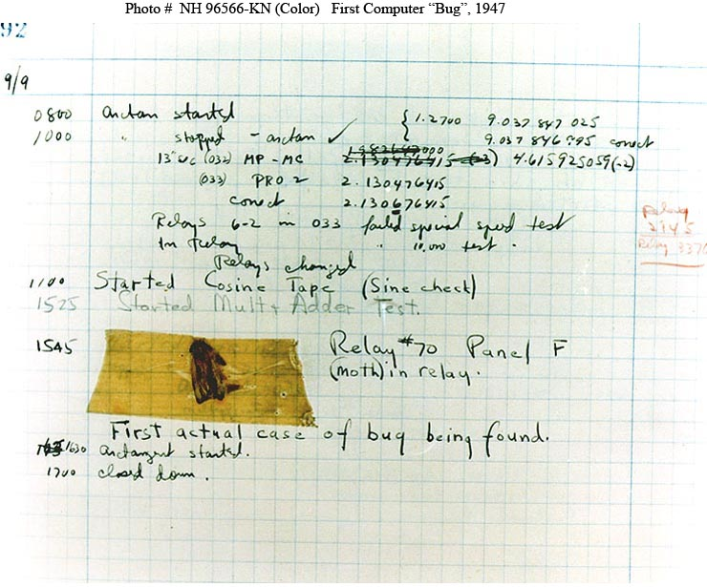
The first computer bug
From DEPARTMENT OF THE NAVY -- NAVAL HISTORICAL CENTER:
“Moth found trapped between points at Relay # 70, Panel F, of the Mark II Aiken Relay Calculator while it was being tested at Harvard University, 9 September 1945. The operators affixed the moth to the computer log, with the entry: "First actual case of bug being found". They put out the word that they had "debugged" the machine, ...
In 1988, the log, with the moth still taped by the entry, was in the Naval Surface Warfare Center Computer Museum at Dahlgren, Virginia.
Courtesy of the Naval Surface Warfare Center, Dahlgren, VA., 1988.

