Slide 1
Simple Types
September 27, 2011

Slide 2
Why Types
let
f x = if x then 5 else 2
in
f 5+1
let
f x = if x then 5 else 2
in
f 6
let
f x = if x then 5 else 2
in
if 6 then 5 else 2
!!

Slide 3
What to do in this situation?
Options
Leave it up to the implementation
that’s the C approach
is it a good idea?
Provide a mechanism to identify and rule out such “bad” programs
programs can only run if you can prove they will execute to completion according to the semantics of the language
type systems will allow us to do this!
Prescribe correct behavior for every program
untyped 𝜆-calculus works like this
do any practical languages do this?
type systems are useful in this situation too.

Slide 4
Self-application and Paradoxes
Self application, i.e., (x x) is dangerous.
Suppose:
u ≡ λy. if (y y) = a then b else a
What is (u u) ?
(u u) → if (u u) = a then b else a
Contradiction!!!
This was one of the original motivations for types

Slide 5
What is a type system
Narrow View
It’s a mechanism for ensuring that variables only take values from predefined sets
Ex. Integers, Strings, Characters
A mechanism for avoiding unchecked errors
by ruling out programs with undefined behaviors
by specifying how a program should fail (eg. NullPointerException)
Expansive View
It’s a light-weight proof system and annotation mechanism for efficiently checking for a specific property of interest
Address bugs that go beyond corner-cases in the semantics
Information flow violations
deadlocks
etc, etc, etc

Slide 6
What are Types?
A method of classifying objects (values) in a language
x :: τ
says object x has type τ or object x belongs to a type τ
τ denotes a set of values.
This notion of types is different from types in languages like C, where a type is a storage class specifier.

Slide 7
Type Correctness
If x :: τ then only those operations that are appropriate to set τ may be performed on x.
A program is type correct if it never performs a wrong operation on an object.
- Add an Int and a Bool
- Head of an Int
- Square root of a list

Slide 8
Type Safety
A language is type safe if only type correct programs can be written in that language.
Most languages are not type safe, i.e., have “holes” in their type systems.
Fortran: Equivalence, Parameter passing
Pascal: Variant records, files
C, C++: Pointers, type casting
However, Java, Ada, CLU, ML, Id, Haskell, Bluespec, etc. are type safe.

Slide 9
Type Declaration vs Reconstruction
Languages where the user must declare the types
CLU, Pascal, Ada, C, C++, Fortran, Java
Languages where type declarations are not needed and the types are reconstructed at run time
Scheme, Lisp
Languages where type declarations are generally not needed but allowed, and types are reconstructed at compile time
ML, Id, Haskell, pH, Bluespec
A language is said to be statically typed if type-checking is done at compile time

Slide 10
Formalizing a Type System

Slide 11
Formalizing a type system
The type system is almost never orthogonal to the semantics of the language
The types in a program can affect its behavior (e.g. operator overloading)
We don’t define the type system in isolation, we define a typed language including definitions of
The syntax
dynamic semantics (e.g. operational semantics)
static semantics
also known as typing rules
describe how types are assigned to elements in a program
type soundness argument
describe the relationship between static and dynamic semantics

Slide 12
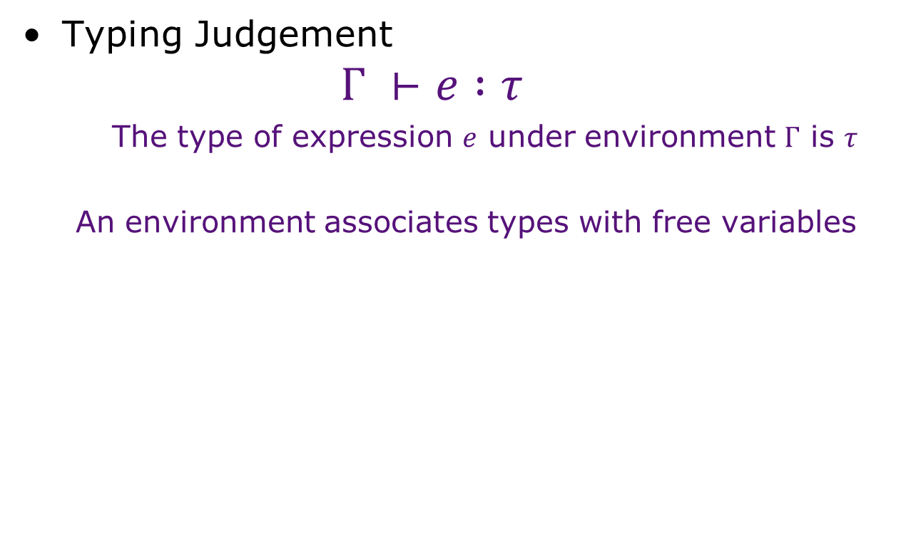
Basic Notation
Notes:
x:int, y:int => x + y

Slide 13


Basic notation
The type system assigns types to elements in the language
basic notation: e : T (e is of type T)
What is the type of :
5 “Hello” x
The types of some elements depends on the environment
basic notation
(Given environment Γ , we can derive that e is of type T)
An environment associates types with free variables
This is called a Judgment
Ex.
?

Slide 14




Static Semantics
Typing rules
Typing rules tell us how to derive typing judgments
Very similar to derivation rules in Big Step OS
Ex. Language of Expressions

Slide 15



Ex. Language of Expressions
Show that the following Judgment is valid

Slide 16





Simply Typed 𝜆 Calculus (F₁)
Basic Typing Rules
Extensions

Slide 17
Example
Is this a valid typing judgment?
How about this one?

Slide 18
Example
What’s the type of this function?
(𝜆 f. 𝜆 x. if x = 1 then x else (f f (x-1) ) * x)
Hint: This IS a trick question

Slide 19
Simply Typed 𝜆 Calculus (F₁)
We have defined a really strong type system on 𝜆-calculus
It’s so strong, it won’t even let us write non-terminating computation
We can actually prove this!

Slide 20
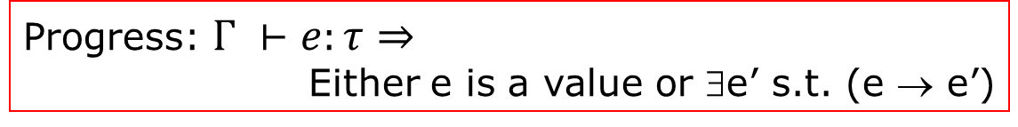
Soundness
The proposed type system is said to be sound if e : τ then e indeed evaluates to a value in τ.
To prove soundness, we need to show two properties

Slide 21




Type Preservation: Pure λ-calculus
Recall our Typing Rules
Evaluation Rules
We want to show that

Slide 22
Induction on the Structure of Derivation (Rule Induction)
Same principle from last time.
You have a set of rules to prove a fact P(e)
You want to show that P(e) => Q(e)
Do induction on the proof steps required to prove P(e)
Base case: Show that any e for which P(e) can be proved in one step, Q(e) holds.

Slide 23
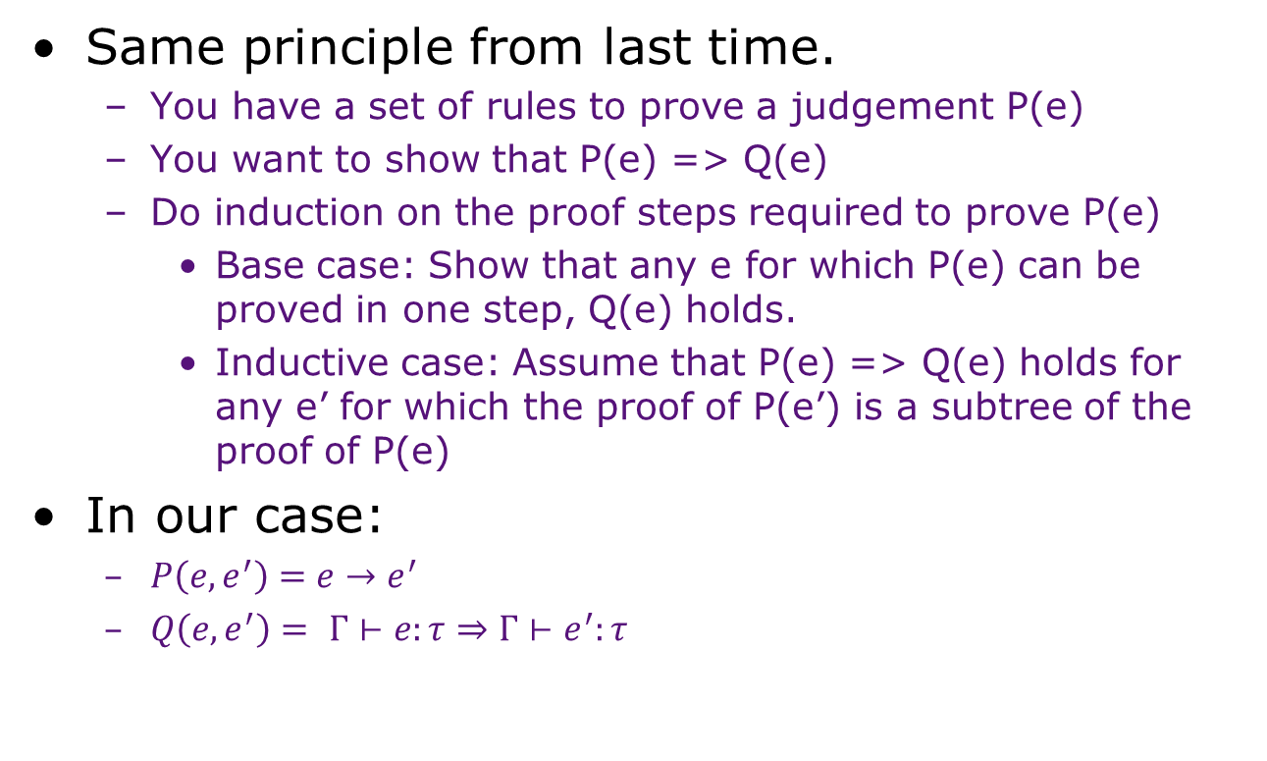
Induction on the Structure of Derivation (Rule Induction)
Same principle from last time.
You have a set of rules to prove a judgement P(e)
You want to show that P(e) => Q(e)
Do induction on the proof steps required to prove P(e)
Base case: Show that any e for which P(e) can be proved in one step, Q(e) holds.
Inductive case: Assume that P(e) => Q(e) holds for any e’ for which the proof of P(e’) is a subtree of the proof of P(e)
In our case:
$P\left(e,e^{′}\right)=e→e^{′}$
$Q\left(e,e^{′}\right)=$ $Γ⊢e:τ⇒Γ⊢e^{′}:τ$

Slide 24

Induction on the Structure of the Derivation
Base case:
e = e’, so property is trivially satisfied
Inductive case

Slide 25





Induction on the Structure of the Derivation
Inductive case
Given we want to show that
By our typing rule, we have
And by the IH, we have that
Which again by the typing rule
Now, we need to show that
And from our IH

Slide 26
The Language
Contexts
H ::= o | H e1 | H + e | e + H | if H then e1 else e2
Local Reduction Rules
n1 + n2 → n1 plus n2
if true then e1 else e2 → e1
if false then e1 else e2 → e2
(𝜆x:𝜏.e1) v2 → [v2/x] e1
Global Reduction Rules
H[r] → H[e] iff r → e

Slide 27
The proof strategy
Progress Theorem
If ├ e:𝜏 and e is not a value, then there is an e’ s.t. e → e’
We can prove this through a decomposition lemma
If ├ e:𝜏 and e is not a value, then there are H and r s.t. e = H[r]
This guarantees one step of progress

Slide 28


Proving the Progress Theorem
If ├ e:𝜏 and e is not a value, then there is an e’ s.t. e → e’
or equivalently, e = H[r]
Proved by induction on the derivation of ├ e:𝜏
Base case:
Irreducible values

Slide 29
Proving the Progress Theorem
Inductive case
by the IH, e can be irreducible,
in which case it must be true or false and the whole thing is a redex
Or, it can be decomposed into H[r]
in which case if H then e1 else e2 is a valid context.

Slide 30
Some observations
A type system restricts the class of programs that are considered “legal”
It is possible a term in the untyped λ–calculus may be reducible to a value but may not be typeable in a particular type system
let
id = λx. x
in
... (id True) ... (id 1) ...
This term is not typeable in the simple type system we have discussed so far. However, it is typeable in the Hindley-Milner system

Slide 31
A few more types
Records
Unions
Algebraic Data types

Slide 32



Product Types
Extend Syntax with binary tuples
e := … | (e1 , e2) | fst e | snd e
𝜏 := … | 𝜏1 x 𝜏2
Additional typing rules

Slide 33



Sum Types
Extend Syntax with binary tuples
e := … | injl e | inr e | case e of injl x → e₁ ; injr y → e₂
𝜏 := … | 𝜏₁ + 𝜏₂
Meaning:
if e : 𝜏₁ + 𝜏₂ then e can be of either 𝜏₁ or 𝜏₂
That’s why we can only use e in the context of a test
case checks e; if e has the left type, x is bound to e in e₁; otherwise, y is bound to e in e₂

Slide 34
Is this enough to define the type of an ADT?

