Slide 1
Type Inference and the Hindley-Milner Type System
September 29, 2011

Slide 2





Type Inference
Consider the following expression
(𝜆f:int→ int. f 5) (𝜆x:int. x + 1)
Is it well typed in F₁?

Slide 3
Type Inference
There wasn’t a single point in the derivation where we had to look at the type labels in order to know what rule to apply!
we could have written the derivation without the labels
The labels helped us determine the actual types for all the 𝜏s in the typing rules.
we could have figured these out even without the labels
this is the key idea behind type inference!

Slide 4
Type Inference Strategy 1
1. Use the typing rules to define constraints on the possible types of expressions
2. Solve the resulting constraint system

Slide 5
Deducing Types
twice f x = f (f x)
What is the most "general type" for twice?
1. Assign types to every subexpression
x :: t0 f :: t1
f x :: t2 f (f x) :: t3
⇒ twice :: ?
t1 -> t0 -> t3
2. Set up the constraints
t1 = because of (f x)
t1 = because of f (f x)
t0 -> t2
t2 -> t3
3. Resolve the constraints
t0 -> t2 = t2 -> t3
⇒ t0 = t2 and t2 = t3 ⇒ t0 = t2 = t3
⇒ twice :: (t0 -> t0) -> t0 -> t0

Slide 6

The language of Equality Constraints
Consider the following Language of Constraints
Constraints in this language have a lot of good properties
Nice and compositional
Linear time solution algorithm

Slide 7



Building Constraints from Typing Rules
Notation
The constraints on the right ensure that the judgment on the left holds
This mapping is defined recursively.
Base cases
Inductive Cases

Slide 8
Back to our example
(𝜆f. f 5) (𝜆x. x + 1)

Slide 9
Equality and Unification
What does it mean for two types τ_{a} and τ_{b} to be equal?
Structural Equality
Suppose τ_{a} = τ₁ -> τ₂
τ_{b} = τ₃ -> τ₄
Is τ_{a} = τ_{b} ?
iff τ₁ = τ₃ and τ₂ = τ₄
Can two types be made equal by choosing appropriate substitutions for their type variables?
Robinson’s unification algorithm
Suppose τ_{a} = t₁ -> Bool
τ_{b} = Int -> t₂
Are τ_{a} and τ_{b} unifiable ?
if t₁= Int and t₂= Bool
Suppose τ_{a} = t₁-> Bool
τ_{b} = Int -> Int
Are τ_{a} and τ_{b} unifiable ?
No

Slide 10
Simple Type Substitutions needed to define type unification
Types
τ ::= ι base types (Int, Bool ..)
| t type variables
| τ₁ -> τ₂ Function types
A substitution is a map
S : Type Variables → Types
S = [τ₁ / t₁,..., τ_{n} / t_{n}]
τ’ = S τ τ’ is a Substitution Instance of τ
Example:
S = [(t -> Bool) / t₁]
S ( t₁ -> t₁) = ?
Substitutions can be composed, i.e., S₂ S₁
Example:
S₁ = [(t -> Bool) / t₁] ; S₂ = [Int / t]
S₂ S₁ ( t₁ -> t₁) ?
( t -> Bool) -> ( t -> Bool)
= S₂ (( t -> Bool) -> ( t -> Bool))
= ( Int -> Bool) -> ( Int -> Bool)

Slide 11
Unification An essential subroutine for type inference
Unify(τ₁, τ₂) tries to unify τ₁ and τ₂ and returns a substitution if successful
def Unify(τ₁, τ₂) =
case (τ₁, τ₂) of
(τ₁, t₂) = [τ₁ / t₂] provided t₂ ∉ FV(τ₁)
(t₁, τ₂) = [τ₂ / t₁] provided t₁ ∉ FV(τ₂)
(ι₁, ι₂) = if (eq? ι₁ ι₂) then [ ]
else fail
(τ₁₁->τ₁₂, τ₂₁ ->τ₂₂)
=
let S₁=Unify(τ₁₁, τ₂₁)
S₂=Unify(S₁(τ₁₂), S₁(τ₂₂))
in S₂ S₁
otherwise = fail
Does the order matter?
No

Slide 12
Type inference strategy 2
Like strategy 1, but we solve the constraints as we see them
Build the substitution map incrementally

Slide 13

Simple Inference Algorithm
W(TE, e) returns (S,τ) such that S (TE) ├ e : τ
The type environment TE records the most general type of each identifier while the substitution S records the changes in the type variables
This is just $Γ$ (it’s hard to write $Γ$ in code)
Def W(TE, e) =
Case e of
x = ...
n = ...
λx.e = ...
(e₁ e₂) = ...
...

Slide 14
Simple Inference Algorithm (cont-1)
Def W(TE, e) =
Case e of
N =
x =
λx.e =
(e₁ e₂) =
u’s represent new type variables
({}, Typeof(N))
if (x ∉ Dom(TE)) then Fail
else let τ = TE(x);
in ({}, τ )
let (S₁, τ₂)= W(TE + { x : u }, e)
in (S₁, S₁(u) -> τ₂)
let (S₁, τ₁) = W(TE, e₁);
(S₂, τ₂) = W(S₁(TE), e₂);
S₃ = Unify(S₂(τ₁), τ₂ -> u);
in (S₃ S₂ S₁, S₃(u))

Slide 15
Simple Inference Algorithm (cont-1)
Def W(TE, e) =
Case e of
c =
x =
λx.e =
(e₁ e₂) =
let x = e₁ in e₂
=
u’s represent new type variables
({}, Typeof(c))
if (x ∉ Dom(TE)) then Fail
else let τ = TE(x);
in ({}, τ )
let (S₁, τ₁) = W(TE + { x : u }, e)
in (S₁, S₁(u) -> τ₁)
let (S₁, τ₁) = W(TE, e₁);
(S₂, τ₂) = W(S₁(TE), e₂);
S₃ = Unify(S₂(τ₁), τ₂ -> u);
in (S₃ S₂ S₁, S₃(u))
let (S₁, τ₁) = W(TE + {x : u}, e₁);
S₂ = Unify(S₁(u), τ₁);
(S₃, τ₂) = W(S₂ S₁(TE) + {x : τ₁}, e₂);
in (S₃ S₂ S₁, τ₂)

Slide 16








Example
Def W(TE, e) =
Case e of
…
λx.e = let (S₁, τ₁) = W(TE + { x : u }, e) in (S₁, S₁(u) -> τ₁)
(e₁ e₂) = let (S₁, τ₁) = W(TE, e₁); (S₂, τ₂) = W(S₁(TE), e₂); S₃ = Unify(S₂(τ₁), τ₂ -> u); in (S₃ S₂ S₁, S₃(u))
$$W\left(\left\{f:u_{0}\right\}, f\right)=$$
$$(∅, u_{0})$$
$$W\left(\left\{f:u_{0}\right\}, 5\right)=$$
$$(∅, Int)$$
$$Unify\left(u_{0}, Int→u_{1}\right)=$$
$$W\left(\left\{f:u_{0}\right\}, f 5\right)=$$
$$W\left(∅, \left(λf. f 5\right)\right)=$$
$$W(∅, \left(λf. f 5\right)\left(λx. x\right))$$

Slide 17
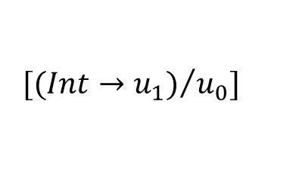

Example
def Unify(τ₁, τ₂) = case (τ₁, τ₂) of
(τ₁, t₂) = [τ₁ / t₂] provided t₂ ∉ FV(τ₁)
(t₁, τ₂) = [τ₂ / t₁] provided t₁ ∉ FV(τ₂)
(ι₁, ι₂) = if (eq? ι₁ ι₂) then [ ] else fail
(τ₁₁->τ₁₂, τ₂₁ ->τ₂₂) = let S₁=Unify(τ₁₁, τ₂₁) S₂=Unify(S₁(τ₁₂), S₁(τ₂₂))
in S₂ S₁
$$W\left(\left\{f:u_{0}\right\}, f\right)=$$
$$(∅, u_{0})$$
$$W\left(\left\{f:u_{0}\right\}, 5\right)=$$
$$(∅, Int)$$
$Unify\left(u_{0}, Int→u_{1}\right)=$
$$[{(Int→u_{1})}/{u_{0}}]$$
$$W\left(\left\{f:u_{0}\right\}, f 5\right)=$$
$$W\left(∅, \left(λf. f 5\right)\right)=$$
$$W(∅, \left(λf. f 5\right)\left(λx. x\right))$$

Slide 18

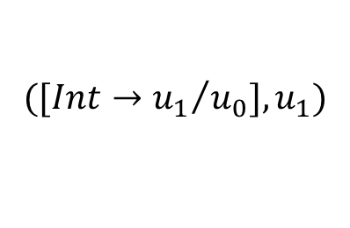
Example
Def W(TE, e) =
Case e of
…
λx.e = let (S₁, τ₁) = W(TE + { x : u }, e) in (S₁, S₁(u) -> τ₁)
(e₁ e₂) = let (S₁, τ₁) = W(TE, e₁); (S₂, τ₂) = W(S₁(TE), e₂); S₃ = Unify(S₂(τ₁), τ₂ -> u); in (S₃ S₂ S₁, S₃(u))
$$W\left(\left\{f:u_{0}\right\}, f\right)=$$
$$(∅, u_{0})$$
$$W\left(\left\{f:u_{0}\right\}, 5\right)=$$
$$(∅, Int)$$
$Unify\left(u_{0}, Int→u_{1}\right)=$
$$[{(Int→u_{1})}/{u_{0}}]$$
$$W\left(\left\{f:u_{0}\right\}, f 5\right)=$$
$$([{Int→u_{1}}/{u_{0}}], u_{1})$$
$$W\left(∅, \left(λf. f 5\right)\right)=$$
$$(\left[{(Int→u_{1})}/{u_{0}}\right], \left(Int →u_{1}\right)→u_{1})$$
$$W(∅, \left(λf. f 5\right)\left(λx. x\right))$$

Slide 19



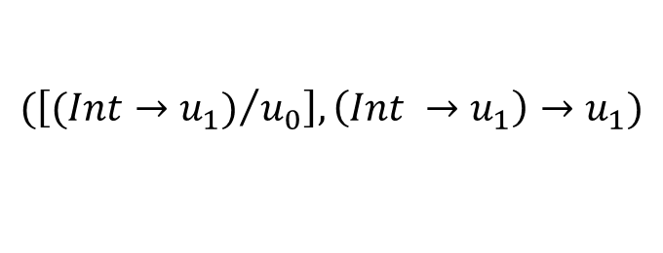
Example
Def W(TE, e) =
Case e of
…
λx.e = let (S₁, τ₁) = W(TE + { x : u }, e) in (S₁, S₁(u) -> τ₁)
(e₁ e₂) = let (S₁, τ₁) = W(TE, e₁); (S₂, τ₂) = W(S₁(TE), e₂); S₃ = Unify(S₂(τ₁), τ₂ -> u); in (S₃ S₂ S₁, S₃(u))
$$W\left(∅, \left(λf. f 5\right)\right)=$$
$$(\left[({Int→u_{1})}/{u_{0}}\right], \left(Int →u_{1}\right)→u_{1})$$
$$W\left(∅, \left(λx. x\right)\right)=$$
$$(∅, u_{3}→u_{3})$$
$Unify\left(\left(Int →u_{1}\right)→u_{1}, \left(u_{3}→u_{3}\right)→u_{4}\right)=$
$$W(∅, \left(λf. f 5\right)\left(λx. x\right))$$

Slide 20
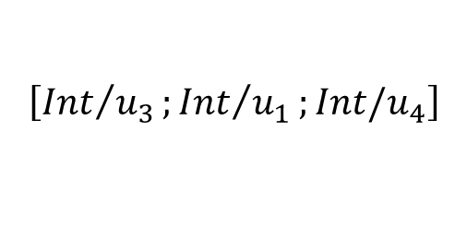
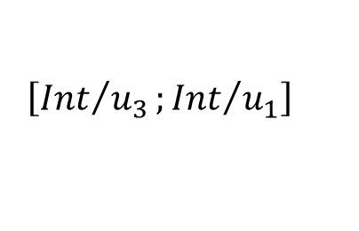

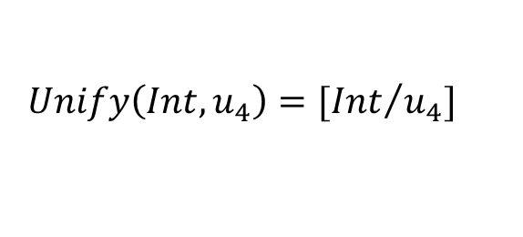
Example
def Unify(τ₁, τ₂) = case (τ₁, τ₂) of
(τ₁, t₂) = [τ₁ / t₂] provided t₂ ∉ FV(τ₁)
(t₁, τ₂) = [τ₂ / t₁] provided t₁ ∉ FV(τ₂)
(ι₁, ι₂) = if (eq? ι₁ ι₂) then [ ] else fail
(τ₁₁->τ₁₂, τ₂₁ ->τ₂₂) = let S₁=Unify(τ₁₁, τ₂₁) S₂=Unify(S₁(τ₁₂), S₁(τ₂₂))
in S₂ S₁
$Unify\left(\left(Int →u_{1}\right), \left(u_{3}→u_{3}\right)\right)$=
$$\left[{Int}/{u_{3}};{Int}/{u_{1}}\right]$$
$$Unify\left(Int, u_{4}\right)=[{Int}/{u_{4}}]$$
$Unify\left(\left(Int →u_{1}\right)→u_{1}, \left(u_{3}→u_{3}\right)→u_{4}\right)=$
$$\left[{Int}/{u_{3}};{Int}/{u_{1}};Int/u_{4}\right]$$
$$W(∅, \left(λf. f 5\right)\left(λx. x\right))$$

Slide 21
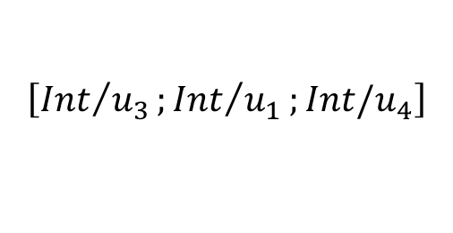

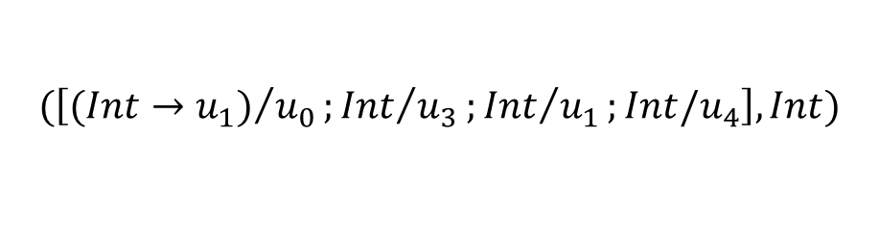
Example
Def W(TE, e) =
Case e of
…
λx.e = let (S₁, τ₁) = W(TE + { x : u }, e) in (S₁, S₁(u) -> τ₁)
(e₁ e₂) = let (S₁, τ₁) = W(TE, e₁); (S₂, τ₂) = W(S₁(TE), e₂); S₃ = Unify(S₂(τ₁), τ₂ -> u); in (S₃ S₂ S₁, S₃(u))
$$W\left(∅, \left(λf. f 5\right)\right)=$$
$$(\left[({Int→u_{1})}/{u_{0}}\right], \left(Int →u_{1}\right)→u_{1})$$
$$W\left(∅, \left(λx. x\right)\right)=$$
$$(∅, u_{3}→u_{3})$$
$Unify\left(\left(Int →u_{1}\right)→u_{1}, \left(u_{3}→u_{3}\right)→u_{4}\right)=$
$$\left[{Int}/{u_{3}};{Int}/{u_{1}};Int/u_{4}\right]$$
$$W\left(∅, \left(λf. f 5\right)\left(λx. x\right)\right)=$$
$$(\left[({Int→u_{1})}/{u_{0}};{Int}/{u_{3}};{Int}/{u_{1}};Int/u_{4}\right], Int)$$

Slide 22

What about Let?
$let x=e_{1} in e_{2}$
Typing rule
$\frac{}{Γ ⊢ }$

Slide 23
Polymorphism

Slide 24
Some observations
A type system restricts the class of programs that are considered “legal”
It is possible a term in the untyped λ–calculus may be reducible to a value but may not be typeable in a particular type system
let
id = λx. x
in
... (id True) ... (id 1) ...
This term is not typeable in the simple type system we have discussed so far. However, it is typeable in the Hindley-Milner system

Slide 25
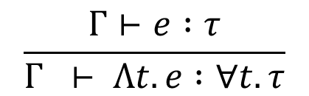
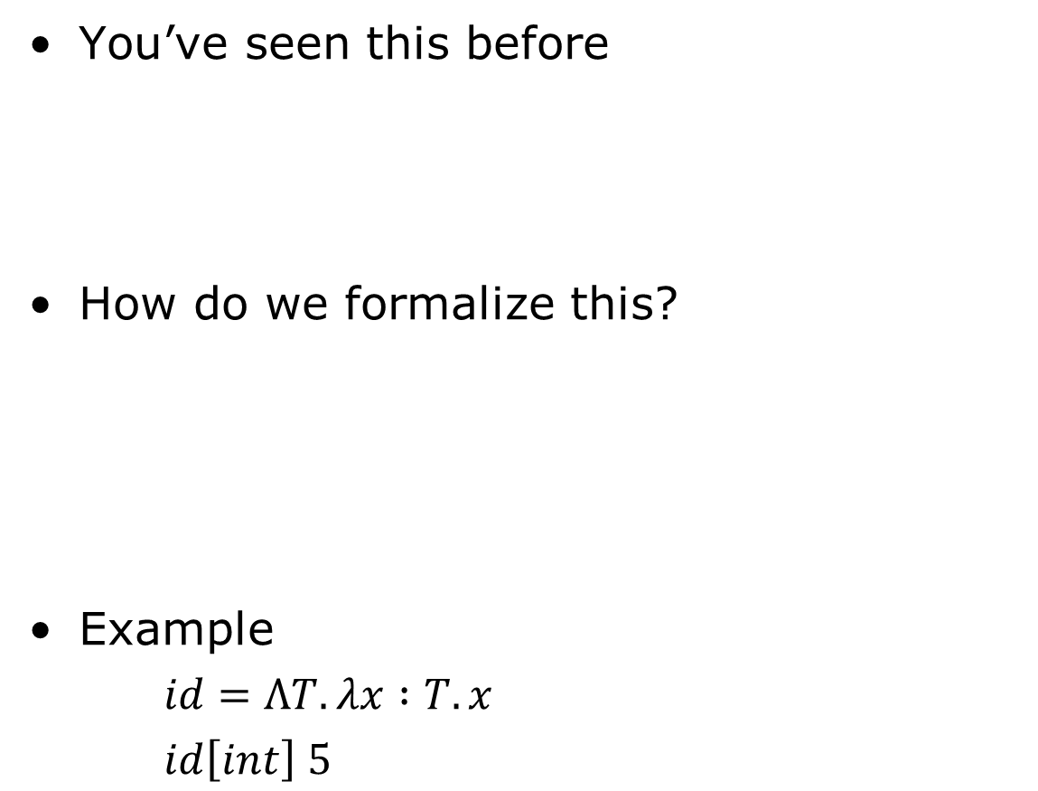
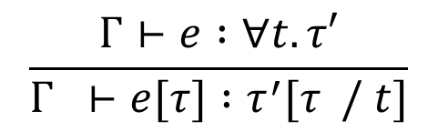
Explicit polymorphism
You’ve seen this before
How do we formalize this?
Example
$id=ΛT. λx :T. x$
$id\left[int\right] 5$
public interface List<E>{
void add(E x);
E get();
}
List<String> ls = ...
ls.add("Hello");
String hello = ls.get(0);
$$\frac{Γ⊢e :τ}{Γ ⊢ Λt. e :∀t. τ}$$
$$\frac{Γ⊢e :∀t. τ′}{Γ ⊢e[τ] :τ^{′}[τ / t]}$$

Slide 26
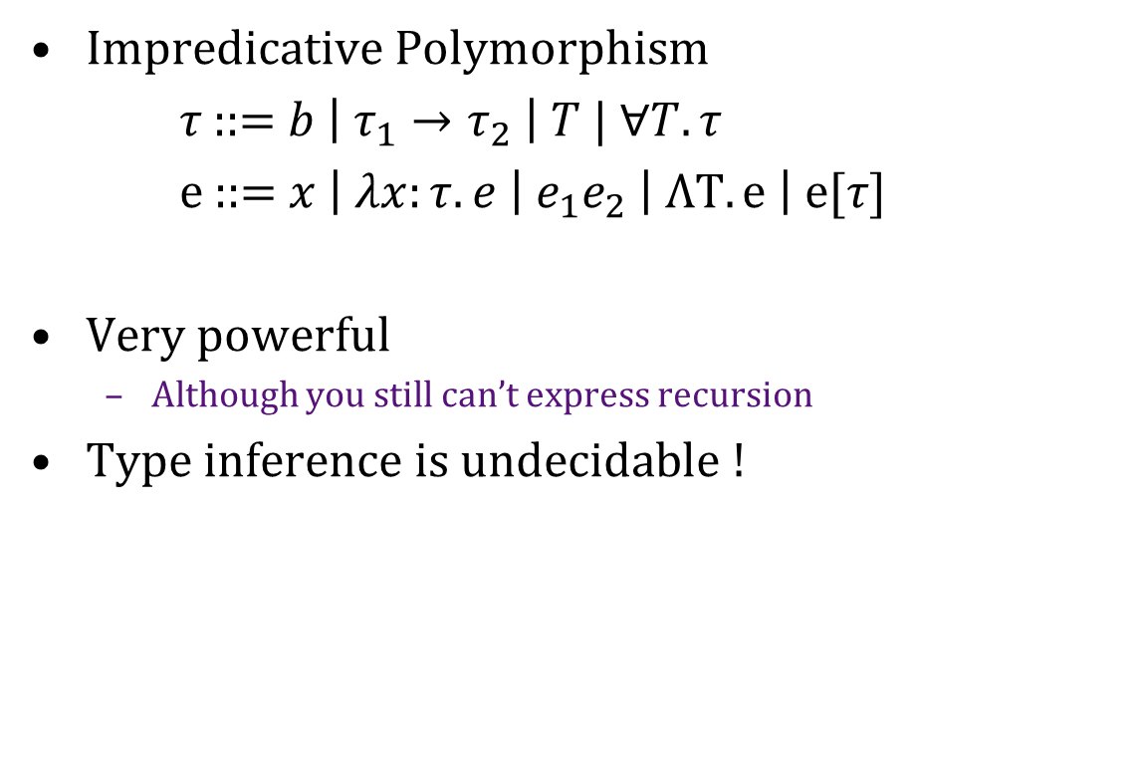
Different Styles of Polymorphism
Impredicative Polymorphism
𝜏 ::= $b \left| τ_{1}→τ_{2} \right| T | ∀T. τ$
e ::= $x \left| λx:τ. e \right|{ e}_{1}e_{2} \left| ΛT. e \right| e[τ]$
Very powerful
Although you still can’t express recursion
Type inference is undecidable !
Notes:
Impredicative: The type includes a quantifier whose domain includes the very thing being defined.
Types above are for system F.

Slide 27
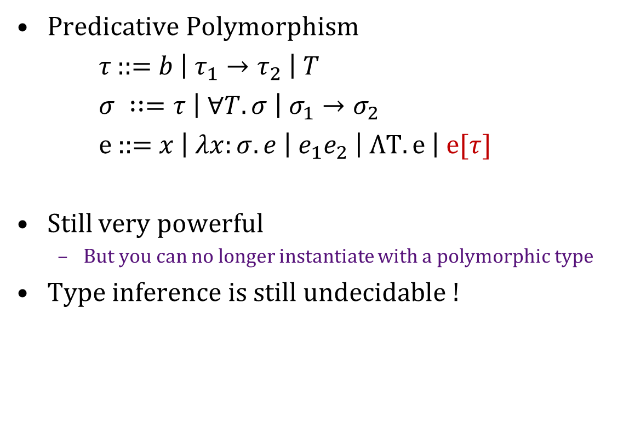
Different Styles of Polymorphism
Predicative Polymorphism
𝜏 ::= $b \left| τ_{1}→τ_{2} \right| T$
$σ ∷=τ \left| ∀T. σ \right| σ_{1}→σ_{2}$
e ::= $x \left| λx:σ. e \right|{ e}_{1}e_{2} \left| ΛT. e \right| e[τ]$
Still very powerful
But you can no longer instantiate with a polymorphic type
Type inference is still undecidable !
Notes:
Predicative: The domain of type variables is restricted to monotypes

Slide 28
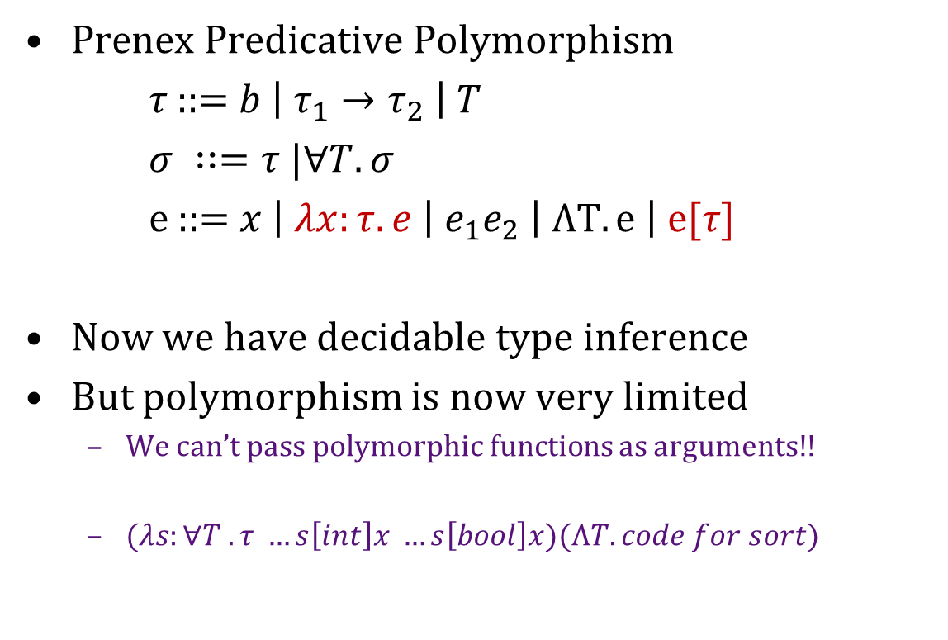
Different Styles of Polymorphism
Prenex Predicative Polymorphism
𝜏 ::= $b \left| τ_{1}→τ_{2} \right| T$
$σ ∷=τ |∀T. σ$
e ::= $x \left| λx:τ. e \right|{ e}_{1}e_{2} \left| ΛT. e \right| e[τ]$
Now we have decidable type inference
But polymorphism is now very limited
We can’t pass polymorphic functions as arguments!!
$(λs:∀T . τ …s\left[int\right]x …s\left[bool\right]x)(ΛT. code for sort)$

Slide 29
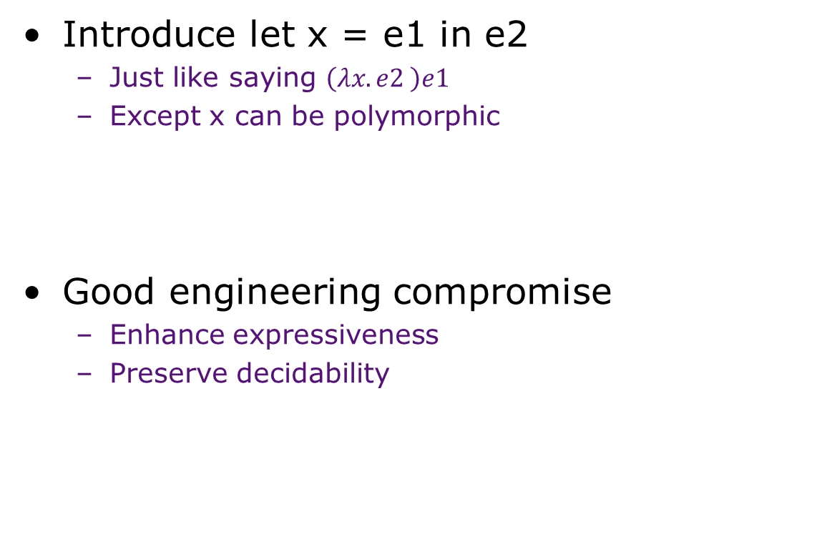
Let polymorphism
Introduce let x = e1 in e2
Just like saying $\left(λx. e2 \right)e1$
Except x can be polymorphic
Good engineering compromise
Enhance expressiveness
Preserve decidability

Slide 30
Type inference with polymorphism

Slide 31
Polymorphic Types
let
id = λx. x
in
... (id True) ... (id 1) ...
Constraints:
id :: t₁ --> t₁
id :: Int --> t₂
id :: Bool --> t₃
Does not unify!!
Solution: Generalize the type variable
id :: ∀t₁. t₁ --> t₁
Different uses of a generalized type variable
may be instantiated differently
id₂ : Bool --> Bool
id₁ : Int --> Int
When can we generalize?

Slide 32
A mini Language to study Hindley-Milner Types
Expressions
E ::= c constant
| x variable
| λx. E abstraction
| (E₁ E₂) application
| let x = E₁ in E₂ let-block
There are no types in the syntax of the language!
The type of each subexpression is derived by the Hindley-Milner type inference algorithm.

Slide 33
A Formal Type System
Types
τ ::= ι base types
| t type variables
| τ₁ -> τ₂ Function types
Type Schemes
σ ::= τ
| ∀t. σ
Type Environments
TE ::= Identifiers → Type Schemes
Note, all the ∀’s occur in the beginning of a type scheme, i.e., a type τ cannot contain a type scheme σ

Slide 34
Instantiations
σ = ∀t₁...t_{n}. τ
Type scheme σ can be instantiated into a type τ’ by substituting types for the bound variables of σ, i.e.,
τ’ = S τ for some S s.t. Dom(S) ⊆ BV(σ)
- τ’ is said to be an instance of σ (σ > τ’)
- τ’ is said to be a generic instance of σ when S maps variables to new variables.
Example:
σ =∀t₁. t₁ -> t₂
t₃ -> t₂ is a generic instance of σ
Int -> t₂ is a non generic instance of σ

Slide 35
Generalization aka Closing
Gen(TE,τ) = ∀ t₁...t_{n}. τ
where { t₁...t_{n} } = FV(τ) - FV(TE)
Generalization introduces polymorphism
Quantify type variables that are free in τ but not free in the type environment (TE)
Captures the notion of new type variables of τ

Slide 36
HM Type Inference Rules
Typing: TE ├ e : τ
(App) TE ├ e₁ : τ -> τ’ TE ├ e₂ : τ
TE ├ (e₁ e₂) : τ’
(Abs)
TE ├ λx.e : τ -> τ’
(Var)
TE ├ x : τ
(Const)
TE ├ c : τ
(Let)
TE ├ (let x = e₁ in e₂) : τ’
TE + {x : τ} ├ e : τ’
(x : σ) ∈ TE σ ≥ τ
typeof(c) ≥ τ
TE+{x : τ} ├ e₁ : τ TE+{x:Gen(TE,τ)} ├ e₂ : τ’

Slide 37
HM Inference Algorithm
Def W(TE, e) = Case e of
c = ({}, Typeof(c))
x =
λx.e =
(e₁ e₂) =
let x = e₁ in e₂
=
u’s represent new type variables
if (x ∉ Dom(TE)) then Fail
else let ∀t₁...t_{n}.τ = TE(x);
in ( { }, [u_{i} / t_{i}] τ)
let (S₁, τ₁) = W(TE + { x : u }, e);
in (S₁, S₁(u) -> τ₁)
let (S₁, τ₁) = W(TE, e₁);
(S₂, τ₂) = W(S₁(TE), e₂);
S₃ = Unify(S₂(τ₁), τ₂ -> u);
in (S₃ S₂ S₁, S₃(u))
let (S₁, τ₁) = W(TE + {x : u}, e₁);
S₂ = Unify(S₁(u), τ₁);
σ = Gen(S₂ S₁(TE), S₂(τ₁) );
(S₃, τ₂) = W(S₂ S₁(TE) + {x : σ}, e₂);
in (S₃ S₂ S₁, τ₂)

Slide 38
Hindley-Milner: Example
A
λx. let f = λy.x
in (f 1, f True)
B
W(∅, A) =
( [ ] , u₁ -> (u₁,u₁) )
W({x : u₁}, B) =
( [ ] , (u₁,u₁) )
W({x : u₁, f : u₂}, λy.x) =
( [ ] , u₃ -> u₁ )
W({x : u₁, f : u₂, y : u₃}, x) =
( [ ] , u₁ )
Unify(u₂ , u₃ -> u₁) =
[ (u₃ -> u₁) / u₂ ]
Gen({x : u₁}, u₃ -> u₁) =
∀u₃.u₃ -> u₁
TE = {x : u₁, f : ∀u₃.u₃ -> u₁}
W(TE, (f 1) ) =
( [ ] , u₁ )
W(TE, f) =
( [ ] , u₄ -> u₁ )
W(TE, 1) = ( [ ] , Int )
...
Unify(u₄ -> u₁ , Int -> u₅) =
[ Int / u₄ , u₁ / u₅ ]

Slide 39
Important Observations
Do not generalize over type variables used elsewhere
Let is the only way of defining polymorphic constructs
Generalize the types of let-bound identifiers only after processing their definitions

Slide 40
Properties of HM Type Inference
It is sound with respect to the type system.
An inferred type is verifiable.
It generates most general types of expressions.
Any verifiable type is inferred.
Complexity
PSPACE-Hard
Nested let blocks

Slide 41
Extensions
Type Declarations
Sanity check; can relax restrictions
Incremental Type checking
The whole program is not given at the same time, sound inferencing when types of some functions are not known
Typing references to mutable objects
Hindley-Milner system is unsound for a
language with refs (mutable locations)
Overloading Resolution

Slide 42
HM Limitations: λ-bound vs Let-bound Variables
Only let-bound identifiers can be instantiated differently.
let
twice f x = f (f x)
in
twice twice succ 4
versus
let
twice f x = f (f x)
foo g = (g g succ) 4
in
foo twice
foo is not type correct !
Generic vs. Non-generic type variables

Slide 43
Puzzle: Another set of Inference rules
(Gen) TE ├ e : τ t ∉ FV(TE)
TE ├ e : ∀t.τ
(Spec) TE ├ e : ∀t.τ
TE ├ e : τ [u/t]
(Var) (x : τ) ∈ TE
TE ├ x : τ
(Let) TE+{x:τ} ├ e₁: τ TE+{x:τ} ├ e₂:τ’
TE ├ (let x = e₁ in e₂) : τ’
(App) and (Abs) rules remain unchanged.
Sound but no inference algorithm !

