Slide 1

Computer Aided Programming
Enabling Software at Scale
Armando Solar-Lezama

Slide 2

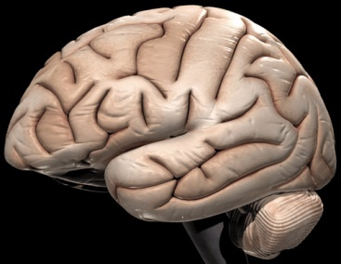
Automation with a human touch
Computer Aided Engineering is a combination of techniques in which man and machine are blended into a problem solving team, intimately coupling the best characteristics of each.
S.A. Meguid 1986
Integrated Computer-aided Design of Mechanical Systems

Slide 3
The challenges of big software
Big software is an ecosystem
No one understands it in its entirety
Challenges
Help programmers leverage their limited understanding to contribute to the ecosystem
Maintain confidence that critical system properties will be preserved

Slide 4
Matchmaker
A data driven approach to Synthesis

Slide 5
The problem with scale
OO Frameworks revolutionized programming
designed around flexibility and extensibility
Overall this was a good thing
facilitates reuse
new applications deliver rich functionality with little new code
But, there were unintended consequences
functionality is atomized into very small methods
proliferation of classes and interfaces
“Ravioli” code

Slide 6
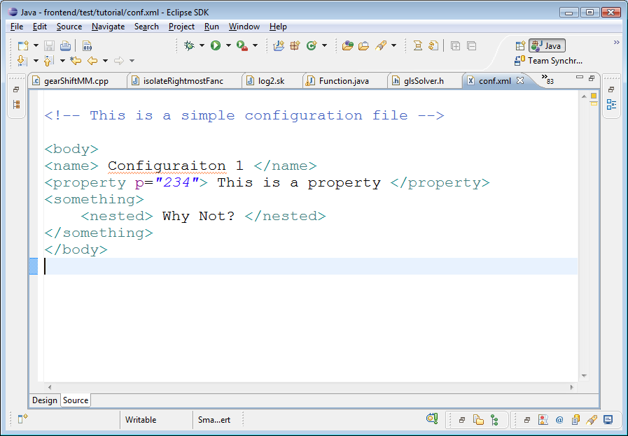
Example: Eclipse Syntax Highlighting
Different lexical elements highlighted in different colors
comment
tag
string
If we create an editor for our own language
how do we get it to do this?

Slide 7
What we know
TextEditor
ITokenScanner
SkEditor
SkScanner
TextEditor.setTokenScanner( );

Slide 8
How do editors and Scanners Meet?
DefaultDamagerRepairer dr =new DefaultDamagerRepairer(new SkScanner());
PresentationReconciler rcr = new PresentationReconciler();
rcr.setDamager(dr, …); rcr.setRepairer(dr, …);
SkEditor
SkScanner
(1)
DamageRepairer
(3)
PresentationReconciler
(2)

Slide 9
How do editors and Scanners Meet?
class SkConfig extends SourceViewerConfiguration {
(4) public IPresentationReconciler getPresentationReconciler(…) {
(1) DefaultDamagerRepairer dr =new DefaultDamagerRepairer(new SkScanner());
(2) PresentationReconciler rcr = new PresentationReconciler();
(1) rcr.setDamager(dr, …); rcr.setRepairer(dr, …);
return rcr;
}
}
class SkConfig extends SourceViewerConfiguration { … }
(5) Constructor of SkEditor must set FooConfig as SourceViewerConfiguration.
SkEditor() { setSourceViewerConfiguration(new SkConfig()); }
DefaultDamagerRepairer dr =new DefaultDamagerRepairer(new SkScanner());
PresentationReconciler rcr = new PresentationReconciler();
rcr.setDamager(dr, …); rcr.setRepairer(dr, …);
SkEditor
SkScanner
(1)
DamageRepairer
SourceViewer
(3)
.config.getPR() (4)
PresentationReconciler
(2)

Slide 10
How do editors and Scanners Meet?
Very complicated!
class SkConfig extends SourceViewerConfiguration { (4)
public getPresentationReconciler(…) {
DefaultDamagerRepairer dr = new DefaultDamagerRepairer(new SkScanner()); (1)
PresentationReconciler rcr = new PresentationReconciler (); (2)
rcr.setDamager(dr, …); rcr.setRepairer(dr, …); (3)
return rcr;
}
}
Class SkEditor extends TextEditor {
SkEditor() {
setSourceViewerConfiguration(new SkConfig()); (5)
}
}
We can synthesize this code!

Slide 11
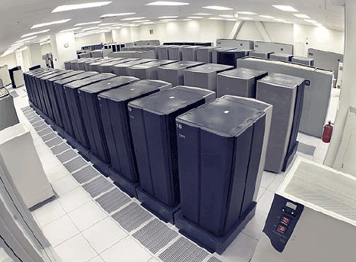
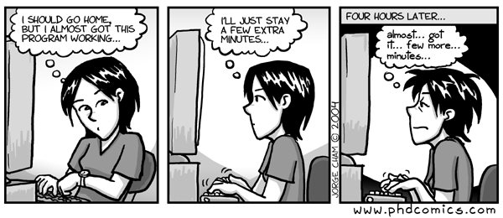
Data Driven Synthesis
The key problem is coping with scale
program is too big & complex to fully analyze statically
Synthesizer must use data
database captures the accumulated insight of project members
Program Behavior Database
Interactive Programming Tools

Slide 12
MatchMaker approach
Observation 1:
Interaction between two objects usually requires a chain of references between them.
Critical Chain
SkEditor
SkScanner
Our goal is to find the important code pieces that work together to build the chain

Slide 13
MatchMaker approach
Observation 2:
Often helpful to imitate the behavior of sibling classes.
TextEditor
ITokenScanner
XMLEditor
XMLScanner
SkEditor
SkScanner

Slide 14
MatchMaker approach
Observation 3:
We have data about many runs with many different editors
(A1 ∧ A2) - B
A1 = {Important code for forming critical chain 1}
Trace 1:
XMLEditor
XMLScanner
A2 = {Important code for forming critical chain 2}
Trace 2:
XMLEditor
XMLScanner
B = {All code in this trace, which forms no critical link}
Trace 3:
FooEditor
No Scanner
Notes:
We have multiple traces for the example “XMLEditor” which uses “XMLScanner”. And we have trace in which there’s some “FooEditor”, but without corresponding Scanner.

Slide 15
Algorithm
Find critical chain in one trace:
iterate over the snapshots
find the earliest pointer dereference chain from X to Y.
X: object of TextEditor’s subclass
Y: object of ITokenScanner’s subclass
Thin slicing connects critical chain to code
Result is a tree of important calls
Compare trees from many different instances
Search for similarities and differences

Slide 16
Database
Currently very rudimentary
Track
method enter/exit,
heap load/store,
class hierarchy.
Many events can be safely ignored
Also contains periodic heap snapshots
Lots of data, but manageable
between 3 and 7 MB per second of real-time execution

Slide 17
How long does this take?
Searching for relevant data could be expensive
but it parallelizes easily
indexing can help a lot
right now our databases are small, so this takes < 30 sec
The rest is easy after the right data is found
finding the critical path takes < 20 sec
building the call tree takes about 30 sec
tree matching takes < 1 sec

Slide 18
Take Home
Modern OOP frameworks are
flexible
extensible
and very very complex.
Hard to match classes so they work together
MatchMaker uses data to synthesize code

Slide 19
Programming with delegation

Slide 20
Delegating Cross Cutting Concerns
Critical properties are cross-cutting concerns
enforced by different bits of code scattered through the system
cross-cutting concerns make software complex
don’t fit natural abstraction boundaries
often come as an afterthought in software design
What if we could delegate them?
let programmer worry about the core functionality
and let the synthesizer deal with the cross-cutting concerns

Slide 21
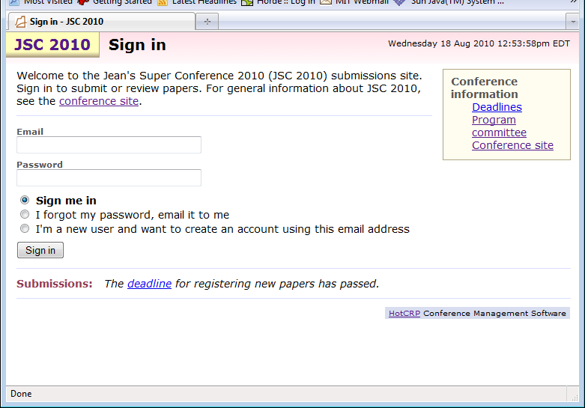
Ex: Controlling Information Flow

Slide 22
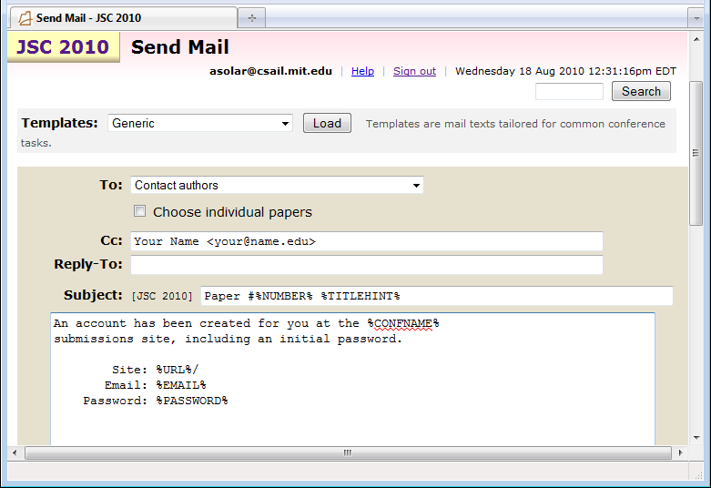
Ex: Controlling Information Flow

Slide 23
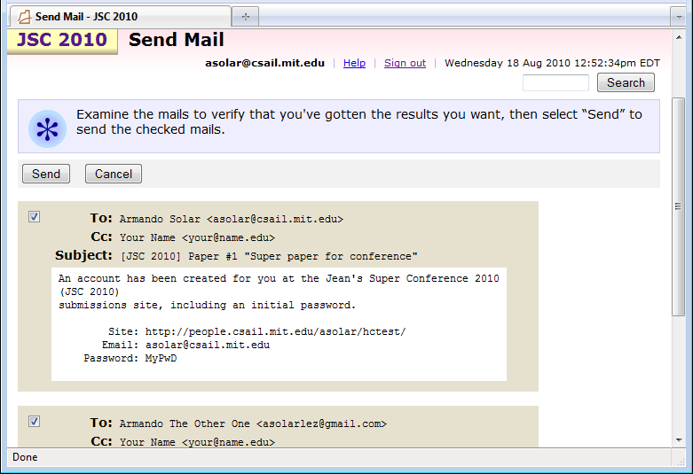
Ex: Controlling Information Flow

Slide 24
Info-Flow is a cross cutting concern
Changes required throughout the code to enforce even simple policies.
poor match for traditional techniques
Aspect oriented programming is not “smart” enough

Slide 25
How was this fixed?
class Mailer {
...
var $hideSensitive;
...
}
Mailer has sole responsibility for composing e-mails.
$hideSensitive determines whether to show pwd
similar fields protect other forms of private information,
e.g. reviews
Notes:
A single Mailer class is completely responsible for composing e-mails.
This class has a field that determines whether to show passwords or not.
It also has similar fields for other forms of private information, such as reviews.

Slide 26
How was this fixed?
An account has been created for you at the %CONFNAME%
submissions site, including an initial password.
Site: %URL%/
Email: %EMAIL%
Password: %PASSWORD%
$password = ($this->hideSensitive ? "HIDDEN" : $contact->password);
if ($what == "%PASSWORD%“) return $password ;
if ($what == "%EMAIL%“) return $this->_expandContact($contact, "e");
An account has been created for you at the POPL 2011
submissions site, including an initial password.
Site: http://www.cs.tau.ac.il/conferences/popl11/
Email: asolar@csail.mit.edu
Password: GoOdPwD

Slide 27
How was this fixed?
Program must create one message to display
And a different one to send
$rest["hideSensitive"] = true;
$show_preparation =
Mailer::prepareToSend($template, $contact, $rest);
$show_preparationil->displayBody();
$rest["hideSensitive"] = false;
$preparation =
Mailer::prepareToSend($template, $contact, $rest);
$preparation->send();

Slide 28
This is too complicated!
Too many points of failure
programmer could
output without using the message class
pass the wrong flag
forget to create multiple versions of a message
use the wrong version of the message
Not to mention the design took a lot of work

Slide 29
Programming with delegation
What if we could ignore the issue altogether
And delegate the information flow control to a high-level policy
$message = Mailer::expandTemplate($template, $contact);
$message->displayBody();
$message->send();
foreach( x in users)
assert flowout.user != x ➔ x.getPwd() == “HIDDEN”

Slide 30
Programming with delegation
How do we allow the policy to be enforced?
preferably with minimal changes to the simple code
Delegated expression gives the system control
function expandTemplate($t, $contact){
...
$t = replace($t, "%PASSWORD%“, $contact->getPwd());
...
}
function getPwd(){
return delegate($this->password) ;
}

Slide 31
Semantics of Delegation
...
mOo43bb
MyPwD
hoM3p
HIDDEN
function getPwd(){
return delegate($this->password) ;
}
delegate($this->password)
Password: %PASSWORD%
$t = replace($t, "%PASSWORD%“, $contact->getPwd());
Password: MyPwD
Password: mOo43bb
...
Password: HIDDEN
Password: hoM3pp

Slide 32
Semantics of Delegation
Password: MyPwD
Password: mOo43bb
...
Password: HIDDEN
Password: hoM3pp
$message = Mailer::expandTemplate($template, $contact);
$message->displayBody();
$message->send();
foreach( x in users)
assert flowout.user != x ➔ x.getPwd() == “HIDDEN”

Slide 33
How does it work?
Program uses Symbolic Values to represent data under the control of the runtime
Runtime tracks logical relationships between symbolic values and program data
Runtime uses an SMT solver to derive values for symbolic data

Slide 34
Status
We have a runtime to do the blended symbolic/concrete execution
Performance is comparable to running an interpreted language
We are formalizing the language semantics
Working on a full language design

Slide 35
Conclusion
It’s time for a revolution in programming tools
Unprecedented ability to reason about programs
Unprecedented access to large-scale computing resources
Unprecedented challenges faced by programmers
Successful tools can’t ignore the programmer
programmers know too much to be replaced by machines
but they sure need our help!

