Slide 1
The Dilate Algorithm
Davide Ceneda – 14/05/2018

Slide 2
Introduction
Dilation is one of the two basic operators in the area of mathematical morphology, the other being erosion.
Dilate is a function that accepts a black and white image.
It is also known by the names “grow”, “bolden”, and “expand”.
The basic effect of the operator on a binary image is to gradually enlarge the boundaries of regions of foreground pixels (i.e. white pixels, typically). Thus areas of foreground pixels grow in size while holes within those regions become smaller.
It turns on pixels which were near pixels that were on originally, thereby thickening the items in the image.

Slide 3
Definition
Dilation (usually represented by ⊕) is one of the basic operations in mathematical morphology.
Originally developed for binary images, it has been expanded first to grayscale images, and then to complete lattices. The dilation operation usually uses a structuring element for probing and expanding the shapes contained in the input image.[source:wiki]
In practice, given an image, the Dilate function should turn on any pixel that is touching a pixel in the north, east, south, or west direction (no diagonals) that is already turned on in the input.

Slide 4
Definition\2
The dilation operator takes two pieces of data as inputs. The first is the image which is to be dilated. The second is a (usually small) set of coordinate points known as a structuring element (also known as a kernel). It is this structuring element that determines the precise effect of the dilation on the input image.
To compute the dilation of a binary input image, we consider each of the background pixels in the input image in turn.
For each background pixel (which we will call the input pixel) we superimpose the structuring element on top of the input image so that the origin of the structuring element coincides with the input pixel position. If at least one pixel in the structuring element coincides with a foreground pixel in the image underneath, then the input pixel is set to the foreground value. If all the corresponding pixels in the image are background, however, the input pixel is left at the background value.

Slide 5
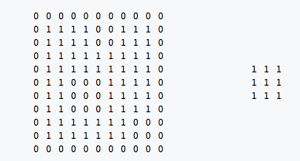
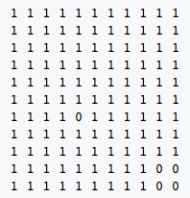
Example
Suppose A (our image) is the following 11 x 11 matrix and the structuring element B is the following 3 x 3 matrix:
⊕
For each pixel in A, superimpose the center of B.
Each pixel of every superimposed B is included in the dilation of A by B.
The dilation of A by B is given by this 11 x 11 matrix.

