Slide 1

Zippier ZMap Internet-Wide Scanning at 10Gbps
David Adrian, Zakir Durumeric, Gulshan Singh, J. Alex Halderman
University of Michigan
WOOT ’14
San Diego, CA

Slide 2
One Year Ago… We released ZMap
ZMap is an Internet-wide port scanner capable of scanning at 97% the maximum theoretical speed of gigabit Ethernet
ZMap completes a single-port TCP SYN scan of all of IPv4 in forty-five minutes
Notes:
Enabling insights into ecosystems, vulnerabilites, Internet as a whole

Slide 3
Networks are Faster Our own got 10x faster!
1 GigE ~ 1.48 million packets per second
10 GigE ~ 14.88 million packets per second
Why not full 10 GigE?
Notes:
Don't imply networks are 10x faster
We have better uplink
University of Michigan – Very good connection (Merit)
10 Gigabit Ethernet connection, hit 14.88 Mpps number hard
Only 1.54 Mpps on 10 GigE, gained 0.1 Mpps
ZMap did not saturate this pipe

Slide 4
Zippier ZMap
A series of performance enhancements to ZMap, enabling scanning at 95% 10 GigE linespeed, completing a single-port TCP scan in under five minutes

Slide 5
Talk Roadmap
Optimizations to ZMap
Evaluation of scanning at >1 Gbps
Applications and Conclusions

Slide 6
Performance Enhancements What do we need to optimize?
Parallelize address generation
Efficient blacklisting and whitelisting
Very low overhead sends (~200 cycle budget)
Notes:
Different needs than the original ZMap. Previously we could get by with very basic multithreading (with locks), and naïve blacklist and whitelist approaches, and fairly efficient sends.
Multi-thread and multi-core
Good Internet citizenship
Single 3 GHz core, 200 cycle average for 14.88 Mpps

Slide 7
Address Generation How do we address outgoing packets?
Multithreaded iteration over a cyclic group of integers modulo p requires a lock
Notes:
Want parallel addressing
Current uses group
Multithreaded send requires a lock
G is a generator, p is prime
Start somewhere, loop back to start
Want to split this up into disjoint sets, give one set to each thread, one thread per core

Slide 8
Address Generation How do we address outgoing packets?
Multithreaded iteration over a cyclic group of integers modulo p requires a lock
Shard the cycle into disjoint sets
Notes:
Want parallel addressing
Current uses group
Multithreaded send requires a lock
G is a generator, p is prime
Start somewhere, loop back to start
Want to split this up into disjoint sets, give one set to each thread, one thread per core
DID SHARDING, MOVE ON TO ADDRESS CONSTRAINTS

Slide 9
Address Constraints
Good Internet citizenship demands honoring blacklist requests
1100 entries from 208 organizations on our blacklist, 0.15% of IPv4 address space
Use blacklist to exclude IANA-reserved addresses, 14% of IPv4 address space
Notes:
Binary search is not quite good enough.
Blacklist accounts for a very small percentage of the address space – the vast majority of the blacklist is the IANA reserved address range (0.0.0.0/8, 10.0.0.0/8, multicast, etc.)
Phrase better
Plug Zakir's paper
Want to ask “yes/no” for each packet

Slide 10
Optimized Address Constraints
Model IPv4 as a binary tree populated with blacklist
Paint leaf nodes as whitelisted or blacklisted
0.0.0.0/0
0.0.0.0/1
128.0.0.0/1
0.0.0.0/2
64.0.0.0/2
Use tree to determine number of allowed addresses n, and map indices 1…n to addresses a₁…a_{n}
Notes:
Want n'th address to scan
Tree doesn’t have to be very wide
Use tree to lookup addresses, check if blacklisted
Iterate over 1..n instead of addresses, ask tree what the I’th allowed address is

Slide 11
Optimized Address Constraints Can we avoid the tree lookup?
Move the whitelisted /20 blocks out of the tree and into an array to bypass tree lookup
64.240.0.0/20
1
2
3
… … … … …
2²⁰
64.0.0.0/20
Notes:
Large majority get cached. Tree doesn’t have to be very wide
We can do this because we’re iterating over indices instead of addresses directly
DID BLACKLISTS, MOVE ON TO SENDS

Slide 12
Zero-Copy NIC Access How can we send packets at line rate?
The Linux kernel is not capable of sending 64 byte packets at 10 GigE linespeed – 14.88 million packets per second
Use the PF_RING ZC library for direct NIC “zero-copy” access to reach linespeed
Bypass the kernel to reach 10 GigE linespeed
Notes:
Issues with many flows, only 64B packets
PF_RING closed source library from ntop
Reduce memory overhead, reduce context switches
Not quite drop and swap in

Slide 13
Zero-Copy NIC Access How do we combine sharding with PF_RING?
Old Architecture
New Architecture
Global Cyclic Group Iterator
Send
Send
Send
Send
Packet Creation
Packet Creation
Packet Creation
Blocking Update
Nonblocking Poll
Notes:
Need ZMap to match PF_RING
Emphasize lock and update, a_i+1 = g a_i
Each packet creation thread gets a shard
----- Meeting Notes (8/6/14 15:00) -----
Use the word polling

Slide 14
Talk Roadmap
Performance Enhancements to ZMap
Evaluation of scanning at >1 Gbps
Applications and Conclusions

Slide 15
10 GigE is Fast Your mileage may vary.
This is as much a stress-test of the University of Michigan’s network as it is a study of ZMap
Building uplink is an aggregated 2x10 gigabit fiber channel
Performance may vary on other networks.
Notes:
Prepare for make friends with sysadmin joke

Slide 16
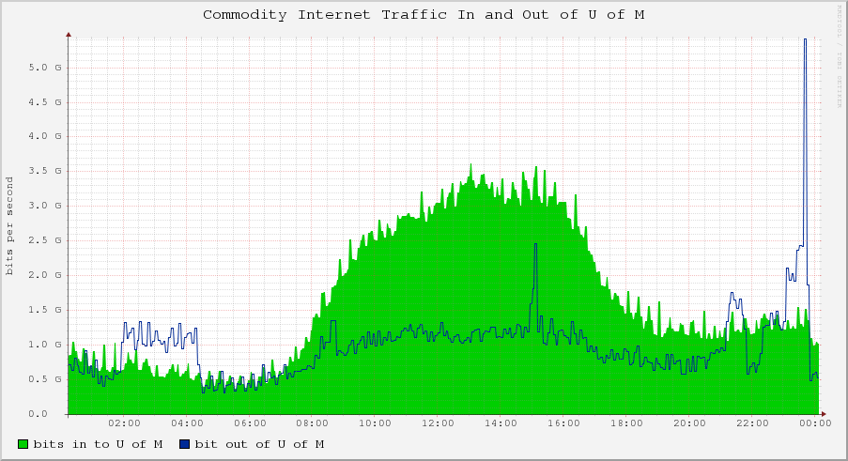
Notes:
----- Meeting Notes (8/14/14 17:03) -----
Slide reveal

Slide 17
Notes:
----- Meeting Notes (8/14/14 17:03) -----
Slide reveal

Slide 18
Complete Scans How fast can we complete full scans of the Internet?
Scan Rate | Duration | Normalized Hit Rate
1.44 Mpps (~1 Gbps) | 42:08 | 1.00
3.00 Mpps | 20:47 | 0.99
4.00 Mpps | 15:38 | 0.97
14.23 Mpps (~10 Gbps) | 4:29 | 0.63
Scan Rate | Duration
1.44 Mpps (~1 Gbps) | 42:08
3.00 Mpps | 20:47
4.00 Mpps | 15:38
14.23 Mpps (~10 Gbps) | 4:29
95% 10 GigE linespeed
37% Drop
Complete scans of port 443 with our enhancements and blacklist
Notes:
1st thing: How fast can we do this
2nd thing: How good are results
Hit rate – percentage of hosts that respond
Is it the same as the slower scans

Slide 19
Hit Rate vs. Scan Rate When does fast become too fast?
50 second long scans of random samples of IPv4 address space on port 443
Notes:
50 second long scans, random samples, 3 trials per speed, 8s cooldown period
5 million pps is 95th percentile (3.5 Gbps)
14 Mpps is 65%
Hit every /16 over 200 times per second

Slide 20
Receive Rate Where are the packets going?
SYN ACK receive rate for 50s sample scans
Split send and receive between two machines
Packets get dropped on the network
Notes:
50s mark, we stop sending, and have an 8 second cooldown period
Spike at start, slow increase
More packets start coming through at the 50s mark (end spike) – Is this CPU?
Two machine scan (same random seed, lied about the IP addresses) (14 Mpps)
3% higher hit rate with two machines, PF_RING reports no dropped packets
See slight difference possibly due to differing network setup required, net enough to explain the drop
Buffer bloat?
Retransmission? Congestion?
Only network.
More of we don't know.

Slide 21
Talk Roadmap
Performance Enhancements to ZMap
Evaluation of scanning at >1 Gbps
Applications and Conclusions

Slide 22
Applications What can we gain from 10 GigE scanning?
Decrease the moving camera effect during Internet-wide scans
Faster multi-packet scanning-related applications
Large scale vulnerability detection and exploitation
Notes:
If we could achieve the same coverage, we would get…
Camera's moving analogy, helps some research
Multipacket examples: traceroute, OS fingerprinting
Emerging threat, as attackers can they will
Mass Pwnage

Slide 23

Conclusion
As faster network infrastructure becomes available, scanning at 10 Gbps will enable powerful new applications for attackers and defenders alike
Notes:
IPv4 is fixed size, networks keep getting faster
Ultimately, these applications are available to both attackers and defenders

Slide 24
Zippier ZMap
https://zmap.io
https://github.com/zmap
@davidcadrian
David Adrian, Zakir Durumeric, Gulshan Singh, J. Alex Halderman
zippier-team@umich.edu
University of Michigan
Notes:
Pull requests welcome
Twitter handles, credit Zakir

Slide 25
Backup Slides

Slide 26
Masscan How are we different?
8-25 Mpps using dual 10 GigE ports
Did not have facilities to perform live network tests faster than 100,000 pps
Masscan peaked at 6.4 Mpps on our machines in a single-port configuration

Slide 27
Hit Rate vs. Scan Rate When does fast become too fast?
Notes:
For more details, see the paper

Slide 28


