Slide 1
Accessing Census ACS and Decennial Survey through API in R: Q&A
DSPG 2022
UVA BII Social Decision and Analytics Divison
Hanna Charankevich hc2cc@virginia.edu
Leonel G. SIWE yhu2bk@virginia.edu
Cesar P. Montalvo* cpm9w@virginia.edu
Joanna Schroeder* js2mr@virginia.edu

Slide 2

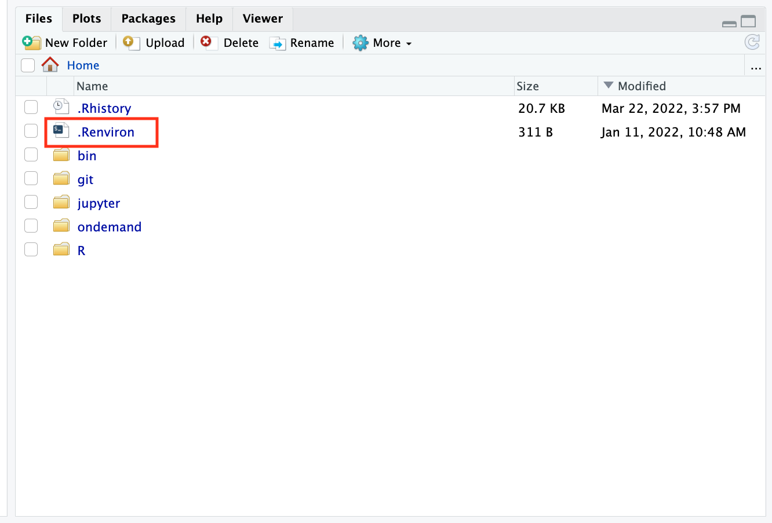
Get Census API Key
Sign up for Census API key: https://api.census.gov/data/key_signup.html
  Example key: 593093e879f40e5da694bc35fe319cadc7823796
Set .Renviron file
  Start R session
  In your Home directory find and open .Reviron file

Slide 3
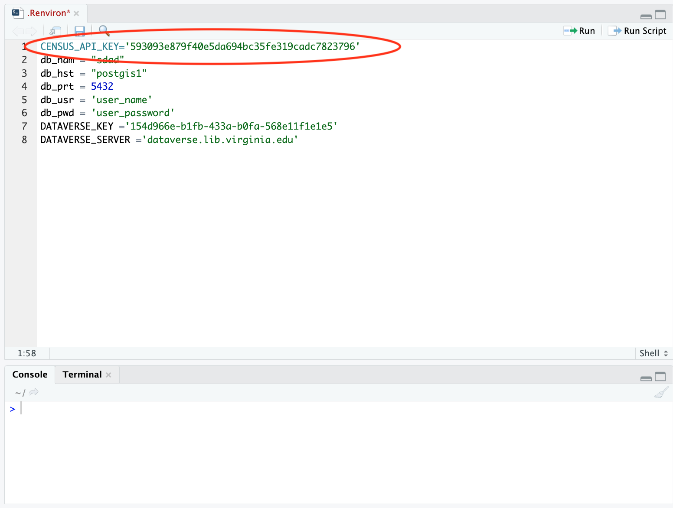
Get Census API Key
Set .Renviron file
  Start R session
  In your Home directory find and open .Reviron file
  Copy paste the Census API key from your email into .Reviron and save!

Slide 4
More Resources to Explore Census
Census Exploration tool:
https://data.census.gov/cedsci/
Census Reporter
https://censusreporter.org/
In R ‘tidycensus’ package functionality

Slide 5
Start: R packages
Load packages (assuming they are installed!)
# packages
library(tidycensus)
library(dplyr)
library(ggplot2)
library(viridis)
Load the installed API key
# installed Census API key
readRenviron("~/.Renviron")
Sys.getenv("CENSUS_API_KEY")
# if not using the environment file
census_api_key("PASTE_YOUR_KEY_HERE", install=TRUE)

Slide 6
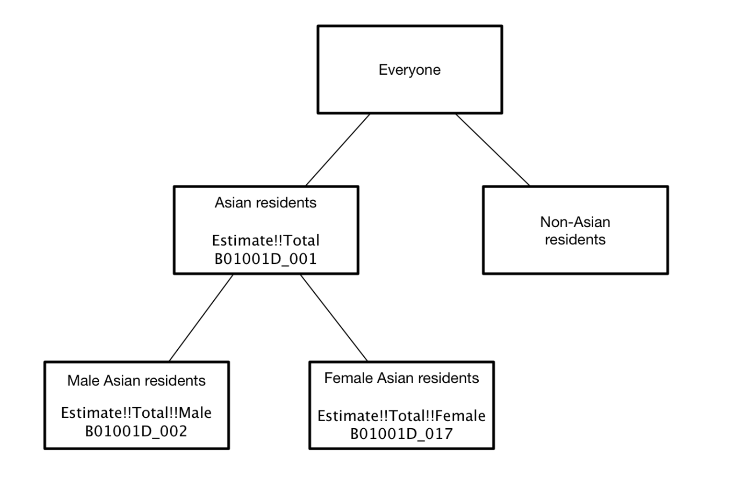
Demo: Find proportion of female population over 65 years old for all counties in VA in 2015
Determine which variables to query:
Go to Census Reporter: https://censusreporter.org/
  Total population: B010010_01
  Females 65+: B010010_44:49

Slide 7
Demo: Find proportion of female population over 65 years old for all counties in VA in 2015
Decide on selection parameters for get_acs () / get_decennial():
acs_data <- get_acs(geography = "county", # <-------- what geography?
state = 51, # <-------- in which state?
#county = 013,
variables = acs_vars, # <-------- what variables?
year = 2015, # <-------- in what year?
survey = "acs5", # <-------- which survey?
cache_table = TRUE, # <-------- cache the selected data for future faster access?
output = "wide", # <-------- variables as columns or rows?
geometry = TRUE, # <-------- include geography geometry?
keep_geo_vars = FALSE)

Slide 8
Demo: Find proportion of female population over 65 years old for all counties in VA in 2015
Do any calculations and transformations with data:
# get the proportion of females 65+
females_65plus <- acs_data %>% transmute(
county = NAME,
geometry = geometry,
female65plus = (B01001_044E+B01001_045E+B01001_046E+B01001_047E+B01001_048E+B01001_049E)
/ B01003_001E * 100)

Slide 9
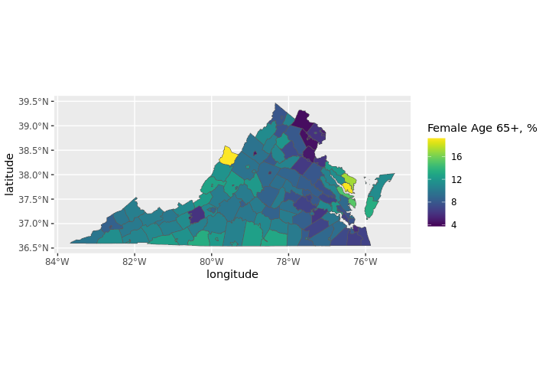
Demo: Find proportion of female population over 65 years old for all counties in VA in 2015
Visualize:

Slide 10
Group Exercise:
Odd exercise:
Find how many single women with kids were receiving SNAP benefits in Fairfax, VA in 2019 by census tract
Even exercise:
Find number of individuals with income to poverty line ratio below 50% in Arlington, VA in 2018 by block group

