Slide 1
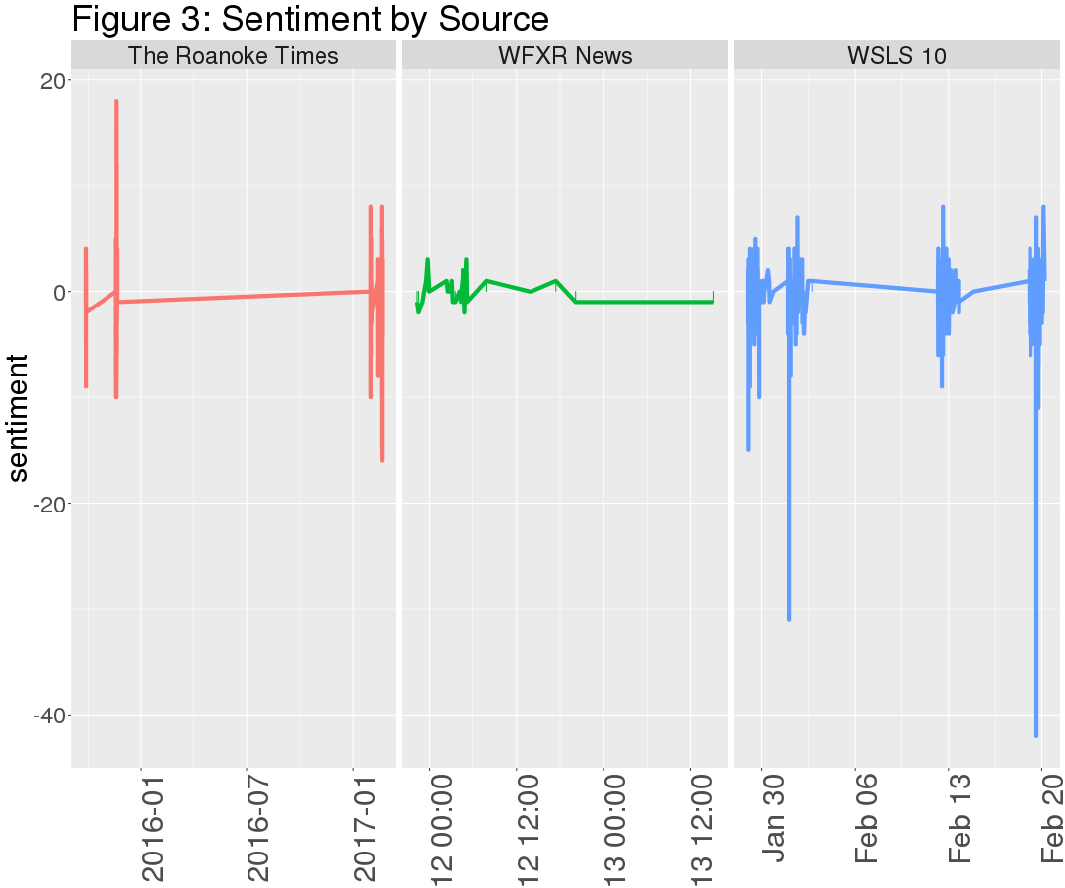
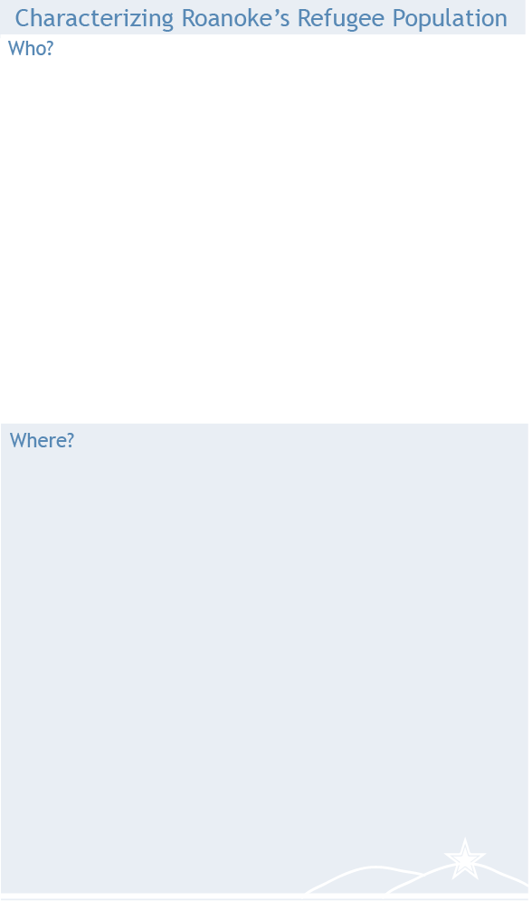
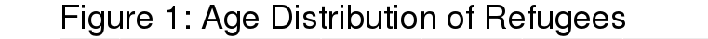
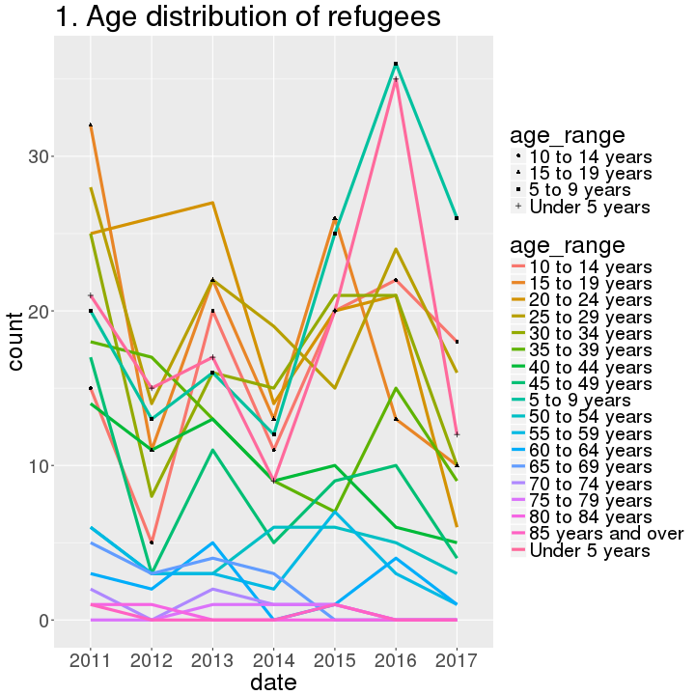
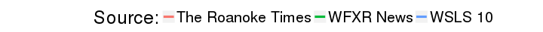
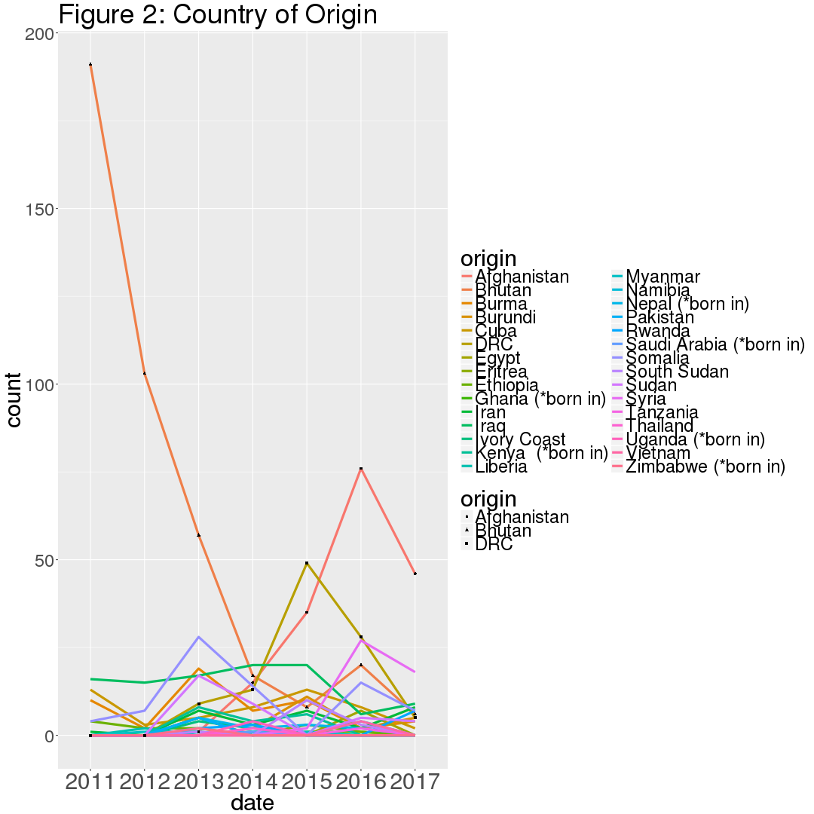
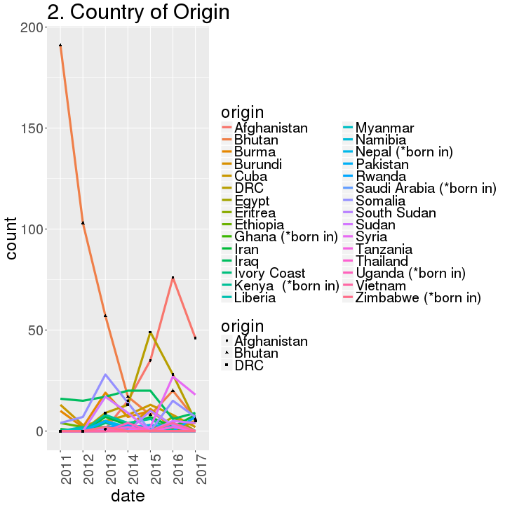
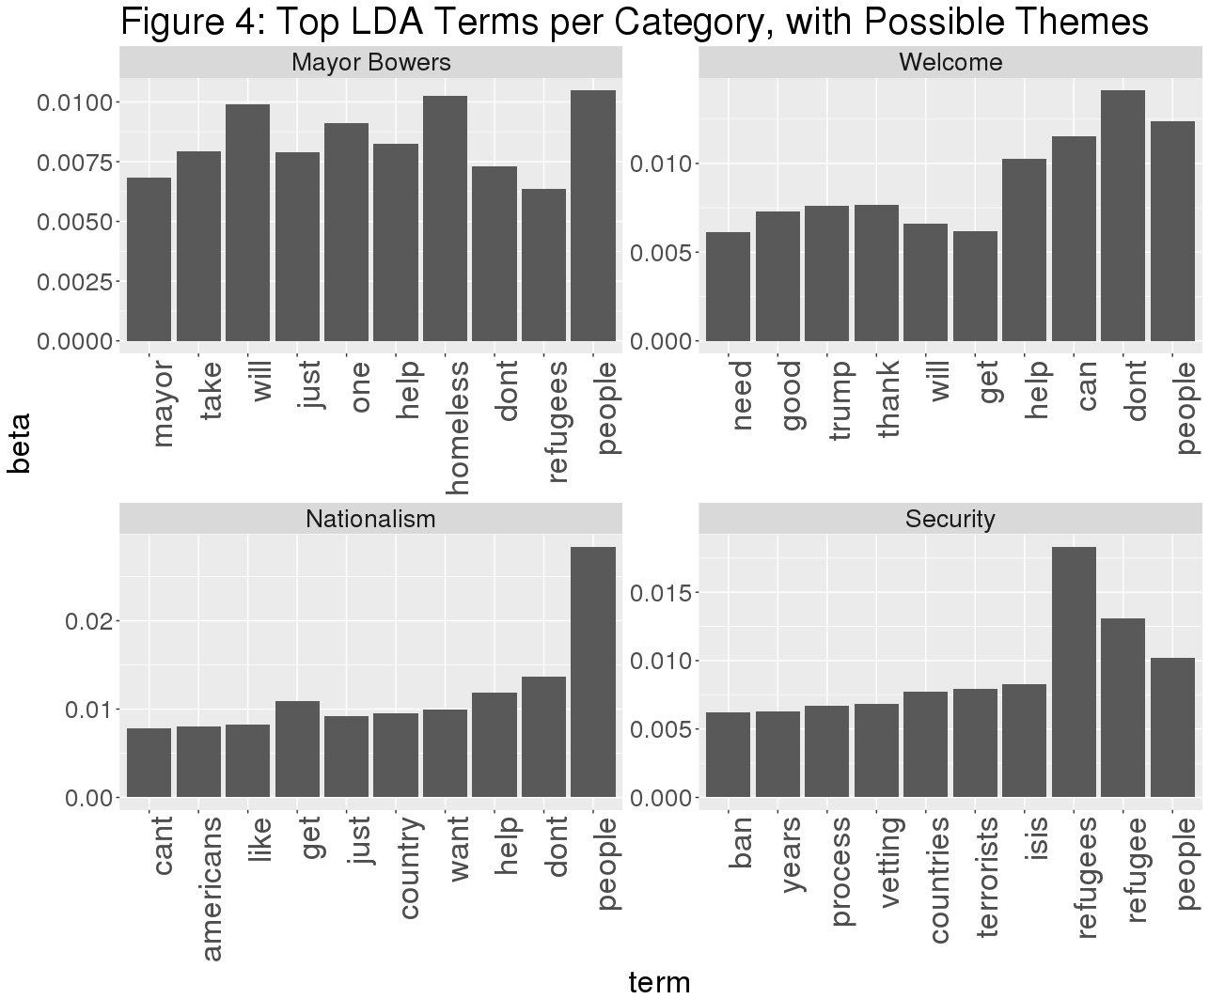
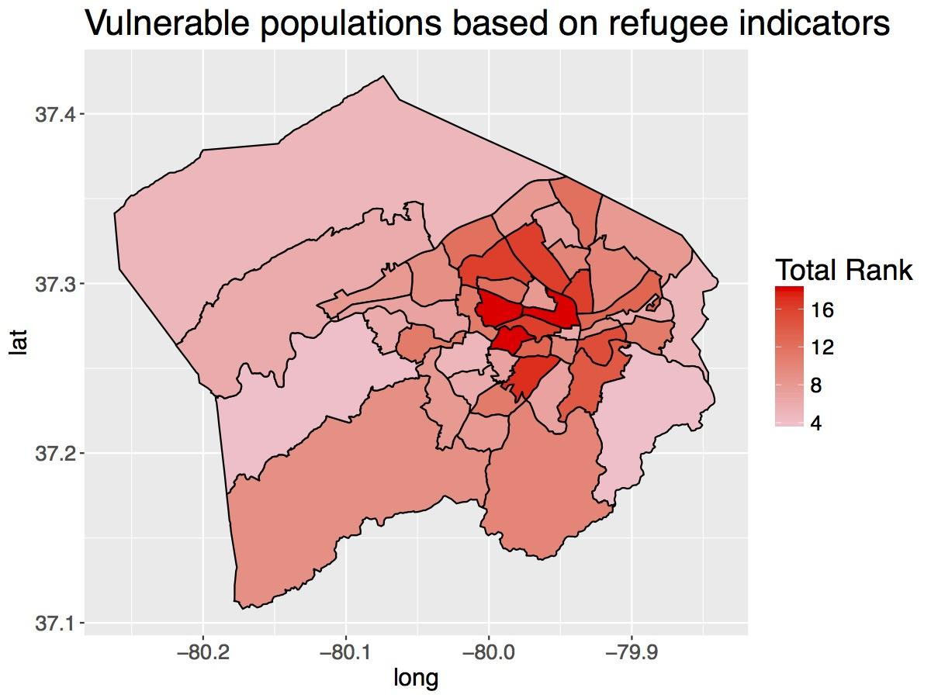
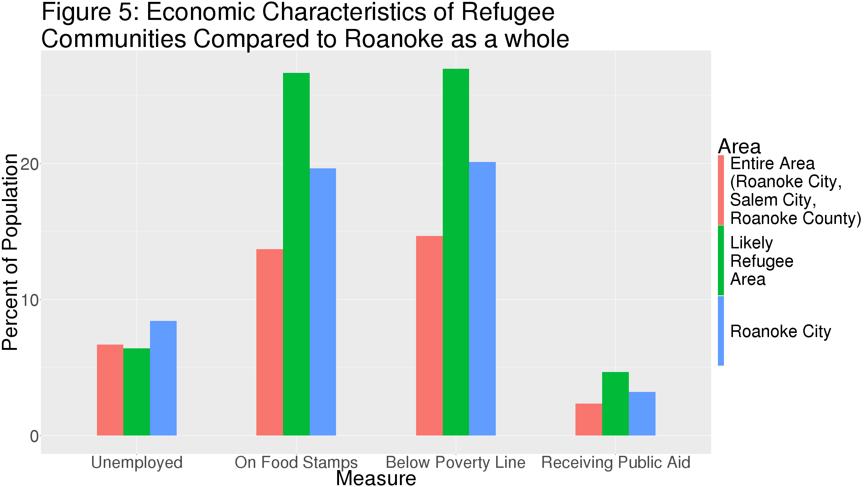
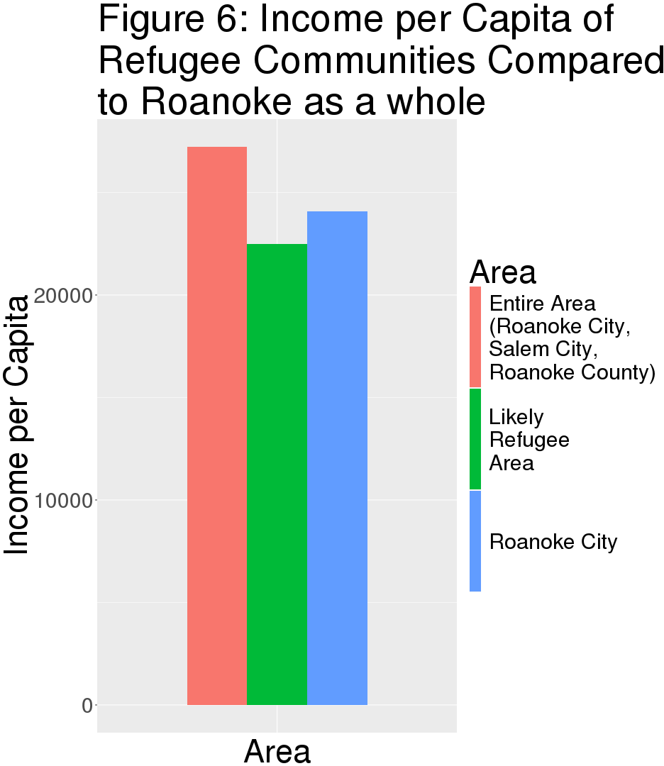
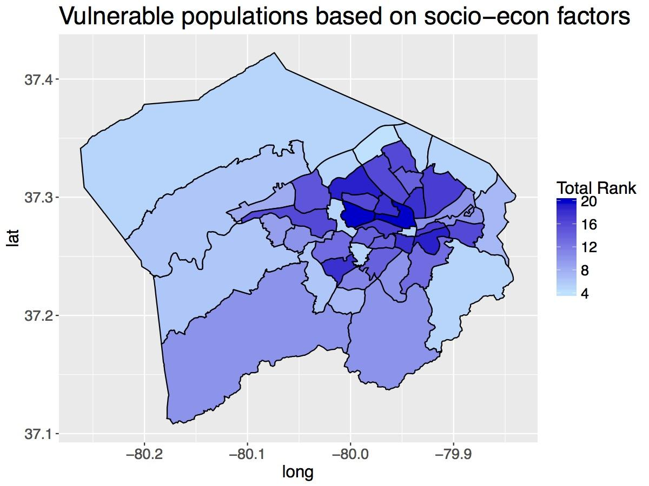
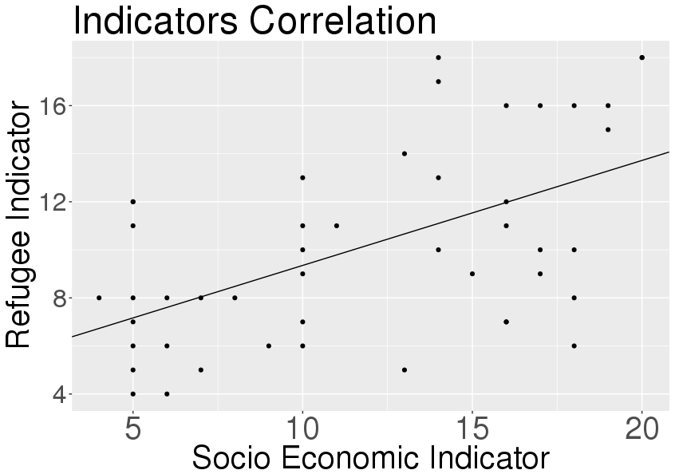



Analyzing the Economic Impact and Social
Integration of Refugees in Roanoke, Virginia
Claire Kelling (PSU), Kyle Morgan (VT), Craig Morton (VT), Hannah Brinkley (VT), Adrienne Rogers (VT) with Mark Orr, Stephanie Shipp, and Bianica Pires (SDAL)
Project Overview
Partners: School for Public and International Affairs (SPIA), Global Forum on Urban and Regional Resilience, and other international groups at Virginia Tech
Purpose: Expand capacity at Virginia Tech for understanding refugees and answer the following two questions:
1) How can we measure the integration of refugees into host communities?
2) How can we measure the economic impact of refugees on host communities?
Social Integration
Goal: Assess the level of social integration
and community acceptance of refugees in Roanoke from local news Facebook
Pages
Sources: The Roanoke Times, WSLS 10,
WFXR News
12 articles, 3,329 comments
Key Events:
November, 2015: Mayor David Bowers requested that the City of Roanoke
suspend assistance to Syrian refugees
First half of 2017: Coverage of recent
presidential policies on immigration
Challenges: Categorizing these comments
into positive/negative was not
effective due to the wide variety of
sentiments present (Figure 3)
Process: Used Latent Dirichlet Allocation
(LDA), a generative, unsupervised
statistical model that allows a set of text observations to be clustered into
groups
Findings: Chose four themed categories,
with the top words per categories shown (Figure 4)
Possible themes: Mayor Bowers, welcome, nationalism, security
Goal: Understand social and economic
demographics of refugees moving to Roanoke
over time
Data Sources: Virginia Department of Health (VDH),
Virginia Newcomer Information System (VNIS)
Findings:
Virginia Department of Health
Most refugees are young (Figure 1)
Most refugees are from Afghanistan, Democratic Republic of the Congo (DRC), and Bhutan, with recent increases from Syria (Figure 2)
Virginia Newcomer Information System
Entering employment within 90 days of entry: 51% (state average: 48%)
Employed full time: 73%
(state average: 68%)
“Mayor Bowers was thinking of the welfare and security of all Roanoker's...he is also concerned with what would happen if the group of refugees were possibly infiltrated by a terrorist that, like the Paris attacks, would only be hours away from the Nation's Capitol and seemingly in a nice quiet place where havoc and widespread destruction could be planned.”
Goal: Use publically available U.S. Census and
Google API data to create demographic and
socio-economic indices to estimate
neighborhoods in Roanoke most likely to
contain larger proportions of refugees
Refugee Index: (top-left)
Variables: number of bus stops, individuals who are non-citizen and foreign born, are from countries that the US accepts refugees
from, have little to no English proficiency
Socio-economic Index: (middle-left)
Variables: households that received food stamps, have no vehicle, have income below poverty line, spend more than 50% of income
on rent/mortgage
Challenges: (bottom-left)
While both visually show areas of potential
interest, the two indices are not well
correlated.
Finding: There are some specific Census Tracts
that we can suggest that with some probability have higher refugee counts than others.
Economic Impact
Goal: Calculate the economic benefit/cost of refugee populations
Preliminary Step: Examine the economic conditions of the Census Tracts that refugees are most likely to reside in
Next Steps
Correlation: 0.5561
Regression r²: 0.2935
Add or remove variables from Refugee and Socioeconomic Indices
Create an Index of Economic Status and compare it to Roanoke averages
Analyze the text of the articles and comments
Use Amazon Mechanical Turk to validate sentiment analysis findings
Continue to develop and refine economic findings using additional data sources and methods
Notes:
I have moved this to the final folder!

