Slide 1
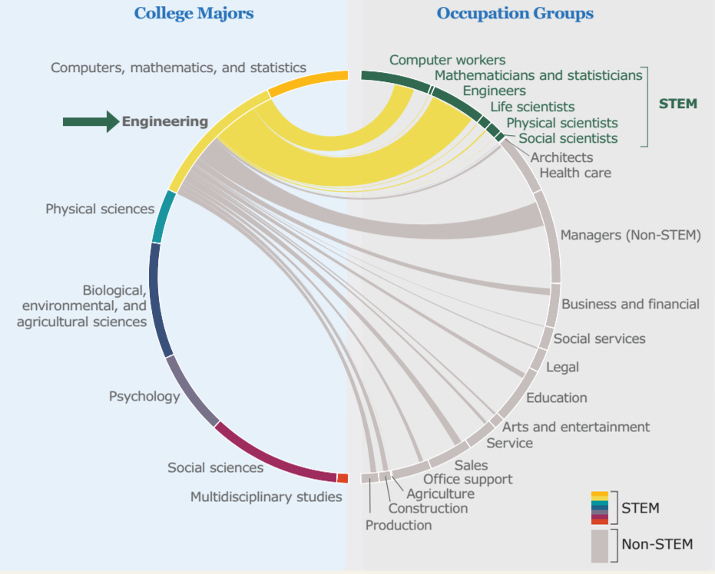
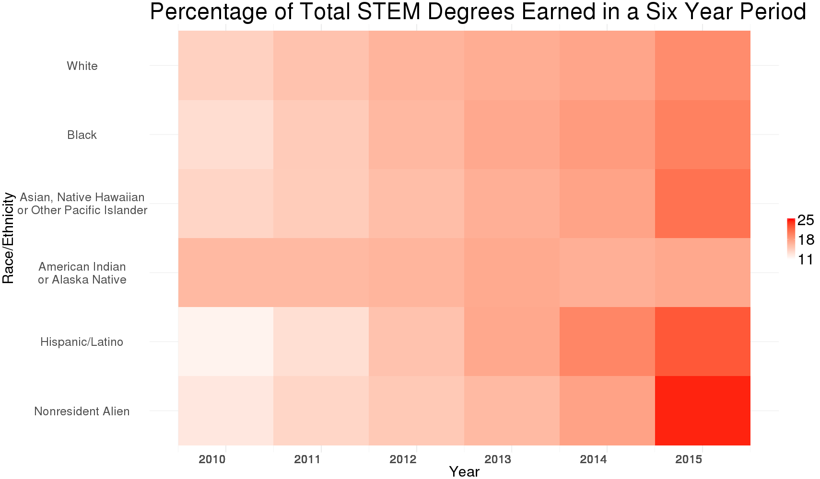
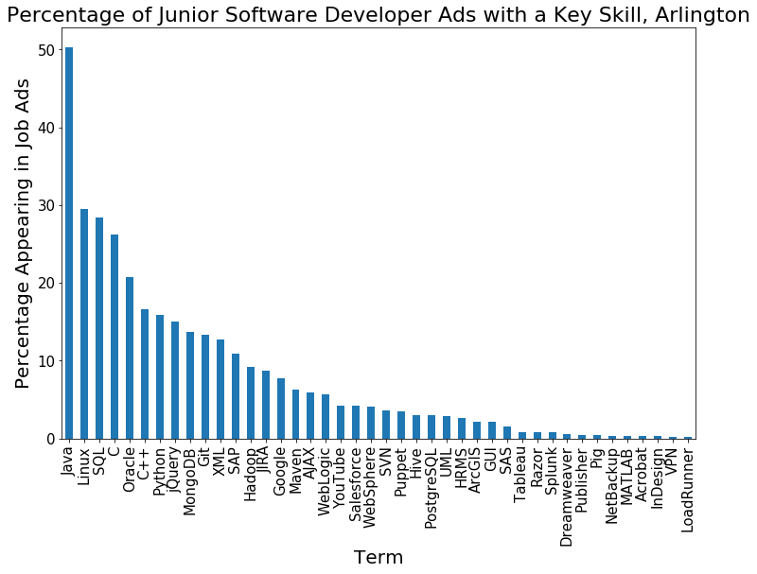
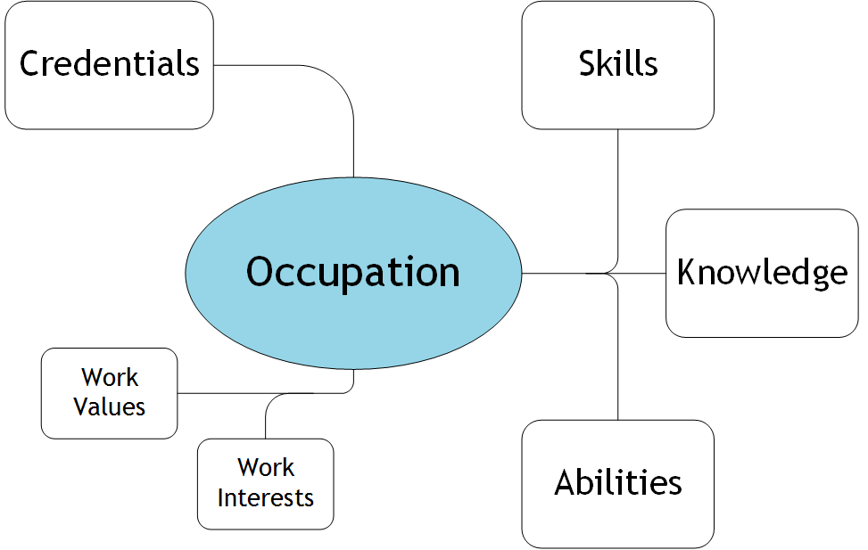
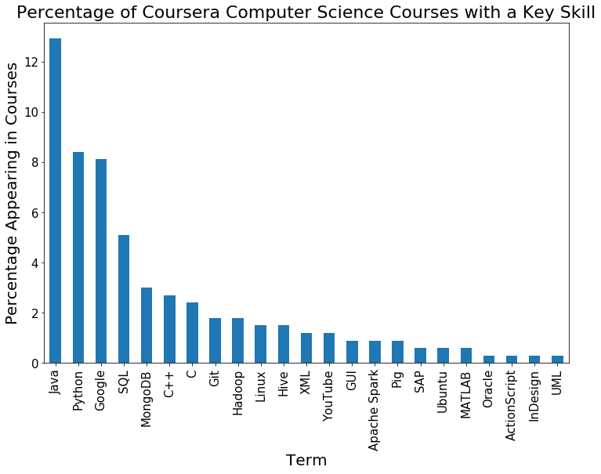
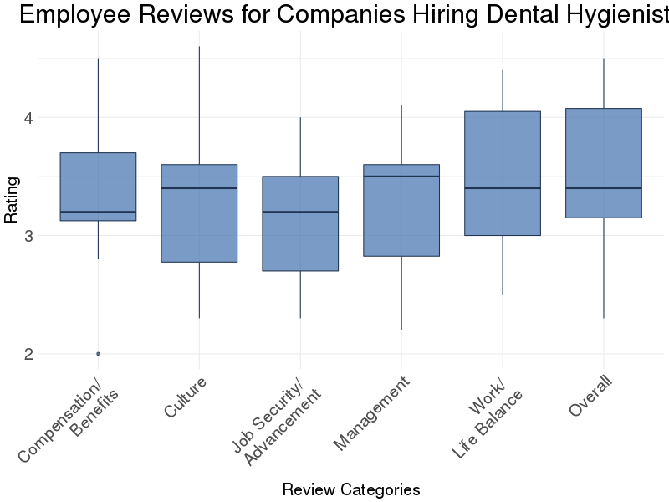
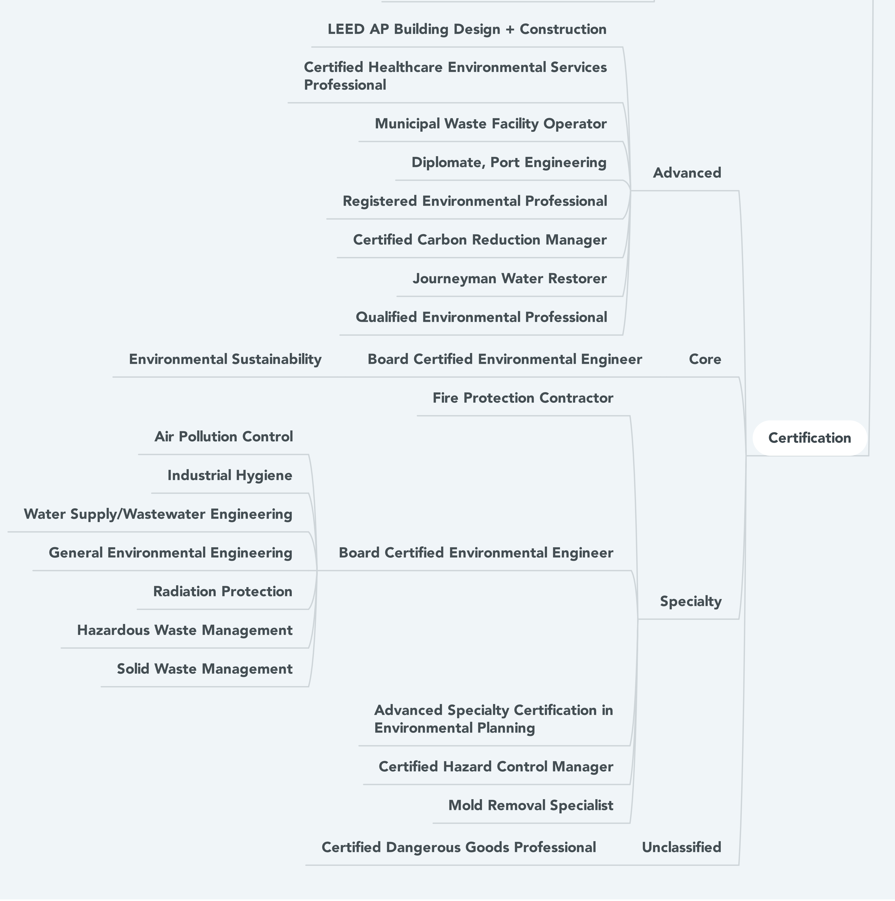
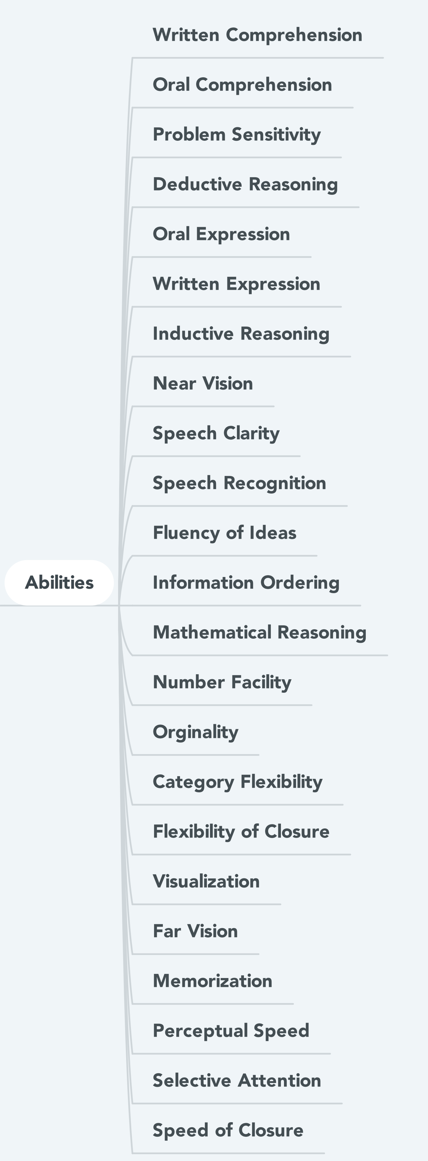
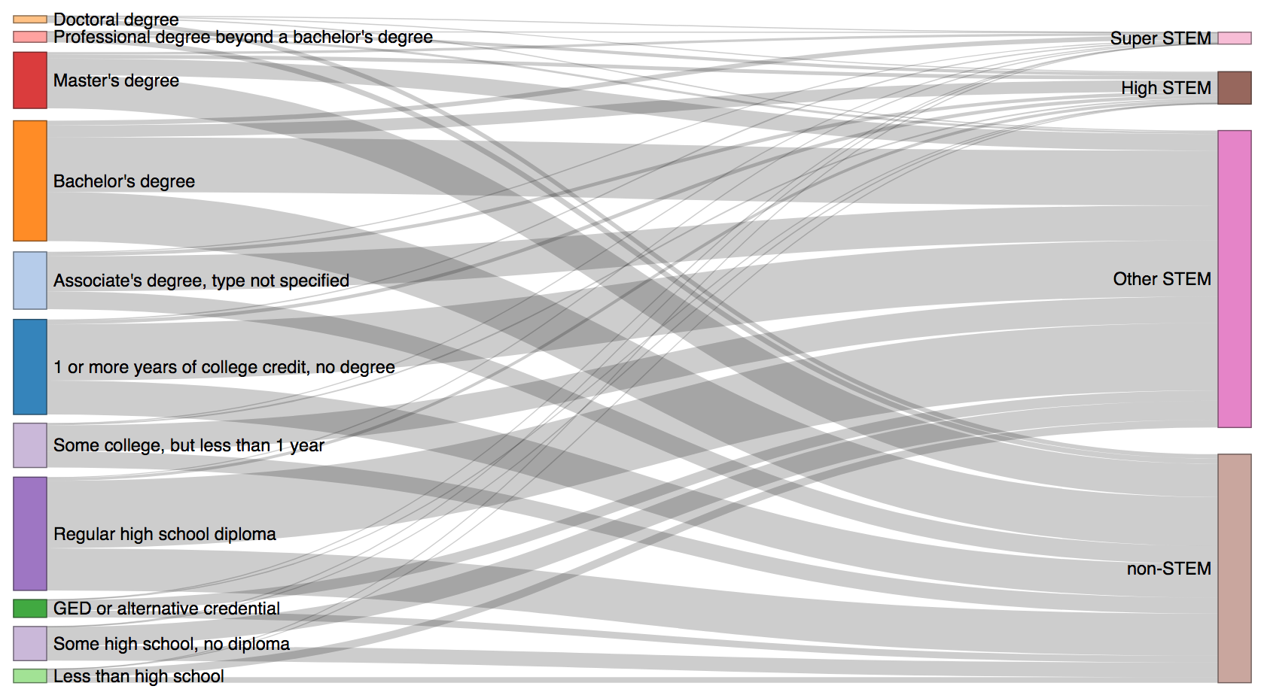

STEM Education PATHWAYS
Madison Arnsbarger, Chanida Lerdritsomboon, Hannah Brinkley, Ben Swartz with Bianica Pires and Stephanie Shipp (SDAL) Sponsor: Pat Ruggles, The National Center for Science & Engineering Statistics at NSF
Project Objective and Motivation¹
Data on traditional STEM (Science, Technology, Engineering, and Mathematics) pathways are well-documented and explored. The Census Bureau, for example, provides an interactive pathway map of bachelor's degrees to occupation on its website. However, half of STEM occupations do not require a bachelor’s degree. Additionally, women and minorities shift to non-STEM fields more on average. We aim to understand STEM pathways, particularly non-traditional pathways with a focus on women and minorities as they enter and leave the STEM field, as well as employer expectations of the STEM workforce.
Exploring Education and Workforce Data by STEM Degrees and Occupations
Source: U.S. Census Bureau, https://www.census.gov/dataviz/visualizations/stem/stem-html/
Trends in STEM Degrees
Skills Assessment
of Software Developers
An increasing number of STEM degrees were awarded from 2010 – 2015
The increase was more pronounced in the black and Hispanic/Latino populations
The proportion of the Nonresident Alien population earning sub-baccalaureate degrees is small (not shown)
Employee skills sought by employers can be compared to skills taught in STEM classes
Programming languages taught in online computer science courses may not align with programming languages in demand by employers
Data Source: Integrated Postsecondary Educational Data System (IPEDS)
Note: Two or More Races and Unknown Race/Ethnicity were removed
Data Source: indeed.com
Company Ratings by Employees on Work Values
Work values and work interests are individual preferences that enhance retention and persistence in an occupation²
Employees at dentists’ offices rate their employers lowest on Job Security and Advancement
Mind Map of Environmental Engineer
Data Source: coursera.com
Data Source: indeed.com
Employers expect workers to have certain knowledge, skills, and abilities (KSAs)
Employees earn credentials that are a proxy for KSAs
Cognitive competencies like abilities are clustered lists
Certifications are branched pathways
Educational Pathways of Women to STEM Occupation
STEM Occupation Category of Women by Education Level
Majority of female STEM employees have less than a bachelor’s degree
“Other STEM” contains jobs classified by Bureau of Labor Statistics as STEM but that do not have a high STEM knowledge score from Occupational Information Network (O*NET) data
Calculation of High-STEM and Super-STEM from Rothwell (2013)¹
Highest Degree Held
Occupation Type
Next Steps
Data Source: Integrated Public Use Microdata Series (IPUMS)
Create pathway map to explore patterns within race/ethnicity
Explore additional longitudinal surveys (e.g., Early Childhood Longitudinal Study-Kindergarten, Baccalaureate and Beyond:2008) that may contain more information for pathway maps
Web-scrape content to explore the connection between educational objectives and O*NET cognitive competencies
Develop a quantitative definition of STEM occupation levels and extend the definition to academic awards
Sources
Rothwell (2013) “The Hidden STEM Economy”
Carnevale (2011) “STEM”
Data Source: O*NET Online U.S. Department of Labor

