Slide 1
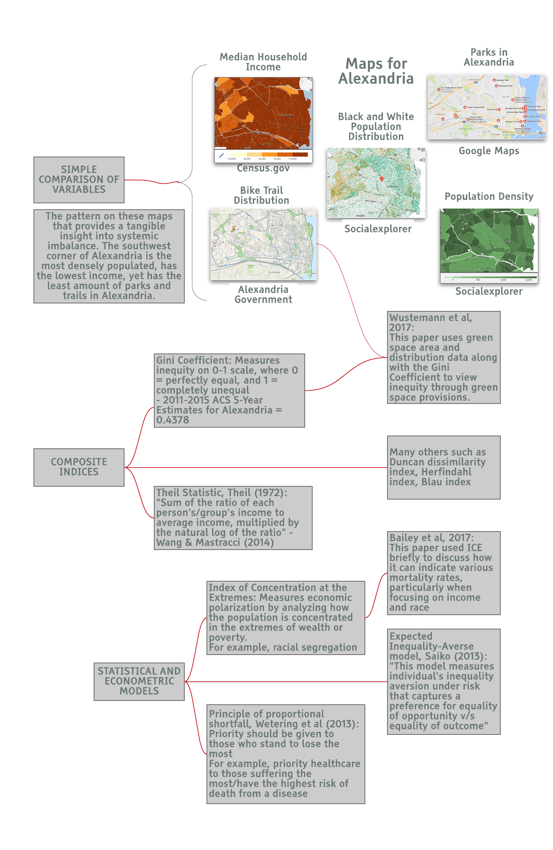
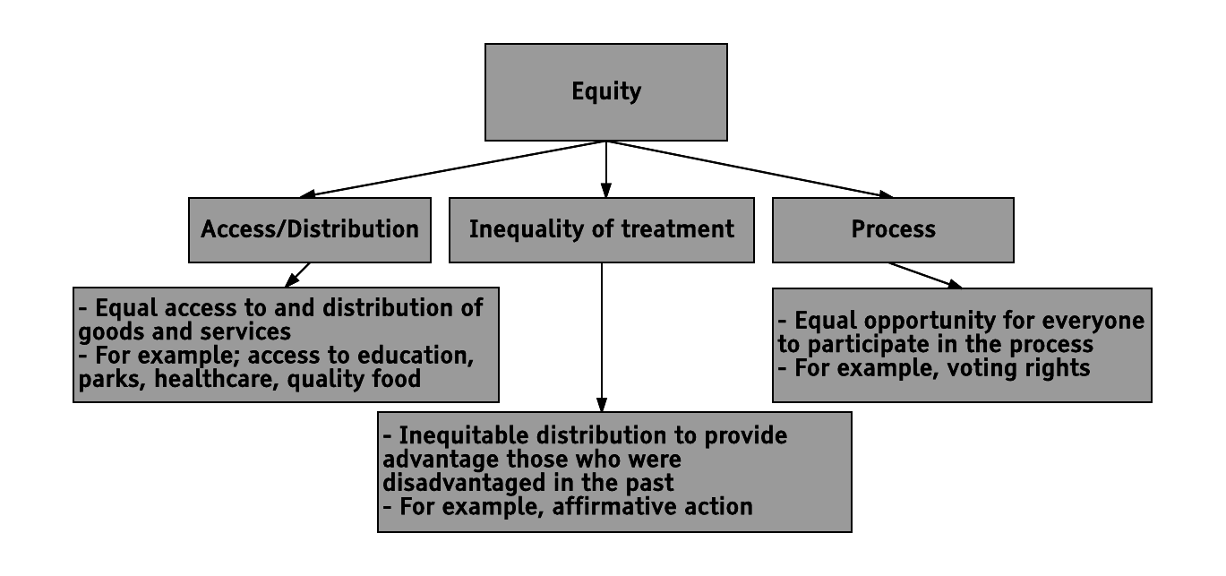
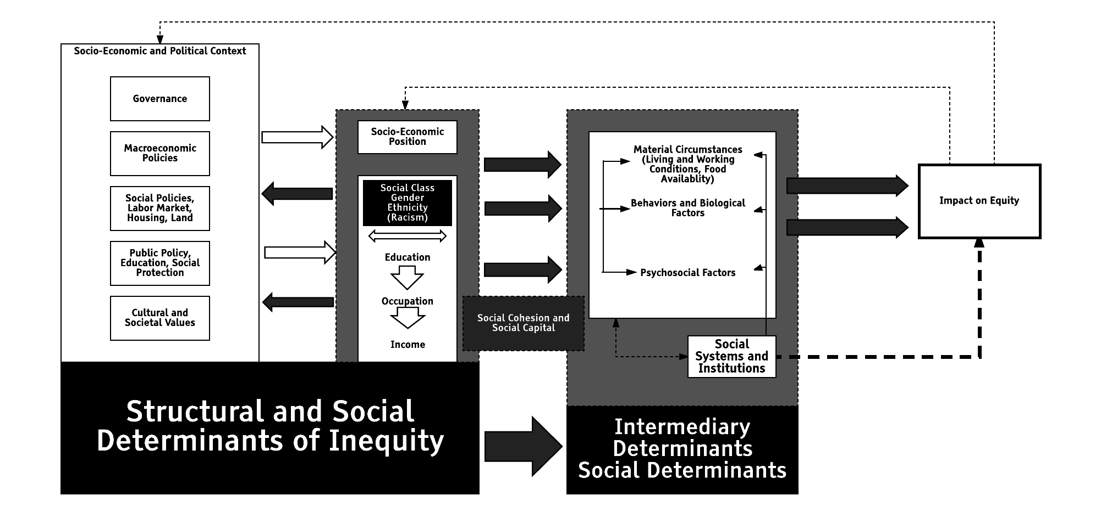

Defining and Measuring Equity in Alexandria, VA
Ronnie Fecso (VT), Daniel Wilkin (VT), Sayali Phadke (PSU)
with Mark Orr (SDAL) and Stephanie Shipp (SDAL)
Sponsor: Emily Molfino, City of Alexandria
Introduction
Equity is imperative to the well-being of citizens, and hence an important policy consideration. The City of Alexandria is striving towards combating inequity in their community. We conducted a literature review to better understand how equity is defined and measured. Our goal is to explain how these definitions and indicators of inequity manifest themselves in Alexandria. We wish to provide recommendations to the city about forming an actionable definition of equity, and collecting the most pertinent data to measure it.
Measuring equity
Various ways of understanding equity
Literature review
Recent (2013 onwards) academic literature with international scope:
  Sociology and Demography
  Public Health
Government reports:
  County and state level reports
    King’s county, WA
    Dane county, WI
    San Francisco, CA
Academic resources:
  http://nationalequityatlas.org
  http://thrivingcities.com
  Economics
  Public Policy
    Multnomah county, OR
    Boston, MA
Generalization of WHO’s Conceptual Framework on the Social Determinants of Health: (WHO 2010, 6)

