Slide 1

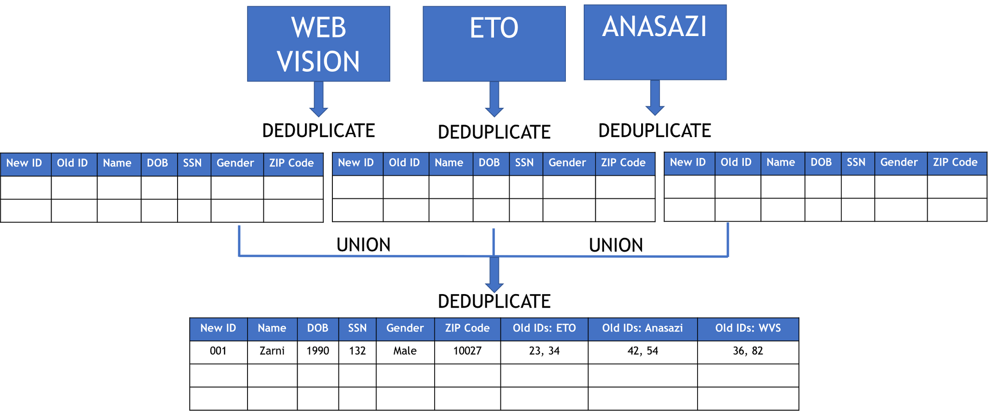
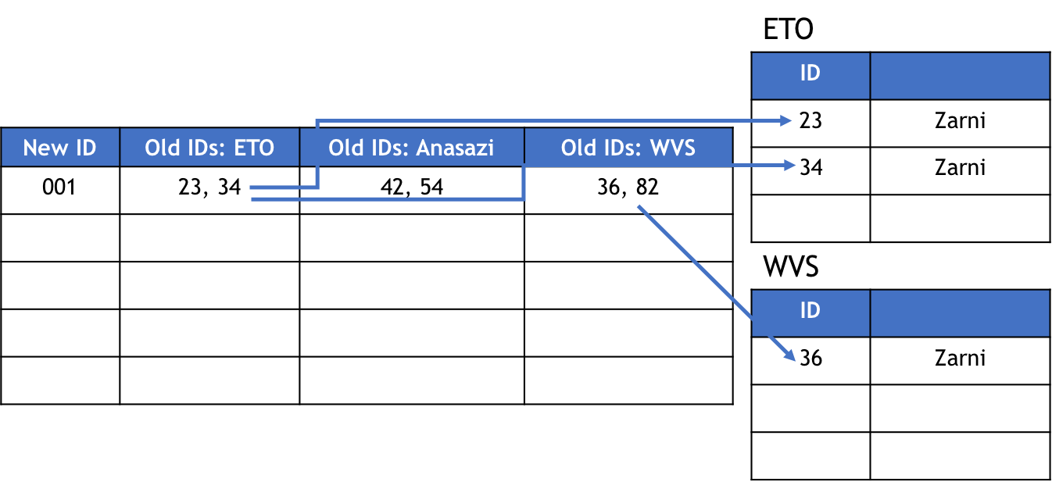
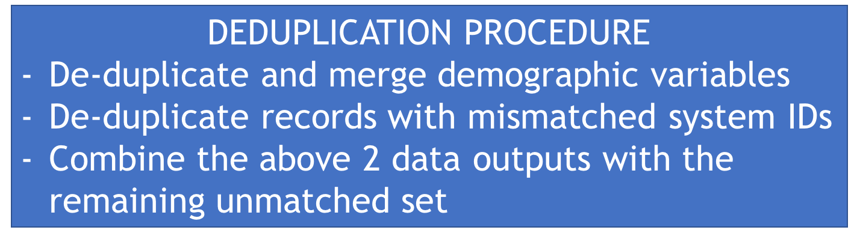
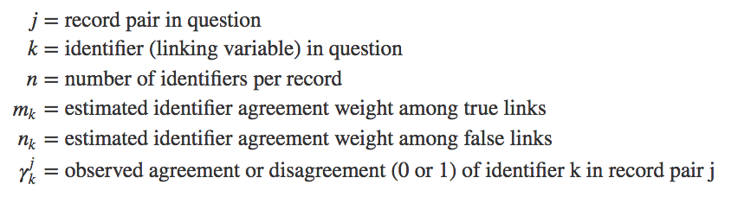

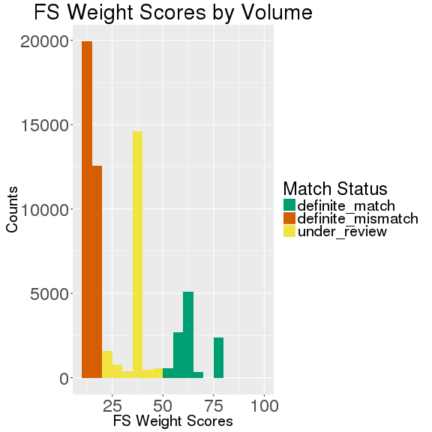

HOW MANY CLIENTS DO WE SERVE?
Arlington Department of Human Services (DHS)
Zarni Htet (NYU) and Sayali Phadke (PSU) with Aaron Schroeder (SDAL),
Anita Friedman, Martha Coelho, Michael-Dharma Irwin, Biljana Culibrk, and Meheret Asfaw (Arlington DHS)
Motivation
Name (Sys2) | SSN | DOB | Gender | Zipcode
Lata | NA | 10/19/1990 | M | 22203
Htet Zarni | NA | 05/27/1991 | M | 22202
Claire | 789013445 | --/07/1975 | F | 22203
If records do not have unique IDs and exact matching fails, how do we link across multiple systems to find records for the same person?
Name (Sys1) | SSN | DOB | Gender
Sayali Phadke | 123-45-6789 | 10/19/1990 | F
Zarni Htet | 456-78-8901 | 05/25/1991 | F
Aaron Schroedner | 789-01-2345 | 03/07/1975 | M
Zarni | 456-78-8901 | 05/25/1991 | M
Is this the same “Zarni”? If so, how would we determine it?
In a single system, clerical errors and misspellings result in duplicates
Across systems, field requirements and conventions are different; shared IDs do not exist
Problem Statement
Schematic for Merging the Three Systems
Each day, multiple clients utilize services offered by DHS
A client may use more than one service on a given day, creating multiple records
Arlington DHS client data are:
  Stored across nine different systems
  Operated by various service providers, from in-house to State and Federal contractors
An individual appearing twice in a single system, or in multiple systems, may or may not have the same ID and demographics, due to clerical error
To answer important questions below, we must identify unique clients:
  On a given day, how many citizens does the DHS serve?
  What are the demographics of the clients they are serving?
  Could DHS be missing eligible individuals they can serve?
Three systems for testing the method:
  Web Vision : Behavioral Health for Children and Aging Population
  ETO : Economic Independence Data
  Anasazi : Community Service
Demographic tables contain new ID paired with old IDs
Master demographic table
Methodology
Probabilistic Linkage
  A method to determine whether two items are the same, even if they do not match exactly due to different specification, or spelling error etc.
Each column is given two weights:
  M probability (quality/reliability)
    Determines how well a record has been documented
  U probability (commonness)
    Determines the commonness of a column
Composite Weight Scores
  Agreement on a given column calculated using Jaro Winkler distance between strings
  Weights are aggregated using probability of linkage formula below (Fellegi and Sunter, 1969)
Results
Next Steps
Results from an initial run on Web Vision system with our current weights and thresholds:
Out of ~64,000 administrative records:
25,745 have repeated system IDs
  reduced to 18,222, removing 7,523 duplicated rows, and merged demographic variables
105 instances of different system IDs pairs
  reduced to 70, removing 35 duplicated system IDs
Clerical review on those below threshold score
Running deduplication process on Anasazi and ETO systems
Finalizing weights that work for all three systems
Calculating weights for additional social service systems
Testing automated weight calculation
  Epiweights
  EM algorithm
Testing automated thresholding
  Epiweights
Comparing automated results with manual inspection
Citations:
Fellegi, I. P., & Sunter, A. B. (1969). A theory for record linkage. Journal of the American Statistical Association, 64(328), 1183-1210.

