Slide 1
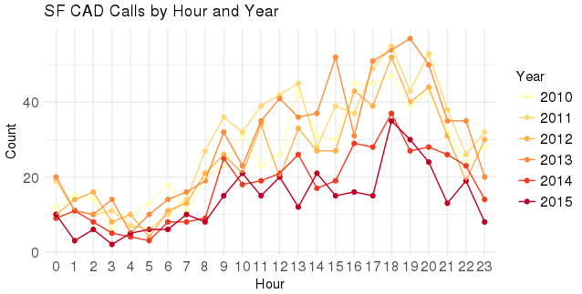

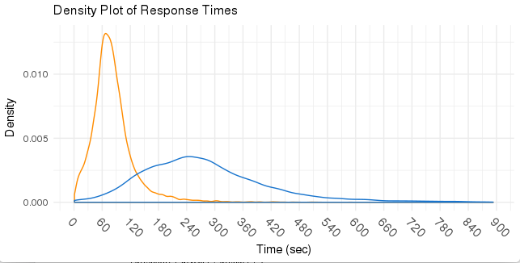
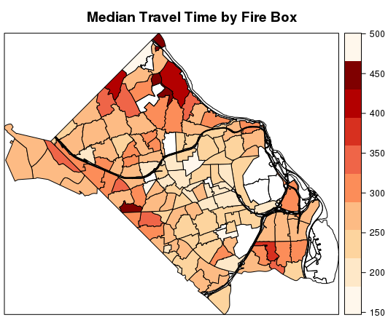
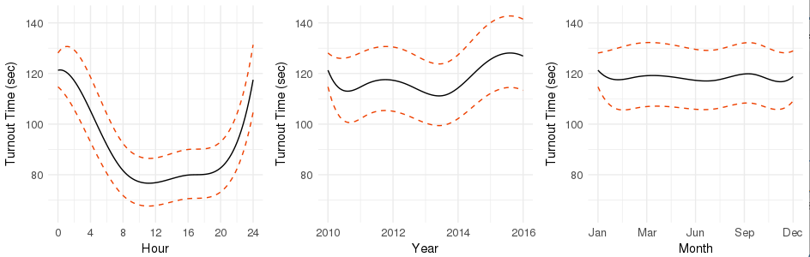
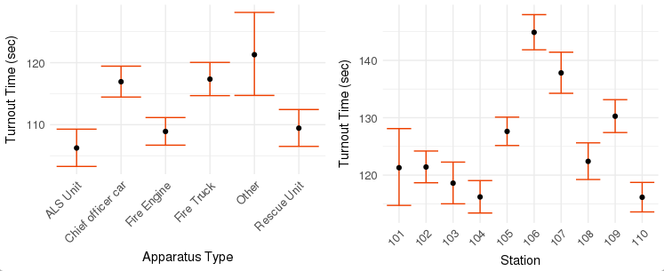
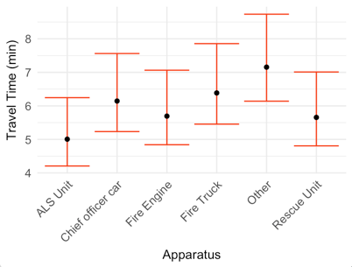
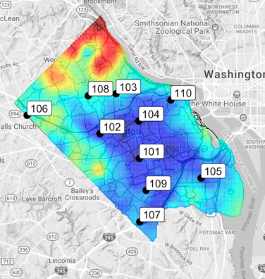
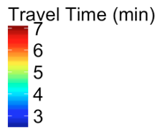


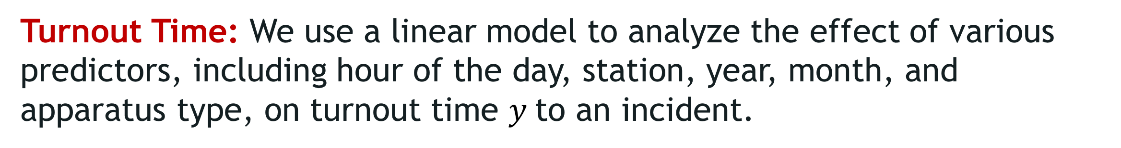
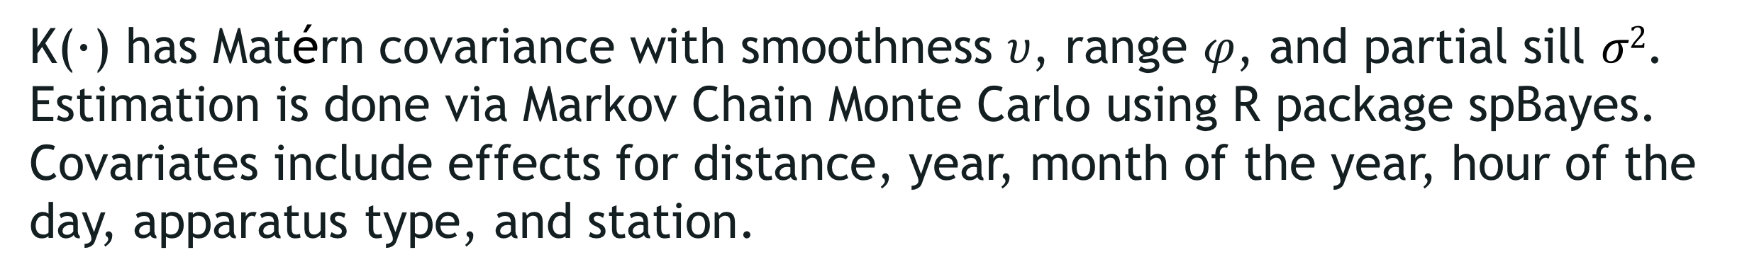
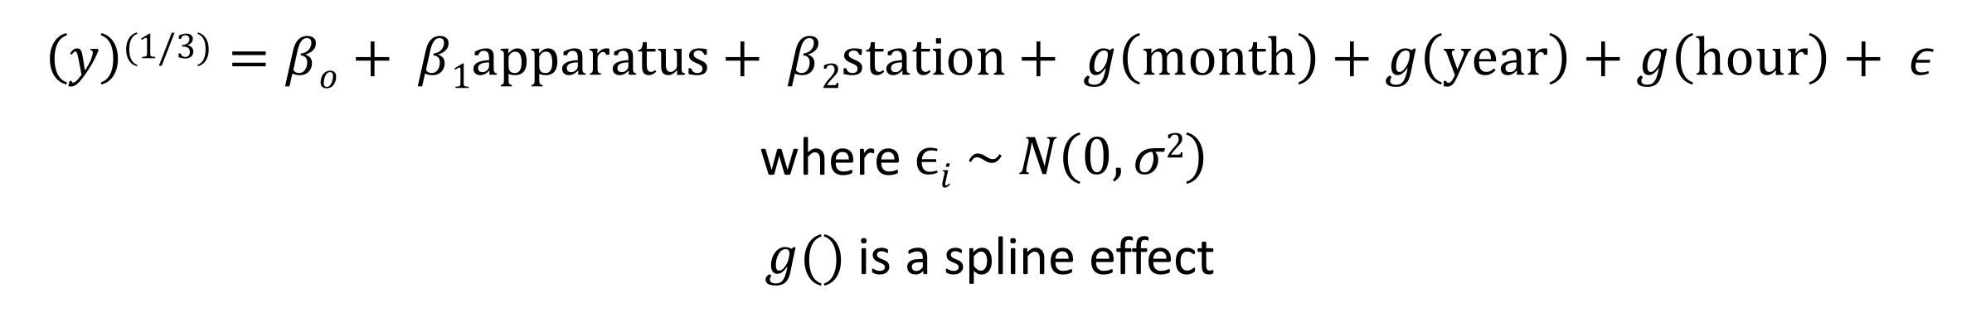
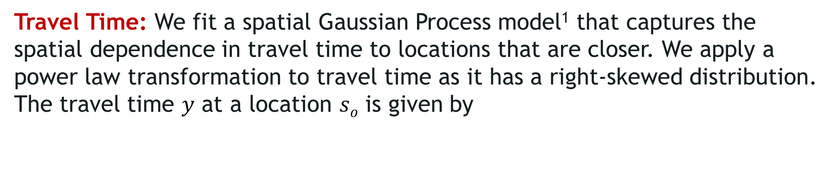

MODELING REsPONSE TIME FOR
STRUCTURE FIRES
Madison Arnsbarger (VT) and Claire Kelling (Penn State) with Joshua Goldstein and Gizem Korkmaz (SDAL)
Sponsor: Battalion Chief Mike Gowen, Arlington County Fire Department
Project Description
In order to improve the general safety of Arlington County residents by making the allocation of emergency resources more efficient, it is important to reduce the response time to incidents. This project aims to identify the factors affecting these response times for Structure Fires (SF) in Arlington County, VA.
Data
Descriptive Analysis
Fire & Emergency Data from Arlington County Fire Department (ACFD)
399,158 observations, 68 variables including the location and the time of the incident, CAD (computer-aided dispatch) call types, fire stations, responding units
Years 2010-2015
  ACFD has 10 fire stations and 30 apparatus types
  We focus on CAD calls coded as Structure Fire (SF)
Structure Fire CAD Call Counts by Hour and Year
The exploratory analysis reveals that structure fires have decreased in 2014 and 2015. Travel times are longer than turnout times on average and have much greater variability. They are longer in north Arlington. These findings are corroborated by our model results.
Year
We use two definitions of response time:
  turnout time = en route time – dispatch time
  travel time = arrival time – en route time
Standards of the National Fire Protection Agency (NFPA):
  80 seconds for turnout time, 240 seconds for travel time
Hour
Median Travel Time by Firebox
Density Plot of Response Times
Turnout time
Travel time
The Model
Time (sec)
Turnout Time: We use a linear model to analyze the effect of various predictors, including hour of the day, station, year, month, and apparatus type, on turnout time $y$to an incident.
$$\left(y\right)\text{(1/3)}=βο+ β1\text{apparatus}+ β2\text{station}+ g\left(\text{month}\right)+g\left(\text{year}\right)+g\left(\text{hour}\right)+ ε$$
where $ϵi \sim N\left(0, σ2\right)$
$g()$ is a spline effect
Time (sec)
Findings: Turnout Time
Travel Time: We fit a spatial Gaussian Process model¹ that captures the spatial dependence in travel time to locations that are closer. We apply a power law transformation to travel time as it has a right-skewed distribution. The travel time $y$ at a location $sο$ is given by
Stations 104, 105, 110 have significantly lower turn out times, while turnout times for stations 106, 107, and 109 are significantly longer. All apparatus types have significantly lower turnout times than apparatus in the "Other" category, with Fire Engines and Advanced Life Support (ALS) Units showing the strongest negative effects.
$$\left[y\left(sο\right)\right]\text{(1/3)}= χΤβ+w\left(sο\right)+ ε\left(sο\right)$$
where $ε\left(s\right)\sim N\left(0, τ2\right)$and $w\left(s\right) \sim GP(0, K\left(∙\right))$
K(·) has Matérn covariance with smoothness $υ$, range $φ$, and partial sill $σ2$. Estimation is done via Markov Chain Monte Carlo using R package spBayes. Covariates include effects for distance, year, month of the year, hour of the day, apparatus type, and station.
Findings: Travel Time
The model reveals some locations in Arlington where the estimated travel time is the longest (esp. in north Arlington). Travel time, as expected, is significantly longer the more distance traveled. The model shows that travel time has much greater variability than turnout time. Advanced Life Support (ALS) units have the shortest travel times.
Future Work
Include fire station resources in the models.
Study other types of incidents besides structure fires.
Improve the models using other data sources such as housing, traffic, weather.
[1] Lindgren, Finn, Håvard Rue, and Johan Lindström. "An explicit link between Gaussian fields and Gaussian Markov random fields: the stochastic partial differential equation approach." Journal of the Royal Statistical Society: Series B (Statistical Methodology) 73.4 (2011): 423-498.
Notes:
INTRO
Turnout objectives:
80 seconds for fire response
60 seconds for EMS response
Travel objectives:
240 seconds for arrival of first-arriving engine at fire incident (4 minutes)
480 seconds for everyone at fire incident (non-high rise)
610 seconds for everyone at fire incident (high rise)
240 seconds for arrival of unit with automatic external defibrillator (AED) or higher capability at emergency medical incident
480 seconds for arrival of advanced life support (ALS) unit at emergency medical incident
DATA
The model excludes non-SF CAD call types and
turnout times longer than 10 minutes (only 0.13% of the data).
DESCRIPTIVE ANALYSIS
TURNOUT TIME MODEL
lm7 <- lm(data=turnout, (turnouttimeVT)^(1/3) ~ bs(hour_frac, degree = 3, df = 5) + bs(year_frac, degree = 3, df = 7) + bs(monthVT, degree = 3, df = 7) + fapparatus + fstation)

