Slide 1

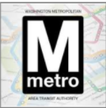
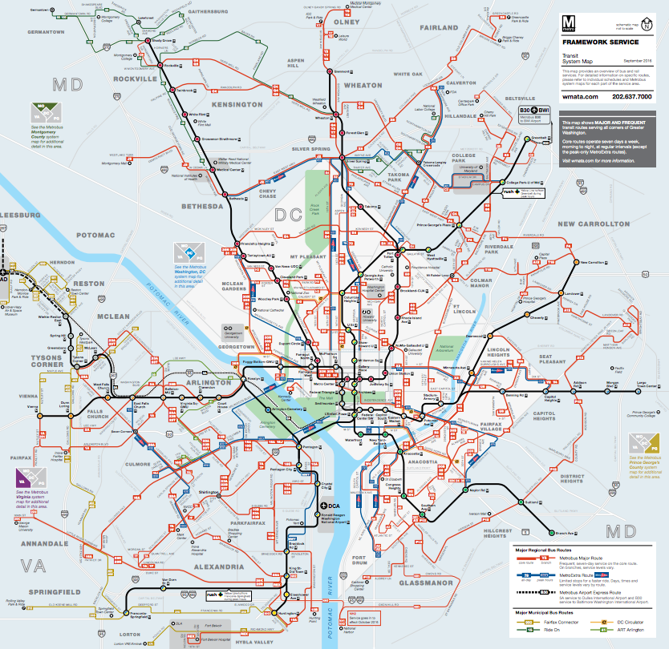
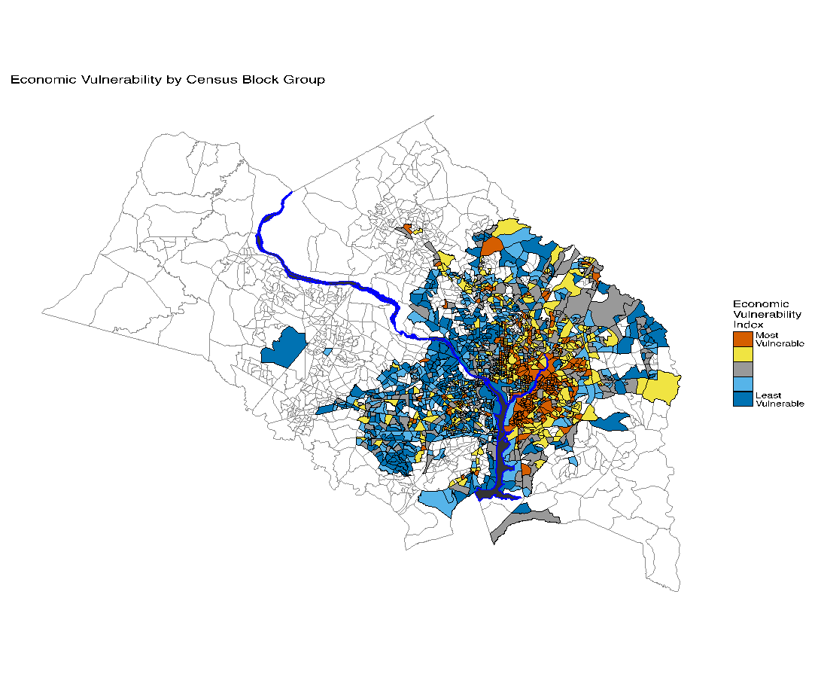
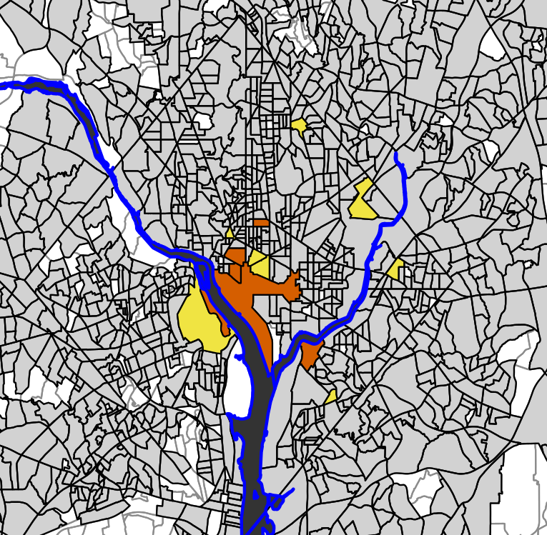
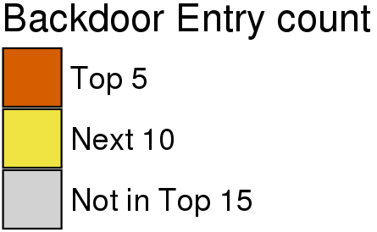
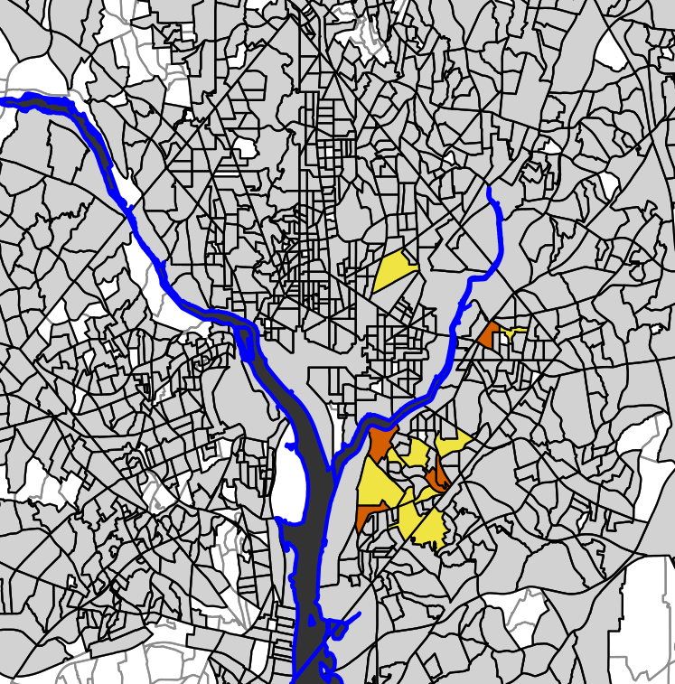
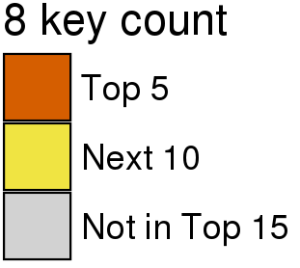

A STUDY ON WMATA Bus Fare Evasion
David Hinkle (VT), Eirik Iversen (VT), Craig Morton (VT), Simmu Phander (VT)
Lata Kodali (VT), Zarni Htet (NYU) with Vicki Lancaster and Aaron Schroeder (SDAL)
Sponsor: Jayme M. Johnson, Catherine Vanderwaart, Washington Metropolitan Area Transit Authority
Introduction
Problem: WMATA loses approximately 10-20 million dollars a year due to bus fare evasion (passenger pays no fare) on its 1300-1500 daily trips.
Research Goal: Provide insights into the problem of bus fare evasion that can be used to guide fare evasion interventions.
Plan: Use WMATA administrative data to locate where fare evaders live and the American Community Survey to tell their story at the census block group level.
Literature Review: General Observations
Data
Fare evasion is an endemic international problem.
Fare evasion is estimated using observer surveys, not administrative data.
Issues inherent in observer surveys include: high costs, missed assignments, difficulty processing large passenger volumes, data interpretation issues, data entry and analysis costs, and data collection inconsistencies between observers.
Observer surveys found that passenger entry rates, time and day of the week, fare control equipment configuration, neighborhood income correlate with fare evasion rates.
The majority of interventions involve increased inspections.
Most fare evasion interventions cited in the literature are not evaluated for efficacy.
WMATA administrative data sources for first week of May (5/1–5/7):
Bus Stops
Bus stop ID, stop description, latitude, and longitude
(10,988 observations)
Approximate Person Counter (APC)
Front and back door entries and exits for each bus, route, and bus stop
(3,779,527 observations)
Farebox
Cash and Smartrip transactions for each bus, trip number, and bus stop
(2,729,668 observations)
Data Processing
APC and Farebox data are mismatched in number of routes, trips, bus stops, and buses.
Cleaning the data included discovering the number of mislabeled or missing bus stops, missing trips, missing transaction information, and imprecise latitude and longitude coordinates.
After cleaning, created a dataset aggregated at the Census Block Group (CBG) level using both the APC and Farebox rush hour data (Monday-Friday between 5:00-10:00 AM).
WMATA Jurisdiction: Bus
Economic Vulnerability Index by Census Block Group
WMATA Jurisdictions for Bus:
DC
VA cities: Alexandria, Falls Church, Fairfax
VA counties: Arlington, Fairfax, Loudoun
MD counties: Montgomery, Prince George’s
Metrobus Information:
11,129 bus stops
269 routes on 170 lines
8 types of buses
Source: https://www.wmata.com/
To begin to tell the story of the fare evader, 2015 American Community Survey data were used to create an index of economic vulnerability at the Census Block Group level. The higher the index (orange) the larger the percentage of vulnerable households (HHs) within the Census Block Group.
The economic vulnerability index (EVI) is a composite indicator based on:
%HHs < federal poverty level
%HHs with no vehicle
%HHs receiving SNAP
%HHs with a HH burden > 50%.
Transit System Map for WMATA
Red indicates Metrobus routes.
The index also provided us with a way to tie fare evasion to neighborhood incomes and evaluate the assertion in the literature that fare evasion correlates with income.
The index is on a scale from 1-5 with 1 being least vulnerable and 5 being most vulnerable.
The EVI was calculated for only those CBGs (1,640) containing WMATA bus stops.
Fare Evasion Estimates by Census Block Group (5/1–5/7)
Two types of fare evasion considered:
APC back door entries (San Francisco Transportation Agency found 55% of passengers entering from the back door do not pay, Lee (2011))
Farebox data key presses (bus driver record of fare evasion).
Top 2 | CBG and Neighborhood | EVI | Fare Evasion | Riders Entry/Exit | Routes | Trips | Stops | Buses
Back Door Entry | 110010107001 Ward 2 | 4 | 113 | 11555/ 24222 | 30 | 968 | 35 | 511
 | 110010108002 Ward 2 | 5 | 88 | 1733/ 6451 | 9 | 174 | 12 | 176
Fare Evasion Key Presses | 110010074011 Ward 8 | 5 | 1000 | 15649/ 17243 | 20 | 760 | 23 | 248
 | 110010078031 Ward 7 | 5 | 911 | 10934/ 10047 | 14 | 532 | 22 | 159
Table summarizes the information across APC and Farebox data for the top 2 in back door entry and fare evasion key presses aggregated by CBG for first week of May. Fare evasion is counts of back door entry or key presses for that CBG. The count of routes, trips, stops, and buses are averaged between APC and Farebox data since they are mismatched.
For fare evasion (out of 1,640 CBGs), 32% of back door entries and 60% of key presses are greater than 0. Back door entries and key presses have a correlation of about 40%.
Back door entries: The top 15 CBGs with the highest number of backdoor entries are concentrated in Central D.C. near GWU. White shaded CBGs contain no WMATA bus stops.
Fare evasion key presses: The top 15 CBGs with the highest fare evasion counts are concentrated in Southeast D.C. White shaded CBGs contain no WMATA bus stops.
Next Steps
Further investigate overcrowding on the bus and the effect on fare evasion and the differences between APC and Farebox datasets by the routes, trips, buses, and bus stops.
Once we determine the variability between APC and Farebox for fare evasion and relationship with EVI, we will tie appropriate interventions from the literature review.
Notes:
Information that might be helpful:
1640 CBG in APC data with 71% of back door entries for CBG are 0
1614 CBG in FB data with 40% of 8key presses for CBG are 0
Isolate the story of why the fare evasion might be happening. If not tied to economic vulnerability, it might be an attitude of fare evading is okay.
Normalize by trips!!!!!!!!!
For each cbg, number of stops and number of fare evaders

