Slide 1
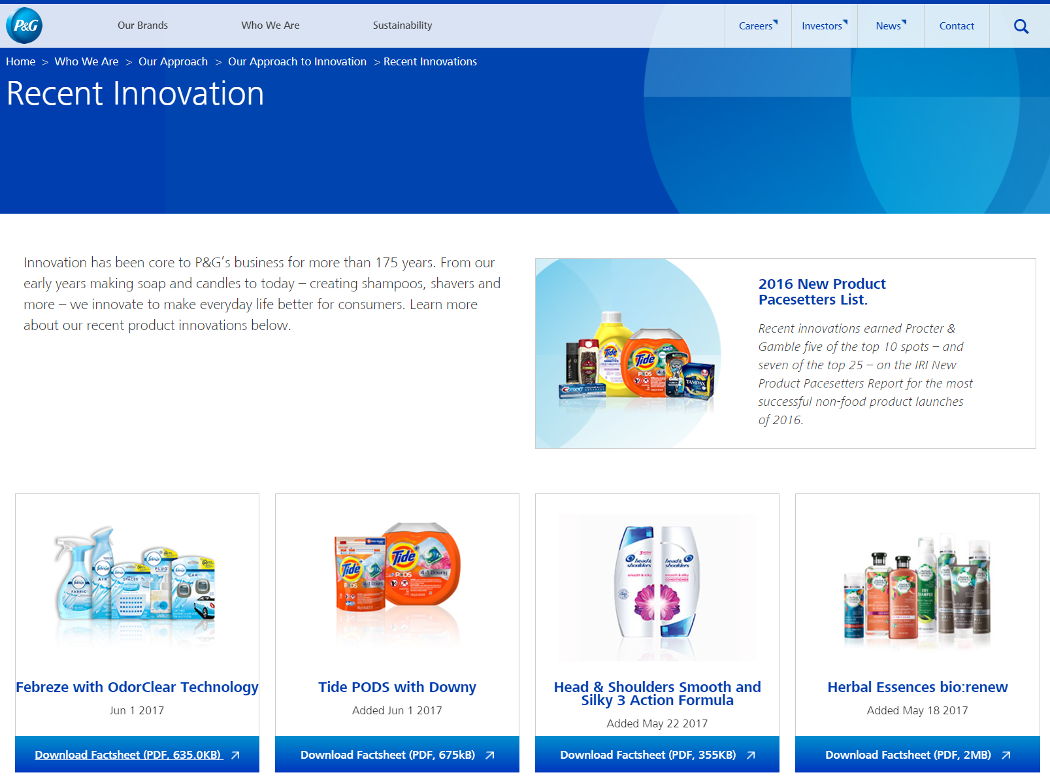

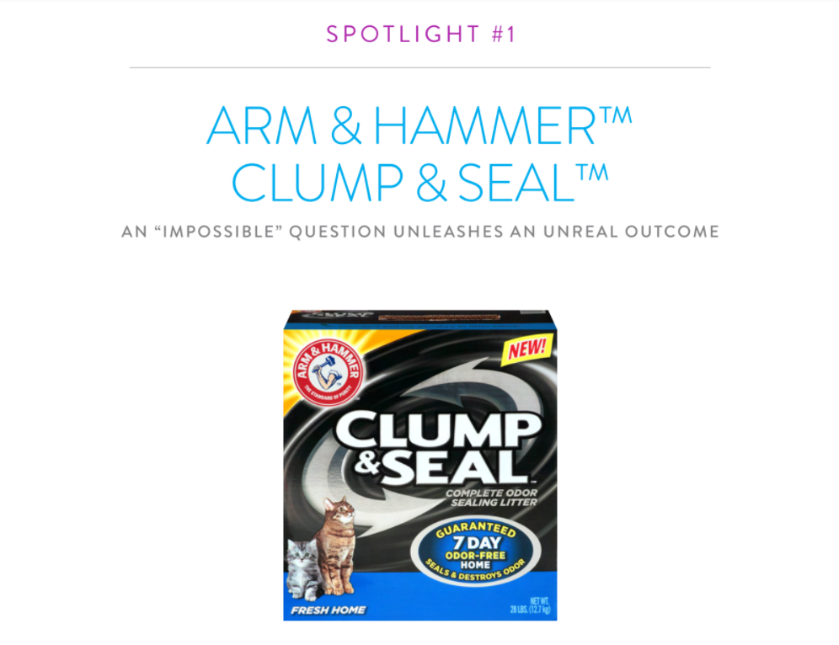
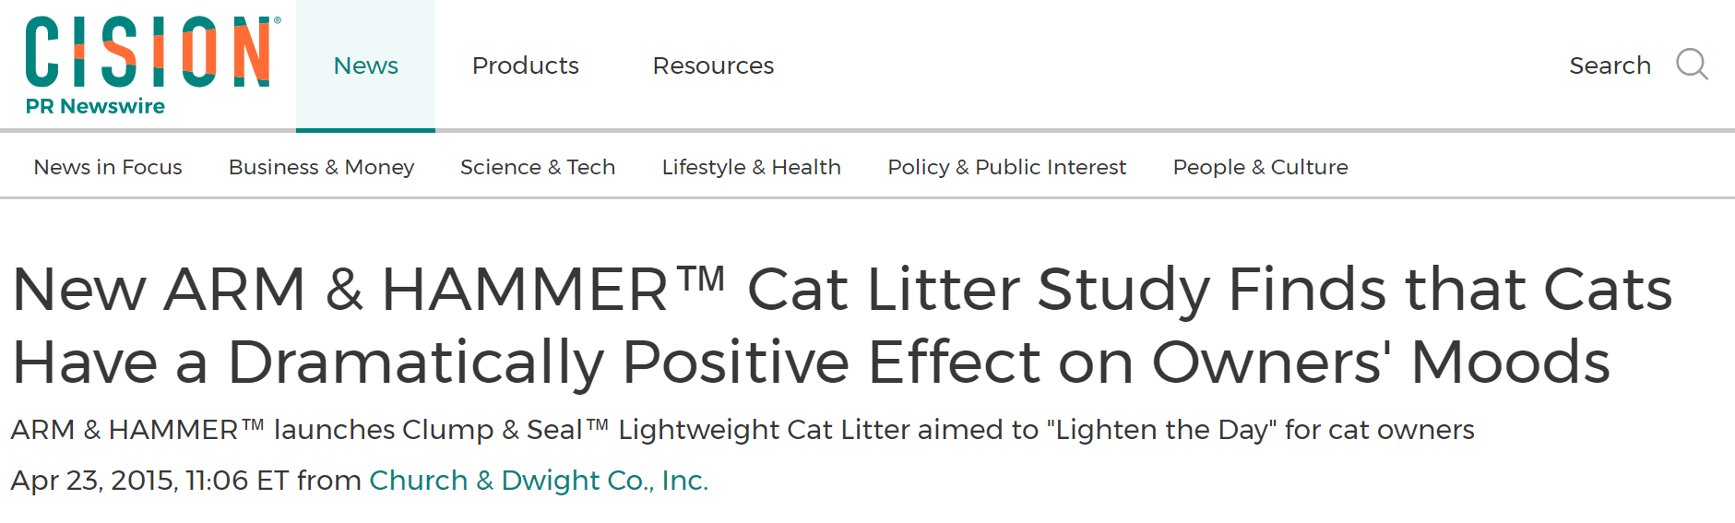
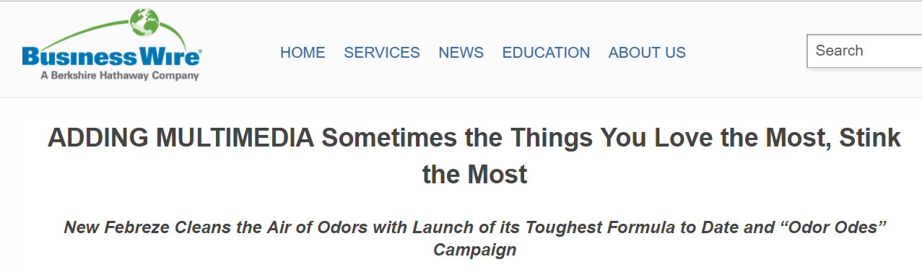

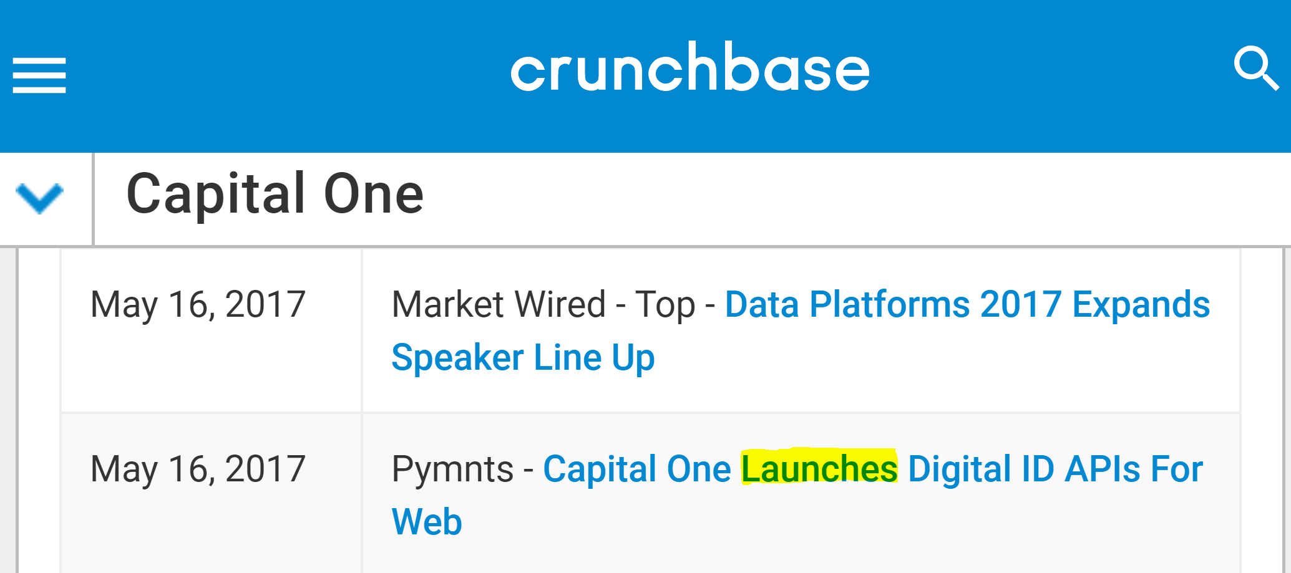
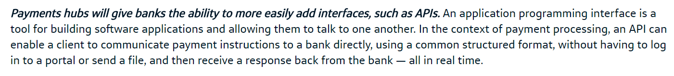
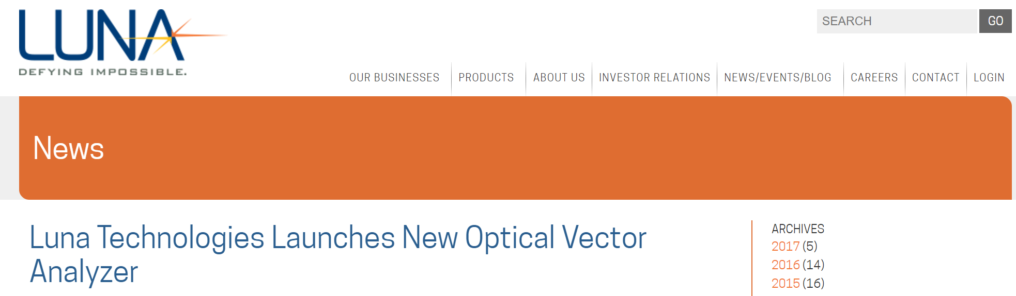
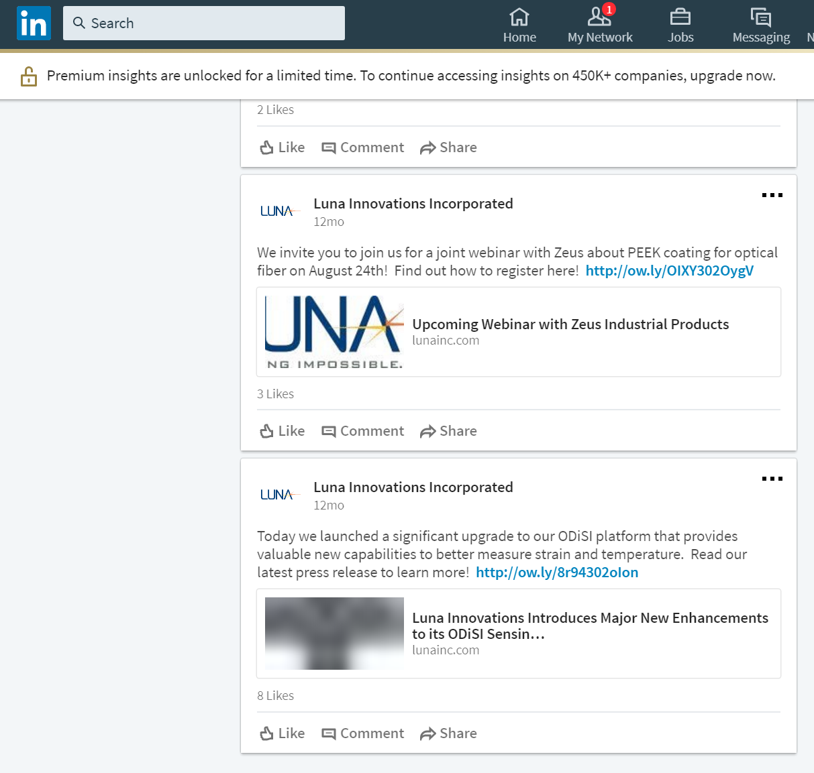
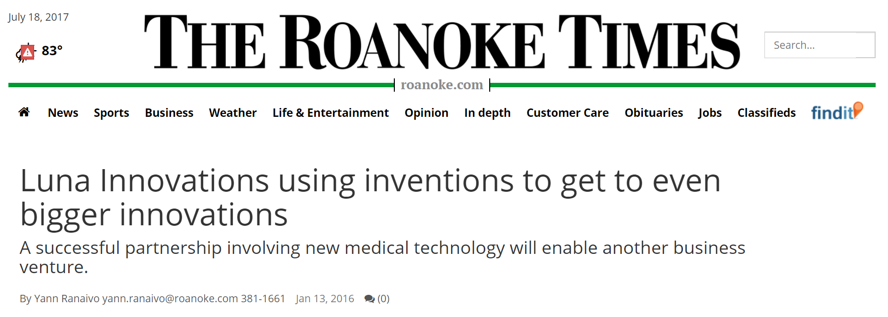

Discovering NON-TRADITIONAL DATA
SOURCES FOR Business innovation
Harsimrat Pandher (VT), David Park (VT), Daniel Wilkin (VT), Joseph Kim (VT)
Claire Kelling (PSU) with Gizem Korkmaz and Stephanie Shipp (SDAL)
Sponsor: Gary Anderson, The National Center for Science & Engineering Statistics at NSF
Project Description
The National Center for Science & Engineering Statistics at NSF traditionally measures innovation through surveys of selected companies (e.g., Business R&D and Innovation Survey (BRDIS)). While BRDIS measures innovation incidence, i.e., the number of innovating firms, NCSES is interested in exploring the possibility of using non-traditional data to richer and complementary innovation measures.
This project focuses on identifying non-traditional data sources to measure product innovation. Non-traditional data sources include administrative and opportunity data (e.g., product announcements, press releases, social media) that are obtained through databases, web-scraping or queries of selected company websites. The goal is to assess the feasibility of using these data sources and to develop methods to measure business innovation.
Data Discovery
The data discovery process aims to identify particular innovations, and where those innovations have left behind observable and traceable evidence that can then be captured with techniques such as web-scraping and text mining.
We identify innovations using two approaches: (i) awards offered to particular innovations, and (ii) company deep dives. Additionally, we conduct a literature review to identify data sources prior researchers have employed.
Company Deep Dives
Data Discovery Process
Innovation Awards
Company deep dives thoroughly examine public sources of data to identify particular innovations and identify data sources that might be used to identify initial market entry of those innovations.
Criteria for choosing companies:
Size
PROCTER & GAMBLE:
“Innovation starts with the consumer”
Open Innovation: Connect + Develop
Product & Marketing Innovation (e.g.,Tide Pods)
Literature & Business Reports e.g., BCG, McKinsey,
InfoWorld
Selected Awards | Product Awarded | Company | Industry
Nielsen | Arm & Hammer Clump & Seal | Church & Dwight Co. | Consumer Goods
 | Bai | Bai
InfoWorld | Amazon Alexa | Amazon | Technology
 | TensorFlow | TensorFlow
Consumer Technology Association | Aipoly Vision | Aipoly | Technology
 | Cota Tile | Ossia
Industry
Connections (for future interviews)
Company Deep Dives:
Procter & Gamble
Capital One
Luna Innovations
Innovation Awards
Internal Sources
Company Websites
News Releases
Social Media
Nielsen
InfoWorld
Consumer Technology Association
CAPITAL ONE:
“To design new experiences that empower customers to better manage their finances”
ENO - Capital One assistant text message
Capital One Labs - towards the digital banking
Criteria used to rate websites/databases:
Does it mention a launch?
Does it have a specific launch date?
Was it released at the time of the launch?
Can the previous criteria be applied to other products (scalability)?
How accessible is it?
External Data Sources:
Websites & News Sources
Product/Company Databases
SELECTED WEBSITES | Industry
Mass Device, Medical Design & Outsourcing | Medical
Food Business News, Food Processing | Food
Ars Technica, The Verge, Inc., Digital Trends, Engadget, Mashable, The Next Web | Science & Technology
Business Wire, Business Insider, Wall Street Journal, Media Post, PR Newswire, Kickstarter, Product Hunt, Reuters | Many Industries
DATABASES | Information Provided
CrunchBase | Company Information, News, Social Media Links, Product Releases
AngelList | Company Info, News, Social Media Links, Product Releases
Owler | Company Information & Analysis, News
VentureBeat | Technology Innovation, News Reports
F6S | Startups, Contests, Investment Info.
Mattermark | Company Information & Analysis
Dow Jones VentureSource | Company Analysis, Investor Info.
CB Insights | Company Analysis, Patents, Startups, Investor Info., News, Social Media
Gust | Early-Stage Investments, Company Info.
LUNA INNOVATIONS:
“Research + Development”
Product Development (e.g., Fiber Optic Sensor)
Create subsidiaries for some successful products they offer
capturing other data sources such as trade magazines, SEC filings
Future work involves:
conducting company interviews to identify data sources and validate findings with follow up interviews
identifying more websites and databases

