Slide 1


Web Content Mining Techniques Tools & Algorithms
Presented By:-
Amarjyoti Gautam
Munmi Lahan

Slide 2

INTRODUCTION
Now a days people are more dependent on internet.
WWW is a popular and interactive medium with tremendous growth of amount of data or information available Today.
WWW is a collection of documents, text files, images and other forms of data in structured, semi structured and unstructured form.
WWW is the information space where documents, web resources are identified by Uniform Resource Locator(URL) ,inter linked by hyper text links and can be accessed via the internet.

Slide 3

What Is Web Mining?
The process of extracting data from the internet is termed as data mining.
Web mining is the application of data mining techniques to discover pattern from the World Wide Web.
Web mining is used to capture relevant information, creating new knowledge out of relevant data, personalization of the information and learning about consumers or individual users and several others.

Slide 4

ProblemS
Finding Appropiate Infomation.
Creation Of New Knowledge From The Web.
Personalizing Data’s
Analyzing Indivisual User Preference

Slide 5
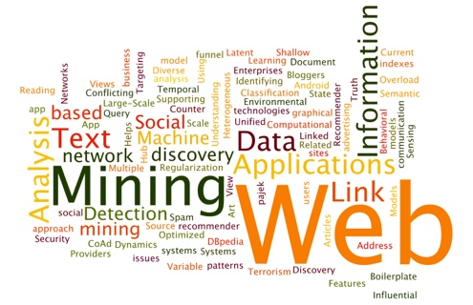
Web Mining Categories

Slide 6
Web Mining
Web Content Mining
Web Structure Mining
Web Usages Mining

Slide 7
Web Content Mining
The Web content mining refers to the discovery of useful information from web contents which include text, image, audio, video, etc.
It includes extraction of structured data/information from web pages, identification, similarity and integration of data’s with similar meaning, view extraction from online sources, and concept hierarchy, knowledge incorporation

Slide 8

Web Structure Mining
Web structure mining is based on the link structures with or without the description of links.
The goal of web structure mining is to generate structured summary about websites and web pages. It uses treelike structure to analyze and describe HTML or XML

Slide 9
Web Usage Mining
The Web usage mining is also known as Web Log mining, which is used to analyze the behavior of website users.
This focuses on technique that can be used to predict the user behavior while user interacts with the web.
It contains four processing stages including
data collection,
preprocessing,
pattern discovery and analysis
Data clustering

Slide 10
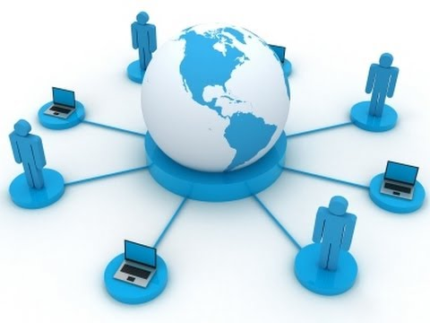
Web Content Mining Approaches

Slide 11
Unstructured Text Data Mining
Unstructured data consist of free text on a web page, audio, video files.
Unstructured text data does not have a clear, overt semantic structure.
Techniques
Information Extraction,
Topic Tracking,
Summarization,
Categorization,
Clustering and
Information Visualization

Slide 12
Structured Data Mining
Structured data represent data which are stored in tabular form or database system.
Structured data on the web represent their host pages.
Structured data are easy to extract when compare to unstructured data.
Techniques
Web Crawler,
Wrapper Generation,
Page content Mining

Slide 13
Semi-Structured Data Mining
Techniques use in semi-structured data mining
Object exchange model(OEM)
Top down extraction
Web data extraction language

Slide 14
Multimedia Data Mining
Technique of multimedia data mining are
SKICAT
Colour Histrogram Matching
Multimedia Miner
Shot Boundary Detection

Slide 15
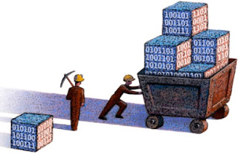
Web Content Mining Tools

Slide 16
Web Info Extractor(WIE)
This is a tool for data mining, extracting Web content, and web content Analysis and it can extract structured or unstructured data from Web page, reform into local file or save to database, place into Web server.
Features:
Facilitates to define extraction tools which enable no need of learning boring and complex template rules.
Extraction of tabular and unstructured data to file or database.
Extraction of new content while updating and monitoring Web pages.
Be able to deal with text, image and other link file.
Deal with Web page in all language.
Running multi-task at the similar time.
Facilitates recursive task definition.

Slide 17
Mozenda
This is a tool to enable users to extract and manage Web data. The Users can setup agents that normally extract, store, and also publish data to multiple destinations.
Features:
Easy to use.
Platform independency. (Runs only on Windows).
Working place independence: Tuning the scraper, managing the scraping process and get scraped data from any computer connected to the Web.

Slide 18

Screen -Scrapper
This is a tool for extracting/mining information from web sites. It is used for searching a database, which interfaced with software to attain content mining needs
Features:
Screen-scraper present a graphical interface allowing the user to allocate URL’s, data elements to be extracted and scripting logic to traverse pages and work with mined data.
Once these items have been created, from external languages such as .NET, Java, PHP, and ASP, the screen-scraper can be invoked.
Facilitates scraping of information at cyclic intervals. The common purpose of this software and its services is to mine data on products and download them to a spreadsheet

Slide 19
Web Content Extractor
WCE is a powerful and easy to use data extraction tool for Web scraping, and data extraction from the Internet. This offers a friendly, wizard-driven interface that will help through the process of building a data extraction pattern
Features:
Helps in the extraction or collection of market figures, product pricing data, or real estate data.
Support users to extract the information about books from online book sellers.
Helps users in automate extraction of auction information from auction sites.
Help to Journalists extract news and articles from news sites.
Helps people seeking job postings from online job websites.
Extracting online information about vacation and holiday places.

Slide 20

Automation Anywhere 6.1(AA)
AA is a Web data extraction tool used in getting web data, screen scratch from Web pages or use it for Web mining.
Features:
Automation Technology for rapid automation of complex tasks.
Recording keyboard and mouse or use point and click wizards to create automated tasks quickly.
Web record and Web data extraction.
This has 305 plus actions were included: Internet, conditional, loop, prompt, file management, database and system, automatic email notifications, task chaining, etc.

Slide 21
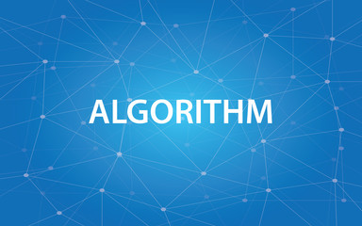

Slide 22

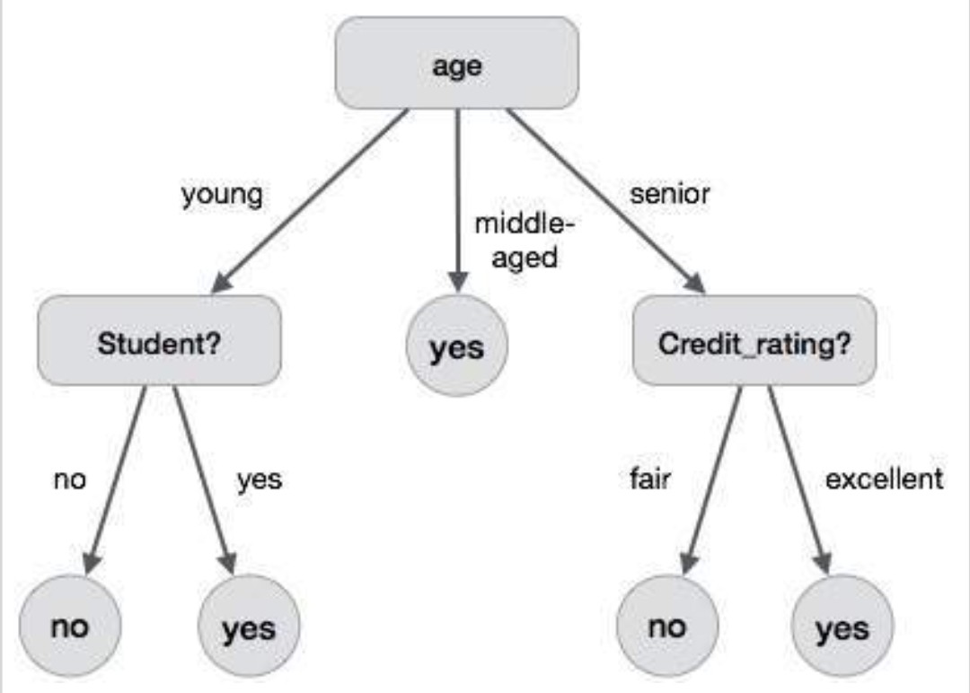
Decision Tree
: The decision tree is one of the powerful classification techniques. Decision trees take the input as its features and output as decision, which denotes the class information. Two widely known algorithms for building decision trees are Classification and Regression Trees and ID3/C4.5.

Slide 23

CONCLUSION
The importance of web mining continues to increase due to the increasing tendency of web documents. The mining of web data still be present as a challenging research problem in the future. Because the web documents possess numerous file formats along with its knowledge discovery process. There are many concepts available in Web Mining but here we have tried to include the Web content mining strategy and explore some of the techniques, tools in Web Content mining.

