Slide 1
Messaging
Aj.Drusawin Vongpramate
Information Technology
Science, BRU

Slide 2

Firebase Cloud Messaging
Firebase Cloud Messaging (FCM) is a cross-platform service that handles the sending, routing, and queueing of messages between server applications and mobile client apps. FCM is the successor to Google Cloud Messaging (GCM), and it is built on Google Play Services.

Slide 3
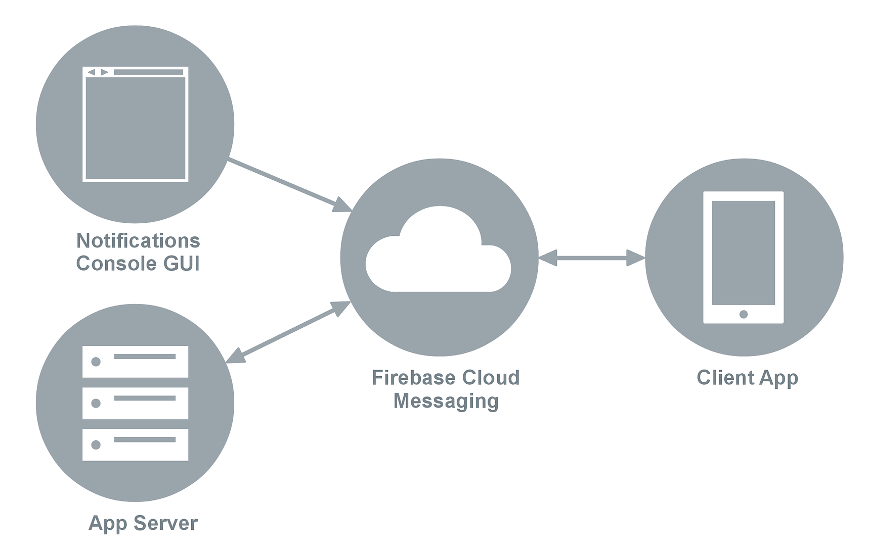
FCM Architecture
Ref :: https://docs.microsoft.com/en-us/xamarin/android/data-cloud/google-messaging/firebase-cloud-messaging#setup_fcm

Slide 4
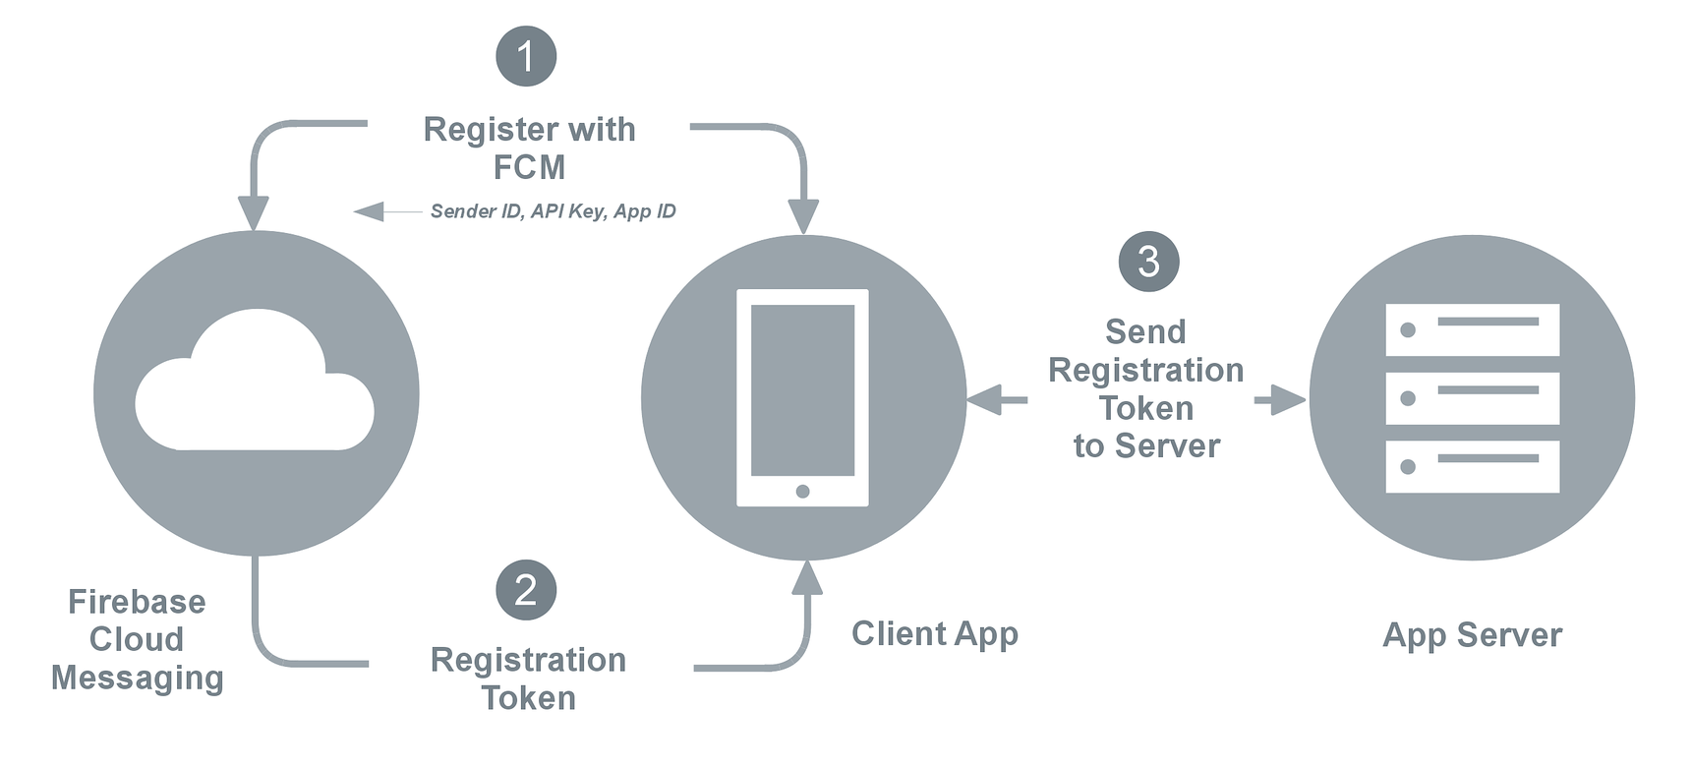
Registration
Sender ID : 496915549731
API Key : AJzbSyCTcpfRT1YRqbzjIwp1h06YdauvewGDzk.
App ID : 1:415712510732:android:0e1eb7a661af2460
Registration : fkBQTHxKKhs:AP91bHuEedxM4xFAUn0z ... dsaeZ Token (a very long string).

Slide 5
Supported Browser
Chrome: 50+
Firefox: 44+
Opera Mobile: 37+
--------------------------------------------
HTTPS only
--------------------------------------------
Direction : https://firebase.google.com/docs/web/setup

Slide 6
Registration
#Step 1
https://console.firebase.google.com
#Step 2
Login/sign-up to your firebase account.
#Step 3
Create a new project

Slide 7
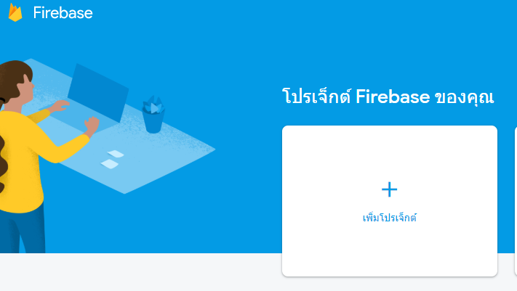
Registration

Slide 8
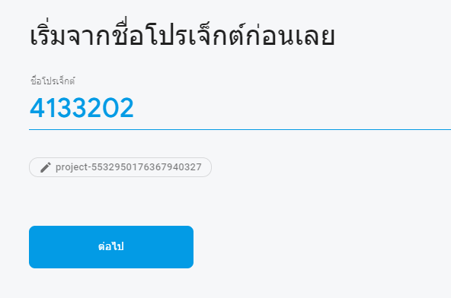
Registration
#Step 4
Put your project name

Slide 9
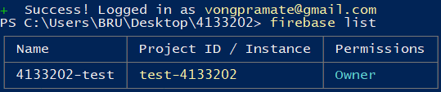
Install the Firebase CLI
1. Install Node.js
2. Install the Firebase CLI using npm by running
$ npm install -g firebase-tools
3. Sign into Firebase using your Google account
$ firebase login
4. Test
$ firebase list

Slide 10
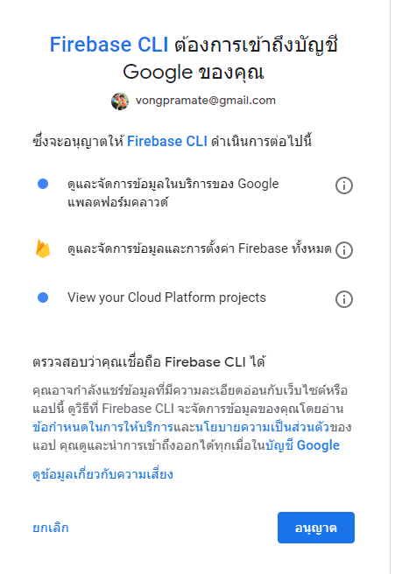
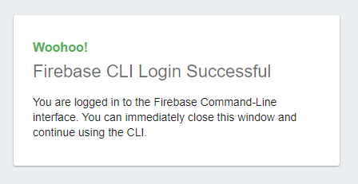

Slide 11
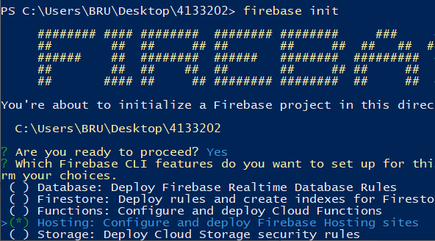
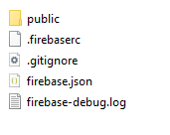
Initialize a Firebase project
A project directory using the firebase init command. A project directory is usually the same directory as your source control root, and after running firebase init, the directory contains a firebase.json configuration
$ firebase init

Slide 12
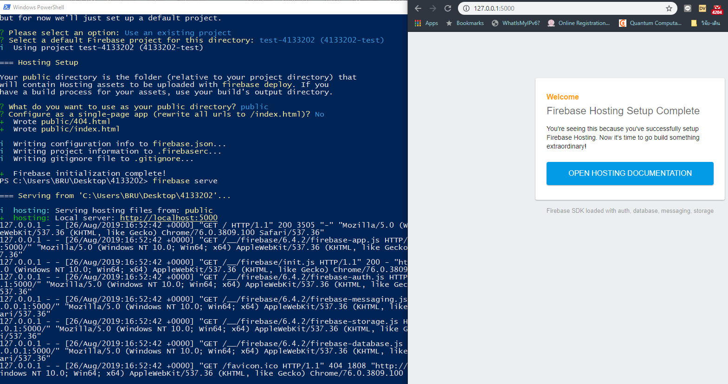
To emulate HTTP
$ firebase serve

Slide 13
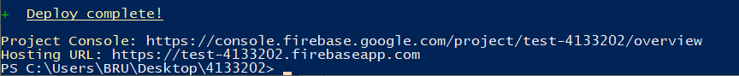
Deploy
$ firebase deploy
View your site at either of your default sites:
project-id.web.app
project-id.firebaseapp.com

Slide 14
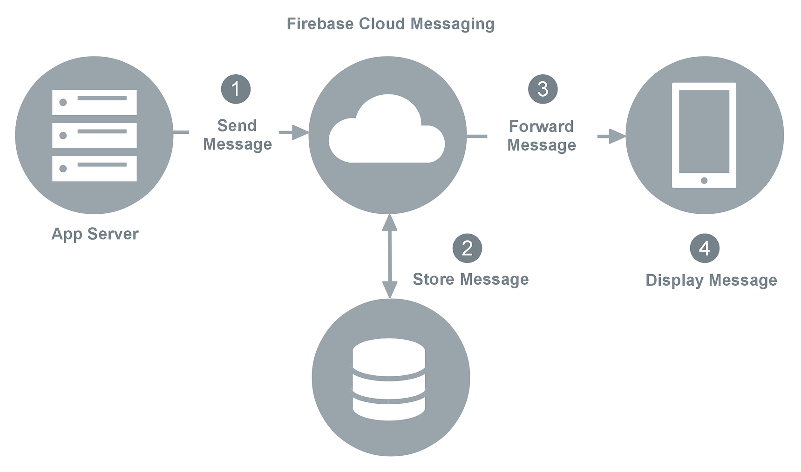
Downstream messaging

Slide 15
Set up a JavaScript Firebase Cloud Messaging client app
The FCM JavaScript API lets you receive notification messages in web apps running in browsers that support the Push API.

Slide 16
Add Firebase SDKs
<body> <!-- Firebase App (the core Firebase SDK) is always required and must be listed first -->
<script src="https://www.gstatic.com/firebasejs/6.4.1/firebase-app.js"></script>
<!-- Add Firebase products that you want to use -->
<script src="https://www.gstatic.com/firebasejs/6.4.1/firebase-auth.js"></script>
<script src="https://www.gstatic.com/firebasejs/6.4.1/firebase-firestore.js"></script> </body>

Slide 17
Initialize Firebase in your app
<body>
<!-- Previously loaded Firebase SDKs -->
<script>
// TODO: Replace the following with your app's Firebase project configuration
var firebaseConfig = {
// ...
};
// Initialize Firebase
firebase.initializeApp(firebaseConfig);
</script>
</body>

Slide 18
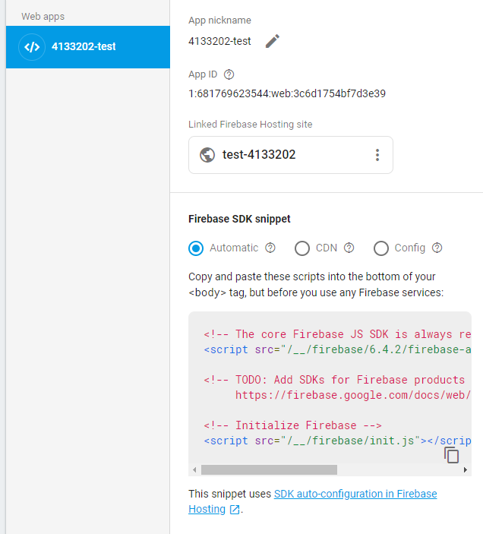
Add App

Slide 19
Firebase config object
var firebaseConfig = {
apiKey: "api-key",
authDomain: "project-id.firebaseapp.com",
databaseURL: "https://project-id.firebaseio.com",
projectId: "project-id",
storageBucket: "project-id.appspot.com",
messagingSenderId: "sender-id",
appID: "app-id",
};

Slide 20
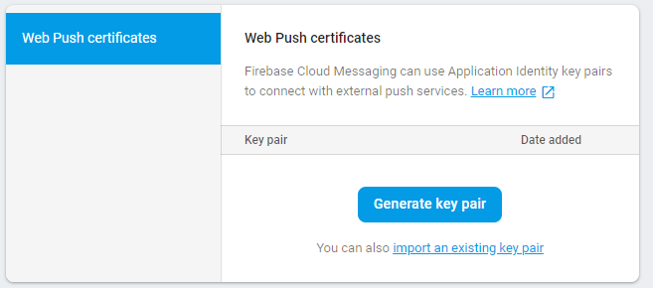
Generate a new key pair
In the Web Push certificates tab, click Generate Key Pair. The console displays a notice that the key pair was generated, and displays the public key string and date added. (PublicVapidKey)

Slide 21
Configure Web credentials in your app
// Add the public key generated from the console here.
messaging.usePublicVapidKey("BMtDA58iV-13pirlzlloMuDOY-OwkIoxVlBgM4WCx-mlsN4GbveRly………………………jvtOWrB6dF6NKgcts");

Slide 22
Retrieve a messaging object
index.html
// Retrieve Firebase Messaging object. const messaging = firebase.messaging();

Slide 23
Request permission to receive notifications
index.html
Notification.requestPermission().then((permission) => { if (permission === 'granted') { console.log('Notification permission granted.'); // TODO(developer): Retrieve an Instance ID token for use with FCM. // ... } else { console.log('Unable to get permission to notify.'); } });

Slide 24
Retrieve the current registration token
The messaging service requires a firebase-messaging-sw.js file. create an empty file with that name and place it in the root of your domain before retrieving a token.
index.html
// Get Instance ID token. Initially this makes a network call, once retrieved // subsequent calls to getToken will return from cache. messaging.getToken().then((currentToken) => { if (currentToken) { sendTokenToServer(currentToken); updateUIForPushEnabled(currentToken); } else { // Show permission request. console.log('No Instance ID token available. Request permission to generate one.'); // Show permission UI. updateUIForPushPermissionRequired(); setTokenSentToServer(false); } }).catch((err) => { console.log('An error occurred while retrieving token. ', err); showToken('Error retrieving Instance ID token. ', err); setTokenSentToServer(false); });

Slide 25
Monitor token refresh
index.html
// Callback fired if Instance ID token is updated. messaging.onTokenRefresh(() => { messaging.getToken().then((refreshedToken) => { console.log('Token refreshed.'); // Indicate that the new Instance ID token has not yet been sent to the // app server. setTokenSentToServer(false); // Send Instance ID token to app server. sendTokenToServer(refreshedToken); // ... }).catch((err) => { console.log('Unable to retrieve refreshed token ', err); showToken('Unable to retrieve refreshed token ', err); }); });

Slide 26
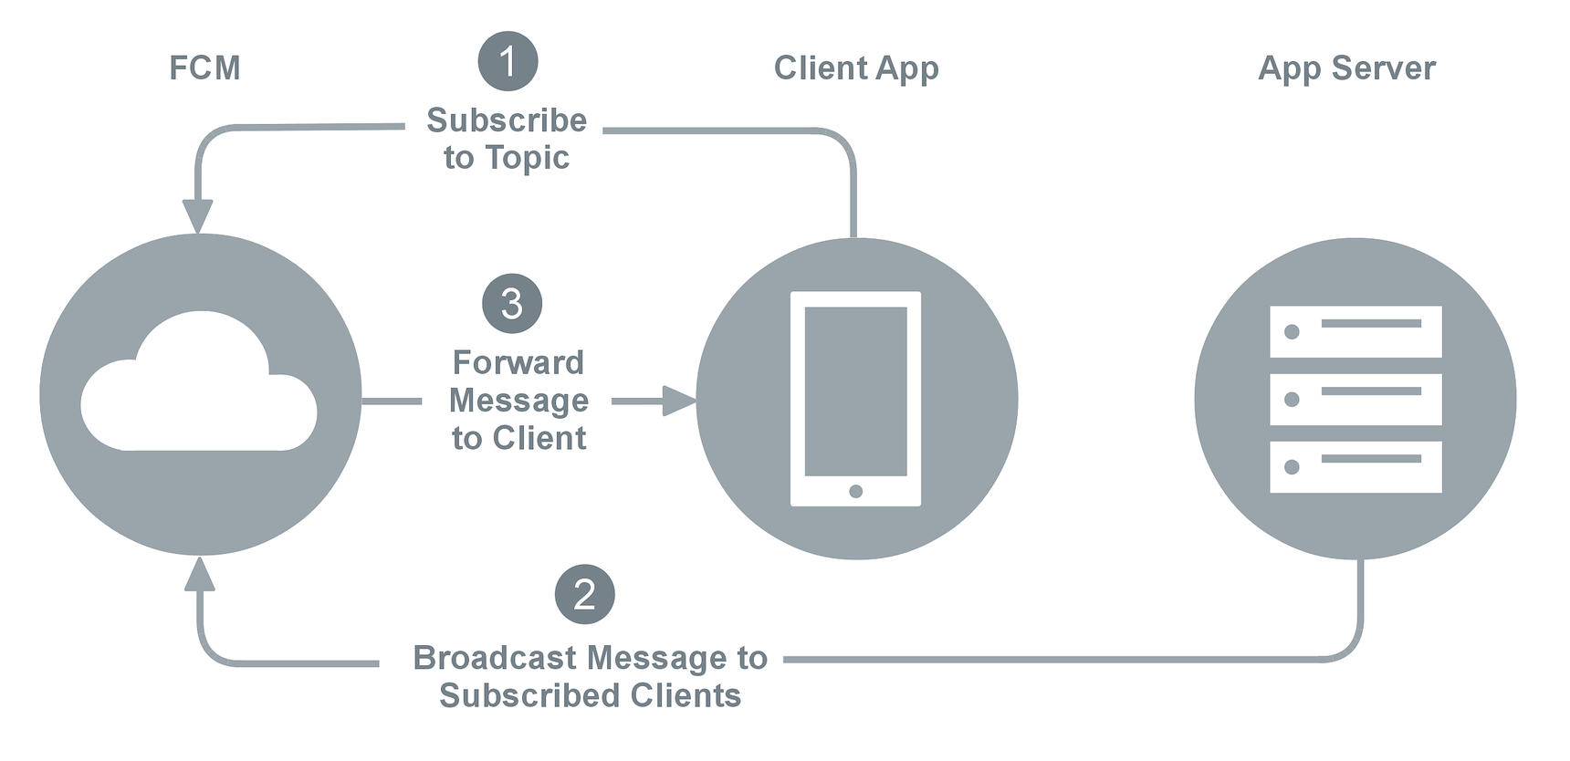
Topic messaging

Slide 27
Q & A

