Slide 1

I-INVENTORY SYSTEM

Slide 2
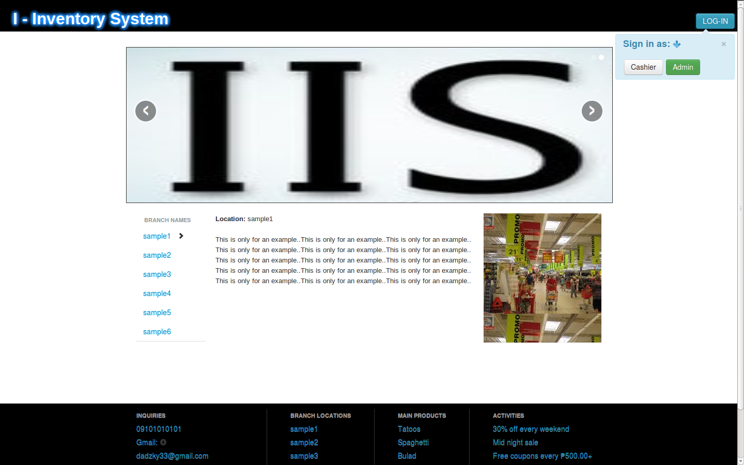

Slide 3
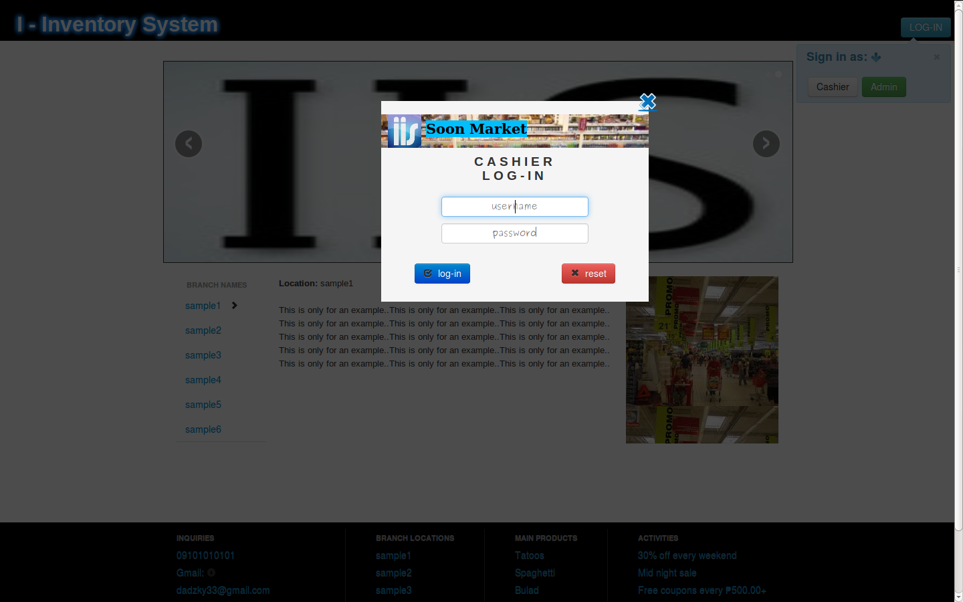
CASHIER LOG-IN

Slide 4
POINT OF SALE or
(POINT OF PURCHASE)

Slide 5
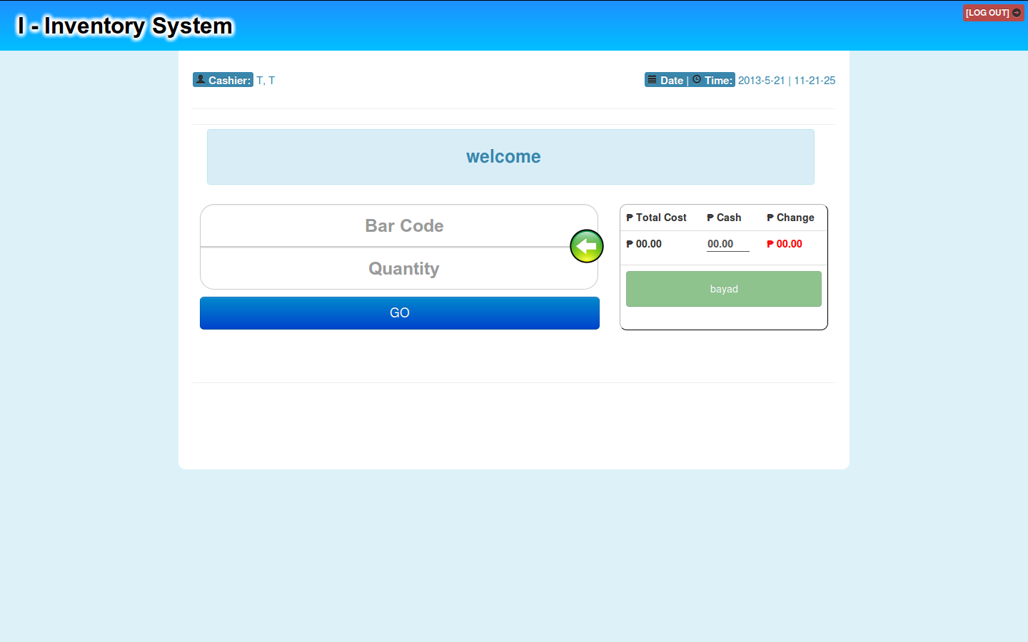

Slide 6
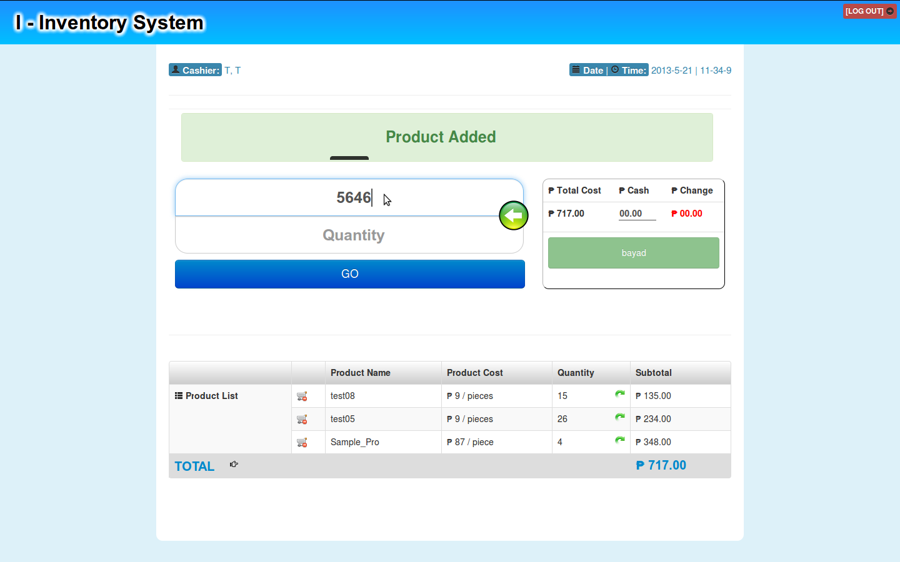

Slide 7
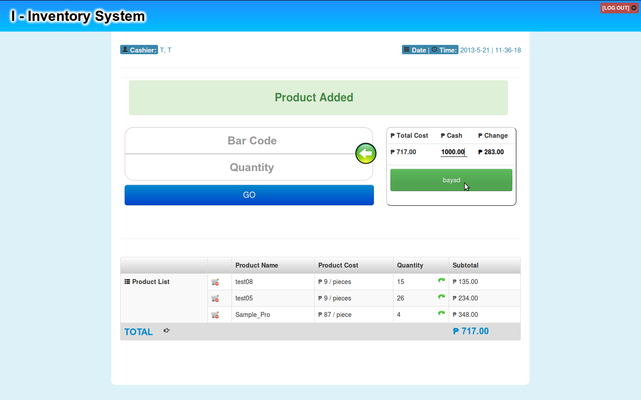
PAYMENT

Slide 8
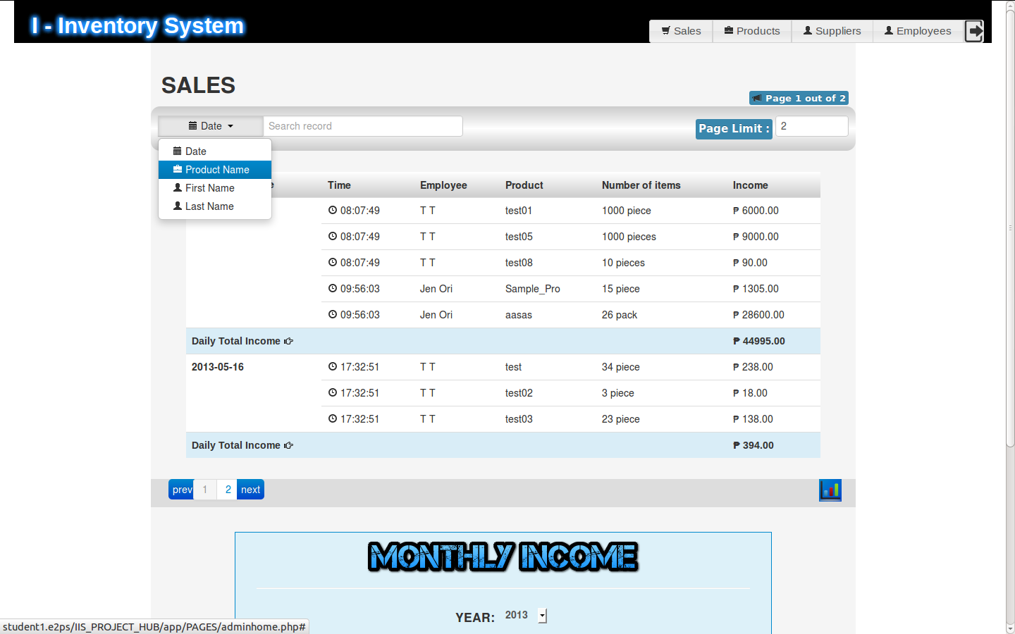
SALES RECORD

Slide 9
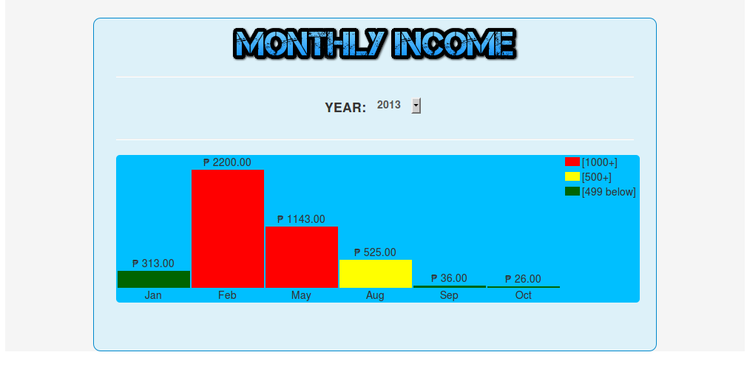
Graphed Monthly Sales

Slide 10
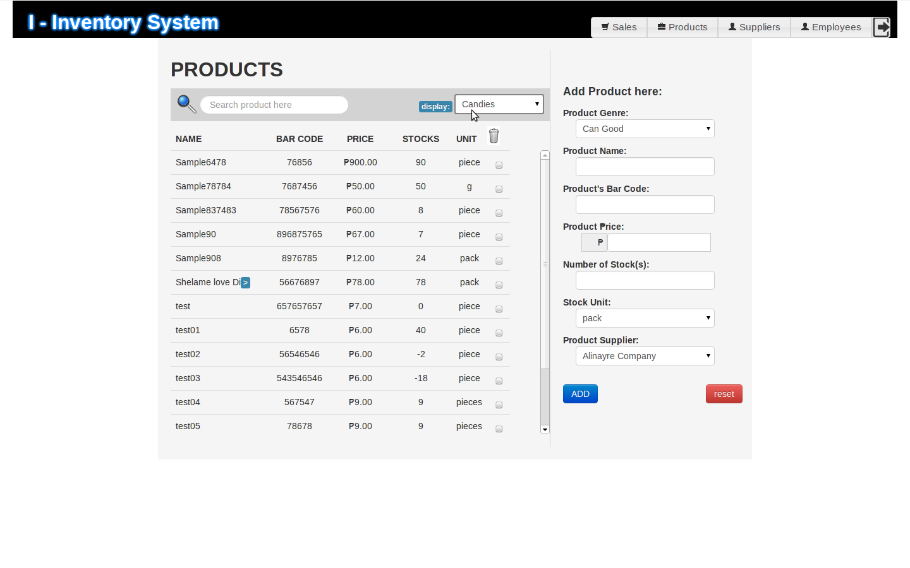
PRODUCTS MANIPULATION

Slide 11
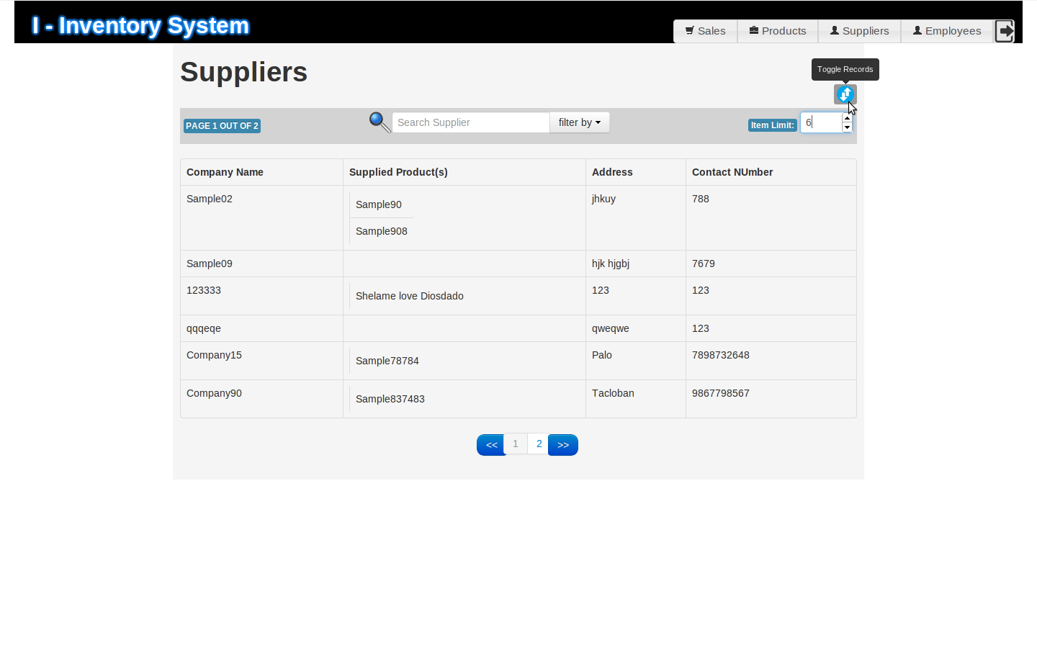
SUPPLIERS PAGE

Slide 12
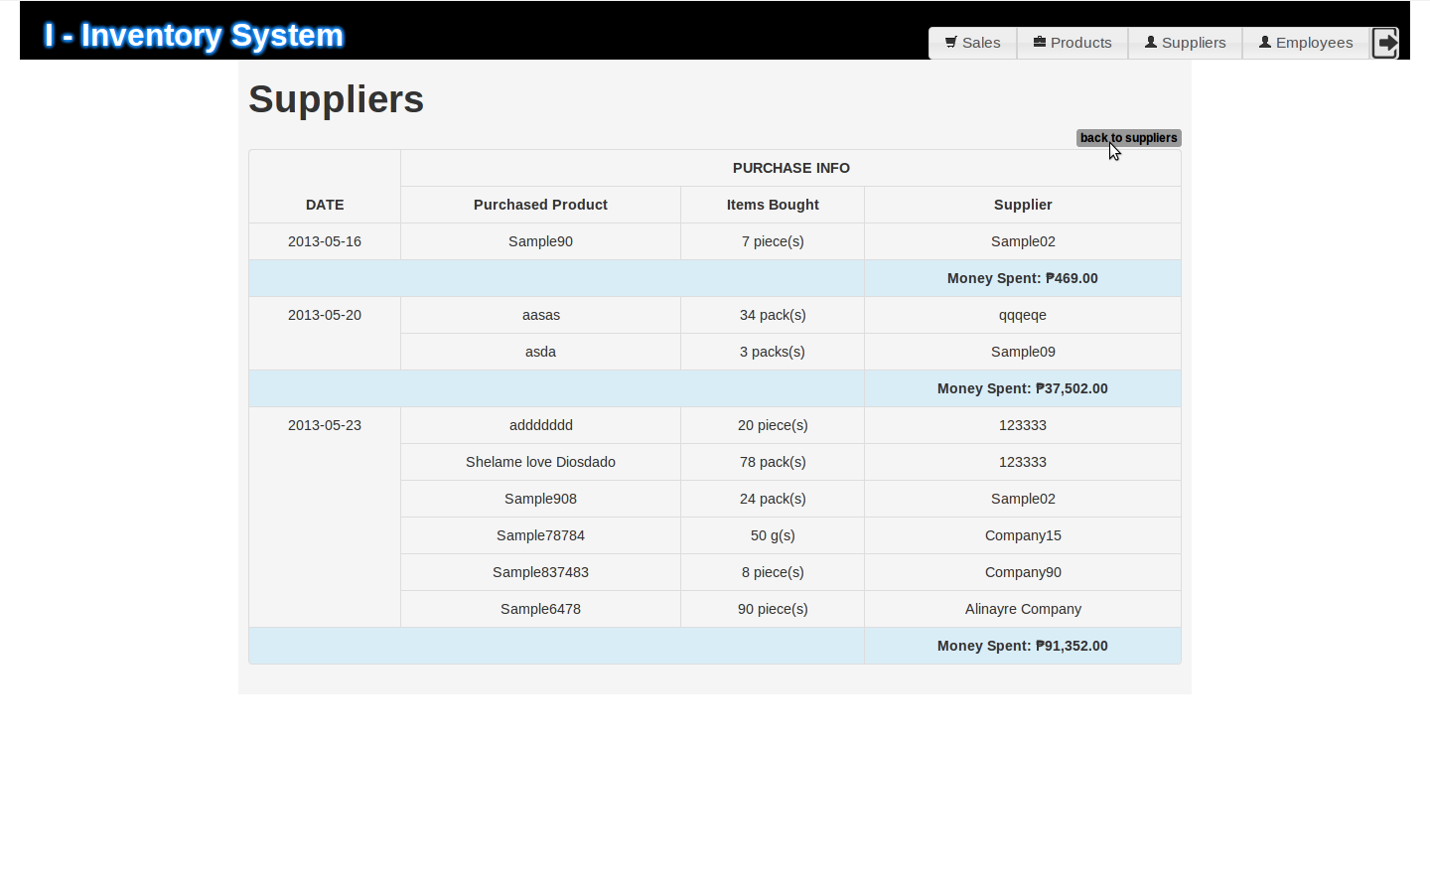
Suppliers Transaction

Slide 13
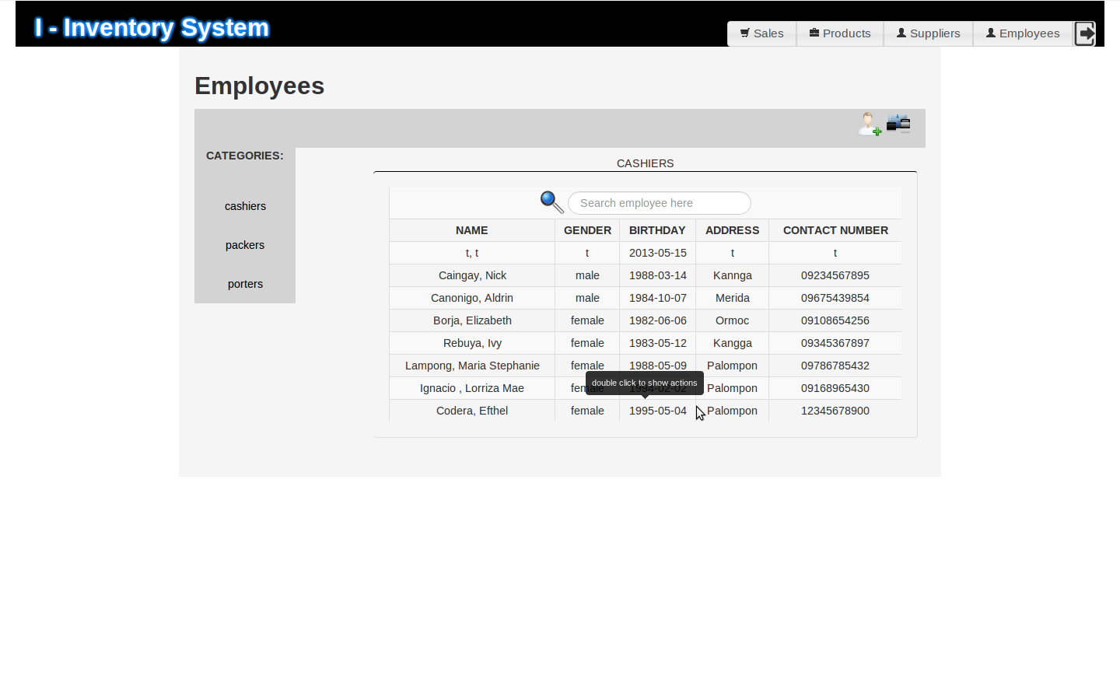
EMPLOYEES PAGE

Slide 14
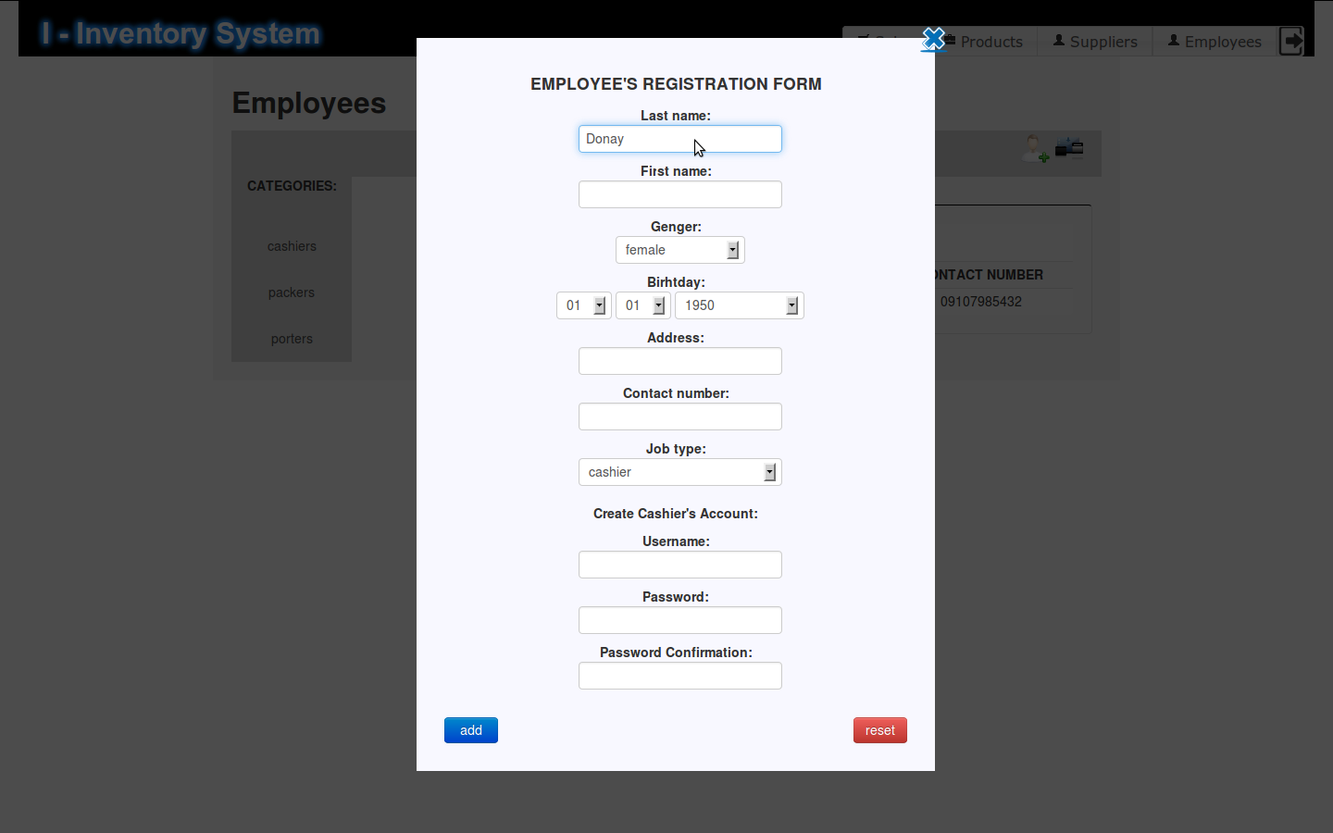
Hiring New Employee
N

Slide 15
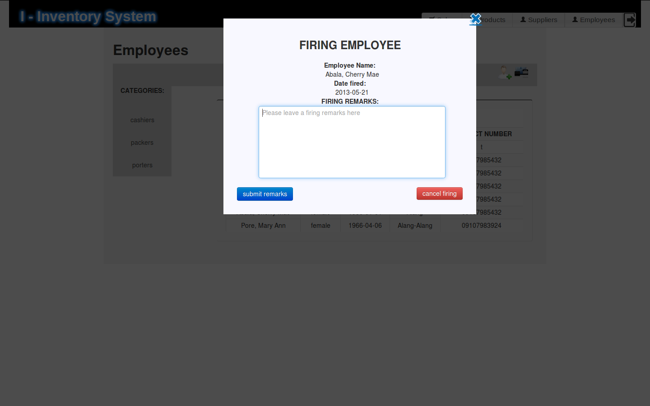
Firing Employee

