Slide 1
Book1
File created on: 6/15/2021 3:25:48 PM

Slide 2
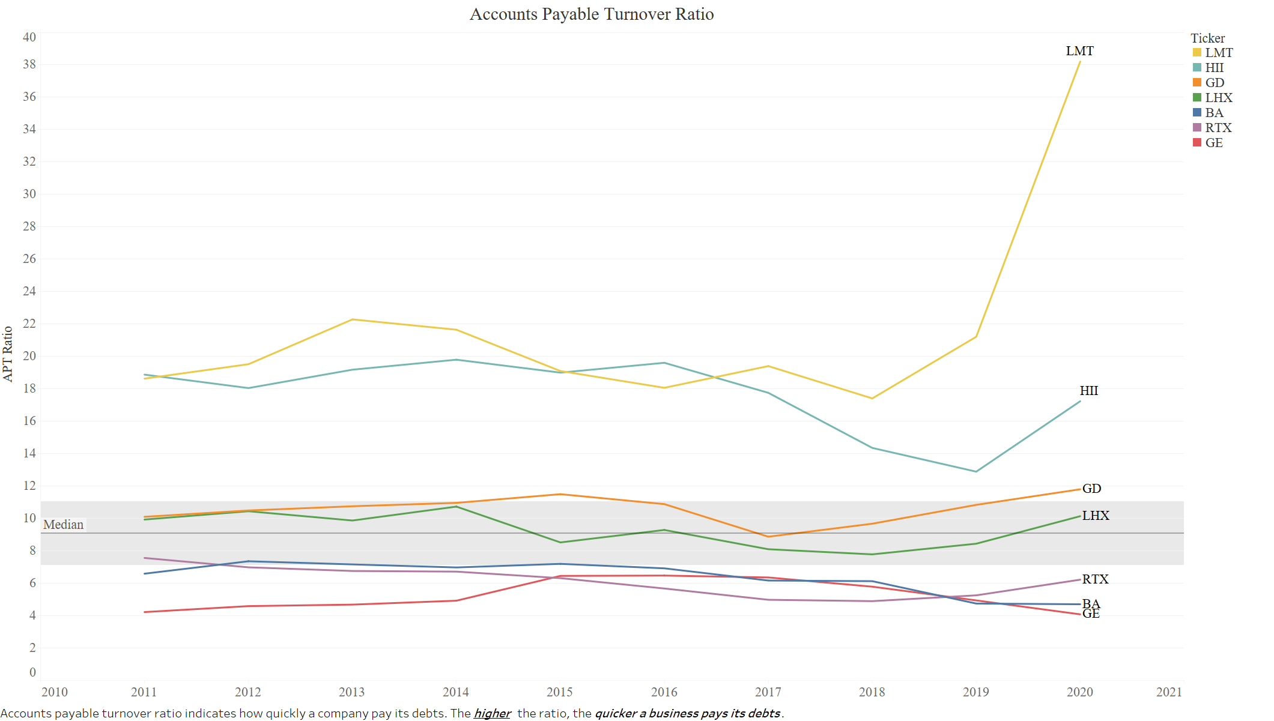

Slide 3
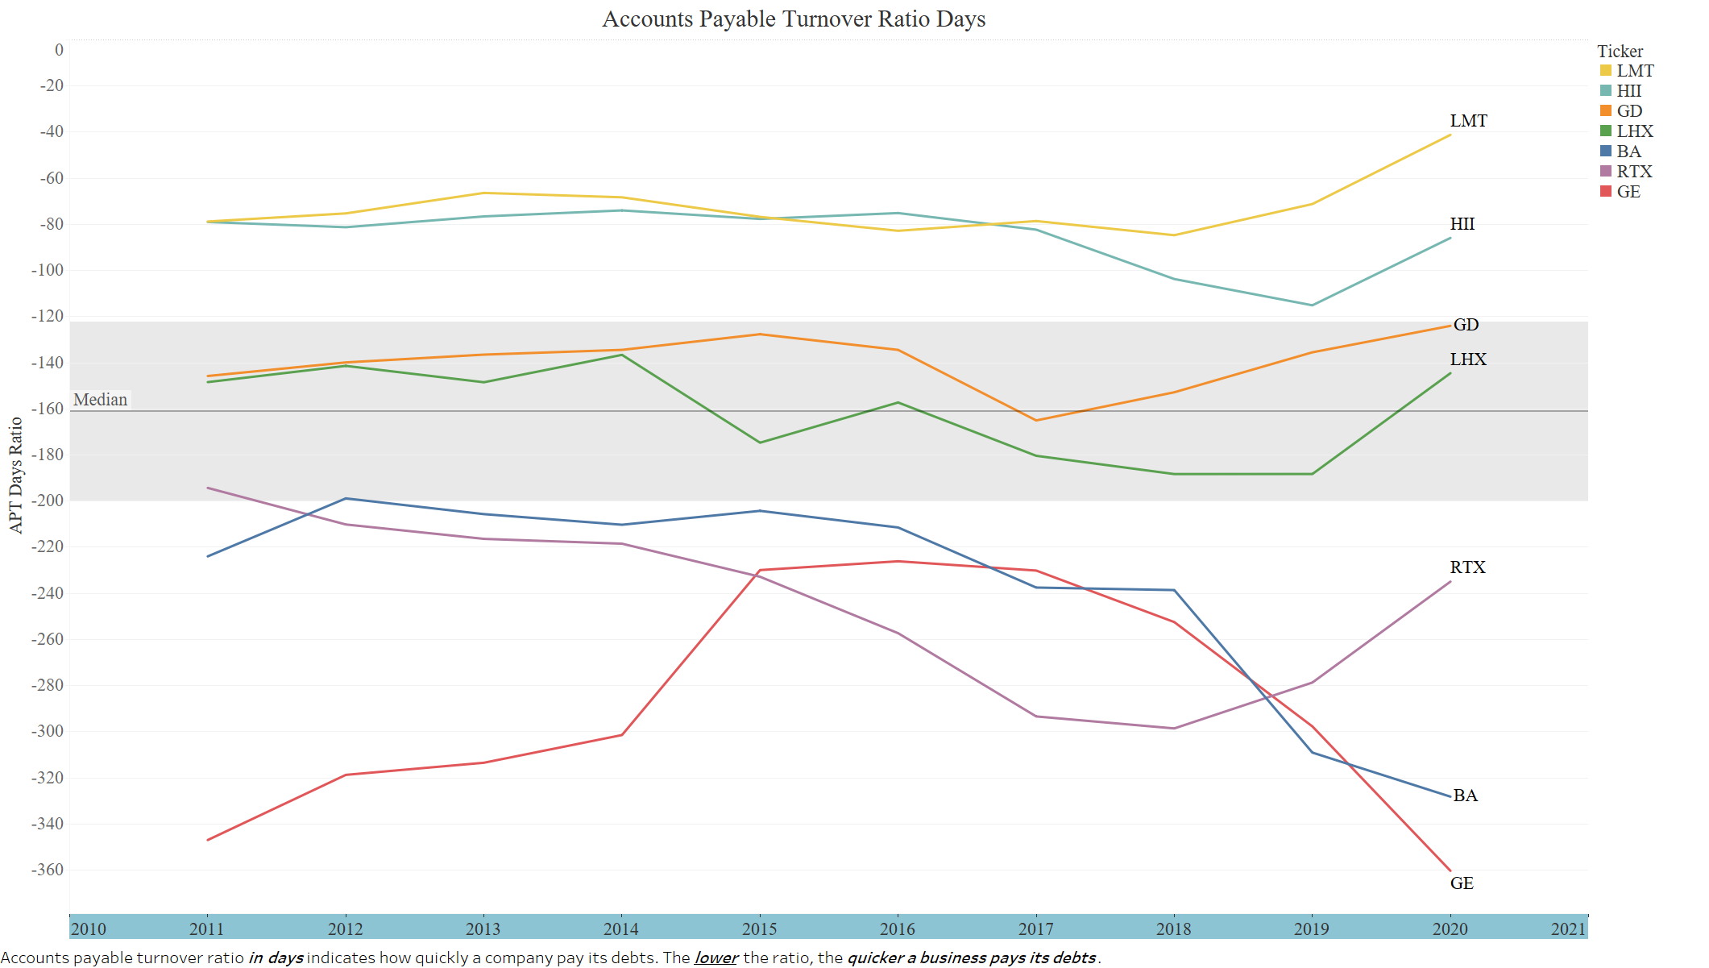

Slide 4
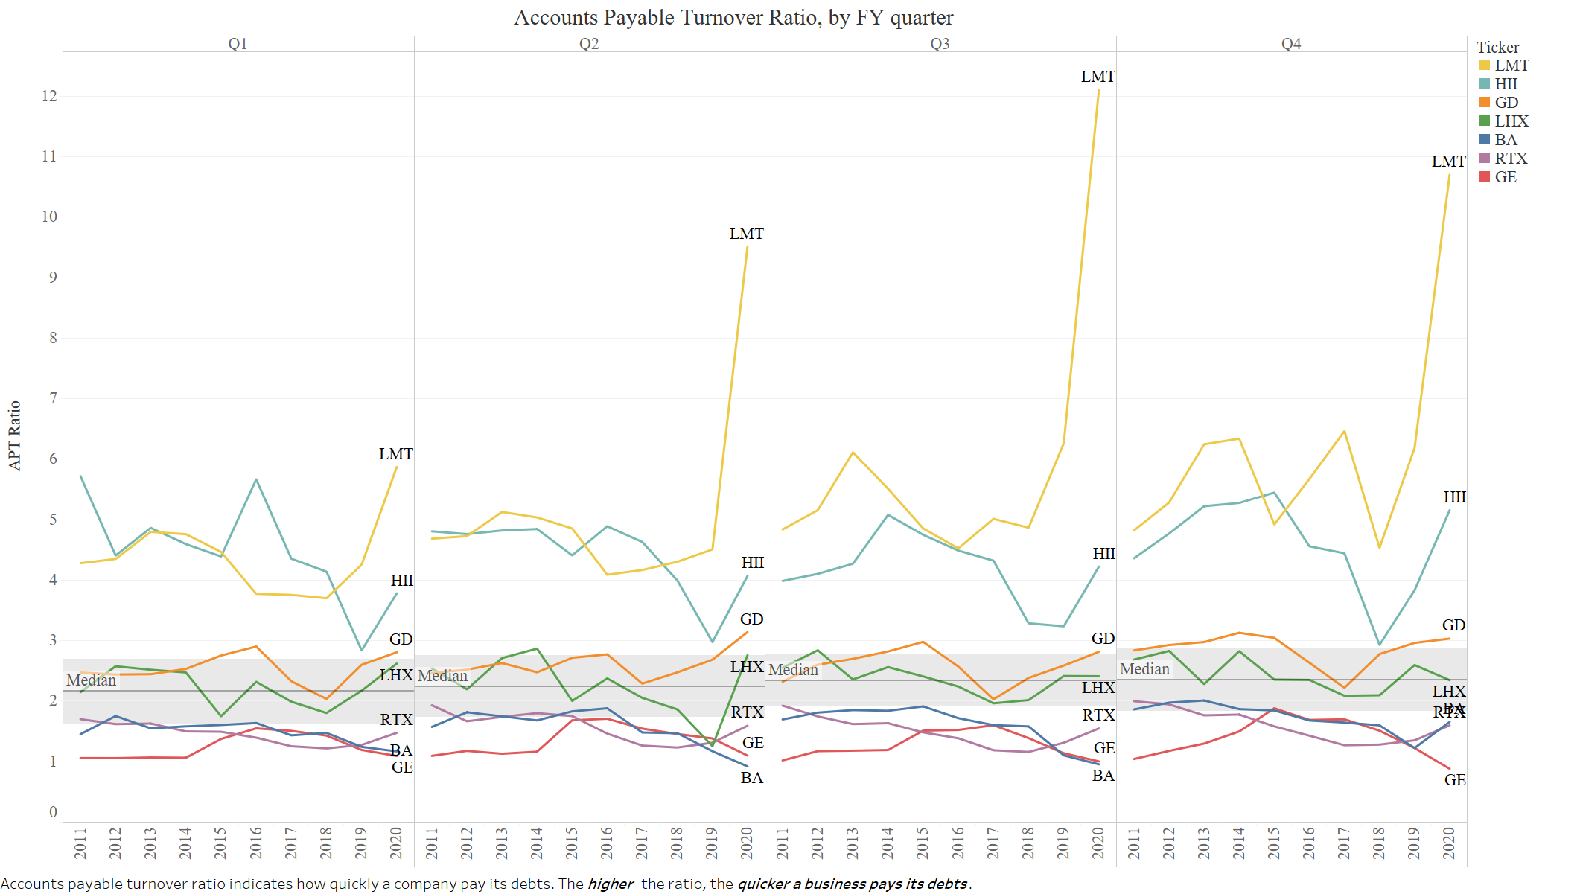

Slide 5
