Slide 1
Janus
The goal of the project was to be able to scan a networked environment for potential security violations through a mobile application.

Slide 2
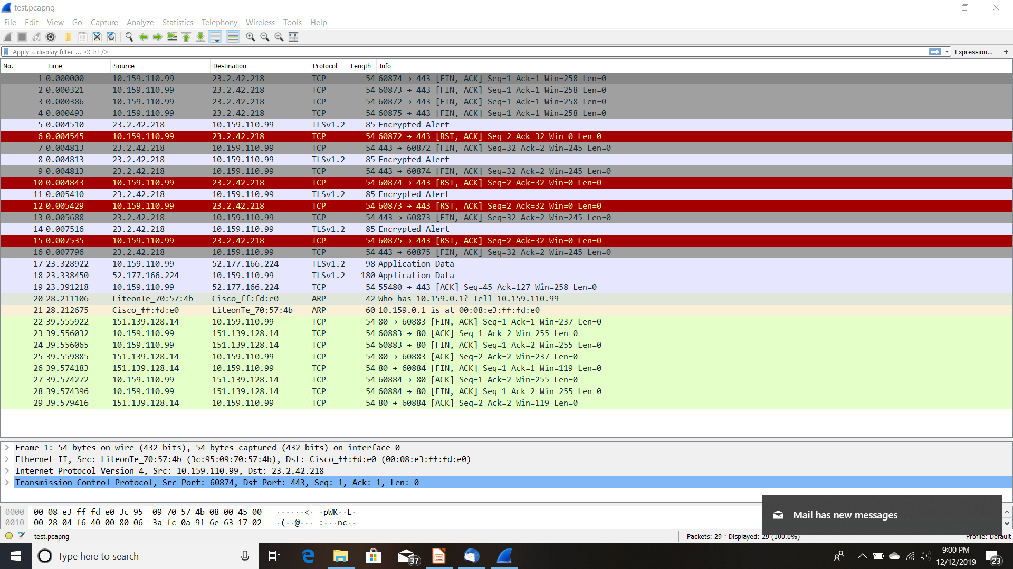
Wireshark Output

Slide 3
Three Parts of The Design
The first part of the design was a sniffer to collect data and tag the location that the data was collected from.
The second part was the storage and the analysis of the data for potential security threats.
The last phase is the ability to take action.

Slide 4
Sniffer
The sniffer collects the following information:
  MAC address of the device. ( allows for the tracking of the device if it changes locations in the network)
  GPS location that the device was located at.
  IP addresses visited.
  Date/Time

Slide 5
Server
The server provides the following functions:
  Stores information in case there is an incident, and the information needs to be reviewed
  Allows the network administrator to flag potential threats for the next stage.
  Allows for the data to be fairly anonymous

Slide 6
Action
This module provides the following functions:
  Sends a “last known GPS location”, a MAC address and the security violation to be addressed.

Slide 7
Results of the Project
Why No One Else Did This
In order for this project to reach it full potential the device has to be rooted and the PCAP libraries have to be added to the device.
Then code has to be added to the App to call a shell on the device and to execute the code for the PCAP libraries.
The results of these calls then have to be translated back to Android, and then interpreted.
All of these calls and interpretation have to occur in real time.

Slide 8

What Started This Project
There is a company called PawnieExpress
A couple of years back they made the prototype phone for a TV series called “Mr Robot”
I was wondering how far I could push this design into a real functioning network testing tool.

Slide 9
Summary of the Results
While a mobile device for the testing of a network may sound appealing, the reality of the design is not.
The better option is to use a laptop running COTS software packages that have years of testing and research behind them.
These results can then be passed to the server, and analyzed.
From this point the results of the analysis could be passed to the mobile devices for remediation

Slide 10
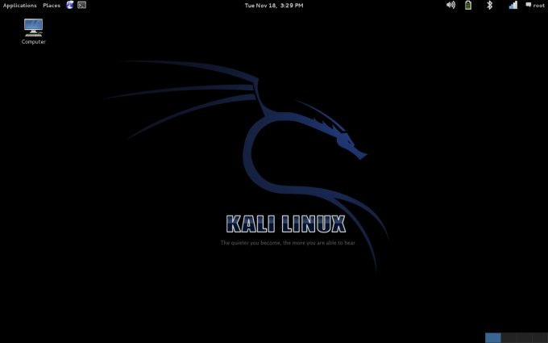
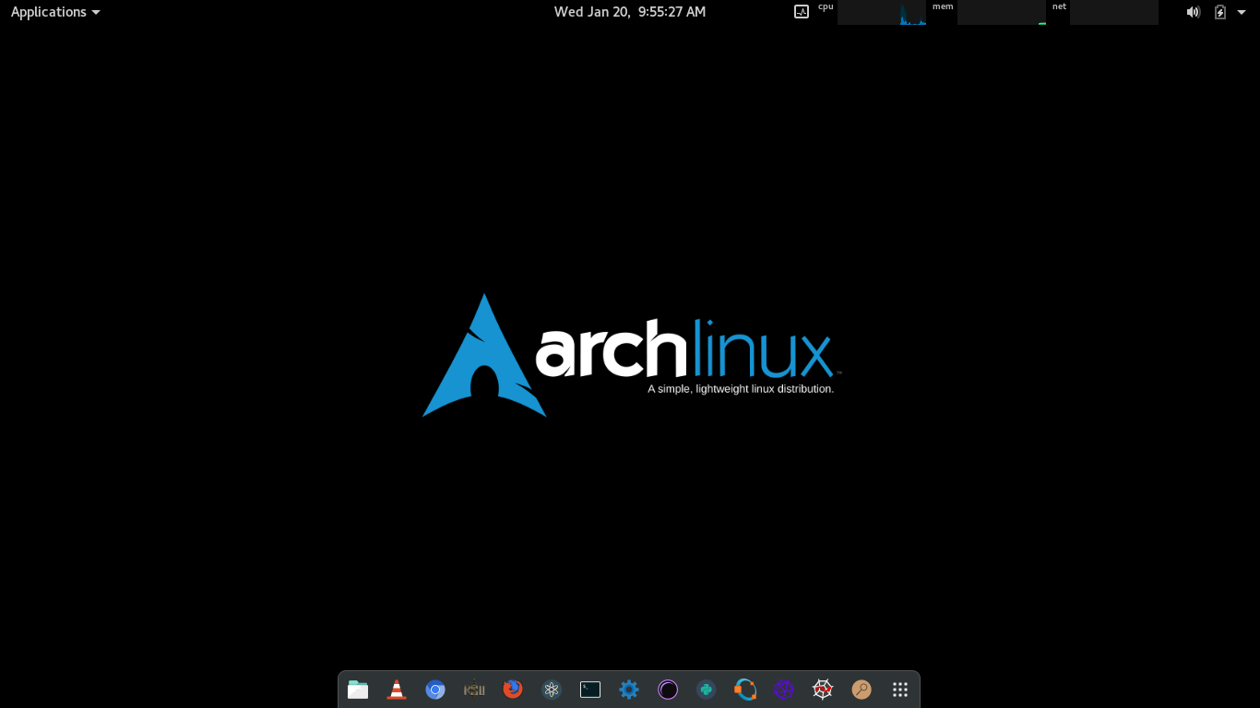
Questions
Better Options for Network Security Testing

