Slide 1
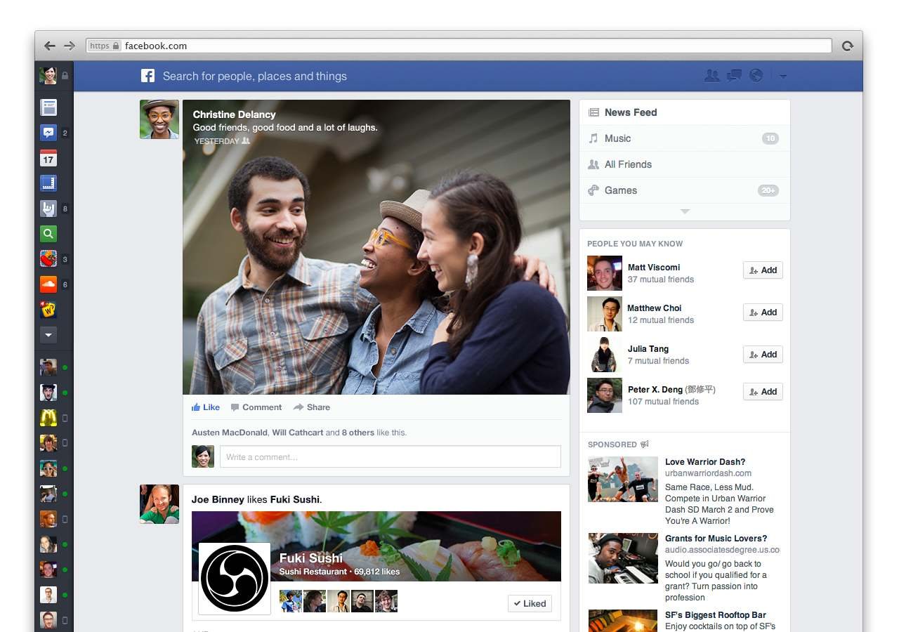


Facebook Newsfeed
Android study

Slide 2
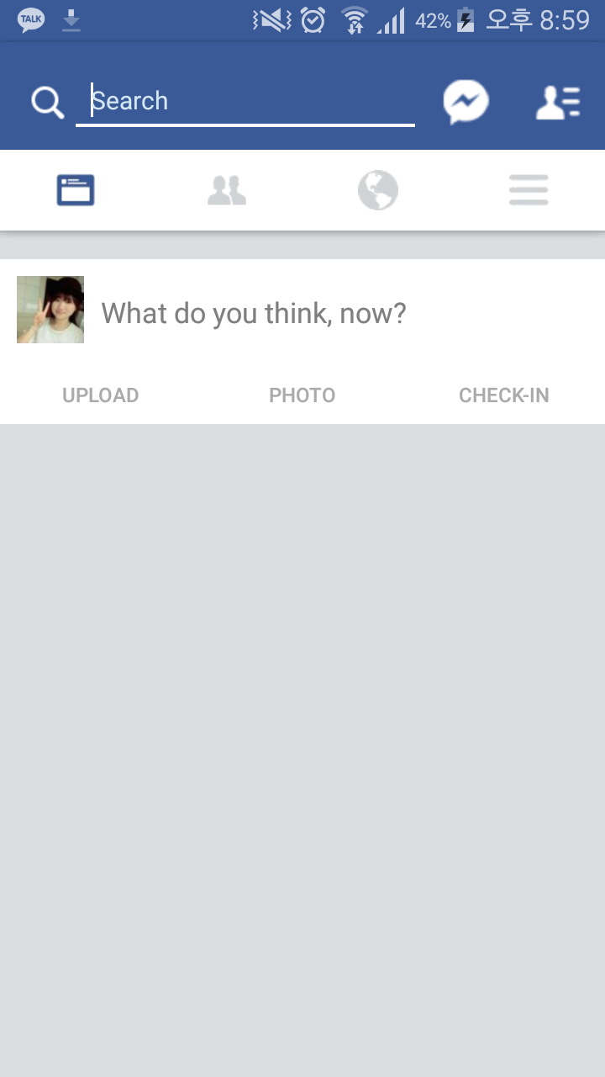
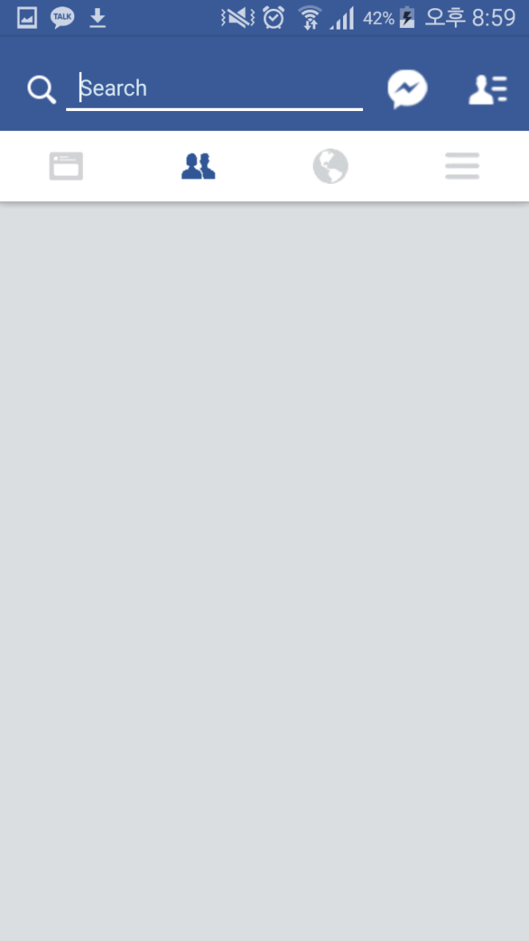
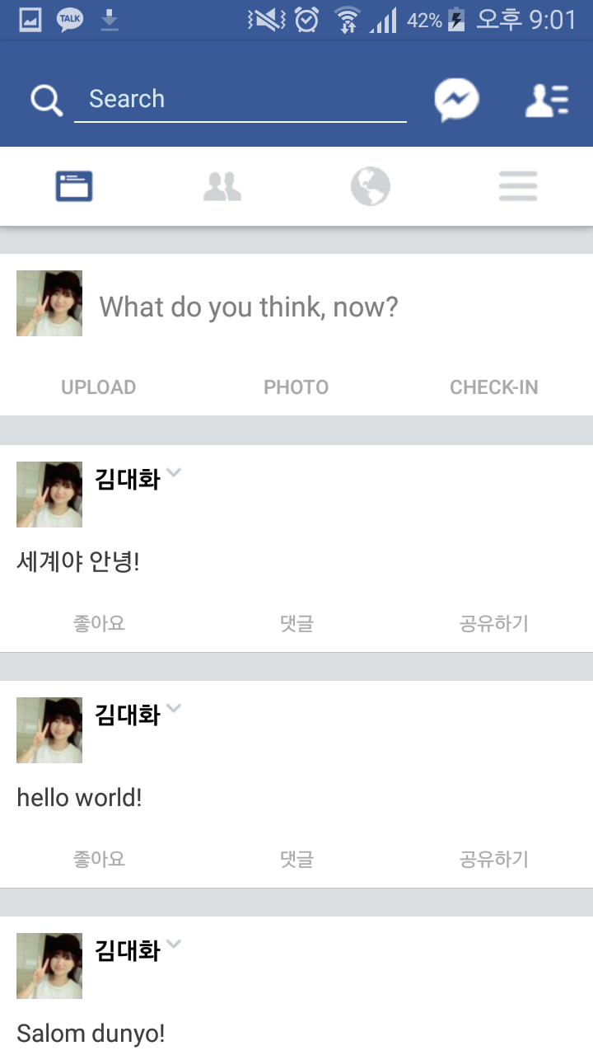
Goal
swipe

Slide 3
Making Tab

Slide 4
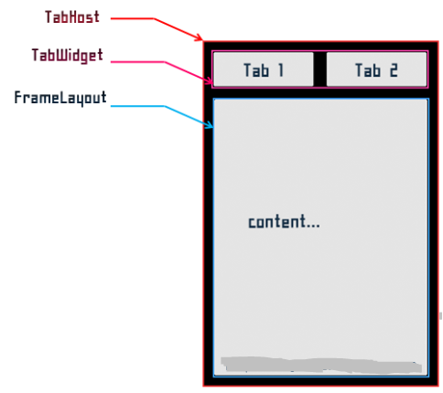
Tab has three component

Slide 5

TabWidget
FrameLayout
TabHost

Slide 6
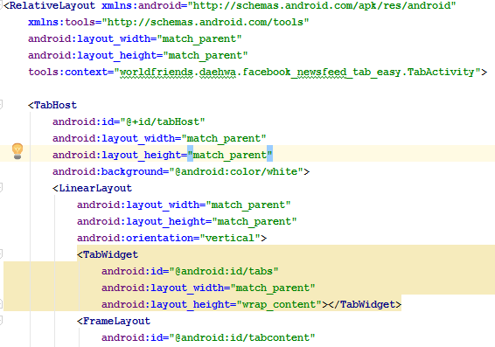

Slide 7


When we use image in drawable ,
We write “@drawable/nameOfImage”

Slide 8
We should use id defined in android
“@android:id/tabs”

Slide 9
ActionBar

Slide 10
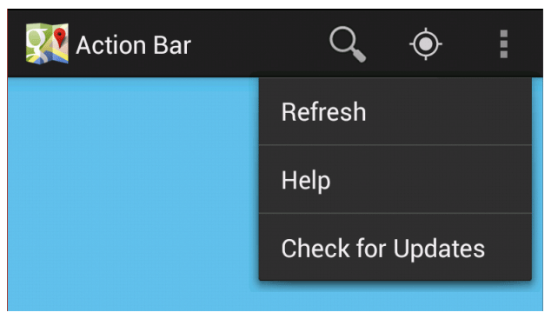

Slide 11
How can we access to ActionBar?
ActiocBar class

Slide 12
ActionBar class
setTitle(CharSequence str)
setDisplayShowCustomEnabled(bool tf) setCustomView(int resId) setDisplayHomeAsUpEnabled(bool tf)
setSubTitle(CharSequence str)
Show()
Hide() setBackgroundDrawable(Drawable d)

Slide 13
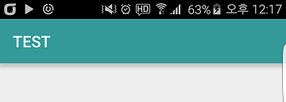
setTitle(“TEST”)

Slide 14

setTitle(“Actionbar”)
setSubTitle(“subtitle”)

Slide 15

setDisplayHomeAsUpEnabled(true)
setDisplayHomeAsUpEnabled(false)

Slide 16
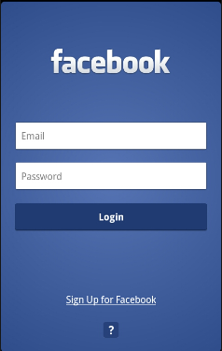
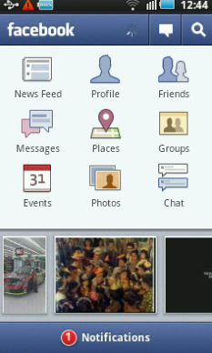
show() & hide()

Slide 17
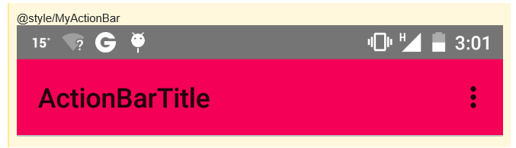
setBackgroundDrawable(Drawable d)

Slide 18
1
ActionBar mActionBar
=getActionBar();
mActionBar.someMethod();
2
getActionBar().someMethod();

Slide 19
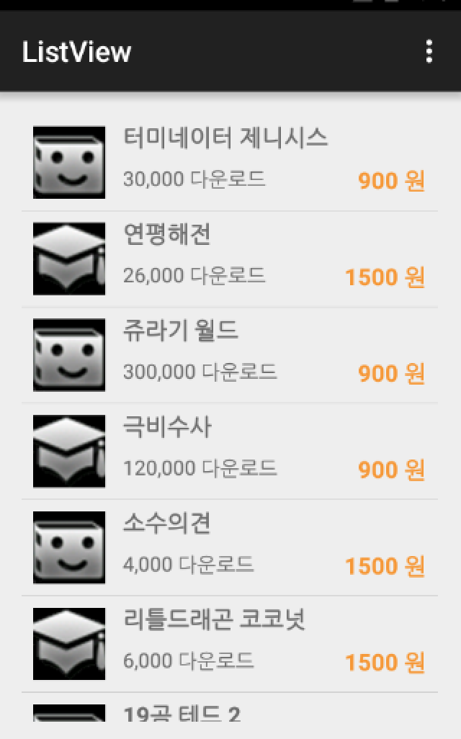
Custom?
Our main Activity
Custom item
Picture
Text

Slide 20
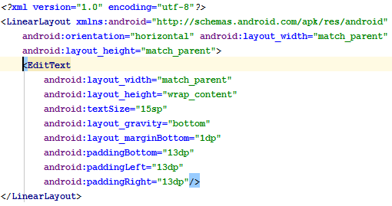
Here!

Slide 22


Slide 23



Slide 24
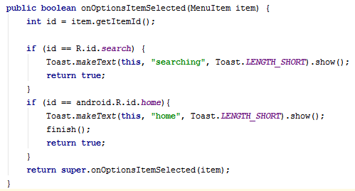

Slide 25
(Easy) Tab

Slide 26
Method of Class TabHost
setup()
newTabSpec(TabHost.TabSpec spec)
addTab(TabHost.TabSpec spec)
getTabWidget()
getCurrentTab();

Slide 27

setup()
Call setup() before adding tabs if loading TabHost using findViewById().

Slide 28
newTabSpec(TabHost.TabSpec spec)
Get a new TabHost.TabSpec associated with this tab host

Slide 29


0
1
2
3
TabWidget
And his Child!

Slide 30
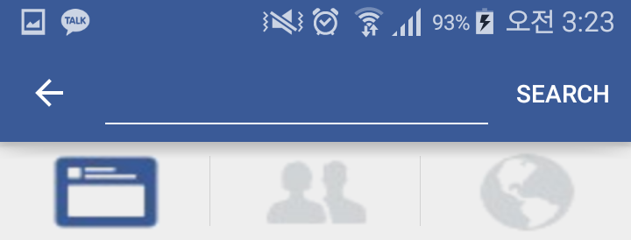
addTab(TabHost.TabSpec spec)

Slide 31
getCurrentTab()
0
1
2
3
int
here == 0

Slide 32
Method of Class TabHost.TabSpec
setIndicator(CharSequence label) setIndicator
(CharSequence label, Drawable icon)
setContent(int viewId)

Slide 33


setContent(R.id.friend)
Linking fragment

Slide 34
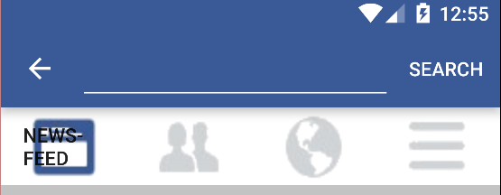
setIndicator(“NewsFeed”)

Slide 35
setOnTabChangedListener Interface
Do you remember 4 ways to using
onClickListener ?

Slide 36

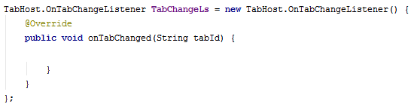
setOnTabChangedListener Interface

Slide 37
setOnTabChangedListener Interface
Determine whether Tab is changed or not
We should override a method
onTabChanged

Slide 38
setOnTabChangedListener Interface
The parameter tabId is

Slide 39

Download skeleton
https://github.com/daehwa/world-friends-Uzbekistan-android/

