Slide 1
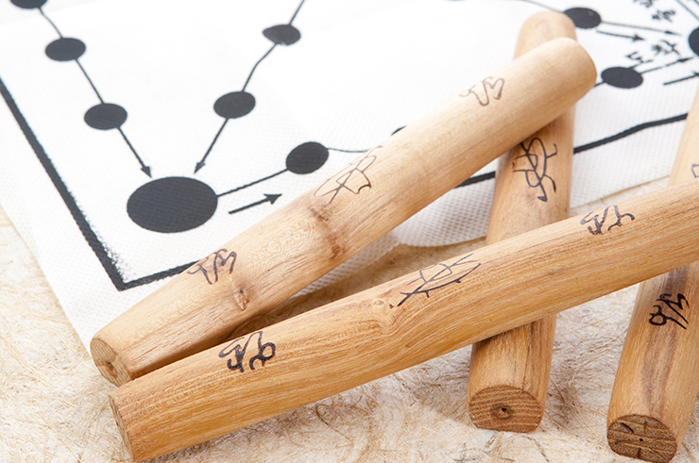


Korea Game Yut Play
Android study

Slide 2
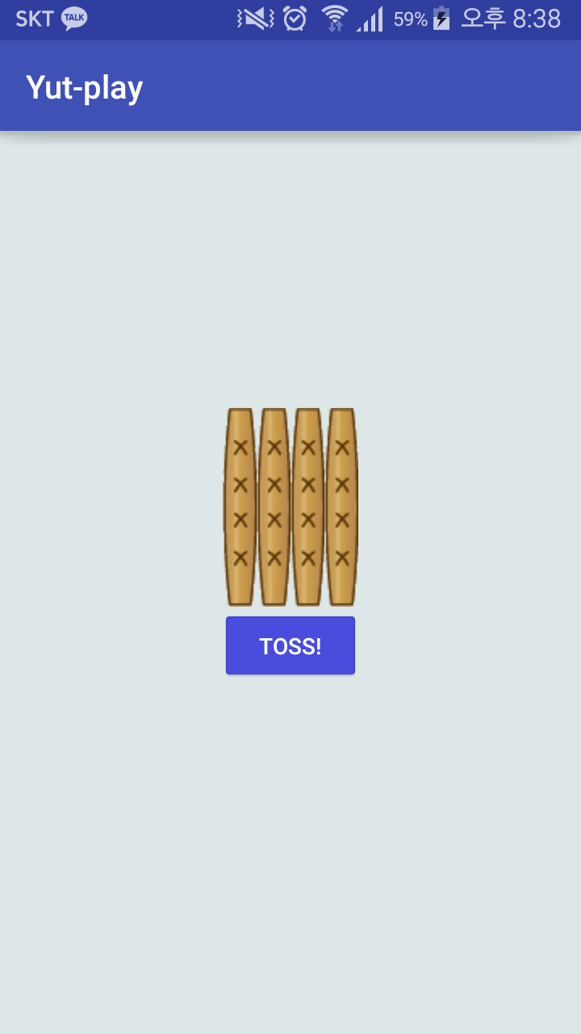
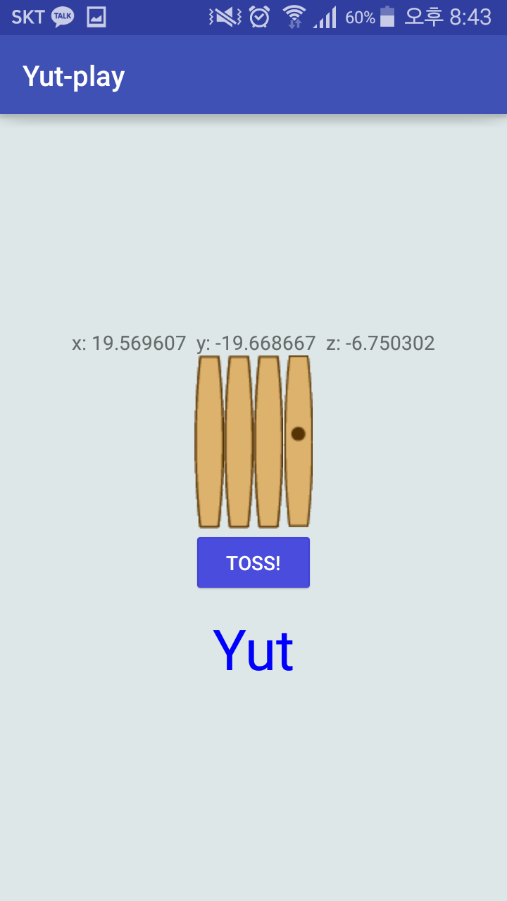
Goal

Slide 3
Random Class

Slide 4
Random Class
Constructor
Random()
Random(long seed)
Make object
Random random = new Random();
Method
nextInt(int n);
// Returns a pseudorandom, uniformly distributed int value between 0 (inclusive) and the specified value (exclusive), drawn from this random number generator's sequence.

Slide 5

Random Class
Constructor
Make object
Method

Slide 6
onResume & onPause

Slide 7


onResume and onPause

Slide 8
Sensor

Slide 9
SensorManager class
SensorManager lets you access the device's sensors.
Get an instance of this class by calling Context.getSystemService() with the argument SENSOR_SERVICE.

Slide 10
Method of SensorManager
getDefaultSensor(int type)
registerListener
(SensorEventListener listener, Sensor sensor, int samplingPeriodUs)
unregisterListener(SensorEventListener listener)
getSensorList(int type)
…

Slide 11
getDefaultSensor(int type)
Constant of Sensor class
TYPE_ACCELEROMETER
TYPE_ALL
TYPE_GYROSCOPE
TYPE_LIGHT
TYPE_ORIENTATION
TYPE_PRESSURE
TYPE_PROXIMITY
TYPE_TEMPERATURE
…

Slide 12
registerListener
(SensorEventListener listener, Sensor sensor, int samplingPeriodUs)
Constant of SensorManager
high
SensorManager.SENSOR_DELAY_FASTEST
SensorManager.SENSOR_DELAY_GAME
SensorManager.SENSOR_DELAY_NORMAL
SensorManager.SENSOR_DELAY_UI
low

Slide 13
unregisterListener(SensorEventListener listener)
unregisterListener
(SensorEventListener listener, Sensor sensor)

Slide 14
SensorEventListener

Slide 15
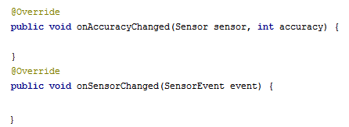
SensorEventListener interface
Used for receiving notifications from the SensorManager when there is new sensor data.

Slide 16
SensorEvent

Slide 17

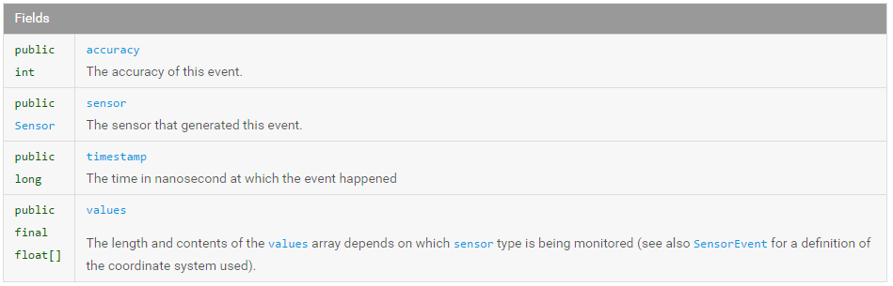
Field of SensorEvent

Slide 18
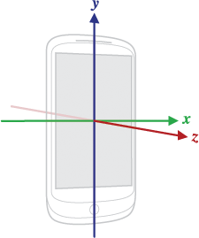
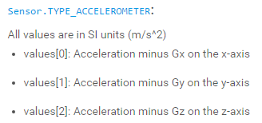
SensorEvent class

Slide 19
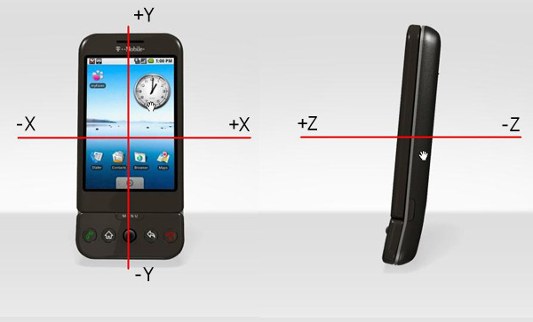
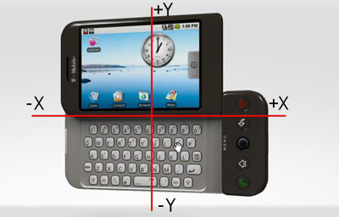

Slide 20
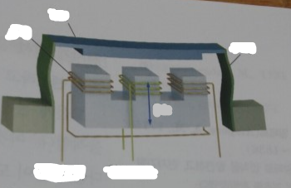
Principle of Accelerator Sensor
Piece of iron
coil
Spring
Vibration
Induced current
Outside current

Slide 21
timestamp | recordtime | accelerationX(g) | accelerationY(g) | accelerationZ(g)
1 | 0.1 | 0 | 0 | -1.000246
2 | 0.2 | 0 | 0 | -0.998568
3 | 0.3 | 0 | 0 | -0.999854
4 | 0.4 | 0 | 0 | -1.000074
5 | 0.5 | 0 | 0 | -1.000101
6 | 0.6 | 0 | 0 | -0.999568
7 | 0.7 | 0 | 0 | -0.996658
8 | 0.8 | 0 | 0 | -1.000245
9 | 0.9 | 0 | 0 | -1.000058
10 | 1 | 0 | 0 | -1.000778
Z

Slide 22
timestamp | recordtime | accelerationX(g) | accelerationY(g) | accelerationZ(g)
1 | 0.1 | -1.000246 | 0 | 0
2 | 0.2 | -0.998568 | 0 | 0
3 | 0.3 | -0.999854 | 0 | 0
4 | 0.4 | -1.000074 | 0 | 0
5 | 0.5 | -1.000101 | 0 | 0
6 | 0.6 | -0.999568 | 0 | 0
7 | 0.7 | -0.996658 | 0 | 0
8 | 0.8 | -1.000245 | 0 | 0
9 | 0.9 | -1.000058 | 0 | 0
10 | 1 | -1.000778 | 0 | 0
X

Slide 23
timestamp | recordtime | accelerationX(g) | accelerationY(g) | accelerationZ(g)
1 | 0.1 | 0 | -1.000246 | 0
2 | 0.2 | 0 | -0.998568 | 0
3 | 0.3 | 0 | -0.999854 | 0
4 | 0.4 | 0 | -1.000074 | 0
5 | 0.5 | 0 | -1.000101 | 0
6 | 0.6 | 0 | -0.999568 | 0
7 | 0.7 | 0 | -0.996658 | 0
8 | 0.8 | 0 | -1.000245 | 0
9 | 0.9 | 0 | -1.000058 | 0
10 | 1 | 0 | -1.000778 | 0
Y

Slide 24
SoundPool

Slide 25
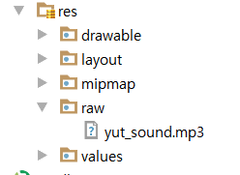

Slide 26
SoundPool class
The SoundPool class manages and plays audio resources for applications
Constructor of SoundPool class
SoundPool
(int maxStreams, int streamType, int srcQuality)

Slide 27
AudioManager class
AudioManager provides access to volume and ringer mode control.
ADJUST_MUTE
ADJUST_LOWER ADJUST_RAISE
STREAM_MUSIC STREAM_ALARM
…

Slide 28
Method of SoundPool
play(int soundID, float leftVolume, float rightVolume, int priority, int loop, float rate)
pause(int streamID)
resume(int streamID)
stop(int streamID)
load(String path, int priority) load(Context context, int resId, int priority)

Slide 29
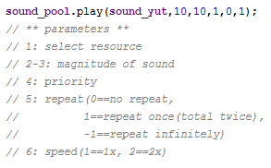
play
(int soundID, float leftVolume, float rightVolume, int priority, int loop, float rate)

Slide 30
resume(int streamID)
pause(int streamID)

Slide 31
Load
(Context context, int resId, int priority)
Return type : int

Slide 32

Download skeleton
https://github.com/daehwa/world-friends-Uzbekistan-android/

