Slide 1
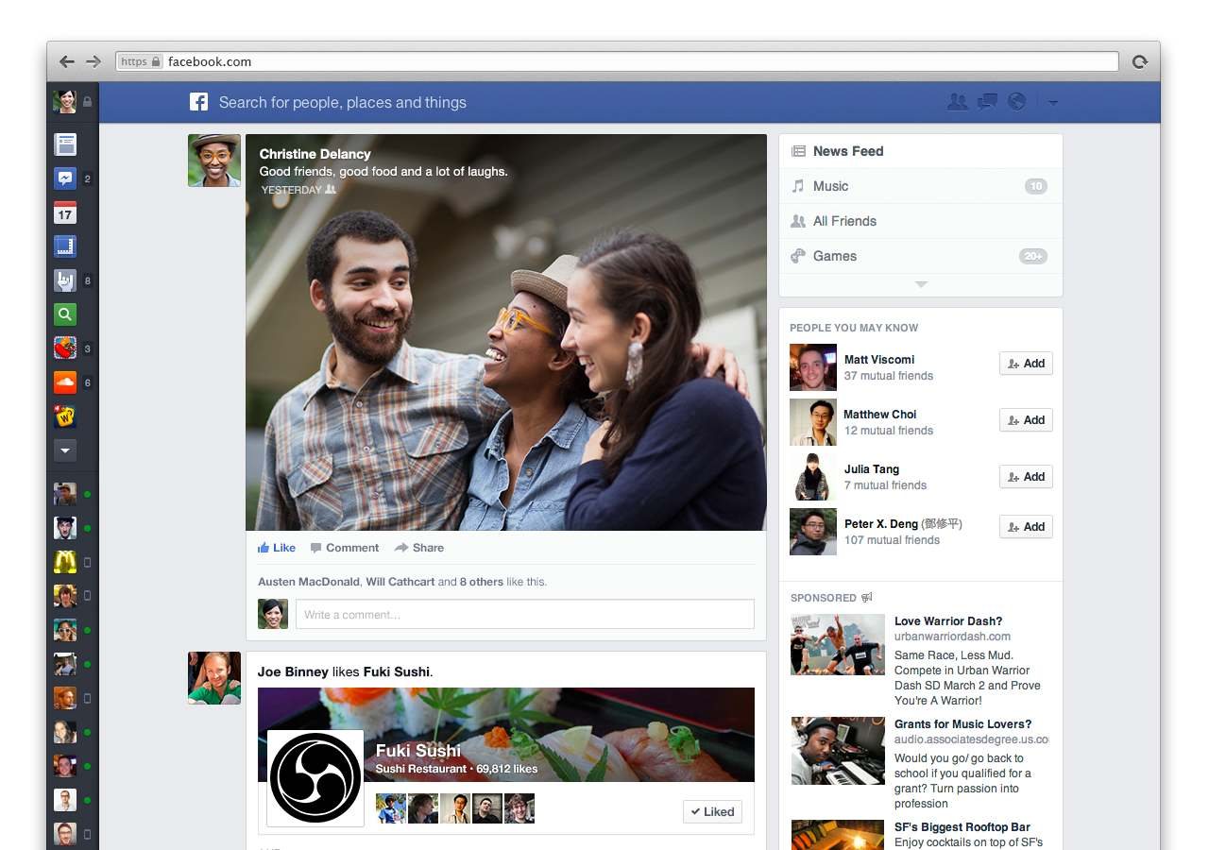
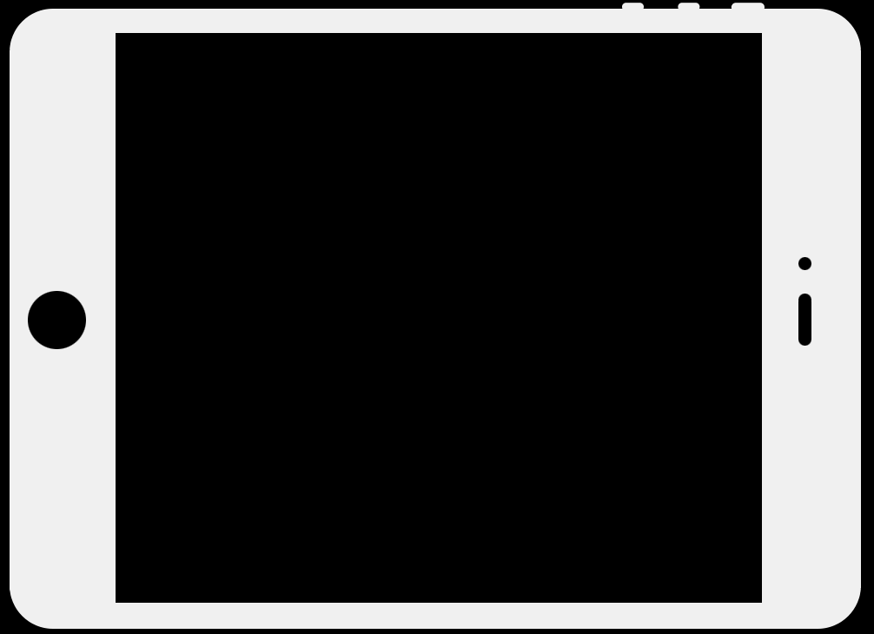

Facebook Newsfeed
Android study

Slide 2
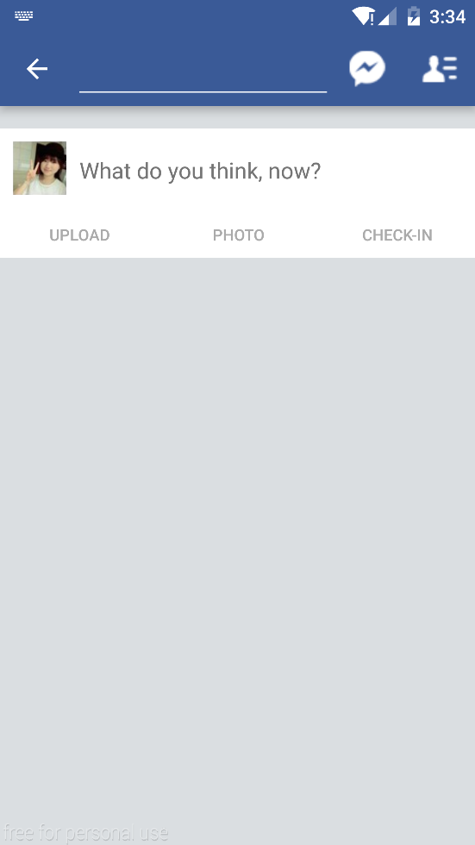
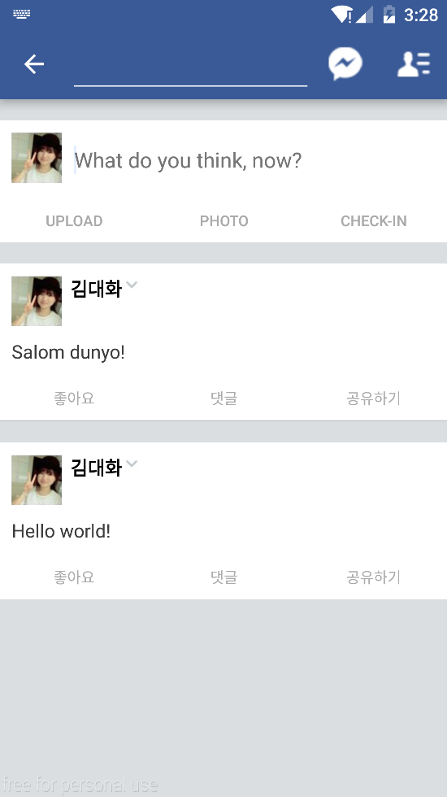
Goal

Slide 3
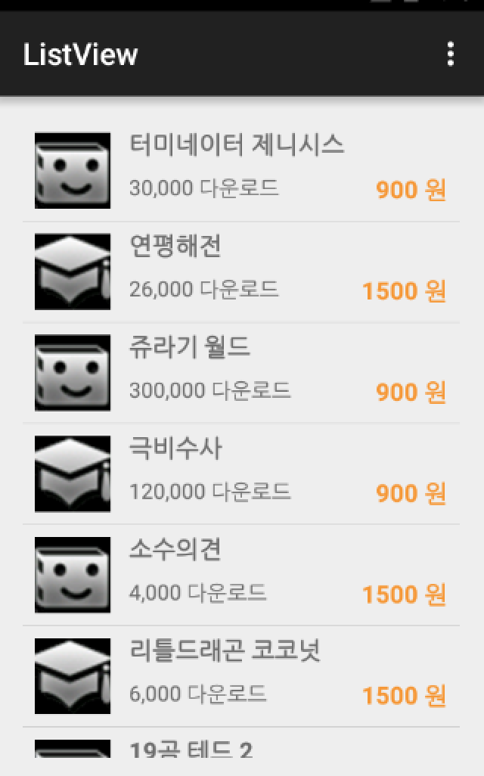
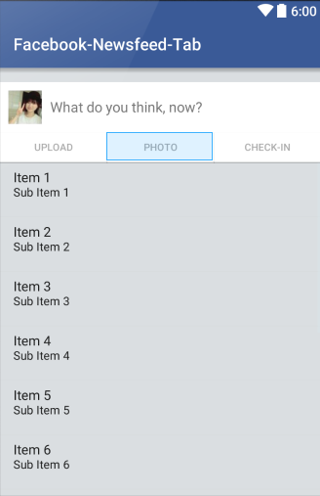
ListView

Slide 4
Custom layout
Our main Activity
Custom item
Picture
Text

Slide 5
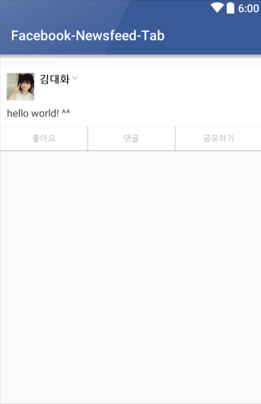

Custom layout

Slide 6
PostedItemData

Slide 7
Making our own Class
named “PostedItemData”
Recall ordinary function of Class

Slide 8
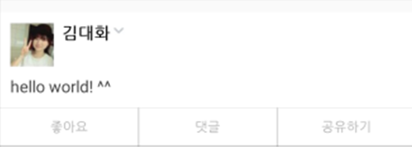
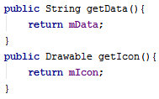

The data of this one box is object of PostedItemData Class

Slide 9
PostedItemView

Slide 10
Default Constructor
If we do not use constructor,
then default constructor is called in some cases.

Slide 11
LinearLayout Class
A Layout that arranges its children in a single column or a single row.

Slide 12

LinearLayout Class
Consturtor
LinearLayout(Context context)

Slide 13
LayoutInflater
Instantiates a layout XML file into its corresponding View objects.
To retrieve a standard LayoutInflater instance that is already hooked up to the current context and correctly configured for the device you are running on.

Slide 14


The form of this one box is object of PostedItemView Class

Slide 15
PostedItemAdapter

Slide 16
Adapter
ListView
Our List
Adapter
Data
Adapter View

Slide 17

Adapter
It binds Data and User Interface
using get View
Data
Data Adaptor
getView()

Slide 18
BaseAdapter
We are making our new adapter.
We need some basic components of Adapter
So our class extends parents class; BaseAdapter

Slide 19

BaseAdapter

Slide 20
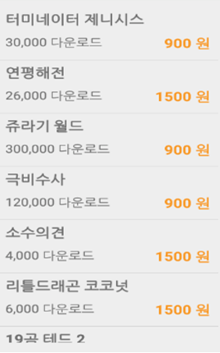
getView
(int pos, View convertView, ViewGroup parent)
Get a View that displays the data at the specified position in the data set.
This method is called when new list is scrolled
because list is created everytime when you scroll

Slide 21
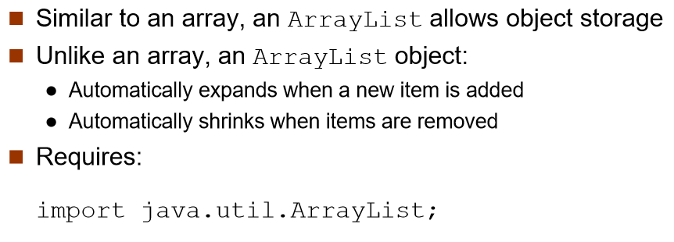
ArrayList

Slide 22
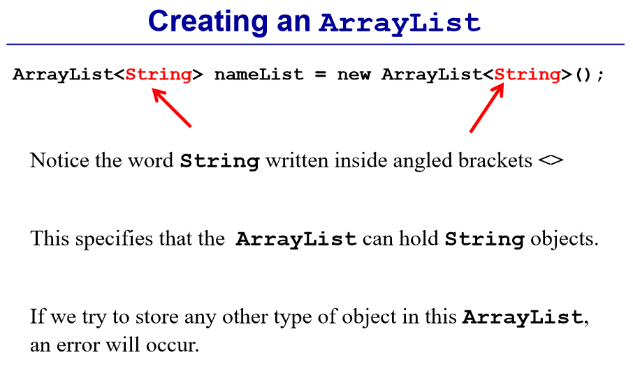
ArrayList

Slide 23
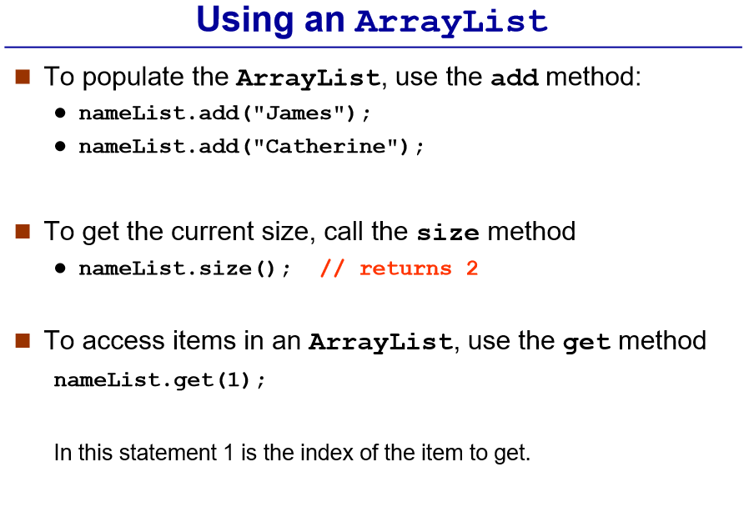
ArrayList

Slide 24
ArrayList

Slide 25



ArrayList

Slide 26

add of ArrayList

Slide 27
MainActivity

Slide 28




Slide 29
File IO

Slide 30

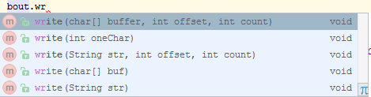
OutputStream
File Writing
BufferedWriter

Slide 31
File Writing
Constructor of BufferedWriter
BufferedWriter(Writer out)
Creates a buffered character-output stream that uses a default-sized output buffer.

Slide 32

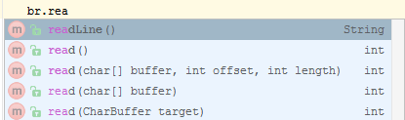
File Reading
InputStream
BufferedReader

Slide 33

Download skeleton
https://github.com/daehwa/world-friends-Uzbekistan-android/

