Slide 1
FLEXDROID: Enforcing In-App Privilege Separation in Android
Jaebaek Seo*, Daehyeok Kim*, Donghyun Cho*, Taesoo Kim†, Insik shin*
* KAIST
† Georgia Institute of Technology
Notes:
Good afternoon! My name is Jaebaek Seo from KAIST.
Today I will present FLEXDROID which provides in-app privilege separation in Android.
This is a joint work between KAIST and GA Tech.

Slide 2








3rd-party libraries become popular in Android
Application
Host code
How can we trust them?
3rd-party libraries
Ad, Analytics, Game engine, Billing, Social
Notes:
In these days, third-party libraries become popular in Android.
Android app developers adopt various third-party libraries in their apps such as ad, analytics, in-app billing and so on.
However, how can we trust them?

Slide 3

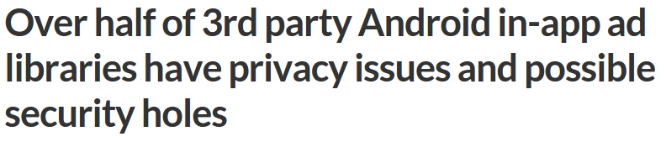



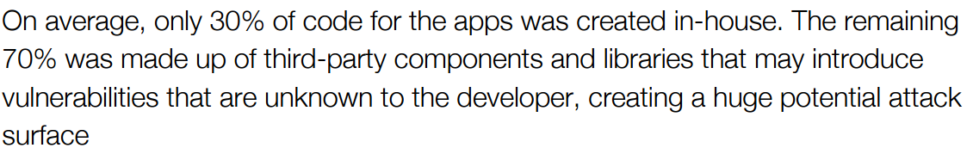
In NDSS 16
The Price of Free: Privacy Leakage in Personalized Mobile In-Apps Ads
What Mobile Ads Know About Mobile Users
Free for All! Assessing User Data Exposure to Advertising Libraries on Android
Fundamental problem in Android’s permission system
Notes:
Actually, we can’t. Many articles report the privacy issues of third-party libraries in Android.
Indeed, this is a fundamental problem of Android permission system.
Why Android permission system has this problem?

Slide 4
Problem: Android Permission System
The unit of trust in Android: Application
Location
<uses-permission ...Location>
<uses-permission ...Contacts>
App
Contacts
Denied
Calendar
Notes:
This is because the unit of trust in Android is an app,
which means an app can access a resource only when it has the corresponding permission.
On the other hand, when an app accesses a resource out of its permissions, Android denies it.

Slide 5
Problem: Android Permission System
Third-party library: having the same access right as the host app
A third-party library can abuse the permissions of its host app
<uses-permission ...Location>
<uses-permission ...Contacts>
App
Location
3rd-party lib
Contacts
(The unit of trust)
Notes:
Because a third-party library is a part of an app, Android grants all permissions of its host application to the third-party library,
So a third-party library can access all resources that are granted to its host application
Which introduce potential permission abuses of third-party libraries.

Slide 6
FLEXDROID
Goal: In-app privilege separation between a host application and its third-party libraries
Notes:
To solve this problem, in our research, we aim to design an extension of Android permission system that provides privilege separation between a host application and its third-party libraries.

Slide 7
Overview of FLEXDROID
Specifying the package name and its permissions in AndroidManifest.xml
<uses-permission ...Location>
<uses-permission ...Contacts>
Location
App
com.ad.sdk
com.ad.sdk
Deny
Contacts
<flexdroid android:name=“com.ad.sdk” >
<allow …Location>
</flexdroid>
Notes:
In the current Android, an app developer cannot set the required permissions of each third-party library.
In contrast, FLEXDROID allows an app developer to specify required permissions of each third-party library by providing XML based policy.
In FLEXDROID, a third-party library can use only the permissions specified in the policy.

Slide 8
Contributions
Report potential privacy threats of third-party libraries by analyzing 100,000 real-world Android apps
Provide an in-app privilege separation in Android
Supporting JNI, reflection, and multi-threading
Adopt a fault isolation using ARM Memory Domain to sandbox native code in Android
Notes:
Here are our contributions.
We analyze real-world Android apps from Google Play to investigate potential privacy threats from third-party libraries and dynamic behaviors of them.
Based on the analysis, we designed a solution to provide an in-app privilege separation in Android, while supporting JNI, reflection, and multi-threading.
In particular, to enable the defense against attacks via JNI, we suggest a fault isolation using ARM Memory Domain to sandbox native code of third-party libraries.

Slide 9
Investigating Real-world Threats
Investigate 100,000 Android apps from Google Play using a static analysis
Q1: How many third-party libraries use undocumented permissions?
Q2: How many of them rely on dynamic code execution?
Notes:
We investigated one hundred thousand Android apps to check out privacy threats from real-world third-party libraries and to get intuitions for designing a solution.
We mainly focused on how many third-party libraries use undocumented permissions and how complicate their behaviors are at runtime.

Slide 10
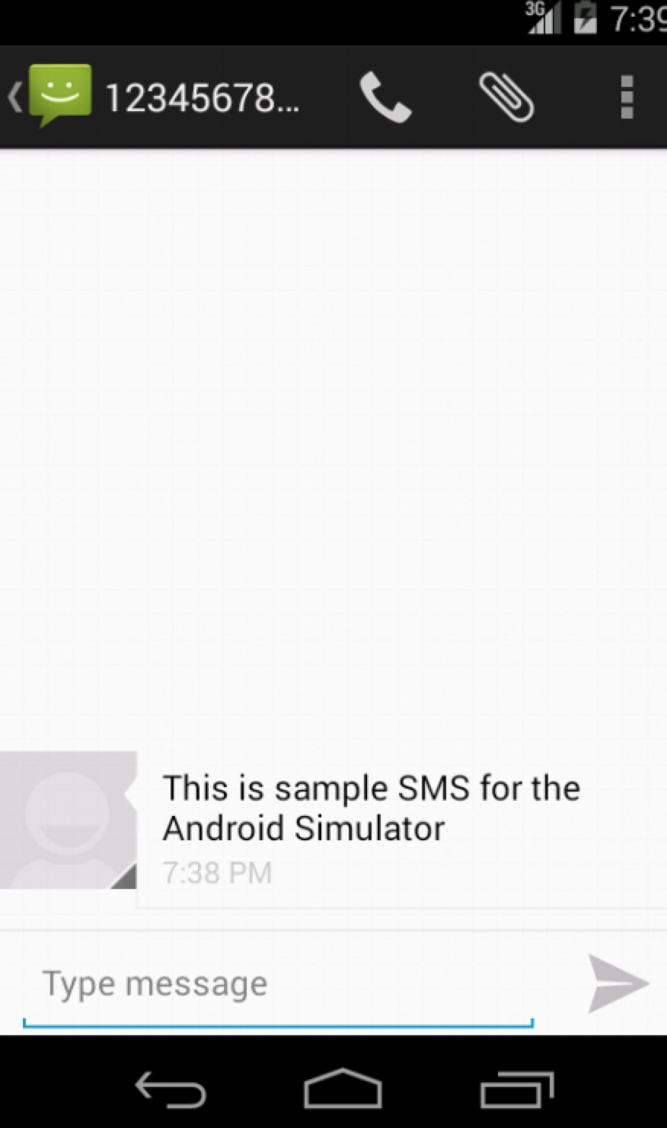
Undocumented Permissions
Required
Phone Information
Location
Internet
R/W SMS
Optional
Undocumented
From XXXBank: Your One-Time Password is 34819. Valid for 5 mins.
Facebook (Social)
Flurry (Analytics)
Paypal (Billing)
InMobi (Ad)
Chartboost (Ad)
Notes:
We found that some third-party libraries contain code to invoke Android APIs which require some Android permissions.
In this table, the red colored X denotes the undocumented permissions which are not specified in the documents of third-party libraries.
Note that the target apps of this analysis were crawled around 2013, so some information can be inconsistent with the current version of third-party libraries.
In particular, a third-party library can exploit “read SMS” permission to leak some critical private data like SMS OTP.
For an app developer, this can be a serious problem.
Even though the app developer does not actually intend the malicious behavior, the app looks like malicious because of its third-party library.

Slide 11
Analysis of Real-World Apps
Control-flow and data dependency
Class Inheritance
Dynamic runtime behavior
Java Native Interface (JNI)
Runtime class loading
Reflection
71.5%
17.1%
27.9%
49.6%
Notes:
As another result of the investigation,
we discovered that many classes in host applications inherit classes of third-party libraries.
In addition, third-party libraries intensively use complicated runtime behaviors such as JNI, runtime class loading and reflection.

Slide 12
Challenges
Control-flow and data dependency
→ Naïvely separating third-party libraries from the host app is not applicable
Dynamic runtime behavior
→ Statically or dynamically detecting malicious behaviors introduces low accuracy
Notes:
The analysis results introduce two system design challenges.
First, because of strong dependency between a host application and its third-party libraries, we cannot easily separate the code of each third-party library from its host application.
Second, because of dynamic and complex runtime behaviors of third-party libraries, it is hard to accurately detect malicious behaviors of third-party libraries.

Slide 13
Threat Model
Potentially malicious third-party libraries
Obfuscated code and logic
Use of dynamic features (e.g., JNI, reflection, multi-threading)
App developers specifying permissions of each third-party library
Notes:
Before going further, I will give you the assumption of our research.
We assume third-party libraries as strong attackers.
Their code and logic are obfuscated.
Additionally, they use dynamic Java language features such as JNI, reflection and multi-threading.
We also assume that app developers exactly know the permissions needed by each third-party library,
So that they can specify the required permissions of each third-party library in the manifest file.

Slide 14
System design
Notes:
Now I will explain the system design of FLEXDROID

Slide 15
Key Idea
Adjusting permissions dynamically
whenever an app requests a resource
Notes:
The key idea is to dynamically adjust the permissions of an app at the runtime, whenever an app requests a resource.
To do so, FLEXDROID maintains a set of permissions for each third-party library specified in the policy.

Slide 16
Dynamic Permission Adjustment
When executing the host application’s code
When executing the 3rd-party lib’s code
Permissions of host application
Location
Contacts
Permissions of host application
Location
Contacts
App Permissions
Permissions of third-party library
Location
Permissions of third-party library
Location
App Permissions
Notes:
When executing the host application’s code, the permissions granted to the host application become the permissions of the app.
On the other hand, when executing the third-party library’s code, the permissions granted to the third-party library become the permissions of the app.
Then how does FLEXDROID know which code is currently executed?

Slide 17
Identification of Executed Code
Identify the principal using stack inspection
Apply the stack inspection to Android
Protect the integrity of call stack information against attacks via:
JNI
Reflection
Multi-threading
Notes:
FLEXDROID identifies the principal of the running code using stack inspection.
We apply the stack inspection to Android with the consideration of Android’s system architecture.
Moreover, FLEXDROID guarantees the integrity of call stack information against attacks, particularly, via JNI, reflection and mutli-threading.

Slide 18
Stack Inspection in Security Context
Process of determining the permissions allowed to the current thread according to principals shown in the call stack
 | P | Call stack
⬇ | A | com.A.functionA
 | B | com.B.functionB
 | C | com.C.functionC
Perm = Perm(A) ∩ Perm(B) ∩ Perm(C)
Notes:
In the view of security, the stack inspection is the process of determining the permissions allowed to the current thread by inspecting the call stack.
For example, suppose that there are three principals A, B, and C in the call stack.
We can decide the current permissions by intersecting permissions of A, permissions of B, and permissions of C.

Slide 19
Inter-process Stack Inspection
Permission Checker
App
LocationManager
PM
Dalvik
Dalvik
Dalvik
User Space
Kernel Space
File Sysm
Internet
SD Card
Permission Checker
Notes:
In Android, permission checkers such as Package Manager and kernel Access Control List checker reside out of the user process,
while the traditional Java process contains the permission checker.

Slide 20
Inter-process Stack Inspection
Permission Checker
App
LocationManager
PM
Dalvik
Dalvik
Dalvik
Stack Tracer
User Space
Kernel Space
File Sysm
Internet
SD Card
Stack Transmission Channel
Notes:
Which means an inter-process communication is needed to deliver the call stack information to the permission checker.
To do so, we create a thread called stack tracer in the Dalvik virtual machine, which gathers the call stack information and send it to the permission checker.
We also create a secure IPC channel called stack transmission channel to transfer the call stack information.

Slide 21

Potential Attack Surface
Reflection
Multi-threading
App
LocationManager
PM
JNI
Dalvik
Dalvik
Dalvik
Stack Tracer
User Space
Kernel Space
Stack Transmission Channel
Notes:
However, third-party libraries also reside in the user address space.
Which means a malicious third-party library can manipulate the call stack using JNI.
Furthermore, the third-party library can compromise the call stack by attacks via reflection and multi-threading.

Slide 22
Potential Attack Surface
Compromising stack tracer
Manipulating Dalvik call stack
Hijacking the control data
e.g., code injection on Dalvik functions, manipulating code pointers
JNI
JNI, Reflection, Multi-threading
JNI
Notes:
Here, I categorize the potential attack surfaces.
The attacker can compromise the stack tracer, manipulate the call stack, and hijack the control data.
These attacks can compromise the integrity of the call stack information.
Because these attacks can be performed via JNI, reflection, and multi-threading,

Slide 23

Protecting Integrity of Call Stack
JNI Sandbox
Defense mechanism against attacks via reflection
Defense mechanism against attacks via multi-threading
JNI Sandbox
Defense mechanism against attacks via reflection
Defense mechanism against attacks via multi-threading
Notes:
We design three defense mechanisms against attacks via these techniques.
Due to the time limitation, I will introduce only JNI sandbox and defense mechanism against attacks via reflection.
Please refer to our paper for the multi-threading issue.

Slide 24
JNI Sandbox
Inspired by ARMlock (CCS’14), applying Fault Isolation using ARM Memory Domain to Android
Key Idea
Regard JNI code of 3rd-party libraries as potentially malicious code
Run JNI in an isolated and restricted memory domain
Notes:
We build JNI sandbox to run JNI code in an isolated memory domain.
To enable this, we apply fault isolation using ARM Memory Domain to Android.

Slide 25
Fault Isolation using ARM Memory Domain
App address space
libc.so
libdvm.so Heap
Stack
Thread Local Storage (TLS)
…
FLEXDROID allows Dalvik VM to access both memory domains
by setting Domain Access Control Register of each thread
libjpeg.so
libimage.so
libad.so
…
Domain Fault
Dalvik VM
JNI code
JNI code
Java domain
JNI domain
Notes:
When an app is initially launched, there is only Java domain in the user address space.
The domain contains all memory objects required to run Dalvik virtual machine, such as shared libraries, heap, stack, and thread local storage.
When the Dalvik interpreter meets the byte code to execute a JNI method, it invokes a system call of FLEXDROID to reserve the JNI domain, and then loads the JNI code into the domain.
FLEXDROID allows Dalvik virtual machine to access both memory domains.
On the other hand, FLEXDROID allows JNI code to access only JNI domain by setting Domain Access Control Register, which is a specialized ARM register to enforce the access control for domains.
If JNI code attempts to access memory of Java domain, a domain fault occurs.

Slide 26
Memory and Shared Libraries for JNI
App address space
libc.so
Heap
Stack
TLS
…
Stay in Java domain!!
Java domain
JNI domain
Notes:
The introduced JNI sandbox successfully denies malicious memory access from JNI code,
But it also prevents JNI code from accessing required memory objects like libc and heap.
This is because the memory objects stay in Java domain.

Slide 27
Memory and Shared Libraries for JNI
Shared libraries (e.g., libc.so), heap, stack and TLS are in Java domain
JNI cannot access them
→ FLEXDROID provides JNI with independent shared libraries, heap, stack and TLS
Notes:
Which implies JNI cannot access them.
To solve this problem, FLEXDROID provides JNI code with independent shared libraries, heap, stack and thread local storage.

Slide 28
Defense against Reflection
Problem: A third-party library can dynamically generate a class with the package name of its host application
package com.malicious.lib
class A
method launch_attack
generateClass(“com.host.B”)
generateClass(“com.host.B”, “malFunction”)
loadClass(“com.host.B”)
com.host.C.setCallback(new com.host.B())
end method
end class
 | P | Call stack
⬇ | H | com.host.C.runCallback
 | L | com.host.B.malFunc
com.malicious.lib
FLEXDROID maintains the information of class loader
Notes:
Now I will explain the defense mechanism against attacks via reflection.
By reflection, a malicious third-party libraries can dynamically generate a class with the package name of its host application.
For example, in this code, a malicious third-party library can generate a class and a method with the package name of its host application to pretend to be its host application.
Later, when calling the generated method, there is only the principal of the host application in the call stack, but no information about the third-party library.
Therefore, the code generated by the third-party library can access resources as its host application code does.
To prevent malicious third-party libraries from using reflection to circumvent the stack inspection, FLEXDROID maintains the information of class loader.

Slide 29
Implementation
Android 4.4.4 Kitkat / Linux 3.4.0
 | # of Files | Insertion (LoC) | Deletion (LoC)
Kernel | 28 | 1831 | 25
Android Framework | 46 | 1466 | 77
Dalvik VM | 24 | 6081 | 22
Bionic | 23 | 2827 | 70
Others | 12 | 95 | 24
Total | 133 | 12300 | 218
Notes:
We implemented FLEXDROID on the top of Android Kitkat.
In total, we add more than ten thousand lines of code from one hundred thirty three files.
We mainly engineered Dalvik VM, dynamic linker, libc, kernel, and Android Framework.

Slide 30
evaluation
Notes:
Now I will show you our evaluation result

Slide 31
Overview
How effective is FLEXDROID’s policy to restrict third-party libraries?
How easy is it to adopt FLEXDROID’s policy to existing Android apps?
How much performance overhead does FLEXDROID impose when adopted?
Notes:
In our evaluation, we mainly focus on the effectiveness, the usability, and the performance overheads of FLEXDROID

Slide 32
Blocking Permissions with FLEXDROID
Choosing 8 third-party libraries from real-world apps
Repackaging their host applications with FLEXDROID policy
No permission given to third-party libraries
→ Denying all accesses to resources from third-party libraries
FLEXDROID can block permission abuses of 3rd-party libs
Notes:
First, to check if FLEXDROID effectively blocks the permission abuses of third-party libraries, we choose 8 real-world third-party libraries.
By repackaging their host applications with FLEXDROID policy, we do not give any permission to the third-party libraries, and observe what happen.
As a result, all accesses to resources from the third-party libraries are denied accordingly,
Which means, FLEXDROID can effectively block permission abuses of third-party libraries.

Slide 33
Blocking Permissions with FLEXDROID
By modifying only AndroidManifest.xml
→ Easy to adopt FLEXDROID’s policy
<flexdroid android:name=“com.ebay.redlasersdk”>
<!-- no permission -->
</flexdroid>
Notes:
Moreover, in this experiment, we only updated the manifests of the apps to add FLEXDROID policy.
This implies an app developer can easily use the FLEXDROID without any modification on the code and logic of the app.

Slide 34
Backward Compatibility
Run 32 popular apps from Google Play without any modification in FLEXDROID
Check to see if each of them crashes during the execution
→ 27 of 32 apps run as normal
Other apps crashed due to JNI sandbox
→ FLEXDROID has a high backward compatibility
Notes:
We also conduct a backward compatibility test.
We download 32 popular apps from Google Play and run them in FLEXDROID without any modification.
As a result, 27 of them run as normal, which means FLEXDROID has a high backward compatibility.

Slide 35
Performance Evaluation
Environment setting
Nexus 5
Turning on all cores with maximum CPU frequency
Micro-benchmark
Macro-benchmark
K-9 email app
Notes:
Now I will explain the performance evaluation.
We turned on all cores and fixed their frequencies as maximum to avoid interference from other system components such as system daemon.
We test both micro-benchmark and macro-benchmark.

Slide 36
Micro-benchmark Result
Main factors of performance overheads
Inter-process stack inspection
Sandbox switch (i.e., switch to JNI domain / Java domain)
→ 438 ~ 594 μs
→ 89 μs
Notes:
There are mainly two factors of performance overheads in FLEXDROID comparing to the current Android.
The first one is inter-process stack inspection, which impose less than 600 micro second overhead.
The second one is sandbox switch between JNI and Java domains, which gives less than 90 micro second overhead.

Slide 37
Macro-benchmark Result
In the experiment using K-9 email app
Launching the app
Send an email
→ 1.55 %
→ 1.13 %
FLEXDROID incurs reasonable performance overheads
Notes:
In K-9 email app, which a popular open-source email app, the performance overhead is less than 2 %.
Moreover, we also performed an experiment with our custom apps and the result showed less than 2.3 % of overhead.
This means FLEXDROID incurs reasonable performance overheads.

Slide 38
Conclusion
Problem: Privacy threats from 3rd-party libraries
FLEXDROID: Extension of Android permission system
Supporting in-app privilege separation
Resistant against attacks via JNI, reflection and multi-threading
Showing reasonable performance overheads
Notes:
In conclusion, we aim to design a solution defending against the privacy threats from third-party libraries.
We propose an extension of Android permission system, FLEXDROID, which supports an in-app privilege separation,
While resisting against attacks via JNI, reflection and multi-threading.
Our evaluation verifies that FLEXDROID can block permission abuses of third-party libraries.
In addition, FLEXDROID incurs reasonable performance overheads.

Slide 39
Thank you!
Notes:
Thank you for listening and I will take your questions.

Slide 40
Backward Compatibility Issues
5 crashed apps
Waze Social GPS Map & Travel
Uber
Adobe Acrobat Reader
Facebook
UC Browser
Pthread / TLS
mmap()
free()
Many JNI libraries (29 and 20, respectively) → too complicated to manually analyze them

Slide 41
Previous Works
AdRisk (Wisec’ 12)
Report private threats from ad libraries
AdSplit (Usenix Sec’ 12) / AdDroid (AsiaCCS’ 12)
Separate an ad library from its host app
NativeGuard (WiSec’ 14)
Separate a library written in native code from its host app
Compac (CODASPY’ 14)
Suggest an idea similar to inter-process stack inspection

Slide 42
Fault Isolation / Java API / Trampoline

