Slide 1
Multi-rate Combination of Opportunistic Routing and Network Coding : An Optimization Perspective
Daehyeok Kim and Young-Joo Suh
Pohang University of Science and Technology

Slide 2

Motivation
Broadcast nature of wireless medium
Opportunistic listening
Exploiting the broadcast nature
Opportunistic routing
Network coding
Notes:
In the wireless communication, every nodes in transmitter’s transmission range can overhear transmitted packets.
Using this broadcast nature of wireless medium, there are two representative approaches for improving the network performance in terms of throughput, so called opportunistic routing and network coding.

Slide 3
Related Work Opportunistic routing
Opportunistic routing [ExOR ’05]
packet
packet
packet
packet
A
B
Opportunistic routing targets
a low-quality wireless environment with
a single flow.
src
dst
packet
packet
packet
packet
packet
C
Every node opportunistically overhear packets
Decide who forwards after reception
Notes:
While traditional routing forwards a packet along to the fixed path, in opportunistic routing, a sender broadcasts its data.
Then, among the nodes that overhear the transmission, the closest one to the destination is selected to forward the data.
In this way, opportunistic routing utilizes transmissions that have reached unexpectedly far or near to increase the network throughput.
Opportunistic routing targets a low-quality wireless environment that has error-prone channels.

Slide 4

Related Work Network coding
With network coding [COPE ’06]
Router
Alice
Bob
XOR
=
Notes:
In network coding, data packets from different flows are mixed at an intermediate node, thereby allowing a single transmission to hold the contents of two or more packets for different receivers. This can improve the capacity of wireless networks, which eventually increases the throughput in wireless networks.

Slide 5
Related Work Network coding
With network coding [COPE ’06]
Router
Alice
Bob
Network coding targets
an error-free channel with
multiple simultaneous flows
XOR
=
XOR
=
Network coding increases throughput !!
4 transmission → 3 transmissions
Notes:
In contrast to opportunistic routing, network coding shows the best performance in the error-free channel with multiple simultaneous flows.

Slide 6
Challenges
Two techniques targets different environments
Few attempts to combine both techniques
[CORE ’10][ML ’09]
Existing combination schemes do not consider bit-rate selection
The bit-rate used for transmitting packets significantly affects the throughput!
Channel occupation time
Packet delivery probability
Notes:
Since those two approaches show their best performance in different environments, there have been a few studies to combine two approaches.
However, there is a limitation of existing solutions that they assumed a fixed bit-rate and they do not consider the effect of bit-rate selection which affects the performance of protocols.

Slide 7
Contributions
Combination of opportunistic routing and network coding in multi-rate wireless environment
A theoretical model for transmission time
An algorithm to find optimal forwarding scheme that minimizes total transmission time
Performance evaluation with real wireless mesh network’s trace-based simulation

Slide 8
Assumption
Bi-directional flows between two nodes (sender)
K common neighbors
Two senders cannot directly hear each other
Nodes A and B sends packet a and b each other
Multiple available bit-rates
1 / 2 / 5.5 / 11Mbps

Slide 9
Problem statement
Finding a optimal forwarding scheme in the multi-rate combination
Optimal in which aspect?
Minimum transmission time
Forwarding scheme
Node and packet selection for each transmission
Bit-rate selection for each transmission
Modeling the total transmission time

Slide 10
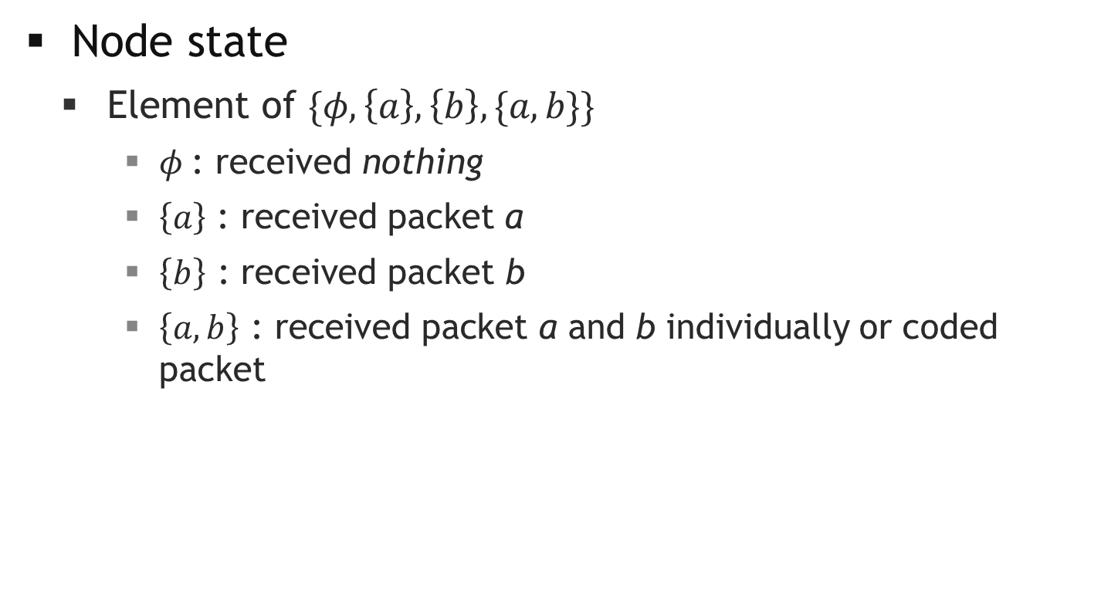
Definition (1/2)
Node state
Element of $\{φ,\left\{a\right\},\left\{b\right\},\{a,b\}\}$
$φ$: received nothing
$\left\{a\right\}$ : received packet a
$\left\{b\right\}\text{ : }\text{received} \text{packet} \text{b}$
$\left\{a,b\right\}\text{ : }\text{received} \text{packet} \text{a} \text{and} \text{b}$ individually or coded packet
Notes:
Before introducing the model, I briefly introduce the important concepts needed to understand the proposed model.
We define a node state as a set of packets a node received or overheard.
In the network we are considering, the node state can be one element of four states.

Slide 11
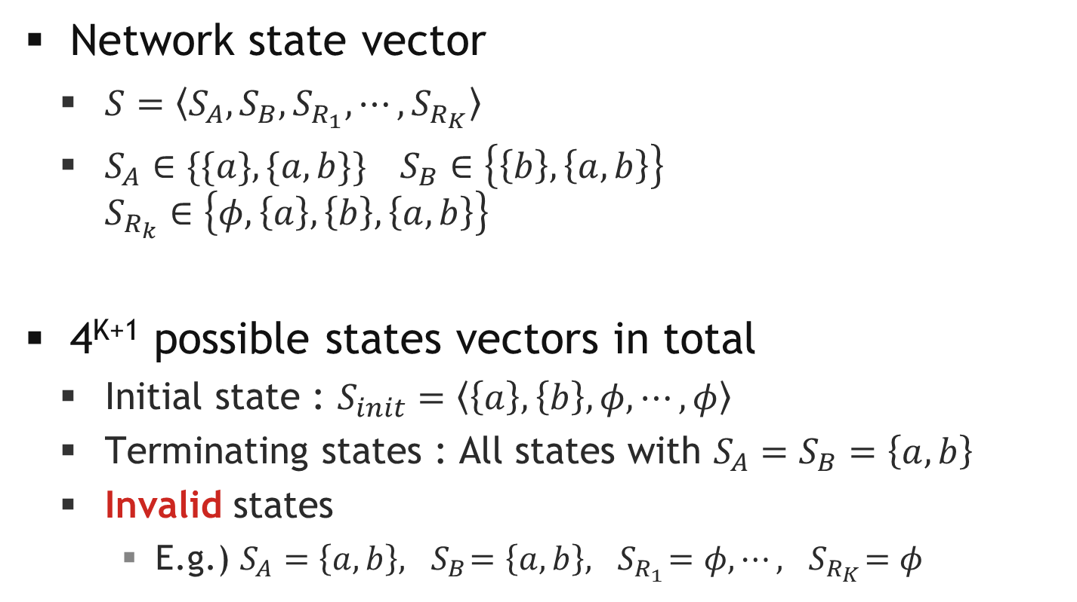
Definition (2/2)
Network state vector
$S=〈S_{A},S_{B},S_{R_{1}},⋯,S_{R_{K}}〉$
$S_{A}∈\{\{a\},\{a,b\}\}$ $S_{B}∈\left\{\left\{b\right\},\left\{a,b\right\}\right\}$ $S_{R_{k}}∈\left\{φ,\left\{a\right\},\left\{b\right\},\left\{a,b\right\}\right\}$
4^{K+1} possible states vectors in total
Initial state : $S_{init}=〈\left\{a\right\}, \left\{b\right\},φ,⋯,φ〉$
Terminating states : All states with $S_{A}=S_{B}=\left\{a,b\right\}$
Invalid states
E.g.) $S_{A}=\left\{a,b\right\},{ S}_{B}=\left\{a,b\right\},{ S}_{R_{1}}=φ,⋯,{ S}_{R_{K}}=φ$
Node state

Slide 12
Model (1/2)
Expected Opportunistically Coded Transmission time (ExOCT)
Expected total transmission time needed to deliver a packet from a given network state to terminated states
E.g.) ExOCT(S)
Why using time?
Send packets at different rates
Normalize each value to total transmission time

Slide 13
Model (2/2)
Five transitions from a network state vector
Node A sends packet a (Case 1)
Node B sends packet b (Case 2)
A relay node forwards packet a, b, or coded packet (Case 3 - 5)
Next step?
Calculate ExOCT for each of five cases

Slide 14
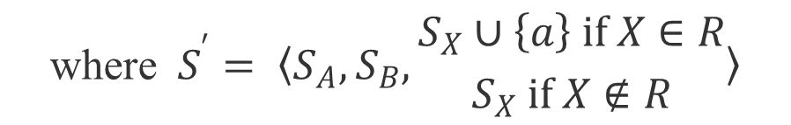
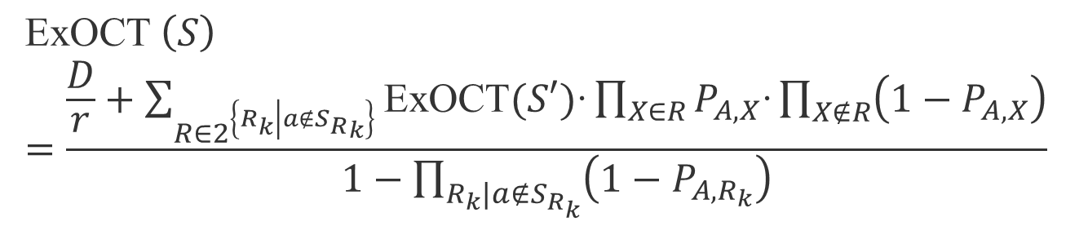
Calculation of ExOCT
Node A is selected and it sends packet a
Packet delivery probability from A to X
Size of transmitted packet (in bits)
$$\text{ExOCT} \left(S\right)=\frac{\frac{D}{r}+\sum_{R∈2^{\left\{R_{k} | a∉{S_{R}}_{k}\right\}}}{\text{ExOCT}(S′)\text{∙}\prod_{X∈R}{P_{A,X}\text{∙}\prod_{X∉R}{\left(1−P_{A,X}\right)}}}}{1−\prod_{R_{k}|a∉S_{R_{k}}}{\left(1−P_{A,R_{k}}\right)}}$$
Bit-rate used for transmission
$${\text{where} S}^{′}= 〈S_{A},S_{B},{S_{X}∪\left\{a\right\} if X∈R \atop S_{X} if X∉R}〉$$
Easily derive equations for
rest of cases

Slide 15

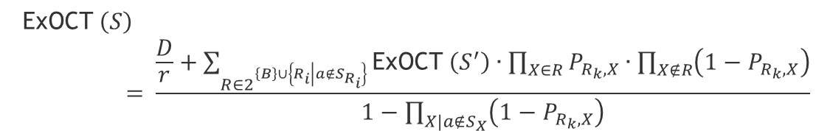
Finding optimal solution
Goal : Finding the optimal forwarding scheme which minimizes ExOCT($S_{init}$)
State relationship graph
Valid states becomes vertices
Make an edge S→ S’ if S’ exists in the right hand side of ExOCT(S)
$$\text{ExOCT} \left(S\right)= \frac{\frac{D}{r}+\sum_{R∈2^{\left\{B\right\}∪\left\{R_{i} | a∉S_{R_{i}}\right\}}}{\text{ExOCT} \left(S^{′}\right)∙\prod_{X∈R}{P_{R_{k},X}∙\prod_{X∉R}{\left(1−P_{R_{k},X}\right)}}}}{1−\prod_{X|a∉S_{X}}{\left(1−P_{R_{k},X}\right)}}$$

Slide 16
Algorithm
Input : G(V,E)
Initialize T
S₁
T₁
I
S₂
S_{Y}
S_{x}
T₂
S₄
S₃
T₃

Slide 17
Algorithm
Find S' ∈ V such that all edges from S' connected to S ∈ T
Select an edge that leads minimum ExOCT
S₁
T₁
I
S₂
S_{Y}
S_{X}
ExOCT(S_{X})
T₂
S₄
S₃
T₃

Slide 18
Algorithm
Record node, packet, and bit-rate selection OFD
S₁
T₁
I
S₂
S_{Y}
ExOCT(S_{Y})
S_{X}
T₂
S₄
S₃
T₃

Slide 19
Algorithm
Do until every possible network state is in T
S₁
T₁
I
S₂
S_{Y}
S_{X}
T₂
S₄
S₃
T₃

Slide 20
Algorithm
Do until every possible network state is in T
S₁
T₁
I
ExOCT(S_{init})
S₂
S_{Y}
S_{X}
T₂
S₄
S₃
T₃

Slide 21
Algorithm
ExOCT (S_{init}): Minimum transmission time
Output: OFD → Optimal forwarding decision
S₁
T₁
I
S₂
S_{Y}
S_{X}
T₂
S₂
S₃
T₃

Slide 22
Simulation environment
Trace-based simulation
Using MIT Roofnet trace data
1/2/5.5/11Mbps
32 nodes wireless mesh network
90 seconds transmission from each node
Packet delivery ratio of every node pairs
90s average
All transmitted packets
Extracting node pairs satisfying the assumption
Packet size : 12000 bits
Notes:
We conducted our performance evaluation study using MIT Roofnet trace data, obtained from 90 seconds broadcast transmissions from each node in a wireless mesh network consisting of 32 nodes equipped with an 802.11b network interface.

Slide 23
Result (1/4)
5
4
3
2
8
6
4
2
ExOCT(ms)
ExOCT(ms)
Simulation I.
Combination vs. multi-rate OR (MU-OR)
Combination vs. multi-rate NC (MU-NC)
2 3 4 5
2 4 6 8
MU-OR (ms)
MU-NC (ms)
Multi-rate combination outperforms
MU-OR by up to 24% and 22% on an average
MU-NC by up to 27% and 16% on an average
Notes:
Our first evaluation was the comparison of the expected transmission time of multi-rate combination (ExOCT), of multi-rate opportunistic routing (MU-OR), and of multi-rate network coding (MU-NC).
This figure shows scatter plots of all node pairs for the comparison with MU-OR and MU-NC. Each mark in the plot shows the expected transmission time for successfully exchanging packets between two nodes in each pair.
Multi-rate combination outperforms MU-NC by up to 27% and 16% on an average, and outperforms MU-OR by up to 24% and 22% on an average.

Slide 24
Result (2/4)
Transmission time improvement (%)
30
28
26
24
22
20
18
16
14
12
20 40 60 80
Topology snapshot time (s)
Improved over both MU-OR and MU-NC during the entire period
Notes:
This figure shows the total transmission time improvement over MU-OR and MU-NC for the snapshot for 1,500 byte packets. We can see that multi-rate combination improves the performance of both MU-OR and MU-NC, and as in the case of the previous result, the improvement over MU-OR is higher than that over MU-NC.

Slide 25
Result (3/4)
30
20
10
0
15
10
5
0
ExOCT(ms)
ExOCT(ms)
Simulation II.
Combination vs. fixed-rate combination
in four different rates
0 10 20 30
0 5 10 15
Expected transmission time with 1Mbps (ms)
Expected transmission time with 2Mbps (ms)
6
4
2
0
6
4
2
0
ExOCT(ms)
ExOCT(ms)
0 2 4 6
0 2 4 6
Expected transmission time with 5.5Mbps (ms)
Expected transmission time with 11Mbps (ms)
Notes:
To observe the effect of adapting a bit-rate selection mechanism on performance, we compared multi-rate combination with fixed-rate combination of opportunistic routing and network coding.
Figure 6(a)–(d) shows scatter plots of all node pairs when data rates are 1, 2, 5.5, and 11 Mbps, respectively. As shown in the figure, multi-rate combination requires shorter expected transmission time than fixed-rate combination at all rates.

Slide 26
Result (4/4)
Transmission time improvement (%)
100
90
80
70
60
50
40
30
20
20 40 60 80
Topology snapshot time (s)
Improved over the fixed-rate approach in all possible rates during the entire period
Notes:
As in the case of the previous result, the largest improvement is made when the data rate is 1 Mbps, and when the data rate is 11 Mbps, multi-rate combination shows up to 29% better performance than fixed-rate combination.

Slide 27
Conclusions
Study the potential benefits of the combination of opportunistic routing and network coding
A theoretical model for transmission time
An algorithm to find optimal forwarding scheme that minimizes total transmission time
Multi-rate combination makes substantial improvements over
Multi-rate opportunistic routing and multi-rate network coding
Fixed-rate combination approach

Slide 28
Backup slides

Slide 29
References
[ExOR’05] S. Biswas and R. Morris, “Exor: opportunistic multi-hop routing for wireless networks,” In Proc. of ACM SIGCOMM, August 2005.
[COPE’06] S. Katti, H. Rahul, W. Hu, D. Katabi, M. M´edard, and J. Crowcroft, “Xors in the air: practical wireless network coding,” In Proc. of ACM SIGCOMM, September 2006.
[CORE’10] Y. Yan, B. Zhang, J. Zheng, and J. Ma, “CORE: a coding-aware opportunistic routing mechanism for wireless mesh networks,” IEEE Wireless Communications, vol. 17, no. 3, pp. 96 -103, June 2010.
[ML’09] T. Mehmood and L. Libman, “Towards optimal forwarding in wireless networks: Opportunistic routing meets network coding,” In Proc. of IEEE LCN, October 2009.

Slide 30
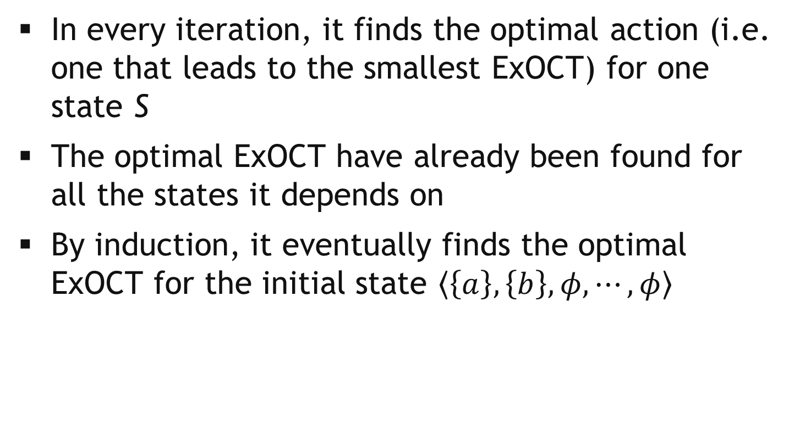
Correctness of algorithm
In every iteration, it finds the optimal action (i.e. one that leads to the smallest ExOCT) for one state S
The optimal ExOCT have already been found for all the states it depends on
By induction, it eventually finds the optimal ExOCT for the initial state $〈\left\{a\right\}, \left\{b\right\},φ,⋯,φ〉$

Slide 31
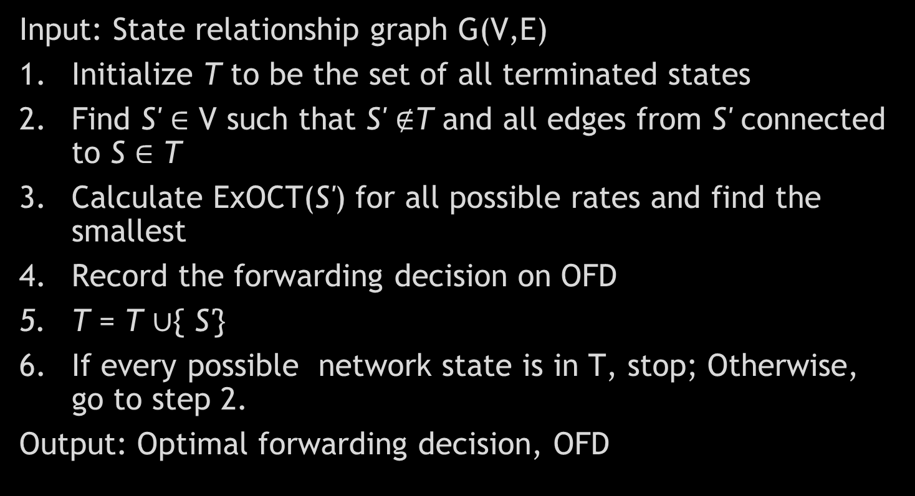
Finding optimal solution Algorithm
Input: State relationship graph G(V,E)
Initialize T to be the set of all terminated states
Find S' $∈$ V such that S' ∉T and all edges from S' connected to S $∈$ T
Calculate ExOCT(S') for all possible rates and find the smallest
Record the forwarding decision on OFD
T = T $∪${ S'}
If every possible network state is in T, stop; Otherwise, go to step 2.
Output: Optimal forwarding decision, OFD

Slide 32

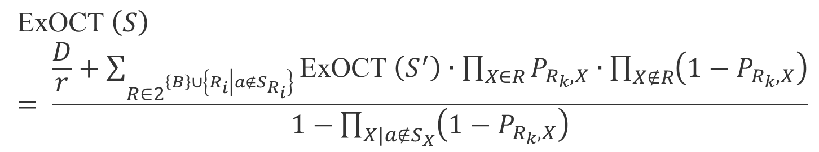
Calculation of ExOCT (2/2)
Relay R_{K} sends packet a
$$\text{ExOCT} \left(S\right)= \frac{\frac{D}{r}+\sum_{R∈2^{\left\{B\right\}∪\left\{R_{i} | a∉S_{R_{i}}\right\}}}{\text{ExOCT} \left(S^{′}\right)∙\prod_{X∈R}{P_{R_{k},X}∙\prod_{X∉R}{\left(1−P_{R_{k},X}\right)}}}}{1−\prod_{X|a∉S_{X}}{\left(1−P_{R_{k},X}\right)}}$$
$${\text{where} S}^{′}= 〈S_{A}, {S_{B}∪\left\{a\right\} if B∈R \atop S_{B} if B∉R},{S_{X}∪\left\{a\right\} if X∈R \atop S_{X} if X∉R}〉$$
Easily derive equations for
rest of cases (2,4 and 5) in the same way

