Slide 1
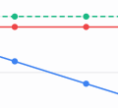

Slide 2
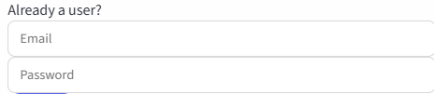

Burndown Studio Landing page
Small image symboizing burndown chart
Burndown Studio
Sprint burndown tracking for teams
(Section for Already a User)
(Section for PM request)

Slide 3
Assign Members
 |  | Total Assigned
 | Member 1
 | Member 2
 | Member 3
Dashboard
TODAY
2026-04-01
Sprint | Member 1 |  |  | Member 2 |  |  | Member 3 |  |  | Total
 | assigned | worked | remain | assigned | worked | remain | assigned | worked | remain | assigned | worked | remain
Sprint 1
Sprint 2
Sprint 3
Total

