Slide 1
Evaluating Graph Embeddings and Graph Similarity Measurements for Database Systems
Josephine Rehak
Profilprojekt Anwendungsforschung in der Informatik
16.4.2019 13:00

Slide 2
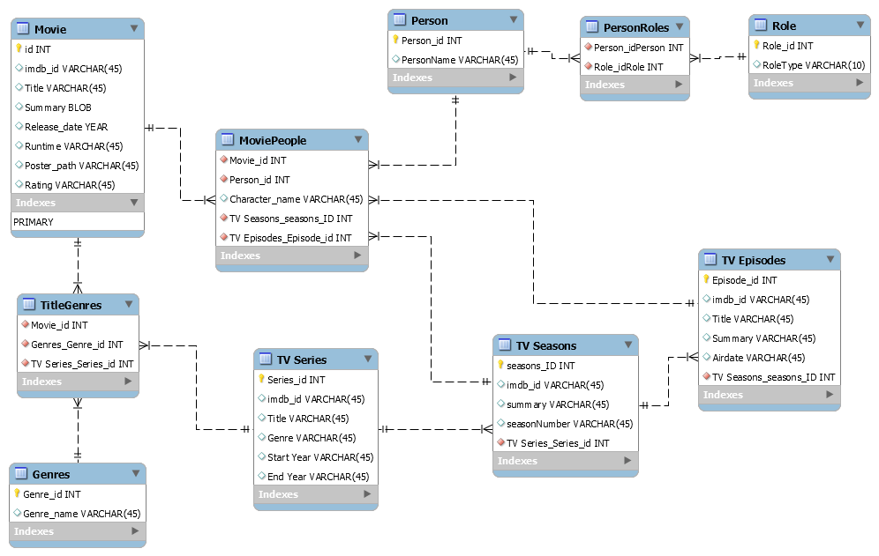
Motivation
spasiba
Спаси́бо
[1]

Slide 3
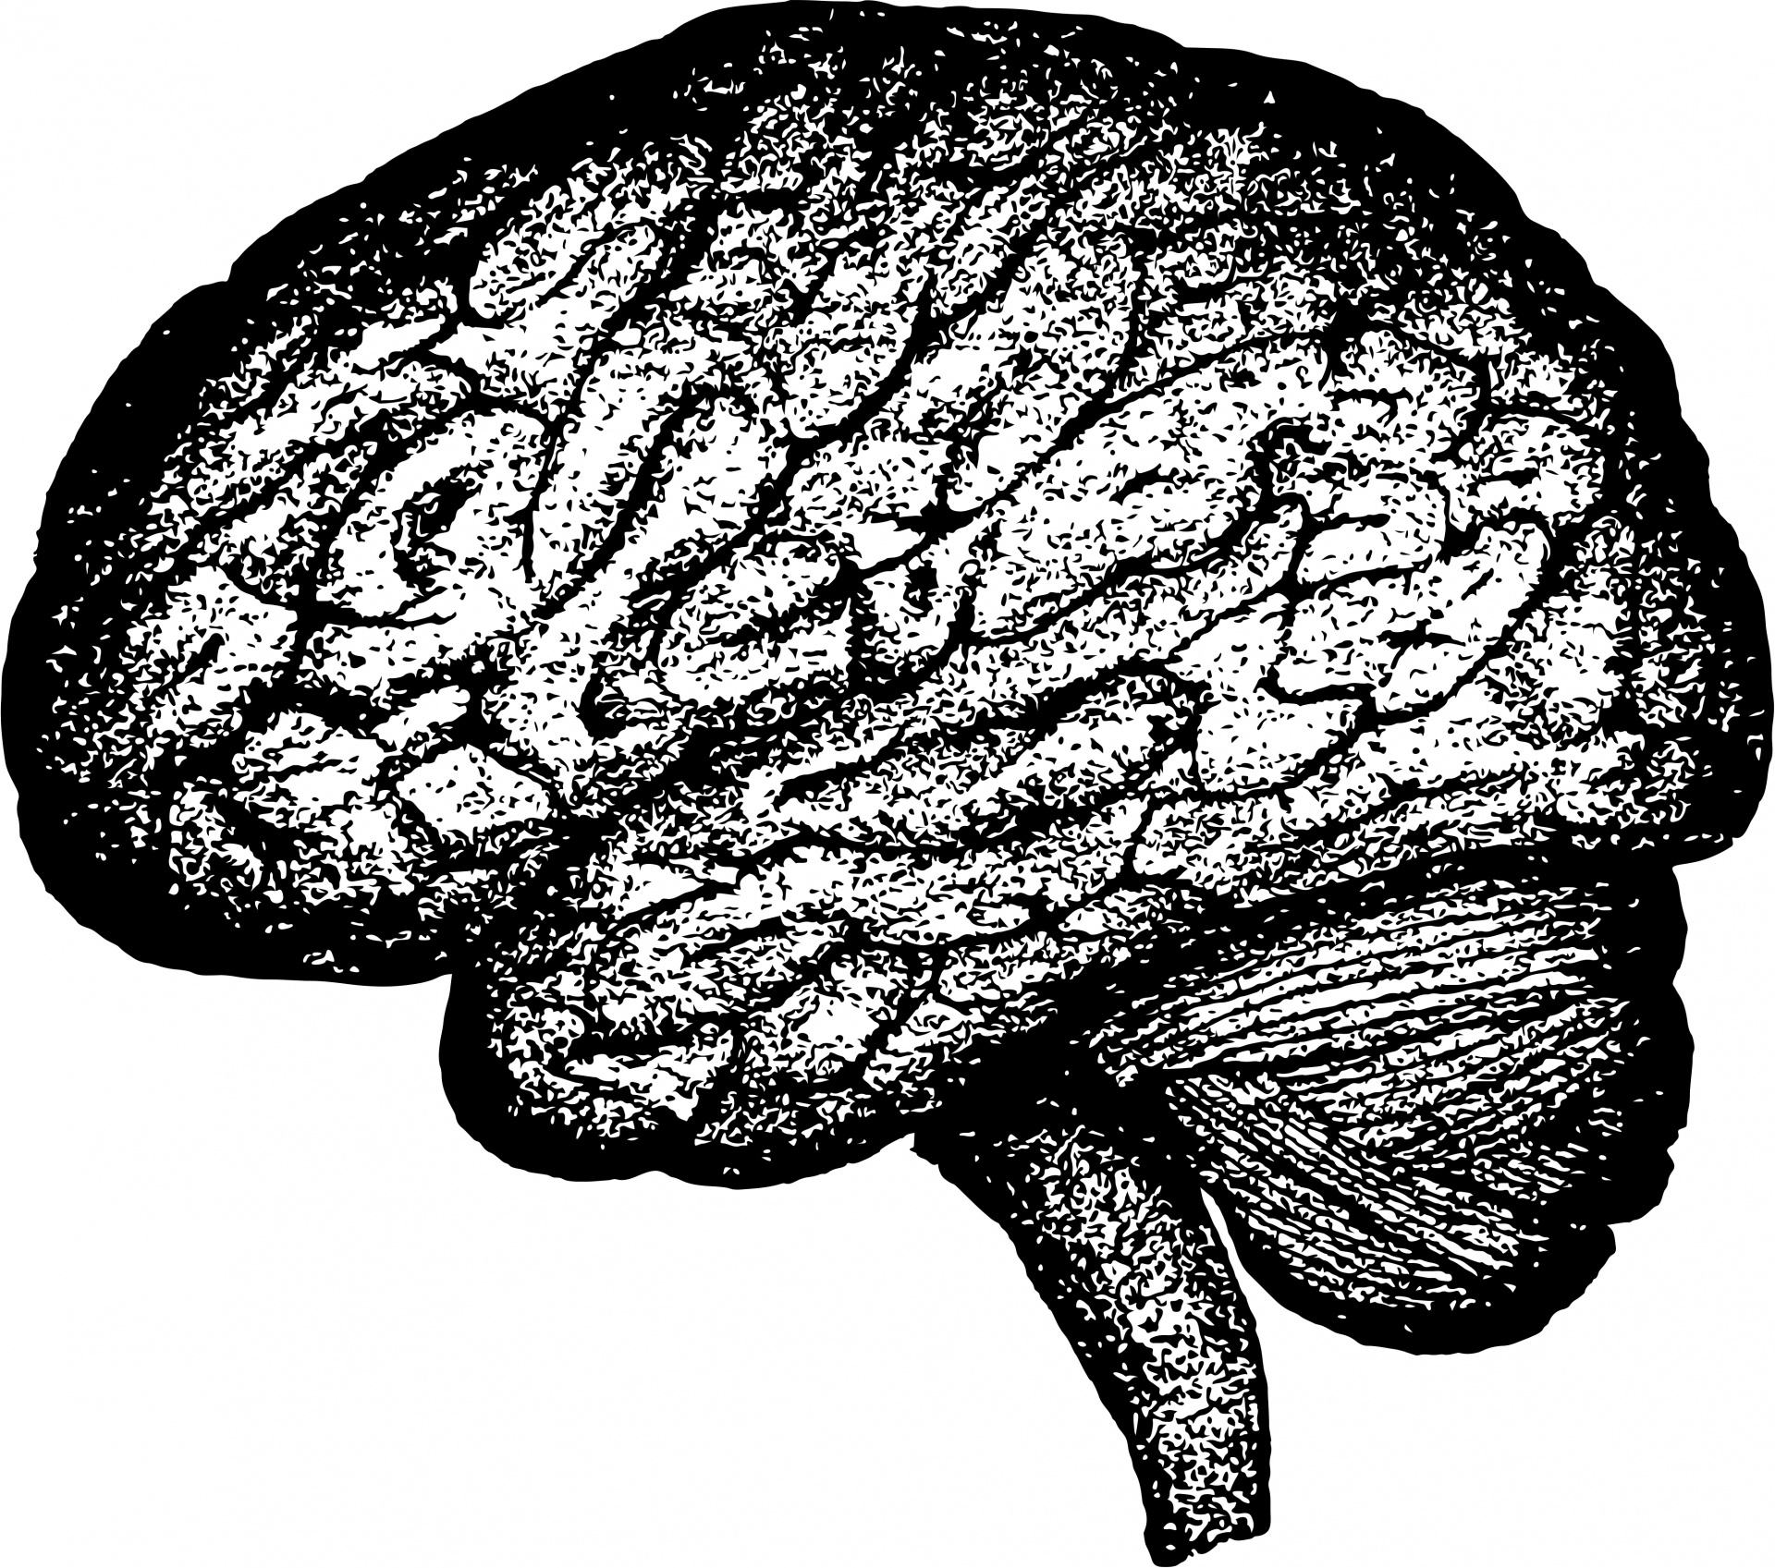
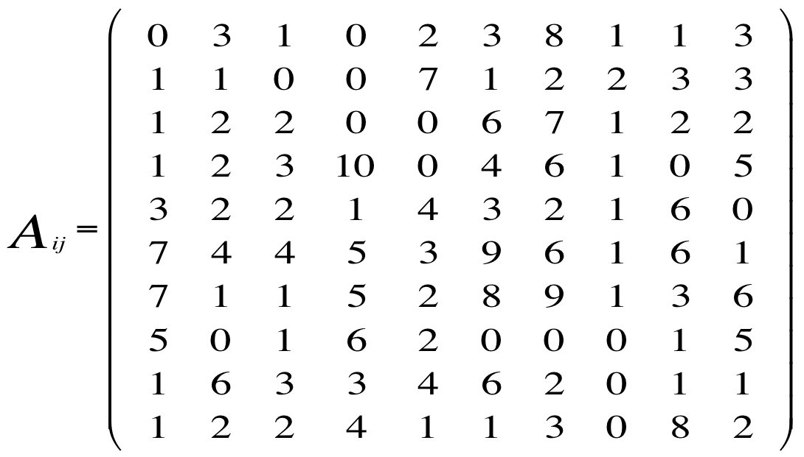
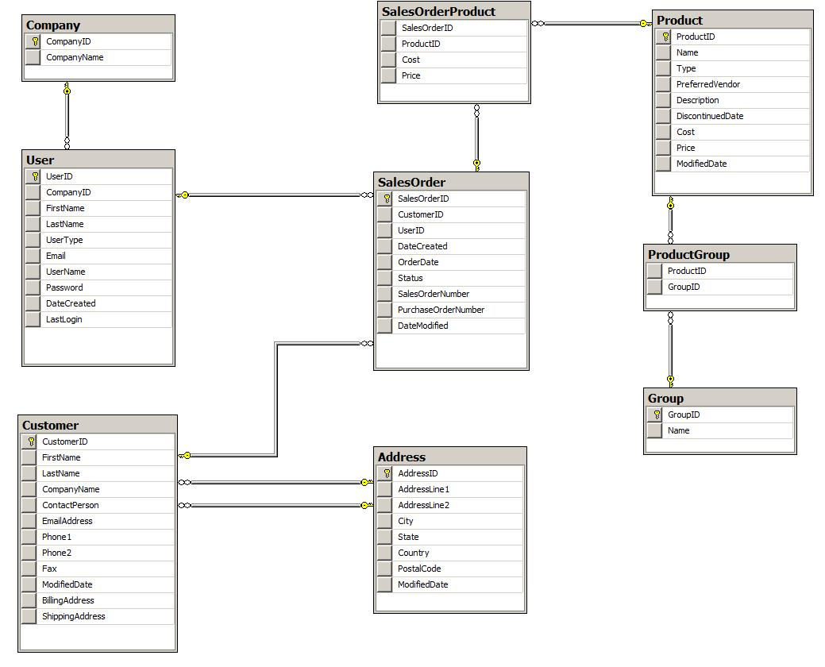
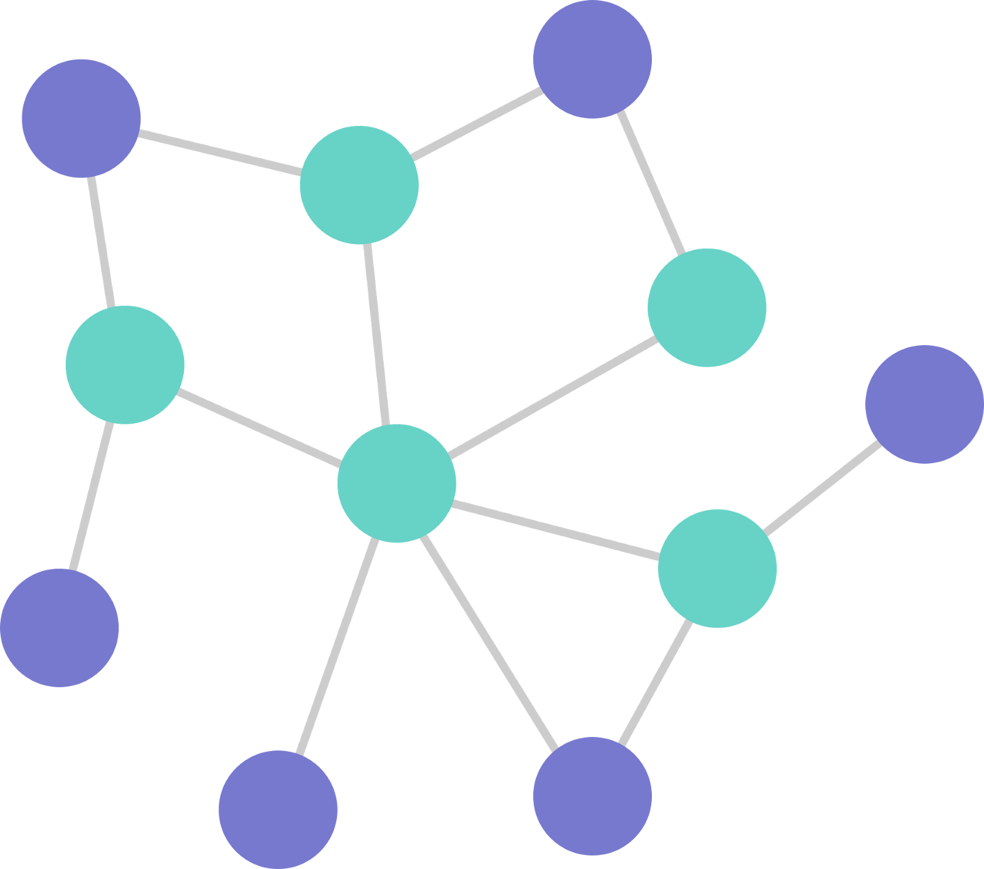
Motivation I
Overview
dataset
graph
verse
embeddings
similarity measures
similarity rankings

Slide 4
Fundamentals

Slide 5
Fundamentals I
Creating a directed graph from database
Vertices: IDs + Table entries
  Except: foreign keys, mn-tables

Slide 6
Fundamentals I
id | Name | Year
1 | Star Wars | 1977
2 | Star Trek | 1979
mid | gid
1 | 1
2 | 1
id | Genre
1 | Science Fiction
197*
“Star Wars”
“Star Trek”
movie_1
movie_2
genre_1
“Science Fiction”

Slide 7
Fundamentals I
Creating a directed graph from database
Vertices: IDs + Table entries
  Except: foreign keys, mn-tables
Edges: Inner + Inter Table Relations
  directed edges: id to table values
  Bidirected edges: MN-Table-Relations + Foreign Keys

Slide 8
Fundamentals I
id | Name | Year
1 | Star Wars | 1977
2 | Star Trek | 1979
mid | gid
1 | 1
2 | 1
id | Genre
1 | Science Fiction
197*
“Star Wars”
“Star Trek”
movie_1
movie_2
genre_1
“Science Fiction”

Slide 9
Discussion
id | Name | Year | d_id
1 | Star Wars | 1977 | 1
2 | Star Trek | 1979 | 2
id | Director
1 | George Lucas
2 | Robert Wise
M
1
197*
“Star Wars”
“Star Trek”
movie_1
movie_2
genre_1
director_1
director_2
“George Lucas”
“Robert Wise”
“Science Fiction”

Slide 10
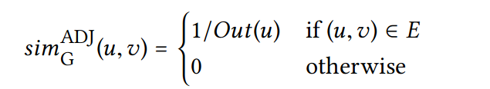
Fundamentals III
Similarity Measures in Verse
Adjacency Similarity:
  Similarity to neighbours only
  Low complexity

Slide 11
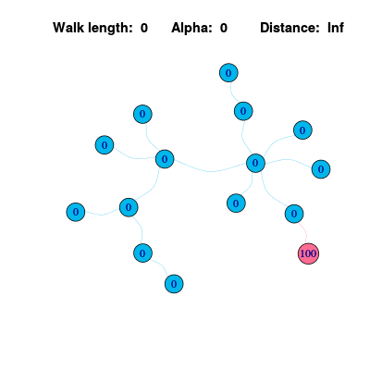

Fundamentals III
Similarity Measures in Verse
Personalized Page Rank:
  Random walker with jump back probability ( α )
  Initial assignment, then recursive
[3]

Slide 12

Fundamentals III
Similarity Measures in Verse
SimRank:
  Objects are similar when referenced by similar objects
  Initial assignment, then recursive
  importance of farther nodes : C
  complexity of O(n4)

Slide 13
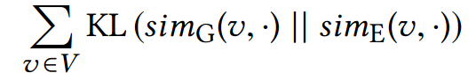
Fundamentals I
Verse (VERtex Similarity Embeddings)
Trains unsupervised 1-layer-NNs
Exceeds previous embedding methods
Scalable: Processes 10⁶ nodes in less than a day
Versatile: supports any similarity measure between nodes

Slide 14
Fundamentals II
Verse Vertex Embeddings
Mapping of graph vertex to vector space
  Maintains: neighborhood, connections, graph topology
  Efficiency for large graphs
  individual dimensions have no meaning
Usecases:
  ML
  similarity measures
  NearestNeighbour
  ...

Slide 15
Motivation I
Overview
dataset
graph
verse
embeddings
similarity measures
similarity rankings

Slide 16


Fundamentals III
Spearman coeficcient
Example,
Values between -1 and 1
  -1 inverted correspondence
  0 no correspondence
  1 strong correspondence
Movie id | r 1 | r 2
1 | 2 | 1 | 1 | 1
2 | 1 | 3 | -2 | 4
3 | 3 | 2 | 1 | 1
-0.5

Slide 17
Experimental Setup

Slide 18
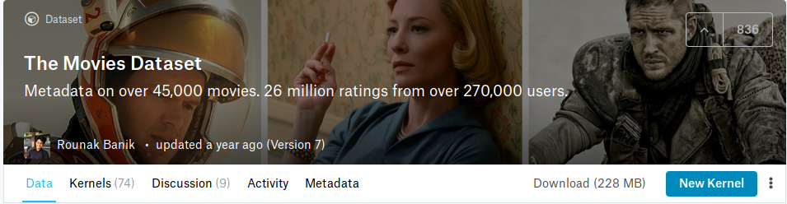
Experimental Setup
Data Set
Used excerpt has: 45433 movies, 18001 directors, 20 genres
https://www.kaggle.com/rounakbanik/the-movies-dataset/home

Slide 19
Motivation I
Overview
dataset
graph
verse
embeddings
similarity measures
similarity rankings

Slide 20
Experimental Setup
Overview
movie dataset
networkx graph
verse
embedding
3 data tables
1 mn table
45433 movies
18001 directors
20 genres
199753 vertices
243410 edges
3x 3h of calculation
3 x 199753 x 180 matrix
similarity measures
3 measures
similarity rankings
6 x199753 rankings

Slide 21



Motivation I
Investigation
dataset
graph
verse
embeddings
similarity measures
similarity rankings

Slide 22
Results

Slide 23
Results I
PPageRank Graph
AdjacencySimilarity Graph
 | Movie Names
1 | Star_Wars
2 | Star Wars Episode II: Attack of the Clones
3 | American Grafitti
4 | THX1138
5 | Star Wars Episode III: Revenge of the Sith
 | Movie Names
1 | Star_Wars
2 | Hellboy
3 | Get_Carter
4 | Der_Totmacher
5 | Begotten
6 | Laws_of_Gravity

Slide 24
Results I
PPageRank Embeddings
SimRank Embeddings
 | Movie Names
1 | Star Wars
2 | Star Wars: Episode III - Revenge of the Sith
3 | THX 1138
4 | Star Wars: Episode II Attack of the Clones
5 | Star Wars: Episode I The Phantom Menace
 | Movie Names
1 | Star Wars
2 | Star Wars: Episode II Attack of the Clones
3 | Electronic Labyrinth THX 1138 4EB
4 | THX 1138
5 | Star Wars: Episode I The Phantom Menace

Slide 25
Results I
Spearman on Similarity Rankings
Adjacency
Similarity
PPageRank
SimRank
0.07
Graph:
0.34
0.56
k = 15
-0.18
0.89
Embeddings:
-0.15

Slide 26
Results I
Computation Time
Adjacency
Similarity
PPageRank
SimRank
2.77s | 12.82s | ∞
0.32s | 0.36s | 0.21s
Graph:
Embeddings:

Slide 27
Discussion

Slide 28
Discussion
id | Name | Year | d_id
1 | Star Wars | 1977 | 1
2 | Star Trek | 1979 | 2
id | Director
1 | George Lucas
2 | Robert Wise
M
1
197*
“Star Wars”
“Star Trek”
movie_1
movie_2
genre_1
director_1
director_2
“George Lucas”
“Robert Wise”
“Science Fiction”

Slide 29
Discussion
id | Name | Year | d_id
1 | Star Wars | 1977 | 1
2 | Star Trek | 1979 | 2
id | Director
1 | George Lucas
2 | Robert Wise
M
1
197*
“Star Wars”
“Star Trek”
movie_1
movie_2
genre_1
director_1
director_2
“George Lucas”
“Robert Wise”
“Science Fiction”

Slide 30
Results I
Directed: SimRank
Bidirected: SimRank
 | Movie Names
1 | Star Wars
2 | Roswell
3 | THE DARK SIDE OF DIMENSIONS
4 | Perfect
5 | Love and Distrust
6 | National Lampoon's Last Resort
 | Movie Names
1 | Star Wars
2 | Star Wars: Episode II Attack of the Clones
3 | Electronic Labyrinth THX 1138 4EB
4 | THX 1138
5 | Star Wars: Episode I The Phatnom Menace

Slide 31
Conclusion

Slide 32
Conclusion I
Translates across tasks/databases
Speeding up similarity calculation
Supports many similarity measures
‚Simple‘ solution for complex db problem
Verse needs preparation time
Similarity measure and graph construction coupled
Needs parameter tuning
+
-

Slide 33
Fragen?

Slide 34
Extra Slides

Slide 35

Kullback-Leibler-Divergenz
Also called „Information Gain“
Measure for divergence of probability distributions

Slide 36
Verse Steps
Sampling: NCE-based
Dimensionality reduction: (linear)
Normalisation: softmax
Optimisation: KL + Stochastic gradient descent
ML: 1-layer NN + input/output layer

Slide 37
Vertice Similarity Measures
closeness
Structure-based
Random Walks
PPageRank
indirect neighborhood
Cosine similarity
Euclidean distance
Jaccard coeficient
SimRank
Direct neighborhood
Adjacency Similarity
complexity

Slide 38
Sources

Slide 39
Image Sources
[1]
https://i.stack.imgur.com/XZROF.png
[3]
https://1.bp.blogspot.com/-5DGkqiLF87U/Uzqm0Vah16I/AAAAAAAABIE/aPgVRreUvts/s1600/g4.gif
Access Time: 10.4. 2019 13:00

