Slide 1
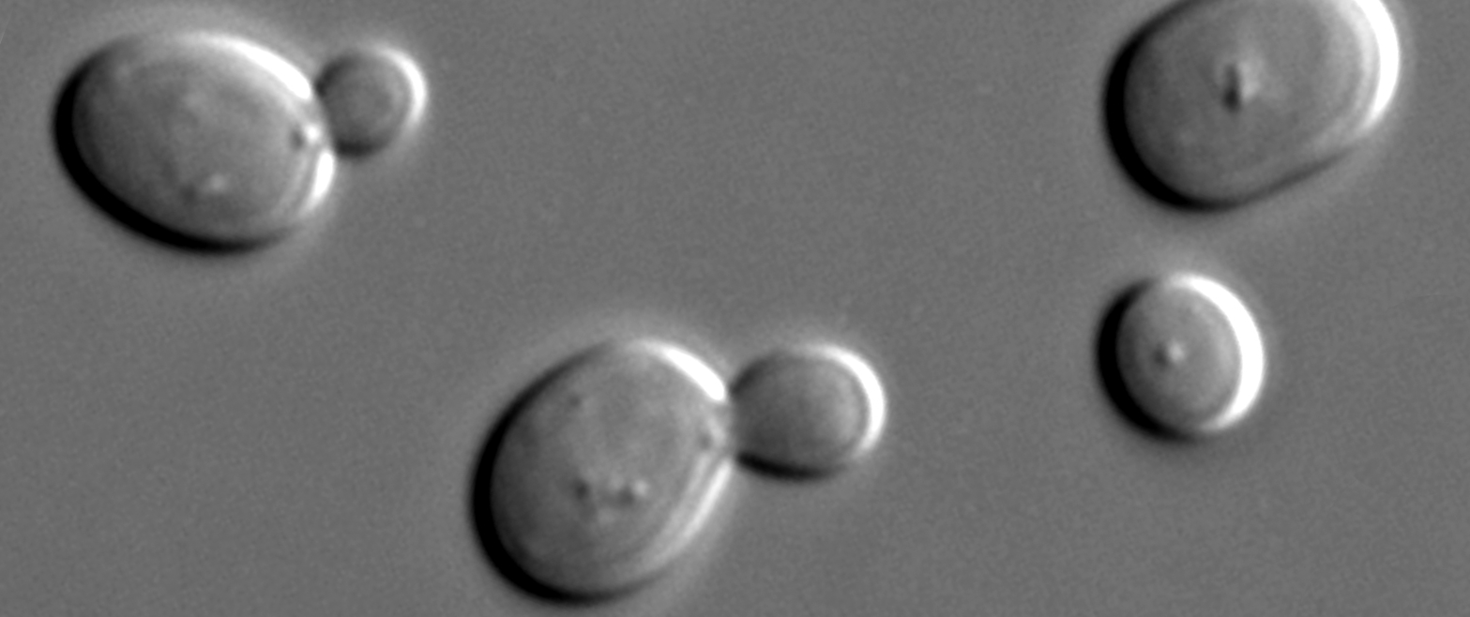
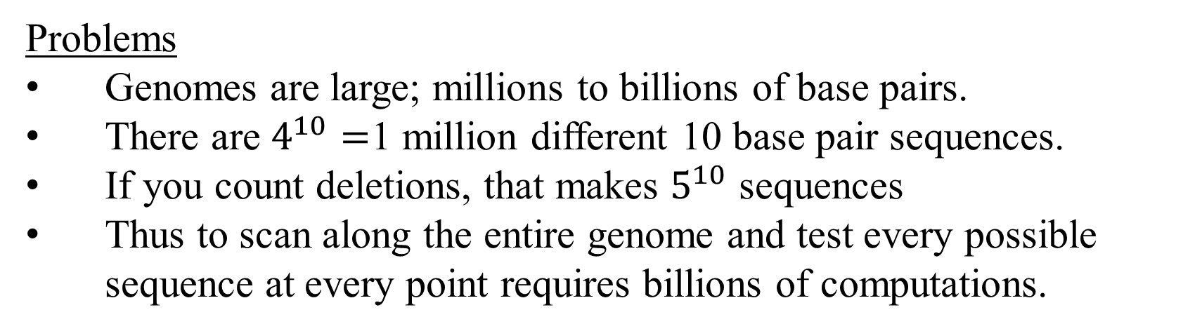
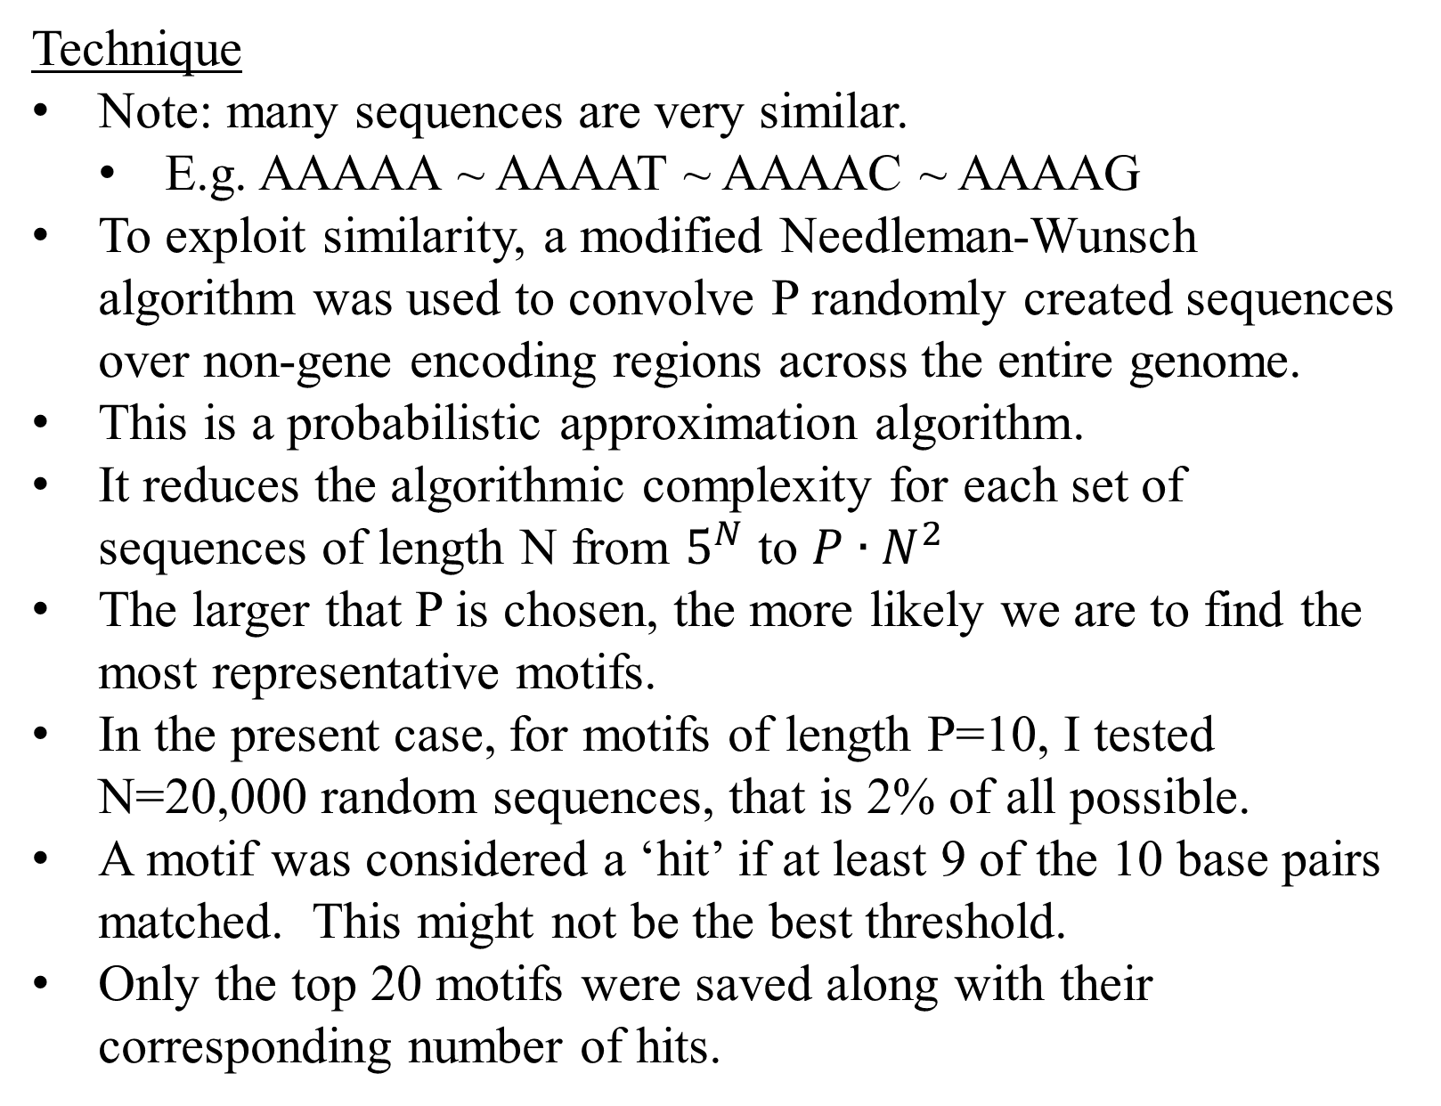
One Man’s Search for Nucleotide Motifs in Saccharomyces cerevisiae
(Baker’s yeast)
Q: Is it possible to find sequence motifs on non-gene encoding regions across an entire genome?
Sequence Motif A widespread, repeated sequence of nucleotides with possible biological significance.
Source: http://en.wikipedia.org/wiki/File:S_cerevisiae_under_DIC_microscopy.jpg
Problems
Genomes are large; millions to billions of base pairs.
There are $4^{10}=$1 million different 10 base pair sequences.
If you count deletions, that makes $5^{10}$ sequences
Thus to scan along the entire genome and test every possible sequence at every point requires billions of computations.
Discussion
Most of the selected motifs are characteristic of TATA boxes, which lends weight to the idea that they have a biological significance.
The motifs appear to be relatively uniformly distributed throughout all chromosomes, though there are definite clusters (e.g. look for the squares) as well as empty areas.
Hits | Forward Strand | Reverse Strand
689 | TACTTTTTTT | AAAAAAAGTA
496 | AAGAAAAATT | AATTTTTCTT
335 | ATATACATTA | TAATGTATAT
293 | AAAAATTCTT | AAGAATTTTT
227 | ATAAAGGAAA | TTTCCTTTAT
200 | AAAACAATTT | AAATTGTTTT
196 | GAAAAGCAAA | TTTGCTTTTC
189 | TTCAATTATT | AATAATTGAA
174 | TGTAAGAAAA | TTTTCTTACA
170 | AAACGTAAAA | TTTTACGTTT
167 | TGTAAAATTA | TAATTTTACA
165 | CTTATTTTTG | CAAAAATAAG
163 | ATTATCCTTT | AAAGGATAAT
154 | AAAAACATCA | TGATGTTTTT
153 | GGAGAAAAAT | ATTTTTCTCC
143 | TAATCGTAAT | ATTACGATTA
143 | AGTAAATGAA | TTCATTTACT
141 | AAATGATGTA | TACATCATTT
138 | AACTTTGAAA | TTTCAAAGTT
133 | TGGGATTCCA | TGGAATCCCA
112 | AATTTTCACC | GGTGAAAATT
111 | ACAGAAACAA | TTGTTTCTGT
109 | TTCTTATGTT | AACATAAGAA
106 | ATTCATTGTC | GACAATGAAT
106 | TTTCTAATTC | GAATTAGAAA
105 | CATATCATAA | TTATGATATG
104 | TTCATTATTG | CAATAATGAA
102 | ATAGAGGAAA | TTTCCTCTAT
100 | CGGAAAAAAG | CTTTTTTCCG
100 | CTCCTTTCTT | AAGAAAGGAG
Technique
Note: many sequences are very similar.
E.g. AAAAA ~ AAAAT ~ AAAAC ~ AAAAG
To exploit similarity, a modified Needleman-Wunsch algorithm was used to convolve P randomly created sequences over non-gene encoding regions across the entire genome.
This is a probabilistic approximation algorithm.
It reduces the algorithmic complexity for each set of sequences of length N from $5^{N}$ to $P∙N^{2}$
The larger that P is chosen, the more likely we are to find the most representative motifs.
In the present case, for motifs of length P=10, I tested N=20,000 random sequences, that is 2% of all possible.
A motif was considered a ‘hit’ if at least 9 of the 10 base pairs matched. This might not be the best threshold.
Only the top 20 motifs were saved along with their corresponding number of hits.
Limitations
If there was a true motif that was involved in the regulation of only a few genes, it would not show up here, and would be hard to sort from the noise.
This technique does not incorporate any prior knowledge of gene interaction.
As can be seen in the table and graph below, the distribution of hits is highly skewed with a long tail. This implies it may be unlikely to find ubiquitous motifs without approaching an exhaustive search.
Implementation Notes
This algorithm is embarrassingly parallel. It took about 20 minutes to test 20,000 random sequences on a run across 26 cores (4 networked computers).
Annotation and genome data for S. cerevisiae were downloaded from genome.uscs.edu
All code in Python using NumPy, IPython, Matplotlib, Cython, and ZeroMQ.
The combination of NumPy and Cython increased calculation speed over plain Python by almost 100X.
Heavy use of memory mapping and shared data structures allows this technique to be efficiently used for genomes larger than will fit in RAM.
Future Work
Play with different thresholds for hit success.
Further exploit motif similarity by testing the utility of adapting multigrid methods. That is, start with shorter sequences (less combinations) to “seed” longer combinations.
Get a larger compute cluster and run longer motif sequences and against larger DNA specimens.
Determine the biological significance of the results.
S. Cerevisiae
Common yeast species used in baking and brewing.
Very highly studied genome (lots of data!).
Nuclear DNA is composed of 16 chromosomes.
Each chromosome has between 200k and 1.5M base pairs
Almost 6000 genes across all chromosomes.
CSE527
Computational Biology
James Youngquist
UW

