Slide 1
Corporate 16x9 Simplified External Template
Date
@qualcomm
Location
Speaker name
Speaker title
Employing entity

Slide 2
This template is a condensed version for general external use.
You can download more templates in the template sections at https://brand.qualcomm.com or go/presentations.

Slide 3
Important legal instructions
Ensure that you use the proper product-trademark symbols, verbiage and product names in your presentation. (Refer to the Trademarks Database at go/trademarks for more information.)
It is also important to use the proper product disclaimers on the final Thank You slide of your presentation.
To edit the disclaimer text in the Thank You slide:
Click View in the Ribbon at the top of the window.
Click Slide Master in the Master Views section.
Scroll down to the Thank You slide in the master.
Insert the proper verbiage into the Thank You slide master.
Click Close Master View. Your Thank You slide will now show your edited content in the normal view.

Slide 4
Header is 34 points
Subtitle is 24 points
Body bullet 01 is 21 points with a blue bullet
Body bullet 02 is 21 points
Body bullet 03 is 18 points
Body bullet 04 is 18 points
Body head is 28 points
Subhead is 24 points
Body copy is 21 points
Limit the number of bullets on a slide
Avoid using type smaller than the recommended font sizes

Slide 6
Legal Requirements – Remove this page before external use
LEGAL REVIEW IS REQUIRED BEFORE ANY EXTERNAL USE
Title Page. The title page of all presentations must contain the speaker’s name, title, and the full legal name of the speaker’s employing entity.
Proper Trademark Use. Qualcomm trademarks must be used correctly and consistently in presentations. For each trademark used in a presentation, a trademark attribution statement must appear on the closing slide. Visit go/trademarks to access the Trademark Database, which illustrates how to properly use Qualcomm trademarks and includes applicable trademark attribution statements.
Product Attribution Statements. For each product name referenced in the presentation, a product attribution statement must appear in the footer of the slide on which the product is first mentioned. The product statement must be set apart from other footnotes and/or legalese, and the text must be large enough and contrast enough with the background such that the statement is clearly legible and visible to the average reader. Visit go/trademarks to access the Trademark Database, which includes applicable product attribution statements.
Images. Use only images that Qualcomm owns or has otherwise obtained sufficient rights to use. Visit go/brandportal to download images that are approved for external use. Images purchased under the Getty Royalty Free License or the iStock Extended License with the multi-seat provision are also approved for use.

Slide 7
Legal Requirements – Remove this page before external use
LEGAL REVIEW IS REQUIRED BEFORE ANY EXTERNAL USE
Third Party Content. Permission must be obtained from the owner(s) of all third party content (e.g., photos, logos, video, music, device images, quotes, etc.).
Releases. A release must be on file for each identifiable individual.
Thank You Slide. The Thank You slide must contain all applicable legal statements, including the copyright notice and the trademark attribution statements, which may need to be updated to reflect all trademarks used in the presentation. Visit go/trademarks to access the Trademark Database, which includes applicable trademark attribution statements. To access or edit the closing slide text:
Click View in the Ribbon at the top of the window.
Click Slide Master in the Master Views section.
Scroll down to the Thank You slide in the master.
Insert the proper verbiage into the Thank You slide master.
Click Close Master View. Your Thank You slide will now show your edited content in the normal view.

Slide 8
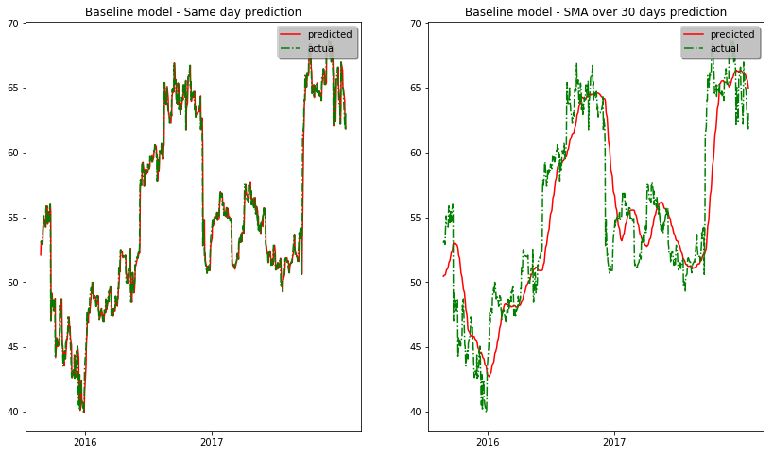
QCOM Adjusted Closing Price
QCOM Adjusted Closing Price
Year on Year Time scale
Year on Year Time scale

Slide 9
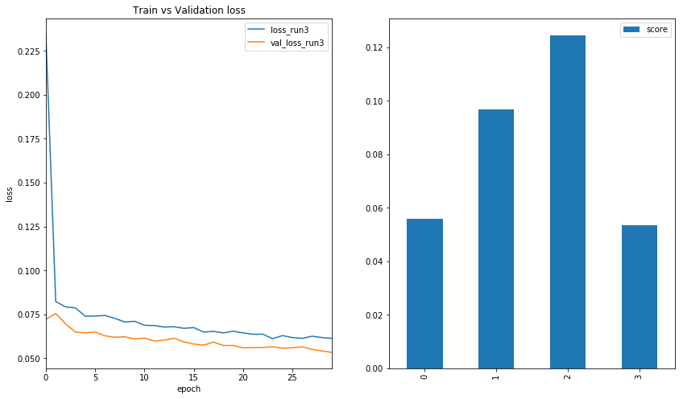

Slide 10
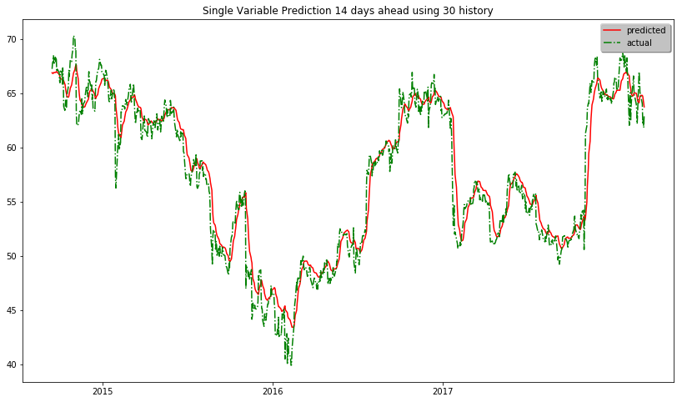
QCOM Adjusted Closing Price
Year on Year Time scale

Slide 11
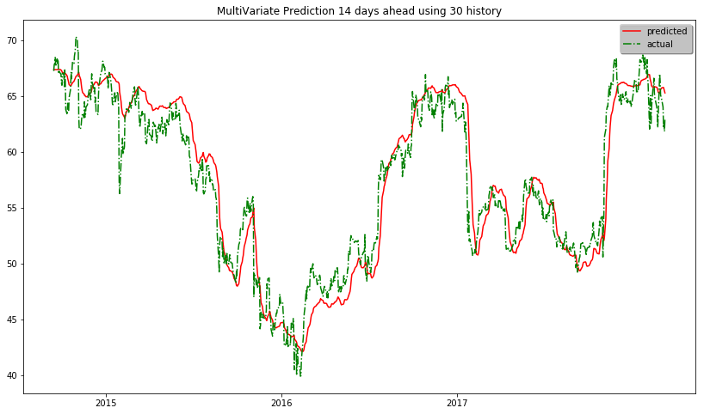
QCOM Adjusted Closing Price
Year on Year Time scale

Slide 12
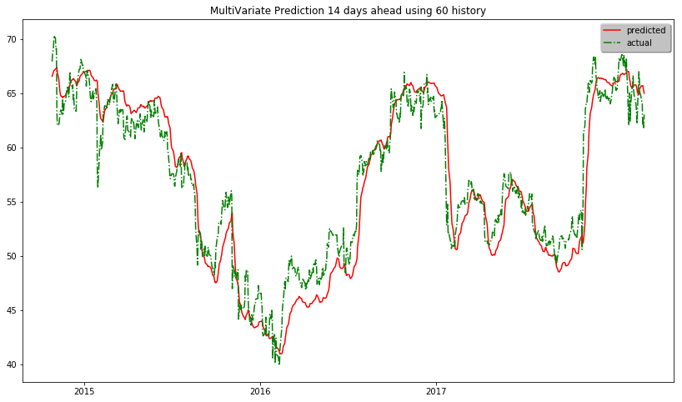
QCOM Adjusted Closing Price
Year on Year Time scale

