Slide 1
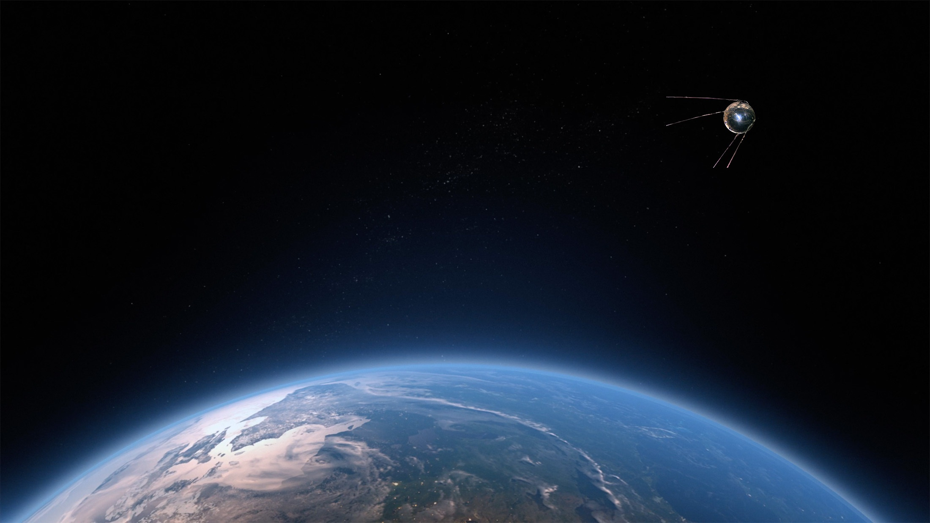
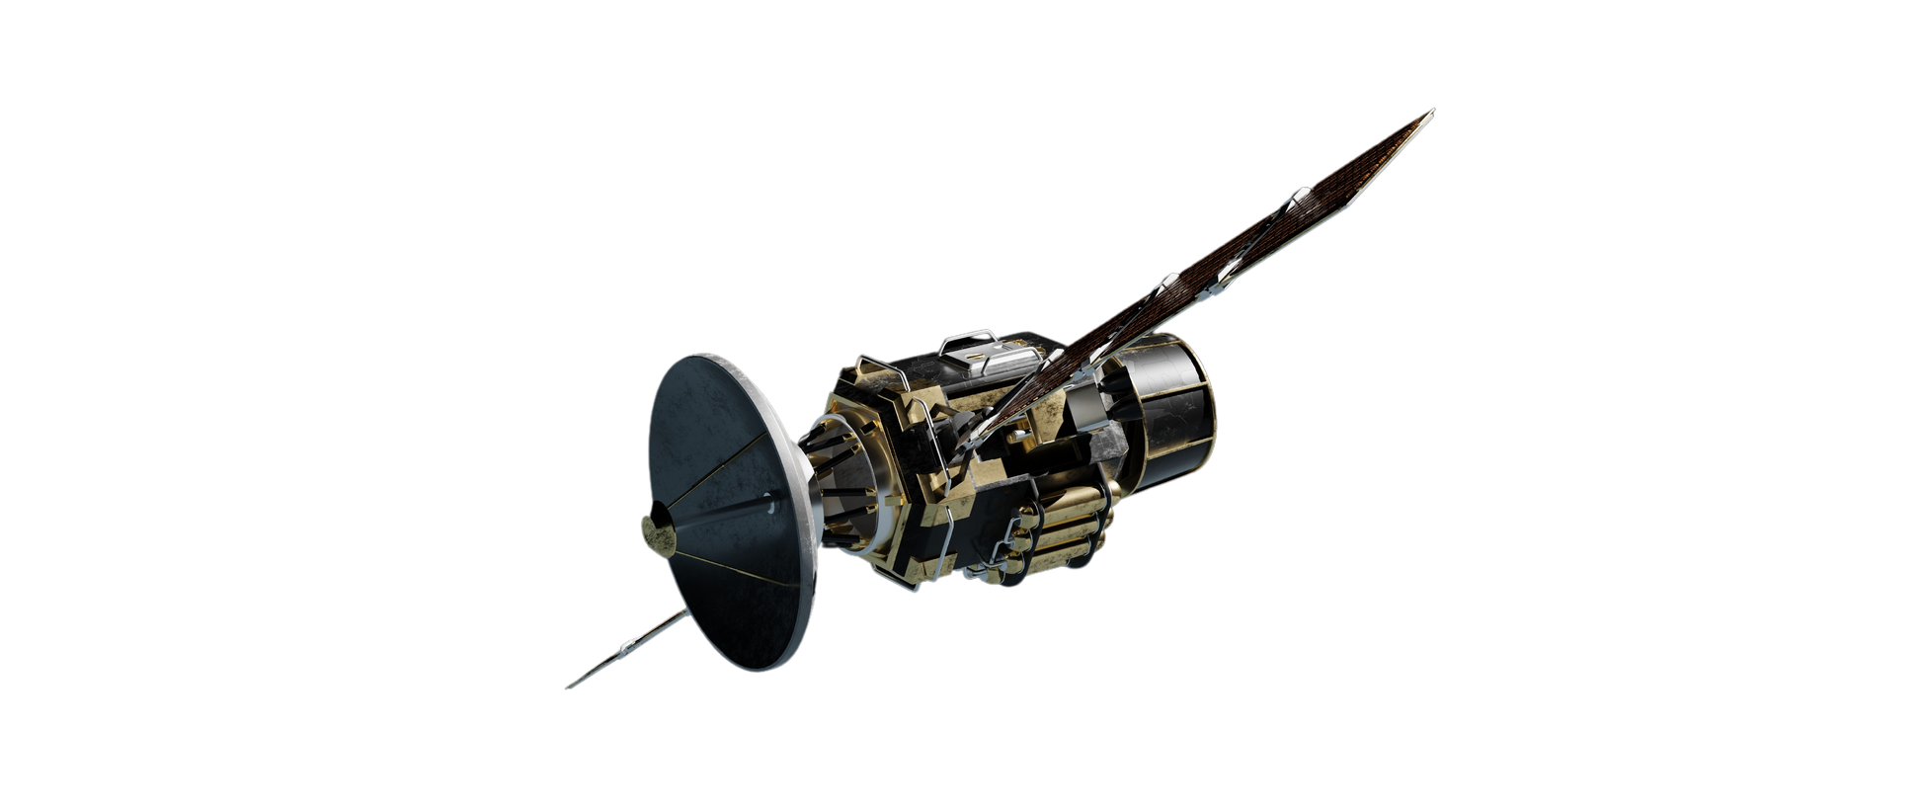
From Launch
to Litter:
Orbital Overload
Tom Rowan, ST20285213
DAT5001_S2_25 PRES1

Slide 2



Table Of Contents
What is the Kessler Syndrome?
Exploring
the Data
Planning for
The Future
And its potential impact on civilization.
Looking at what’s in orbit.
How can we avoid a disaster?

Slide 3
What is the Kessler Syndrome?
Collision Cascade
A scenario where satellite and/or space debris collisions cause a cascade effect, making low Earth orbit unusable.
Disaster Scenario
First identified in 1978 by Donald J. Kessler and Burton G. Cour-Palais.

Slide 4
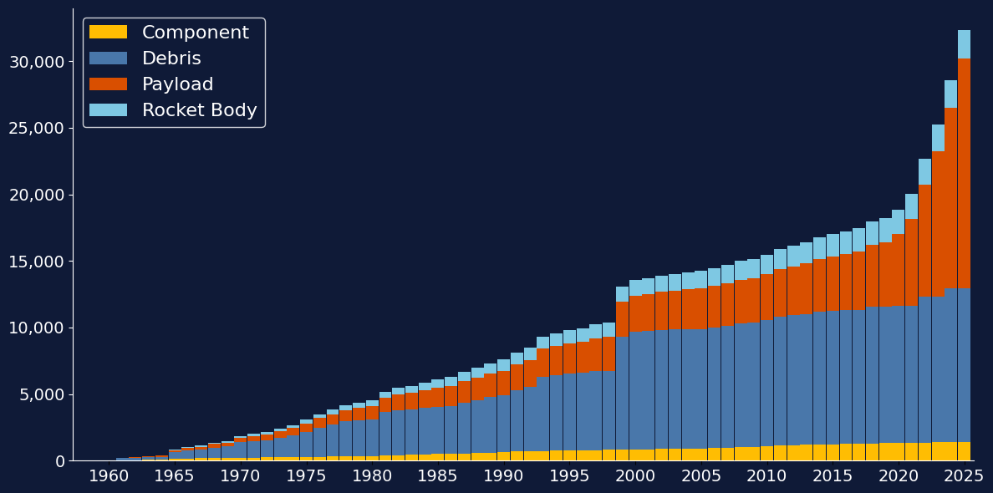
Satellite Launch Trends
Objects In Orbit, Cumulative
Up to date graph needed

Slide 5
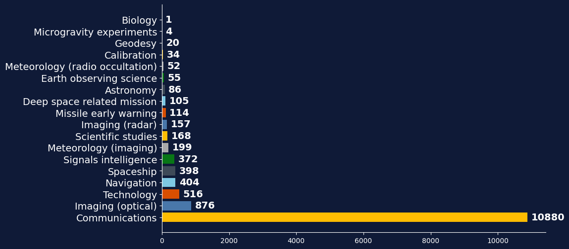
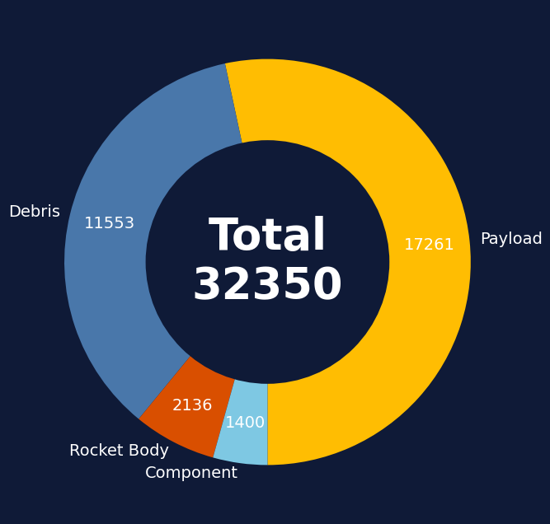
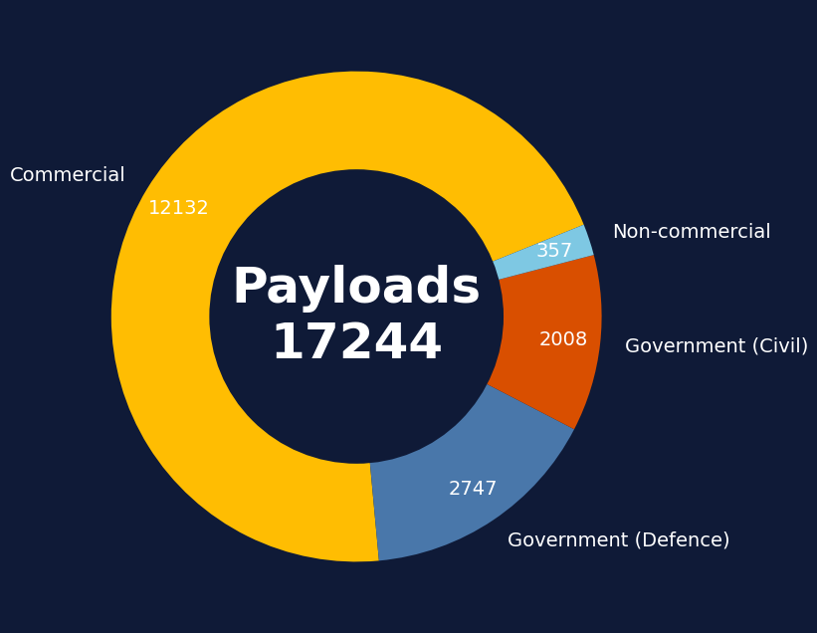
What’s up in Orbit?
Count of Objects In Low Earth Orbit
Up to date graph needed

Slide 6
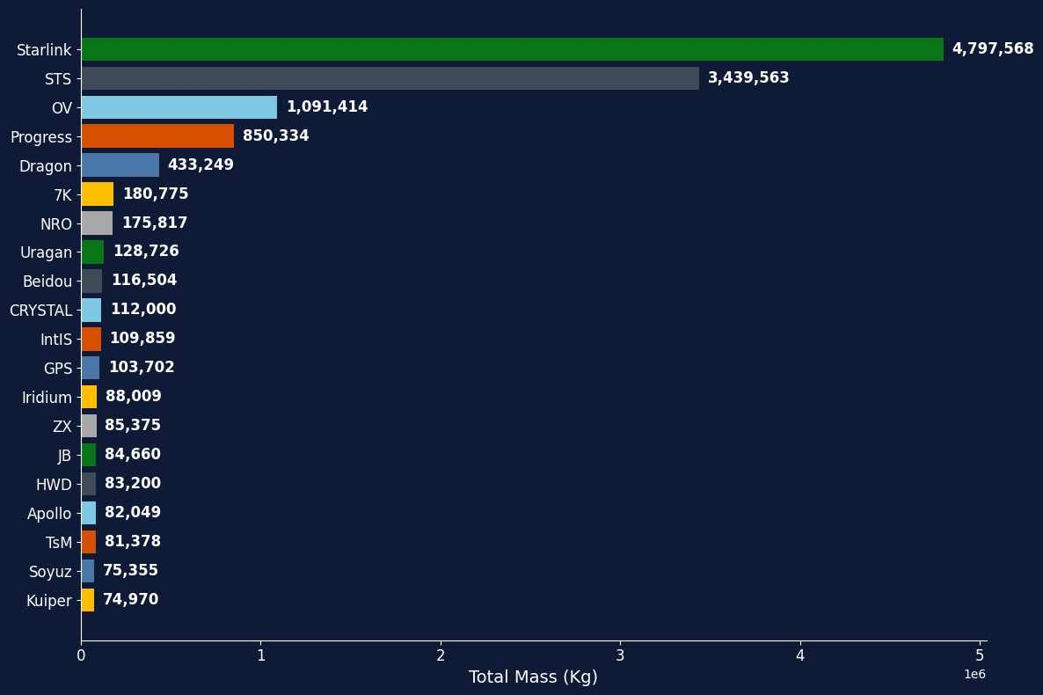
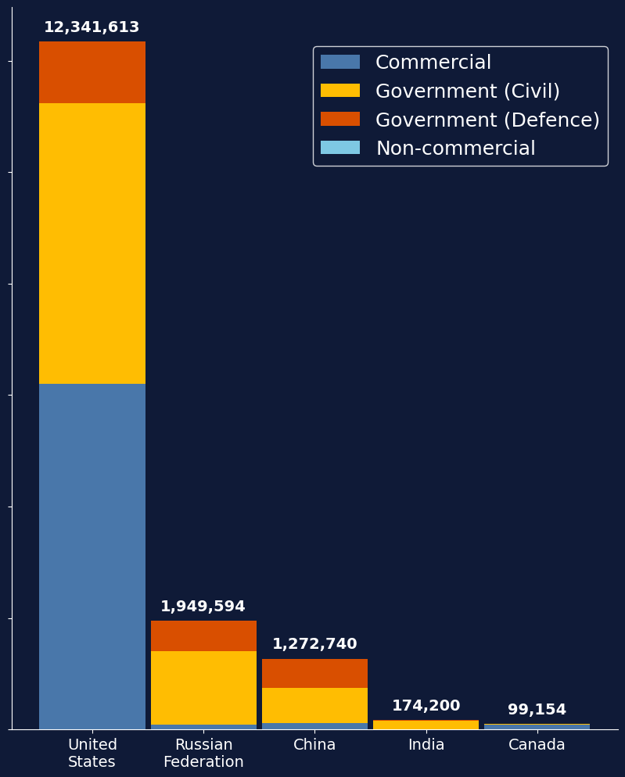
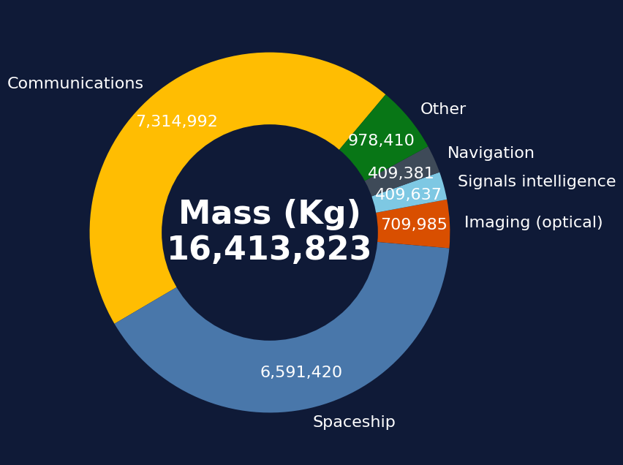
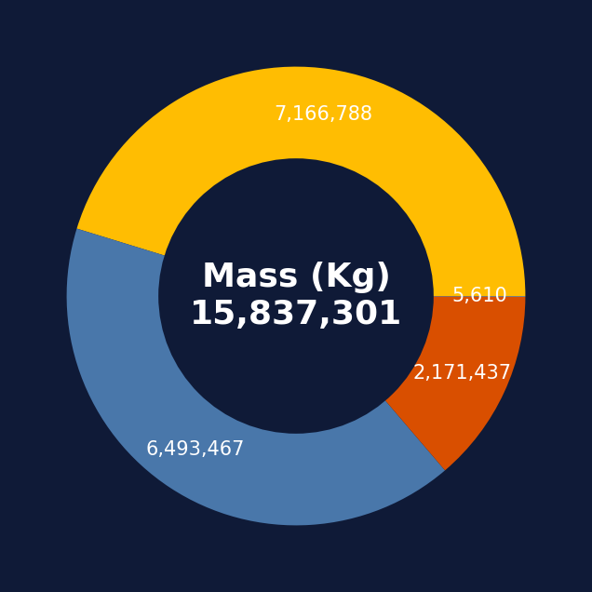
Heavy Metal
Mass of Payloads
in Low Earth Orbit
Up to date graph needed

Slide 7
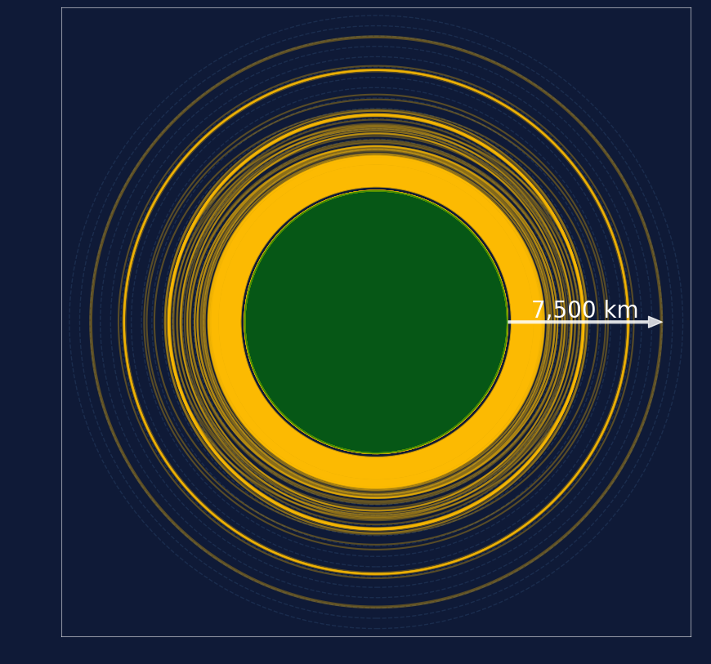
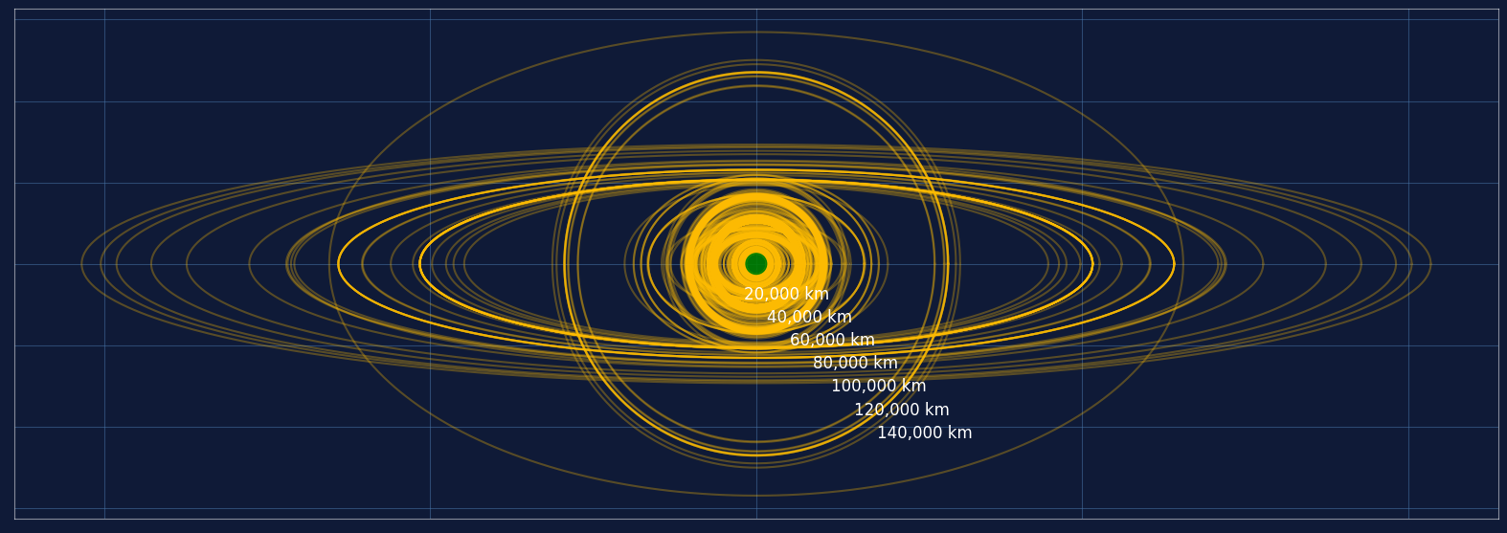
Where are they all?
Orbital Paths of Payloads currently in Orbit

Slide 8
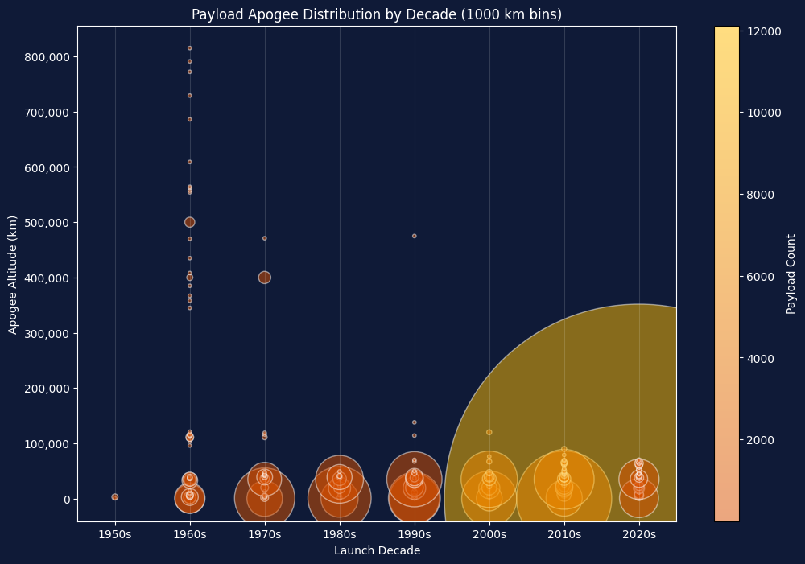
Crowded LEO
Up to date graph needed
Deep Space
In the 1960’s, many more payloads were launched into deep space.
Communications
Most modern satellites are for communications, requiring Low Earth Orbit.

Slide 9
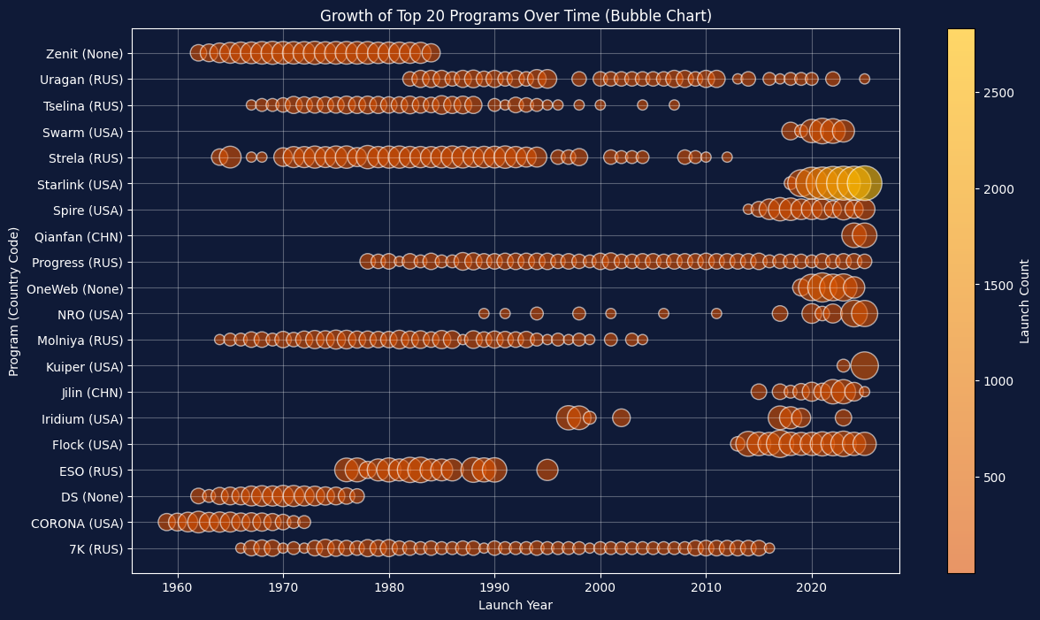
Operators and Origins
Starlink
First launch: 2018
Total launches: 10,413
Purpose: Comms
OneWeb
First launch: 2019
Total launches: 656
Purpose: Internet
Flock
First launch: 2015
Total launches: 548
Purpose: Earth Observation

Slide 10
Lifespan and Litter
Service Two
Elaborate on what you want to discuss.
Elaborate on what you want to discuss.
Service Three
Service Four
Elaborate on what you want to discuss.
Elaborate on what you want to discuss.

Slide 11
Collision Risk
Service One
Service Two
During the first four years after the first Starlink launch, the number of evasive maneuvers kept doubling every six months, reaching 25,299 in the half-year leading up to May 31, 2023
Elaborate on what you want to discuss.
Service Three
In The News
Elaborate on what you want to discuss.
Elaborate on what you want to discuss.

Slide 12
What is at Stake?
1. Disruption of Communication Networks
Satellites form the backbone of global communication. GPS navigation, internet services, television broadcasting, and emergency response systems all depend on them. A dense debris field could wipe out this critical infrastructure, plunging the world into a technological dark age.
2. Threat to Space Exploration
A debris-filled orbit would make it nearly impossible to launch spacecraft. This could halt scientific missions, including plans to explore Mars and beyond. Even vital operations like resupplying the International Space Station (ISS) could be jeopardized.
3. Economic Catastrophe
The global space industry, worth over $400 billion, would face devastating losses. Industries relying on satellite technology—like telecommunications, agriculture, and finance—would also suffer severe setbacks, causing a domino effect in the global economy.
4. Military and National Security Risks
Many nations rely on satellites for surveillance and defense. Losing these capabilities could lead to geopolitical instability and increased vulnerability to cyber or physical threats.
Service One
Service Two
Elaborate on what you want to discuss.
Elaborate on what you want to discuss.
https://arstechnica.com/space/2025/11/landing-postponed-for-chinese-astronauts-after-suspected-space-debris-strike/
Service Three
Service Four
Elaborate on what you want to discuss.
Elaborate on what you want to discuss.

Slide 13
Stop it and Tidy up
Service One
Service Two
Elaborate on what you want to discuss.
Elaborate on what you want to discuss.
Service Three
Service Four
Elaborate on what you want to discuss.
Elaborate on what you want to discuss.

Slide 14


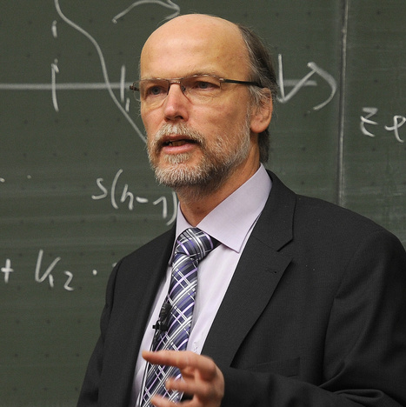
Key figures
Scientist name
Scientist name
Scientist name
Elaborate on what you want to discuss.
Elaborate on what you want to discuss.
Elaborate on what you want to discuss.

Slide 15
In Conclusion
Service One
Service Two
Elaborate on what you want to discuss.
Elaborate on what you want to discuss.
Service Three
Service Four
Elaborate on what you want to discuss.
Elaborate on what you want to discuss.

