Slide 1
Analysis of Air Quality Data
Tom Rowan – ST20285213
DAT5003 – S2_24 - PRES1

Slide 2
Agenda
Choosing a Relevant Question
Reference Resources
Preprocessing Challenges
Answering the Question:
Data Analysis
Limitations of the Dataset
Notes:
As requested in the PRES1 assignment document, this presentation aims to answer:
What is your motivation behind the chosen analytic question relevant to the given dataset?
Which articles, blogs, case studies, etc. did you refer to formulate your data analysis steps and understanding of the domain? You should provide a brief critical evaluation of those materials and methods.
What were the challenges you encountered while pre-processing the data before the actual analysis and how did you overcome those challenges?
What were the major steps taken by you for performing the data analysis in order to answer the chosen question? You should also show your key results.
After working through the given dataset what do you think as the major limitations of this dataset?

Slide 3
What can we learn from this dataset?
The Dataset:
One year of pollution sensor readings in an Italian city
from 2004 to 2005
Analytical Questions:
Is it possible to predict future pollution levels based on historical data?
And can this data be used to inform residents of the city about potentially risky times, and when to take precautions or to avoid going outside without a mask?
Notes:
What can we learn from this dataset?
The dataset provides a year of data from a pollution sensor in an Italian city.
The data were recorded in 2004 and 2005.
There are a readings from a number of sensors, each tuned to a particular pollutant, along with localized atmospheric readings.
While the dataset is twenty years old, there are a number of relevant questions that can be posed that may have impact even today.
The questions that I chose to address were:
Is it possible to predict future pollution levels based on historical data?
And can this data be used to inform residents of the city about potentially risky times, and when to take precautions or to avoid going outside without a mask?

Slide 4
Potential Impacts from this Study
Reduced exposure to pollutants, for:
Those vulnerable due to respiratory conditions
Young children
Support for policy and planning initiatives
Implement traffic restrictions when high levels are predicted.
Pedestrian only zones.
Increased Public Health Awareness
Voluntary reductions by residents.
Switching to public transport and/or electric vehicles.

Slide 5
Research and Reference Resources
UK Gov ”How to”
Cited papers from Dataset page

Slide 6
Preprocessing Challenges
Feature | Values Missing | %
CO(GT) | 1683 | 18.0%
C6H6(GT) | 366 | 3.9%
NMHC(GT) | 8443 | 90.2%
NO2(GT) | 1642 | 17.5%
NOx(GT) | 1639 | 17.5%
PT08.S1(CO) | 366 | 3.9%
PT08.S2(NMHC) | 366 | 3.9%
PT08.S3(NOx) | 366 | 3.9%
PT08.S4(NO2) | 366 | 3.9%
PT08.S5(O3) | 366 | 3.9%
Missing values
Dropped NMHC(GT) from study
Filled in by Imputation from surrounding values (KNN Means)

Slide 7
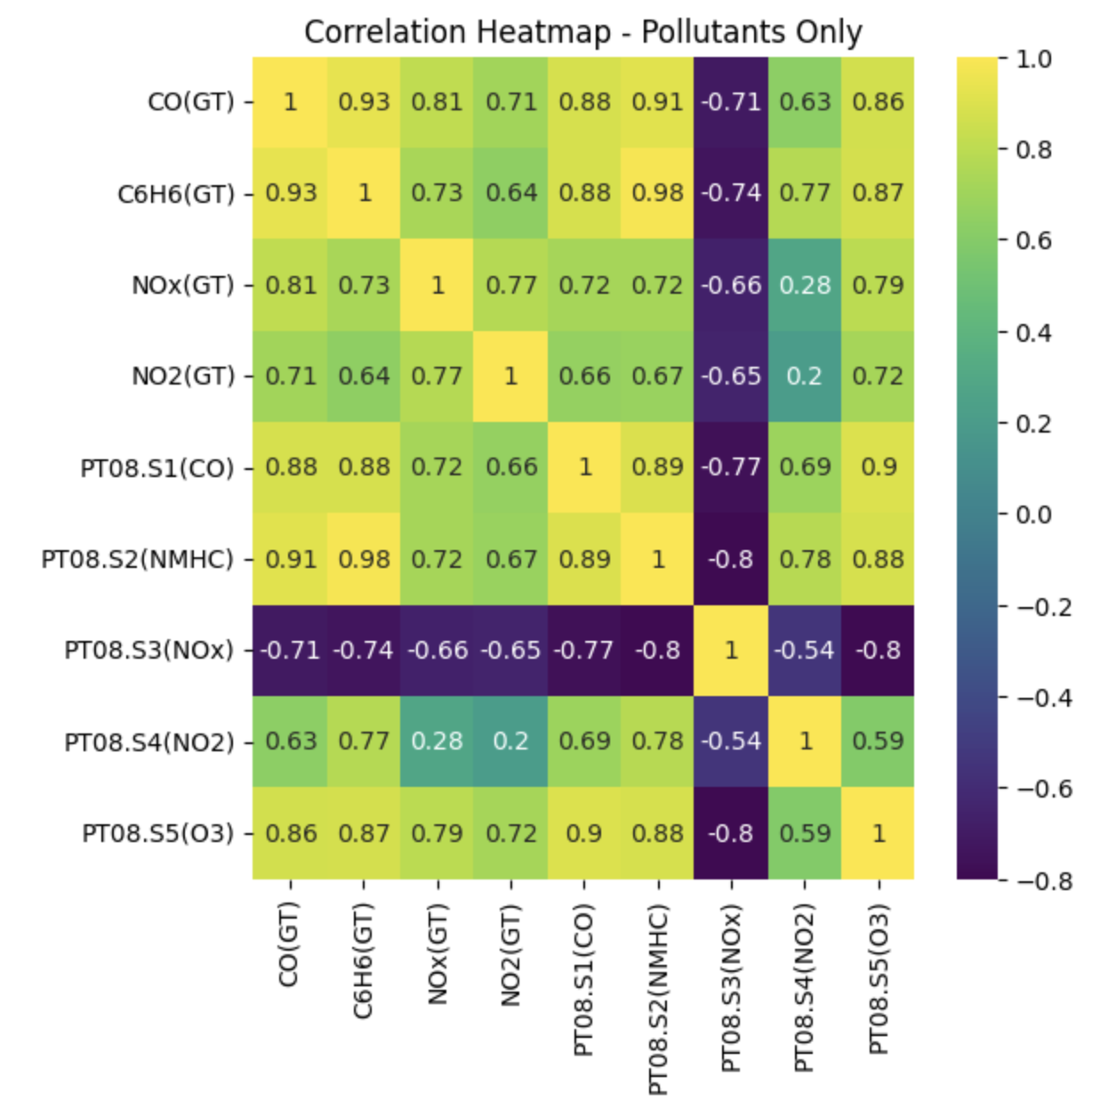
Preprocessing Challenges
Pollutants correlate positively
Except one!
Dropped PT08.S3(NOx) from further study

Slide 8
Analysis: Safe Levels?
Safety Breaches

Slide 9
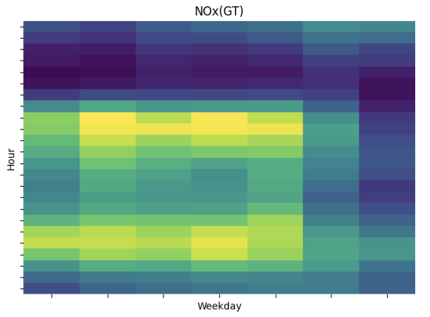
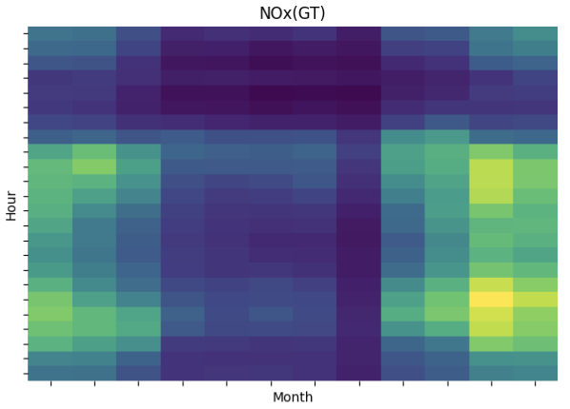
Analysis: Patterns in the Data
Heatmaps of any one pollutant, e.g. NOx (GT)
More pollution in ‘rush hours’
More pollution in cold months. (((REDRAW CHARTS???)))

Slide 10
Analysis: Statistical Predictions
Stuff

Slide 11
Limitations in the Dataset
Single Year
Single Sensor
Sensor failure – missing values
Calibration – poor values

