Slide 1
Analysis of Air Quality Data
Tom Rowan – ST20285213
DAT5003 – S2_24 PRES1
Notes:
Course Details
Title: Applied Data Science
Code: DAT5003 S2_24
Term: Spring 2025
Assessment: PRES1
Student Details
Tom Rowan ST20285213
Project Tutor
Dr. Angesh Anupam

Slide 2
Agenda
Choosing a Relevant Question
Reference Resources
Preprocessing Challenges
Answering the Question:
Data Analysis
Limitations of the Dataset
Notes:
As requested in the PRES1 assignment document, this presentation aims to answer:
What is your motivation behind the chosen analytic question relevant to the given dataset?
Which articles, blogs, case studies, etc. did you refer to formulate your data analysis steps and understanding of the domain? You should provide a brief critical evaluation of those materials and methods.
What were the challenges you encountered while pre-processing the data before the actual analysis and how did you overcome those challenges?
What were the major steps taken by you for performing the data analysis in order to answer the chosen question? You should also show your key results.
After working through the given dataset what do you think as the major limitations of this dataset?

Slide 3
What can we learn from this dataset?
The Dataset:
One year of pollution sensor readings in an Italian city
from 2004 to 2005
Analytical Questions:
Is it possible to predict future pollution levels based on historical data?
And can this data be used to inform residents of the city about potentially risky times, and when to take precautions or to avoid going outside without a mask?
Notes:
What can we learn from this dataset?
The dataset provides a year of data from a pollution sensor in an Italian city.
The data were recorded in 2004 and 2005.
There are a readings from a number of sensors, each tuned to a particular pollutant, along with localized atmospheric readings.
While the dataset is twenty years old, there are a number of relevant questions that can be posed that may have impact even today.
The questions that I chose to address were:
Is it possible to predict future pollution levels based on historical data?
And can this data be used to inform residents of the city about potentially risky times, and when to take precautions or to avoid going outside without a mask?

Slide 4
Potential Impacts from this Study
Reduced exposure to pollutants for:
Those vulnerable due to respiratory conditions
Young children
Support for policy and planning initiatives
Implement traffic restrictions when high levels are predicted.
Pedestrian only zones.
Increased Public Health Awareness
Voluntary reductions by residents.
Switching to public transport and/or electric vehicles.
Notes:
The main motivation in choosing these questions was see whether improvements can be made in air quality, or at least to limit exposure for vulnerable people and children.
According to the Welsh Government "air pollution in the UK reduces the life expectancy of every person by an average of 7–8 months, with an associated cost [to the NHS] of up to £20 billion each year.”
Proactive public health measures are very much needed.
Answering the questions posed allows city planners and residents alike to act in an ethical and positive way to reduce pollution. This might result in traffic restrictions, pedestrian only or low-pollution zones – like the London ULEZ.
Knowing more about pollution levels may also cause residents to switch to public transport or electric vehicles.

Slide 5
Domain Research Resources
Fine GF, Cavanagh LM, Afonja A, Binions R. (2010), Metal Oxide Semi-Conductor Gas Sensors in Environmental Monitoring, https://pmc.ncbi.nlm.nih.gov/articles/PMC3247717/
UKGov (2024) Monitoring ambient air: data analysis techniques. https://www.gov.uk/guidance/monitoring-ambient-air-data-analysis-techniques
WelshGov (2025) About air quality | Air quality in Wales. https://www.airquality.gov.wales/about-air-quality.
Notes:
Here are the most important of the resources I used to gain some domain knowledge before attempting this assignment.
I did some background research to understand the workings of metal oxide pollution sensors.
I also researched how the UK and Welsh governments approach the monitoring and analysis of air quality.
There is now a network of sensors across the UK; government data is available for free on their website.

Slide 6
Preprocessing Challenges
Feature | Values Missing | %
CO(GT) | 1683 | 18.0%
C6H6(GT) | 366 | 3.9%
NMHC(GT) | 8443 | 90.2%
NO2(GT) | 1642 | 17.5%
NOx(GT) | 1639 | 17.5%
PT08.S1(CO) | 366 | 3.9%
PT08.S2(NMHC) | 366 | 3.9%
PT08.S3(NOx) | 366 | 3.9%
PT08.S4(NO2) | 366 | 3.9%
PT08.S5(O3) | 366 | 3.9%
Missing values
Dropped NMHC(GT) from study
Filled in by Imputation from surrounding values (K Nearest Neighbour)
Notes:
The dataset is missing a number of values across the features.
One sensor had completely failed early on, so was disregarded completely.
The missing values for the others were imputed using the K Nearest Neighbour algorithm.
This seemed to work well, apart from creating some 30℃ values in November.
The rest of the data seemed to follow the trend of the dataset.

Slide 7
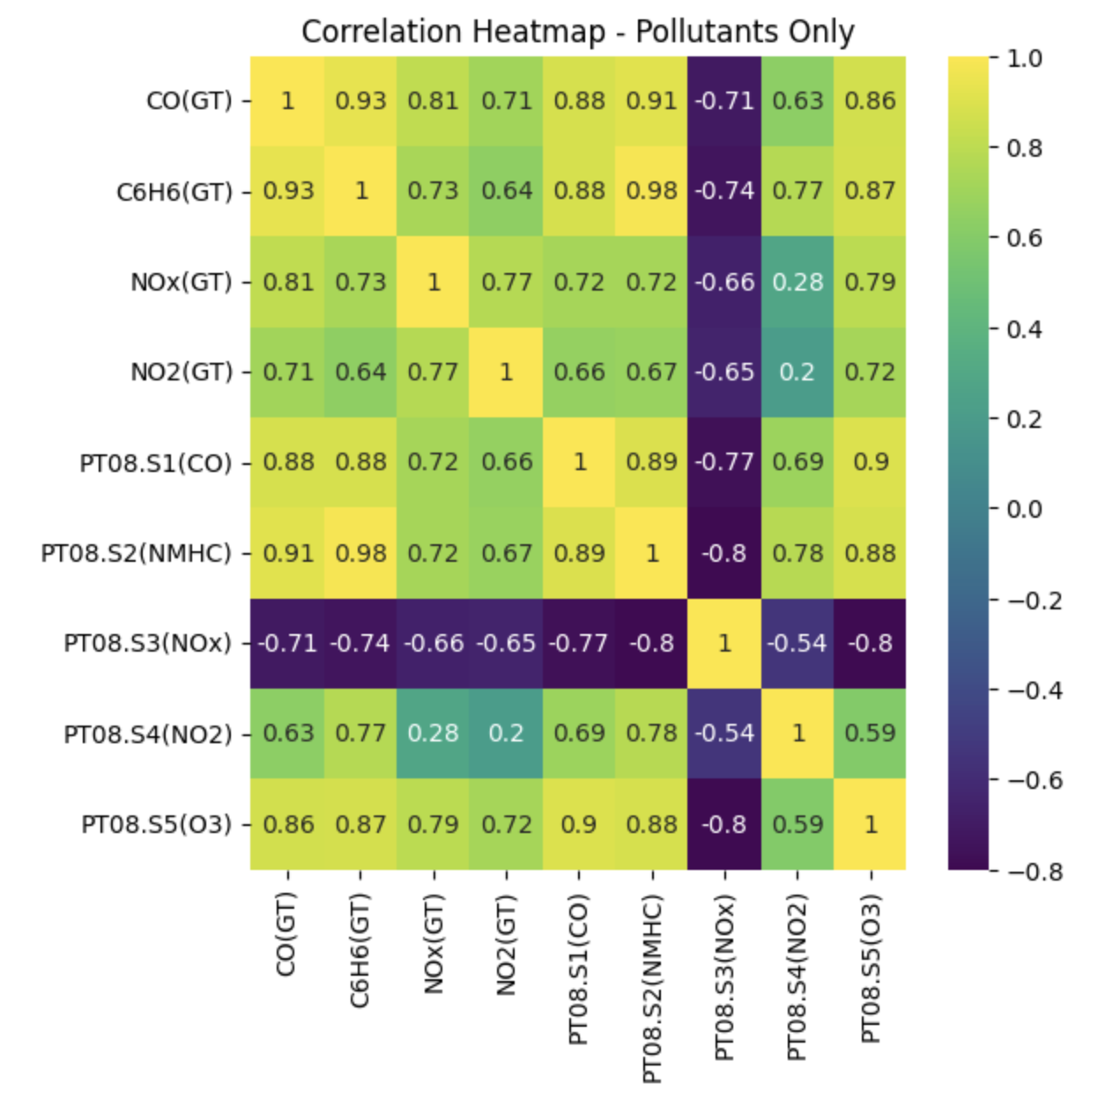
Preprocessing Challenges
Pollutants correlate positively
Except one!
Dropped PT08.S3(NOx) from further study
Notes:
Heatmaps were drawn showing the correlation between features in the dataset.
As expected, most pollutants are positively strongly correlated, meaning that the presence of one indicates the likely presence of any other of them.
There was one PT08.S3 (NOx biased) that showed the opposite.
It is likely that this sensor was poorly calibrated during the original date gathering.
These sensor values were dropped from this study.

Slide 8
Analysis: Within Safe Levels?
The pollutant levels frequently breached recognized WHO safety limits:
Pollutant | 24 Hour Average | 8 Hour Average | 1 Hour Average
CO (Carbon Monoxide) | 8 times (2%) | 0 | 0
C6H6 (Benzene) | 381 times (98%) | (Safe level unavailable) | 94 times (1%)
NO2 (Nitrogen Dioxide) | 391 times (100%) | (Safe level unavailable) | 400 times (4%)
Notes:
It is difficult to find standardised legal limits for each of the chemicals in the dataset. The legal limits expected by countries vary wildly.
The data was gathered twenty years ago in 2004-2005. The World Health Organisation has proposed stricter limits since this time.
The data was averaged over one, eight and 24 hours and compared to the legal limit for that period. As the table shows, the pollutant levels frequently breached WHO safety limits, particularly for benzene and nitrogen dioxide.

Slide 9
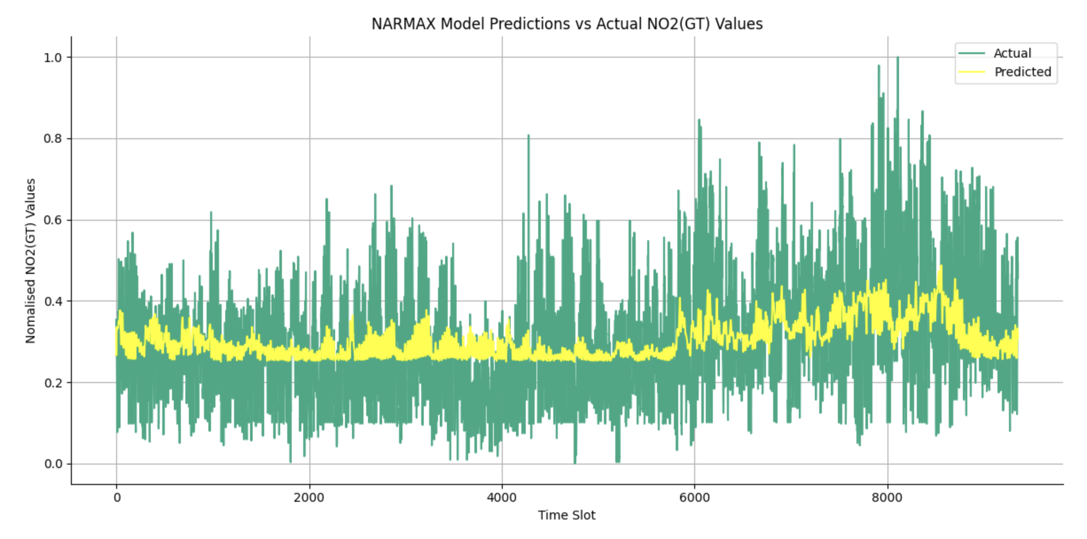
Analysis: Statistical Predictions
NARMAX modelling using SysIdentPy
Inconclusive
Notes:
The NARMAX model takes into account previous data values to predict the current one.
This is suitable for complex systems, such as the air quality data, where three are external influences – such as other pollutants.
There is only one python module available – SysIdentPy – and information on the library is highly technical.
This proved to be complicated to set up to create a reliable model. The results were not particularly useful.
The data was normalised before processing by the model.
But, predicted levels are much lower than the actual levels.

Slide 10
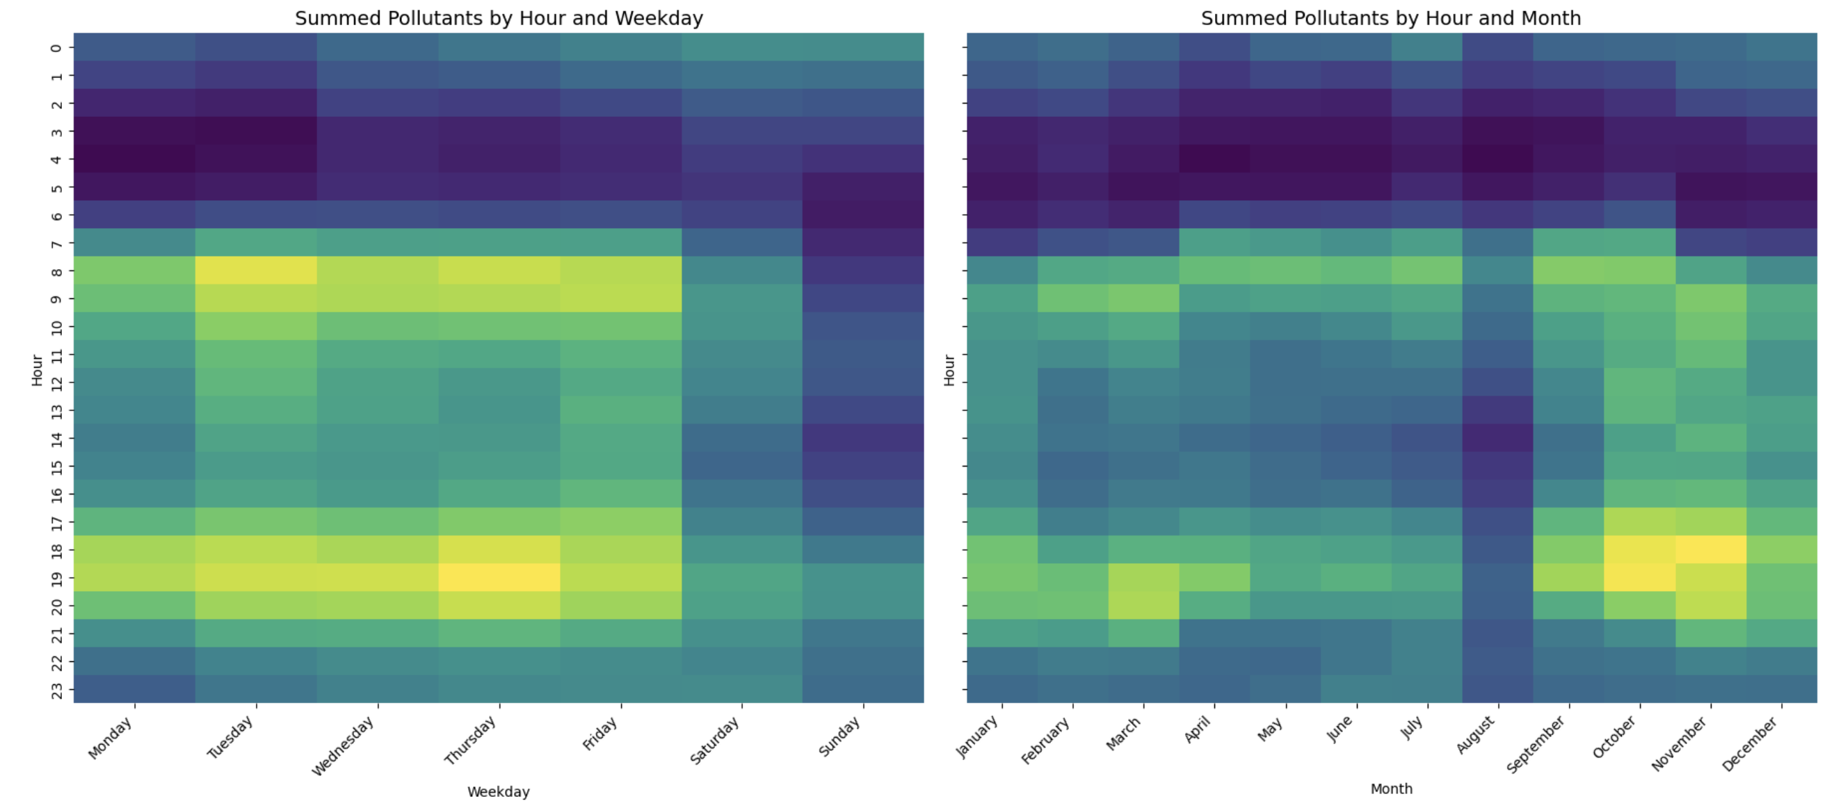
Analysis: Patterns in the Data
Heatmaps of All Pollutants
Pollution peaks in ‘rush hour’.
It takes time to disperse.
More pollution in cold months.
Notes:
Heatmaps are effective to show the time when pollution levels are at their highest.
The most useful charts plotted the hour of the day against weekday and against the month.
The data for all pollutants has been normalised and summed.
Pollution levels are highest from 0730 to 1000, and again from 1630-2030 on weekdays.
This effect is increased in the winter months, when more drive to work due to the weather.
August is comparatively pollution free. This is because August is when Italians take their summer holidays. (Crowded Planet, 2025)
(Crowded Planet (2025) Italy in August – Where to Go + Weather 2025, https://www.thecrowdedplanet.com/italy-in-august/)

Slide 11
Limitations and Further Study
Single Year
Single Sensor
Sensor failure – missing values
Calibration – inaccurate values
Notes:
The dataset is limited in several ways:
There is only a single year of data. This limits the effectiveness of time based analysis.
There is only a single sensor.
The more sensor readings that are available, the easier it would be to spot false readings, particularly where a sensor is wildly out of calibration with its peers.
Placing sensors away from traffic may identify pollution from other sources – such as garden bonfires, construction sites, human waste management or landfill sites.
Sensor failure leading to missing values. One sensor failed completely, while others were missing values.
Poor sensor calibration leading to inaccurate values and built-in biases in the data.
When the sensor was deployed in 2004, these were large expensive items. Cheaper, more reliable sensors are available today.
Future studies would use a grid of sensors deployed across a local and would also record wind direction and strength.
This would enable analysis of dispersion and identification of pollutant sources.

Slide 12

Conclusion
The Air Quality Dataset
  posed some preprocessing challenges.
  has limitations.
Answering the analytical questions:
  Statistical NARMAX modelling was inconclusive
  But heatmaps are effective.
Further study
  multiple sensors in a grid
  more atmospheric features
Notes:
The Air Quality Dataset
posed some preprocessing challenges.
And has limitations.
Answering the analytical questions:
Statistical NARMAX modelling was inconclusive
But the heatmaps proved to be effective.
Further study
multiple sensors in a grid
more atmospheric features – wind direction and strength

Slide 13
Thank you. Any Questions?

