Slide 1
NATURAL LANGUAGE PROCESSING AND TEXT CLASSIFICATION

Slide 2
LEARNING OBJECTIVES
NATURAL LANGUAGE PROCESSING AND TEXT CLASSIFICATION
Define natural language processing
List common tasks associated with
use-cases
tokenization
tagging
parsing
Demonstrate how to classify text or documents using scikit-learn

Slide 3
COURSE
PRE-WORK

Slide 4
PRE-WORK REVIEW
Experience with scikit-learn classifiers, specifically random forests and decision trees
Install the Python package spacy with pip install spacy
Run the spacy download data command
python -m spacy download en

Slide 5
OPENING
NATURAL LANGUAGE PROCESSING AND TEXT CLASSIFICATION

Slide 6
WARNING
BEFORE WE CONTINUE, UNDERSTAND:
Natural Language Processing (NLP) is HEAVILY based in the field of Linguistics (study of language).
Linguistics CAN NOT be taught in a 3 hour class.
The goal is to get you COMFORTABLE with some of the concepts involved with NLP (terms, words as numbers), NOT Linguistics.
Want to get further into NLP? Read Noam Chomsky.

Slide 7
REVIEW: DECISION TREES AND RANDOM FORESTS
What are decision trees?
What are random forests?

Slide 8
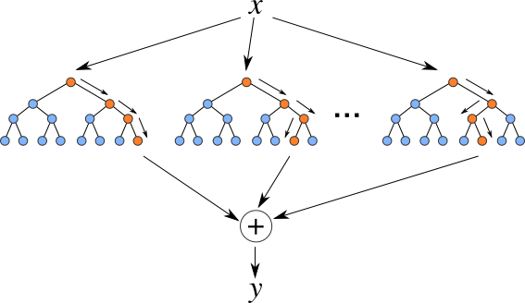
REVIEW: DECISION TREES AND RANDOM FORESTS
Decision trees are models that ask a series of questions. The next question depends upon the answer to the previous question.
Random forest models are ensembles of decision trees that are randomized in the way they are created.

Slide 9
REVIEW: DECISION TREES AND RANDOM FORESTS
Decision trees are weak learners that are easy to overfit.
Random forests are strong models that are made up of a collection of decision trees.
They are non-linear (as opposed to logistic regression).
They are mostly black-boxes (no coefficients, although we do have a measure of feature importance).
They can be used for classification or regression.

Slide 10
INTRODUCTION
NATURAL LANGUAGE PROCESSING

Slide 11
WHAT IS NATURAL LANGUAGE PROCESSING (NLP)?
Natural language processing is the task of extracting meaning and information from text documents.
There are many types of information we might want to extract.
These tasks may range from simple classification tasks, such as deciding what category a piece of text falls into, to more complex tasks like translating or summarizing text.
For most tasks, a fair amount of pre-processing is required to make the text digestible for our algorithms. We typically need to add structure to our unstructured data.

Slide 12

WHAT IS NATURAL LANGUAGE PROCESSING (NLP)?
Many AI assistant systems are typically powered by fairly advanced NLP engines.
A system like Siri uses voice-to-transcription to record a command and then various NLP algorithms to identify the question asked and possible answers.

Slide 13
TOKENIZATION
Tokenization is the task of separating a sentence into its constituent parts, or tokens.
Determining the “words” of a sentence seems easy but can quickly become complicated with unusual punctuation (common in social media) and / or different language conventions.

Slide 14
TOKENIZATION
What sort of difficulties can you find in the following sentence?
The L.A. Lakers won the NBA championship in 2010, defeating the Boston Celtics.

Slide 15
TOKENIZATION
What sort of difficulties can you find in the following sentence?
The L.A. Lakers won the NBA championship in 2010, defeating the Boston Celtics.
Nearly 25% of words in sentence contain no information (the).
L.A. - End of a sentence?
in - Ambiguous word, multiple meanings
2010 - This is a word, not the number two thousand and ten.
L.A. Lakers and Boston Celtics are related concepts (“similar”).

Slide 16
TOKENIZATION EXAMPLES
My house is located in Uptown. → [My, house, is, located, in, Uptown]
The Lakers are my favorite team. → [The, Lakers, are, my, favorite, team]
Data Science is the future! → [Data, Science, is, the, future]
GA has many locations. → [GA, has, many, locations.]

Slide 17
LEMMATIZATION AND STEMMING
How would you describe the relationship between the terms ‘bad’ and ‘badly’ or ‘different’ and ‘differences’?
Stemming and lemmatization help identify common roots of words.
Stemming is a crude process of removing common endings from sentences, such as ‘s’, ‘es’, ‘ly’, ‘ing’, and ‘ed’.

Slide 18
LEMMATIZATION AND STEMMING
Lemmatization is a more refined process that uses specific language and grammar rules to derive the root of a word.
This is useful for words that do not share an obvious root such as ‘better’ and ‘best’.
What are some other examples of words that do not share an obvious root?

Slide 19
LEMMATIZATION AND STEMMING EXAMPLES
Lemmatization
shouted → shout
best → good
better → good
good → good
wiping → wipe
hidden → hide
Stemming
badly → bad
computing → comput
computed → comput
wipes → wip
wiped → wip
wiping → wip

Slide 20

ACTIVITY: KNOWLEDGE CHECK
ANSWER THE FOLLOWING QUESTIONS
EXERCISE
What other words or phrases might cause problems with stemming? Why?
Is lemmatization an objective or subjective method? Why?
DELIVERABLE
Answers to the above questions
Notes:
Stemming - ran / run, ride / rode, laziness / lazy (depending on stemming method)

Slide 21
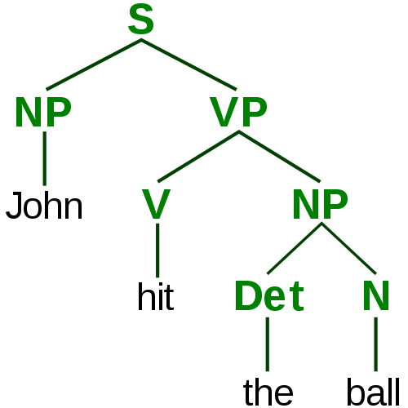
PARSING AND TAGGING
In order to understand the various elements of a sentence, we need to tag important topics and parse their dependencies.
Our goal is to identify the actors and actions in the text in order to make informed decisions.
Notes:
Actors - Things that affect a change.
Actions - Things through which change is affected.
phrase structure tree
NP = Noun phrase
VP = Verb phrase
V = Verb
Det = Determiner
N = Noun

Slide 22
PARSING AND TAGGING
If we are processing financial news, we might need to identify which companies are involved and which actions they are taking.
If we are writing an assistant application, we might need to identify specific command phrases in order to determine what is being asked:
e.g. “Siri, when is my next appointment?”

Slide 23
PARSING AND TAGGING
Tagging and parsing is made up of a few overlapping subproblems:
“Parts of speech” tagging: What are the parts of speech in a sentence (e.g. noun, verb, adjective, etc)?
Chunking: Can we identify the pieces of the sentence that go together in meaningful chunks (e.g. noun or verb phrases)?
Named entity recognition: Can we identify specific proper nouns? Can we pick out people and locations?
Similarity: How similar is one word to another?

Slide 24
ACTIVITY: KNOWLEDGE CHECK
ANSWER THE FOLLOWING QUESTIONS
EXERCISE
How might NLP be applied within your current jobs or final projects?
What are some other potential NLP use-cases?
DELIVERABLE
Answers to the above questions

Slide 25
DEMO
NATURAL LANGUAGE PROCESSING WITH ‘SPACY’

Slide 26
NATURAL LANGUAGE PROCESSING WITH ‘SPACY’
Most NLP techniques require pre-processing large collections of annotated text in order to learn specific language rules.
There are many tools available for English and other popular languages.
Each tool typically requires a large amount of data and large databases of special use-cases, including language inconsistencies and slang.
In Python, two popular NLP packages are nltk and spacy.
nltk is more popular but not as advanced and well maintained. spacy is more modern.

Slide 27
NATURAL LANGUAGE PROCESSING WITH ‘SPACY’
We’ll be using spacy to process some news article titles. First load the NLP toolkit by specifying the language.
from spacy.en import English nlp_toolkit = English()
This toolkit has 3 pre-processing engines:
A tokenizer: to identify the word tokens
A tagger: to identify the concepts described by the words
A parser: to identify the phrases and links between different words
Each of these engines can be overridden with a different, specialized tool. You can even write your own and use them in place of the defaults.

Slide 28

NATURAL LANGUAGE PROCESSING WITH ‘SPACY’
The first title is “IBM Sees Holographic Calls, Air Breathing Batteries”.
From this, we may want to extract several pieces of information: this title references a company and that company is referencing a new possible product: air-breathing batteries.

Slide 29
NATURAL LANGUAGE PROCESSING WITH ‘SPACY’
We can use spacy to get information about this title.
title = "IBM sees holographic calls, air breathing batteries" parsed = nlp_toolkit(title)
for (i, word) in enumerate(parsed): print("Word: {}".format(word)) print("\t Phrase type: {}".format(word.dep_)) print("\t Is the word a known entity type? {}".format(word.ent_type_ if word.ent_type_ else "No")) print("\t Lemma: {}".format(word.lemma_)) print("\t Parent of this word: {}".format(word.head.lemma_))
nlp_toolkit runs each of the individual pre-processing tools.

Slide 30
NATURAL LANGUAGE PROCESSING WITH ‘SPACY’
The output will look similar to this:
Word: IBM Phrase type: nsubj Is the word a known entity type? ORG Lemma: ibm Parent of this word: see Word: sees Phrase type: ROOT Is the word a known entity type? No Lemma: see Parent of this word: see Word: holographic Phrase type: amod Is the word a known entity type? No Lemma: holographic Parent of this word: call

Slide 31
NATURAL LANGUAGE PROCESSING WITH ‘SPACY’
In this output:
“IBM” is identified as an organization (ORG).
We identify a phrase: “holographic calls”.
We identify a compound noun phrase: “air breathing batteries”.
We identify that “see” is at the root as an action “IBM” is taking.
We can see that “batteries” was lemmatized to “battery”.

Slide 32
NATURAL LANGUAGE PROCESSING WITH ‘SPACY’
We can use this output to find all titles that discuss an organization.
def references_organization(title): parsed = nlp(title) return any([word.ent_type_ == 'ORG' for word in parsed]) data['references_organization'] = data['title'].fillna('').map(references_organization) data[data['references_organization']][['title']].head()

Slide 33
ACTIVITY: KNOWLEDGE CHECK
COMPLETE THE FOLLOWING TASKS
EXERCISE
Using the code on the previous slide, write a function to identify titles that mention an organization (ORG) and a person (PERSON).
DELIVERABLE
New function

Slide 34
COMMON PROBLEMS IN NLP
These subtasks are very difficult, because language is complex and changes frequently.
Most often, we are looking for heuristics to search through large amounts of text data. The results may not be perfect... and that’s okay!
Older techniques rely on rule-based systems. More recent techniques use flexible systems, focusing on the words used rather than the structure of the sentence.

Slide 35
BREAK POINT
TIME FOR A BREAK

Slide 36
INTRODUCTION
TEXT CLASSIFICATION

Slide 37
TEXT CLASSIFICATION
Text classification is the task of predicting which category or topic a text sample is from.
For example, we may want to identify whether an article is a sports or business story. Or whether an article has positive or negative sentiment.
Typically, this is done by using the text as features and the label as the target output. This is referred to as bag-of-words classification.
To include text as features, we usually create a binary feature for each word, i.e. does this piece of text contain that word?

Slide 38
TEXT CLASSIFICATION
To create binary text features, we first create a vocabulary to account for all possible words in our data set.
As we do this, we need to consider several things.
Does order of words matter?
Does punctuation matter?
Does upper or lower case matter?

Slide 39
TEXT CLASSIFICATION
This table illustrates features created from the following passage.
“It’s a great advantage not to drink among hard drinking people.”
Feature | Value
it’s | 1
great | 1
good | 0
advantage | 1
not | 1
think | 0
drink | 1
from | 0
hard | 1
drinking | 1
Feature | Value
people | 1
withhold | 0
random | 0
smoke | 0
among | 1
whenever | 0
thoughtful | 0
inexhaustible | 0
men | 0
Nick | 0

Slide 40
ACTIVITY: KNOWLEDGE CHECK
ANSWER THE FOLLOWING QUESTIONS
EXERCISE
Discuss your answers to the following questions and explain your reasoning.
Does word order matter?
Does word case (e.g. upper or lower) matter?
Does punctuation matter?
DELIVERABLE
Answers to the above questions

Slide 41
ACTIVITY: KNOWLEDGE CHECK
ANSWER THE FOLLOWING QUESTIONS
EXERCISE
What is “bag-of-words” classification and when should it be used?
What are some benefits / problems with this approach?
DELIVERABLE
Answers to the above questions

Slide 42
DEMO
TEXT PROCESSING IN SCIKIT-LEARN

Slide 43
TEXT PROCESSING IN SCIKIT-LEARN
Scikit-learn has many pre-processing utilities that simplify tasks required to convert text into features for a model.
These can be found in the sklearn.preprocessing.text package.
We will use the StumbleUpon dataset again to perform text classification. This time, we will use the text content itself to predict whether a page is ‘evergreen’ or not.
Open the starter code notebook to follow along.

Slide 44
COUNTVECTORIZER
CountVectorizer converts a collection of text into a matrix of features. Each row will be a sample (an article or piece of text) and each column will be a text feature (usually a count or binary feature per word).
CountVectorizer takes a column of text and creates a new dataset. It generates a feature for every word in all of the pieces of text.
REMEMBER: Using all of the words can be useful, but we may need to use regularization to avoid overfitting. Otherwise, rare words may cause the model to overfit and not generalize.

Slide 45
COUNTVECTORIZER
Instantiate a new CountVectorizer.
from sklearn.feature_extraction.text import CountVectorizer vectorizer = CountVectorizer(max_features = 1000, ngram_range=(1, 2), stop_words='english', binary=True)

Slide 46
COUNTVECTORIZER PARAMETERS
There are several parameters to utilize.
ngram_range - a range of word phrases to use
(1,1) means use all single words
(1,2) means use all contiguous pairs of word
(1,3) means use all triples
Possible issues?
stop_words=’english’
Stop words are non-content words (e.g. ‘to’, ‘the’, ‘it’, etc). They aren’t helpful for prediction, so they get removed.

Slide 47
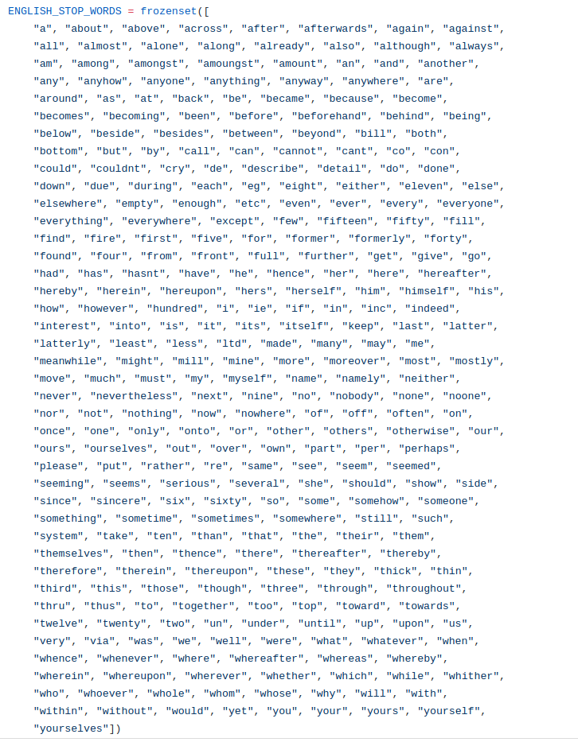
STOP WORDS

Slide 48
COUNTVECTORIZER PARAMETERS
max_features=1000
Maximum number of words to consider (uses the first N most frequent)
binary=True
To use a dummy column as the entry (1 or 0, as opposed to the count). This is useful if you think a word appearing 10 times is no more important than whether the word appears at all.

Slide 49
COUNTVECTORIZER
Vectorizers are like other models in scikit-learn.
We create a vectorizer object with the parameters of our feature space.
We fit a vectorizer to learn the vocabulary.
We transform a set of text into that feature space.

Slide 50
COUNTVECTORIZER EXAMPLE
titles = data['title'].fillna('') from sklearn.feature_extraction.text import CountVectorizer vectorizer = CountVectorizer(max_features = 1000, ngram_range=(1, 2), stop_words='english', binary=True) # Use `fit` to learn the vocabulary of the titles vectorizer.fit(titles) # Use `transform` to generate the sample X word matrix - one column per feature (word or n-grams - Returns sparse matrics) X = vectorizer.transform(titles)

Slide 51
RANDOM FOREST PREDICTION MODEL
We can now build a random forest model to predict “evergreenness”.
from sklearn.ensemble import RandomForestClassifier model = RandomForestClassifier(n_estimators = 20) # Use `fit` to learn the vocabulary of the titles vectorizer.fit(titles) # Use `transform` to generate the sample X word matrix - one column per feature (word or n-grams) X = vectorizer.transform(titles) y = data['label'] from sklearn.cross_validation import cross_val_score scores = cross_val_score(model, X, y, scoring='roc_auc') print('CV AUC {}, Average AUC {}'.format(scores, scores.mean()))

Slide 52
TERM FREQUENCY - INVERSE DOCUMENT FREQUENCY
An alternative bag-of-words approach to CountVectorizer is a Term Frequency - Inverse Document Frequency (TF-IDF) representation.
TF-IDF uses the product of two intermediate values, the Term Frequency and Inverse Document Frequency.

Slide 53
TERM FREQUENCY - INVERSE DOCUMENT FREQUENCY
Term Frequency is equivalent to CountVectorizer features, just the number of times a word appears in the document (i.e. count).
Document Frequency is the percentage of documents that a particular word appears in.
For example, “the” would be 100% while “Syria” is much lower.
Inverse Document Frequency is just 1/Document Frequency.

Slide 54
TERM FREQUENCY - INVERSE DOCUMENT FREQUENCY
Combining, TF-IDF = Term Frequency * Inverse Document Frequency or TF-IDF = Term Frequency / Document Frequency
The intuition is that the words that have high weight are those that either appear frequently in this document or appear rarely in other documents (and are therefore unique to this document).
This is a good alternative to using a static set of “stop” words.
from sklearn.feature_extraction.text import TfidfVectorizer vectorizer = TfidfVectorizer()

Slide 55
ACTIVITY: KNOWLEDGE CHECK
ANSWER THE FOLLOWING QUESTIONS
What does TF-IDF stand for?
What does this function do and why is it useful?
Use TfidfVectorizer to create a feature representation of the StumbleUpon titles.
EXERCISE
DELIVERABLE
Answers to the above questions and feature representation

Slide 56
INDEPENDENT PRACTICE
TEXT CLASSIFICATION IN SCIKIT-LEARN

Slide 57
ACTIVITY: TEXT CLASSIFICATION IN SCIKIT-LEARN
DIRECTIONS (30 minutes)
EXERCISE
Use the text features of title with one or more feature sets from the previous random forest model. Train this model to see if it improves AUC.
Use the body text instead of the title. Does this give an improvement?
Use TfIdfVectorizer instead of CountVectorizer. Does this give an improvement?
Check: Were you able to prepare a model that uses both quantitative features and text features? Does this model improve the AUC?
DELIVERABLE
Three new models

Slide 58
CONCLUSION
TOPIC REVIEW

Slide 59
LET’S REVIEW
Natural language processing (NLP) is the task of pulling meaning and information from text.
This typically involves many subproblems including tokenization, cleaning (stemming and lemmatization), and parsing.
After we have structured our text, we can identify features for other tasks, including classification, summarization, and translation.
In scikit-learn, we use vectorizers to create text features for classification, such as CountVectorizer and TfIdfVectorizer.

Slide 60
COURSE
BEFORE NEXT CLASS

Slide 61
DUE DATE
BEFORE NEXT CLASS
Project: Unit Project 4 - TONIGHT!
Project: Final Project 2 - Wednesday!

