Slide 1
DIMENSIONALITY REDUCTION, LATENT VARIABLE MODELS AND PCA

Slide 2
LEARNING OBJECTIVES
LATENT VARIABLES AND NATURAL LANGUAGE PROCESSING
Understand what the curse of dimensionality is
Understand what latent variables are
Understand the uses of latent variables in language processing
Use the LDA algorithms of genism
Understand the use of PCA for dimensionality reduction

Slide 3
COURSE
PRE-WORK

Slide 4
PRE-WORK REVIEW
Install gensim with pip install gensim
Recall and apply unsupervised learning techniques
Recall probability distributions
Recall NLP essentials, including experience with spacy

Slide 5
CURSE OF DIMENSIONALITY
Each column in X adds a dimension
Each dimension adds complexity to the analysis
Human-centric:
As dimensionality increases, visualisation of information decreases.
Data-centric:
As dimensionality increases, observations per “division” decreases by N * 1 / D (where N = number of observations, D = dimensions)
More observations per division = better performance.
http://cleverowl.uk/2016/02/06/curse-of-dimensionality-explained/
Notes:
Where D = 1, all observations are present to make an assessment.
Where D > 1, observations become more sparse in the variable space with the formula N * 1 / D

Slide 6
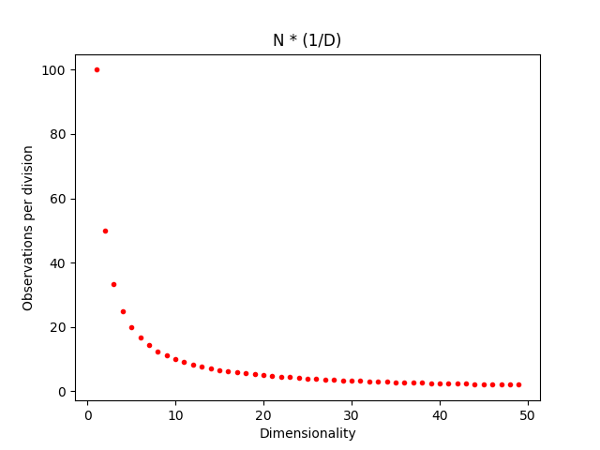
CURSE OF DIMENSIONALITY

Slide 7
OPENING
LATENT VARIABLE MODELS

Slide 8
LATENT VARIABLE MODELS
This lesson will continue on natural language processing with an emphasis on latent variables models.
Mining and Refining data is a key part of the data science workflow.
In our last class, we saw many techniques for mining the data, including preprocessing, building linguistic rules to uncover patterns, and creating classifiers from unstructured data.
In this class, we’ll continue with methods to Refine our understanding of the text by attempting to uncover structure or organization in the text (with a brief discussion on Principle Components Analysis along the way).

Slide 9
LATENT VARIABLE MODELS
Many advances in NLP are based on using data to learn rules of grammar and language. We saw these tools in our last class.
Tokenization
Stemming or lemmatization
Parsing and tagging
Each of these are based on a classical or theoretical understanding of language.

Slide 10
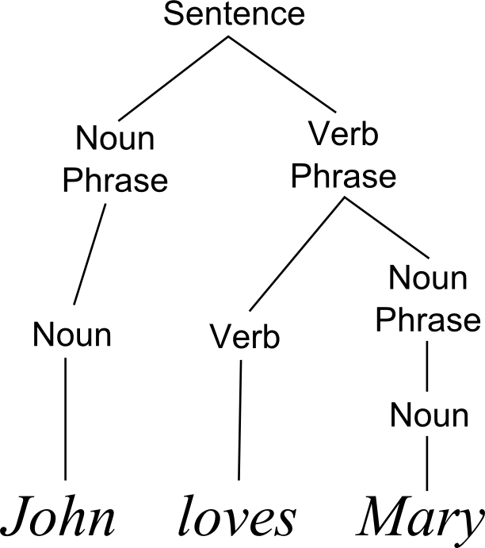
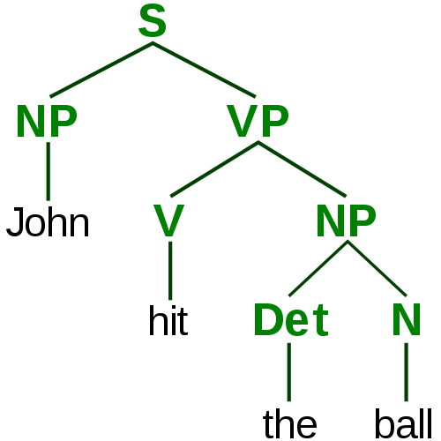
LATENT VARIABLE MODELS
Tokenization:
John hit the ball → [John, hit, the, ball]
Where did you go → [Where, did, you, go]
Stemming or lemmatization: shouted → shout, better → good
Parsing and tagging:

Slide 11
LATENT VARIABLE MODELS
Latent variable models are different in that they try to understand language based on how the words are used.
For example, instead of learning that ‘bad’ and ‘badly’ are related because they share the same root, we’ll determine that they are related because they are often used in the same way often or near the same words.
We’ll use unsupervised techniques (discovering patterns or structure) to extract the information.

Slide 12
LATENT VARIABLE MODELS
Traditional NLP Models
Focused on theoretical understanding of language
Tries to learn the rules of a particular language
Preprogrammed set of rules
Latent Variable Models
Focused on how the language is actually used in practice
Infers meaning from how words are used together
Uses unsupervised learning to discover patterns or structure

Slide 13
LATENT VARIABLE MODELS
Traditional NLP Models
‘bad’ and ‘badly’ are related because they share a common root.
‘Python’ and ‘C++’ are both programming languages because they are often a noun preceded by the verb ‘program’ or ‘code’.
Latent Variable Models
‘bad’ and ‘badly’ are related because they are used the same way or near the same words.
‘Python’ and ‘C++’ are both programming languages because they are often used in the same context.

Slide 14
INTRODUCTION
LATENT VARIABLE MODELS

Slide 15
LATENT VARIABLE MODELS
Latent variable models are models in which we assume the data we are observing has some hidden, underlying structure that we can’t see, and which we’d like to learn.
These hidden, underlying structures are the latent (i.e. hidden) variables we want our model to understand.
Text processing is a common application of latent variables.

Slide 16
LATENT VARIABLE MODELS
While language (in the classical sense) is defined by a set of pre-structured grammar rules and vocab, we often break those rules and create new words (e.g. selfie).
Instead of attempting to train our model on the rules of proper grammar, we’ll ignore grammar and seek to uncover alternate hidden structures.

Slide 17
LATENT VARIABLE MODELS
Latent variable techniques are often used for recommending news articles or mining large troves of data to find commonalities.
Topic modeling, a method we’ll cover today, is used in the NY times recommendation engine.
The New York Times attempts to map their articles to a latent space of topics using the content of the article.

Slide 18
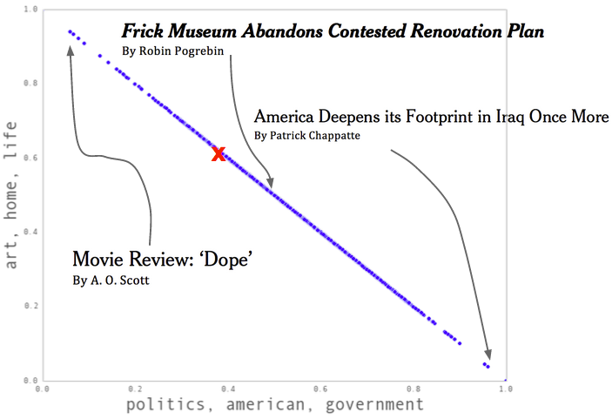
LATENT VARIABLE MODELS
Notes:
As an example, we run our algorithm supposing that all New York Times articles published in the last month can be represented as a combination of two topics. Under these constraints, the algorithm identifies these topics, roughly, as Politics and Art. Our algorithm finds an article, America Deepens its Footprint in Iraq Once More, as 100% Politics, and a film review by A.O. Scott as 100% Art. It labels mixtures, too; for example, an article about art politics, Frick Museum Abandons Contested Renovation Plan, is labeled 50% Politics, 50% Art.

Slide 19
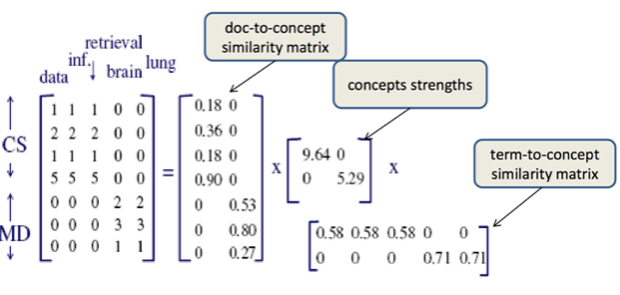
DIMENSIONALITY REDUCTION IN TEXT REPRESENTATION
Our previous ‘representation’ of a set of text documents (articles) for classification was a matrix with one row per document and one column per word (or n-gram).

Slide 20
DIMENSIONALITY REDUCTION IN TEXT REPRESENTATION
While this sums up most of the information, it does drop a few things, mostly structure and order.
Additionally, many of the columns may be correlated.

Slide 21
DIMENSIONALITY REDUCTION IN TEXT REPRESENTATION
For example, an article that contains the word ‘IPO’ is likely to contain the word ‘stock’ or ‘NASDAQ’.
Therefore, those columns are repetitive and likely to represent the same concept or idea.
For classification, we may only care that there are finance-related words.

Slide 22
DIMENSIONALITY REDUCTION IN TEXT REPRESENTATION
One way to deal with this is through regularization - L1/Lasso regularization tends to remove repetitive features by bringing their learned coefficients to 0.
Regularization is the solution to a problem
Another is to perform dimensionality reduction ,where we first identify the correlated columns and the replace them with a column that represents the concept they have in common.
Dimensionality reduction ensures the problem doesn’t take place.
For instance, we could replace ‘IPO’, ‘stocks’, and ‘NASDAQ’ with a single column - ‘HasFinancialWords’ column.

Slide 23
DIMENSIONALITY REDUCTION IN TEXT REPRESENTATION
There are many techniques to do this automatically and most follow a very similar approach.
Identify correlated columns.
Replace them with a new column that encapsulates the others.
Doc # | Car | Truck | Van | Dog
6344 | 1 | 1 | 1 | 0
6345 | 0 | 1 | 1 | 1
6346 | 1 | 1 | 1 | 0
Doc # | Vehicle | Dog
6344 | 1 | 0
6345 | 1 | 1
6346 | 1 | 0

Slide 24
DIMENSIONALITY REDUCTION IN TEXT REPRESENTATION
The techniques vary in how they define correlation and how much of the relationship between the original and new columns you need to save.
Dimensionality techniques can vary between linear and non-linear.

Slide 25
MIXTURE MODELS AND LANGUAGE PROCESSING
Mixture models (specifically LDA or Latent Dirichlet Allocation) take this concept further and generate more structure around the documents.
Instead of just replacing correlated columns, we create clusters of common words and generate probability distributions to explicitly state how related words are.

Slide 26
MIXTURE MODELS AND LANGUAGE PROCESSING
To understand this better, let’s imagine a new way to generate text:
Start writing a document
Choose a topic (sports, news, science).
Choose a random word from that topic.
Repeat.
Repeat for the next document.

Slide 27
MIXTURE MODELS AND LANGUAGE PROCESSING
This ‘model’ of text is assuming that each document is some mixture of topics.
It may be mostly science but may contain some business information.
The latent structure we want to uncover are the topics (or concepts) that generate that text.

Slide 28
MIXTURE MODELS AND LANGUAGE PROCESSING
Latent Dirichlet Allocation is a model that assumes this is the way text is generated and then attempts to learn two things:
The word distribution of each topic
The topic distribution of each document.

Slide 29
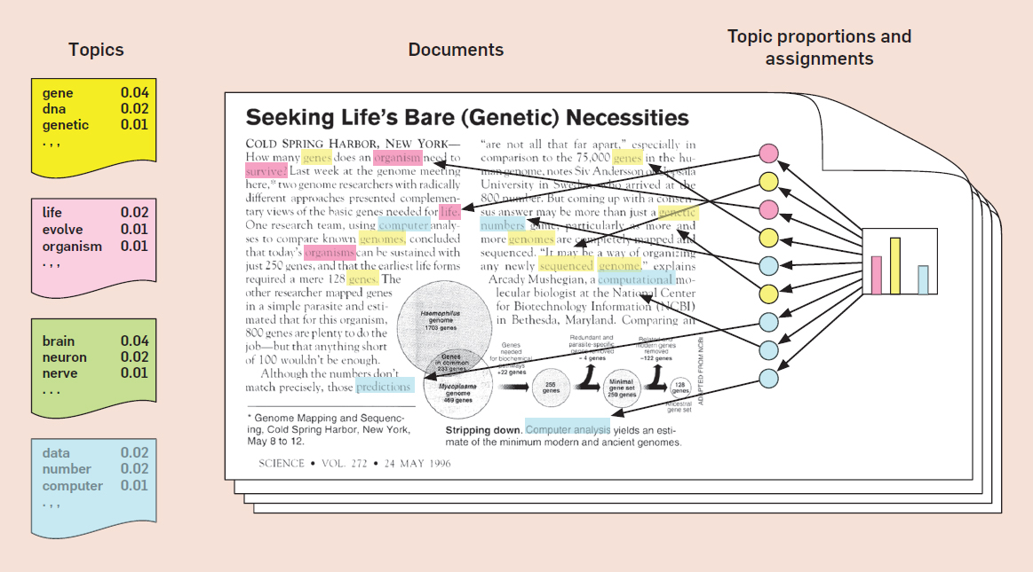
MIXTURE MODELS AND LANGUAGE PROCESSING

Slide 30
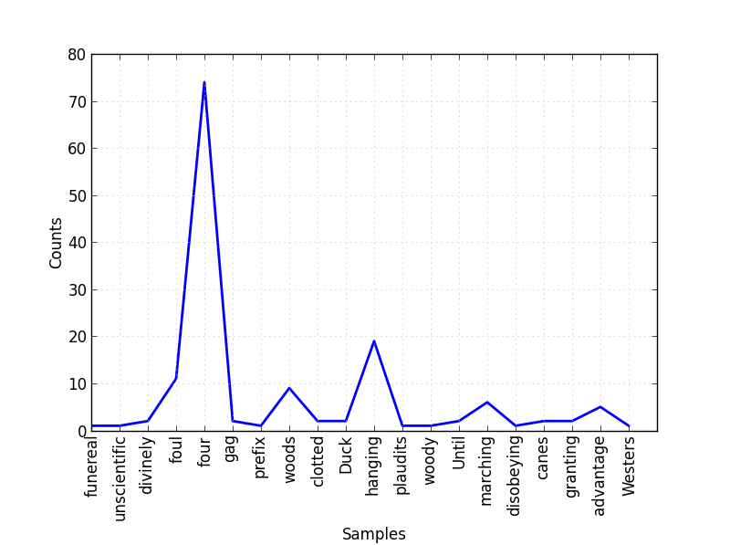
MIXTURE MODELS AND LANGUAGE PROCESSING
The word distribution is a multinomial distribution of each topic representing what words are most likely from that topic.

Slide 31
MIXTURE MODELS AND LANGUAGE PROCESSING
For example, let’s say we have three topics: sports, business, and science.
For each topic, we uncover the most likely words to come from them:
sports: [football: 0.3, basketball: 0.2, baseball: 0.2, touchdown: 0.02 ... genetics: 0.0001] science: [genetics: 0.2, drug: 0.2, ... baseball: 0.0001] business: [stocks: 0.1, ipo: 0.08, ... baseball: 0.0001]
For each word and topic pair, we learn some probability: P(word|topic).

Slide 32
MIXTURE MODELS AND LANGUAGE PROCESSING
The topic distribution is a multinomial distribution for each document representing what topics are most likely to appear in that document.
For all the sample documents, we have a distribution over {sports, science, business}.
ESPN article: [sports: 0.8, business: 0.2, science: 0.0] Bloomberg article: [business: 0.7, science: 0.2, sports: 0.1]
For each topic and document pair, we learn some probability, P(topic|document).

Slide 33
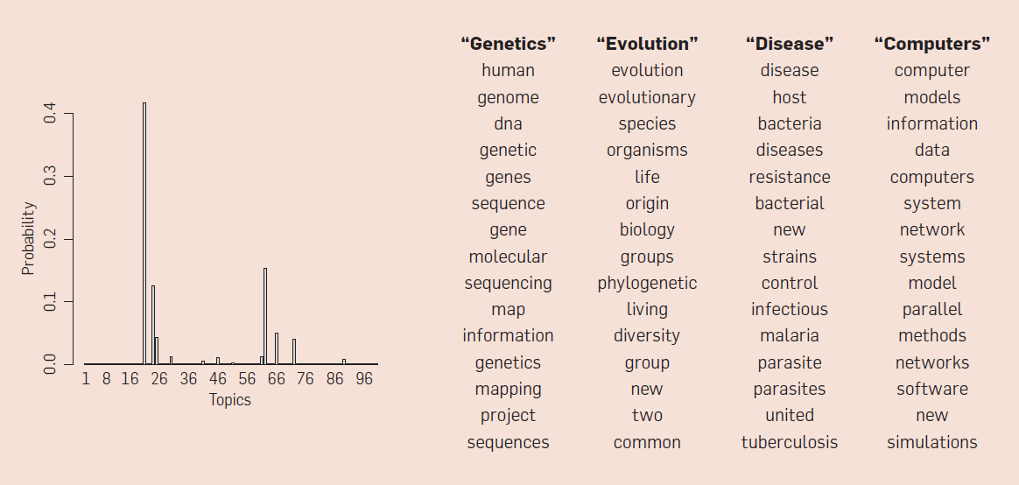
MIXTURE MODELS AND LANGUAGE PROCESSING

Slide 34
MIXTURE MODELS AND LANGUAGE PROCESSING
Topic models are useful for organizing a collection of documents and uncovering the main underlying concepts.
There are many variants that attempt to add even more structure to the ‘model’:
Supervised topic models guide the process with pre-decided topics.
Position-dependent topic models ignore which words occur in which document and instead focus on where they occur.
Variable number topic models test different numbers of topics to find the best model.

Slide 35
DEMO
LDA IN GENSIM

Slide 36
LDA IN GENSIM
gensim is a library of language processing tools focused on latent variable models of text.
It was originally developed by grad students dissatisfied with current implementations of latent models.
Documentation and tutorials are available on the package’s website.

Slide 37
LDA IN GENSIM
Let’s first translate a set of documents (articles) into a matrix representation with a row per document and a column per feature (word or n-gram).

Slide 38
LDA IN GENSIM
from sklearn.feature_extraction.text import CountVectorizer cv = CountVectorizer(binary=False, stop_words='english', min_df=3) docs = cv.fit_transform(data.body.dropna()) # Build a mapping of numerical ID to word id2word = dict(enumerate(cv.get_feature_names()))

Slide 39
LDA IN GENSIM
We want to learn which columns are correlated (i.e. likely to come from the same topic).
This is the word distribution.
We can also determine what topics are in each document, the topic distribution.

Slide 40
LDA IN GENSIM
from gensim.models.ldamodel import LdaModel from gensim.matutils import Sparse2Corpus # First we convert our word-matrix into gensim's format corpus = Sparse2Corpus(docs, documents_columns = False) # Then we fit an LDA model lda_model = LdaModel(corpus=corpus, id2word=id2word, num_topics=15)

Slide 41
LDA IN GENSIM
In this model, we need to explicitly specify the number of topic we want the model to uncover.
This is a critical parameter, but there isn’t much guidance on how to choose it. Try to use domain expertise where possible.

Slide 42
LDA IN GENSIM
Now we need to assess the goodness of fit for our model.
Like other unsupervised learning techniques, our validation techniques are mostly about interpretation.
Use the following questions to guide you:
Did we learn reasonable topics?
Do the words that make up a topic make sense?
Is this topic helpful towards our goal?

Slide 43
LDA IN GENSIM
We can evaluate fit by viewing the top words in each topic.
gensim has a show_topics function for this:
num_topics = 25 num_words_per_topic = 5 for ti, topic in enumerate(lda.show_topics(num_topics = num_topics, num_words_per_topic = n_words_per_topic)): print("Topic: %d" % (ti)) print (topic) print()

Slide 44
LDA IN GENSIM
Some topics will be clearer than others. The following topics represent clear concepts:
0.009*cup + 0.009*recipe + 0.007*make + 0.007*food + 0.006*sugar
→ Cooking and Recipes
0.013*butter + 0.010*baking + 0.010*dough + 0.009*cup + 0.009*sugar
→ Cooking and recipes
0.013*fashion + 0.006*like + 0.006*dress + 0.005*style
→ Fashion and Style

Slide 45

ACTIVITY: KNOWLEDGE CHECK
ANSWER THE FOLLOWING QUESTIONS
EXERCISE
Complete exercises 1 and 2.
DELIVERABLE
Code and topics

Slide 46
BREAK TIME
LEAVE THE ROOM
TAKE A WALK
TALK TO YOUR CLASSMATES!

Slide 47
INTRODUCTION
PRINCIPAL COMPONENTS ANALYSIS

Slide 48
HIGH LEVEL OVERVIEW
Principal Components Analysis (PCA) is a NUMERICAL method and one of the most used transforms in data science.
The aim is to increase signal (information) and decrease the dimensions of the dataset.
PCA combines linearly correlated variables together into “Principal Components” (components).
“Components” are rated from highest explanation of variance to the lowest.
This assumes variance (the upsy-downsyness of the data) matters.

Slide 49
HIGH LEVEL OVERVIEW
This is accomplished by rotating the axes towards the highest upsy-downsyness. Then the next. And the next. And the next, et al.
Each “component” is a weighted coefficient (how much of each variable contributes to each component).
Observations are weighted by the coefficient.
BONUS: Each component is “orthogonal” to each other (aka, no longer correlated).

Slide 50
HIGH LEVEL OVERVIEW
Note: Like other non-supervised methods, interpretation of components can range from obvious (0.4 * height + 0.6 * weight) to nonsensical (0.8 * octopus arms + 1.9 * cupcakes).
Examine component weights on original variables and spend time thinking about the interpretation.

Slide 51
HIGH LEVEL OVERVIEW
The vector from the original variable space to the direction of variance is called the Eigenvector.
The amount of variance explained by each eigenvector is called an Eigenvalue.

Slide 52
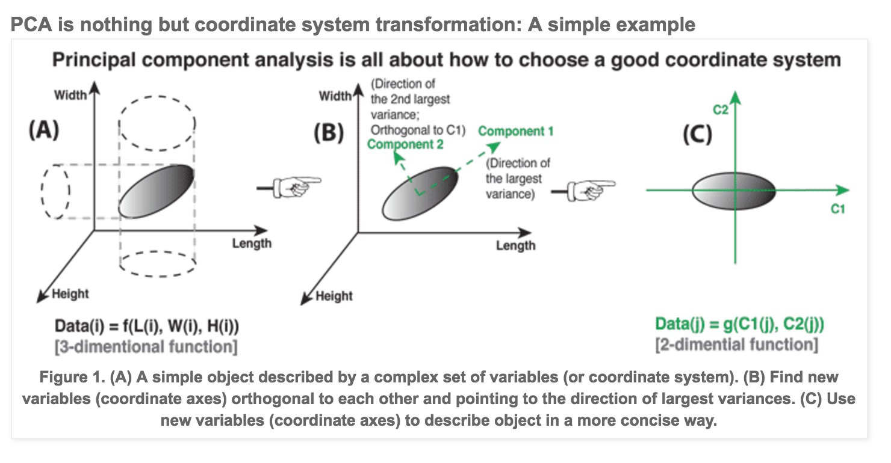
HIGH LEVEL OVERVIEW
Eh?

Slide 53
HIGH LEVEL OVERVIEW
Eh?
It’s a different view of the data that maximises variance and decreases variables.
Eh?
Linear algebra magic.

Slide 54
ACTIVITY: KNOWLEDGE CHECK
ANSWER THE FOLLOWING QUESTIONS
EXERCISE
What is the aim of PCA?
What does the first Principal Component represent? The last?
3. What’s an eigenvector? What’s an eigenvalue?
DELIVERABLE
Answers to questions
Notes:
Linearity and variance as an adjunct to information
Increase signal, decrease dimensions
Vector from original data to variance. The amount of variance explained.

Slide 55
STEPS TO PCA SUCCESS
Data should be standardised prior to PCA.
Higher magnitude variables will dominate output otherwise.
Check for linear relationships (correlations).
Run PCA in sklearn
Instantiate, fit, transform...
Examine explained variance of components & choose number of components to use (just the 1st? Top 5? 95% explained variance?)
Explore component weights on original variables.

Slide 56
BASIC PIPELINE
from sklearn.decomposition import PCA from sklearn.preprocessing import StandardScaler
zscore = StandardScaler()
Xz = zscore.fit_transform(X)
pca = PCA(n_components=None, whiten=True)
pca.fit(Xz)
Xpca = pca.transform(Xz)

Slide 57
ACTIVITY: KNOWLEDGE CHECK
ANSWER THE FOLLOWING QUESTIONS
EXERCISE
Complete exercise 3
Which method (standard vs. dimensionality reduction) worked better?
DELIVERABLE
Code and scores

Slide 58
CONCLUSION
TOPIC REVIEW

Slide 59
CONCEPT REVIEW
Latent variable models attempt to uncover structure data.
Dimensionality reduction is focused on replacing related columns.
Topic modeling (or LDA) uncovers the topics that are most common to each document and then the words most common to those topics.
LDA avoids learning grammar rules and instead rely on large datasets. It learns based on how the words are used, making it very flexible.
PCA creates linear weightings of variables that decreases dimensionality.
Weights are based on level of variance.

Slide 60
COURSE
BEFORE NEXT CLASS

Slide 61
DUE DATE
BEFORE NEXT CLASS
Project: Final Project, Deliverable 3
Due Lesson 16

