Slide 1
TIME SERIES ANALYSIS

Slide 2
LEARNING OBJECTIVES
TIME SERIES ANALYSIS
Understand what time series data is and what is unique about it
Become familiar with DateTime objects and manipulating DateTime information.
Perform time series analysis in Pandas including rolling mean/median and autocorrelation

Slide 3
COURSE
PRE-WORK

Slide 4
PRE-WORK REVIEW
Load data with Pandas
Plotting data with Seaborn
Understand correlation

Slide 5
OPENING
TIME SERIES ANALYSIS

Slide 6
TIME SERIES ANALYSIS
In this class, we’ll discuss analyzing data that is changing over time.
In most of our previous examples, we didn’t care which data points were collected earlier or later than others.
We made assumptions that the data was not changing over time.
All observations were independent (remember that?)
This class will focus on statistics around data that is changing over time and how to measure that change.

Slide 7
TIME SERIES ANALYSIS
In this lesson, we will focus on Identifying problems related to time series.
Additionally, we will discuss the unique aspects of Mining and Refining time series data.

Slide 8
INTRODUCTION
WHAT IS TIME SERIES DATA?

Slide 9
WHAT IS TIME SERIES DATA?
Time series data is any data where the individual data points change over time.
This is fairly common in sales and other business cases where data would likely change according to seasons and trends.
Time series data is also useful for studying social phenomena. For instance, there is statistically more crime in the summer, which is a seasonal trend.

Slide 10
WHAT IS TIME SERIES DATA?
Most datasets are likely to have an important time component, but typically we assume that it’s fairly minimal.
For example, if we were analyzing salaries in an industry, it’s clear that salaries shift over time and vary with the economic period.
However, if we are examining the problem on a smaller scale (e.g. 3-5 years), the effect of time on salaries is much smaller than other factors, like industry or position.

Slide 11
WHAT IS TIME SERIES DATA?
When the time component is important, we need to focus on identifying the aspects of the data that are influenced by time and those that aren’t.
Typically, time series data will be a sequence of values. We will be interested in studying the changes to this series and how related individual values are.
For example, how much does this week’s sales affect next week’s? How much does today’s stock price affect tomorrow’s?

Slide 12

ACTIVITY: KNOWLEDGE CHECK
ANSWER THE FOLLOWING QUESTIONS
EXERCISE
Think about the various datasets we’ve used so far. For each dataset, identify the time components of those datasets. What time related features might be important to our analysis?
DELIVERABLE
Answers to the above questions

Slide 13
WHAT IS TIME SERIES DATA?
Time series analysis is useful in many fields: sales analysis, stock market trends, studying economic phenomena, social science problems, etc.
Typically, we are interested in separating the effects of time into two components:
Trends - significant increases or decreases over time
Seasonality - regularly repeating increases or decreases

Slide 14
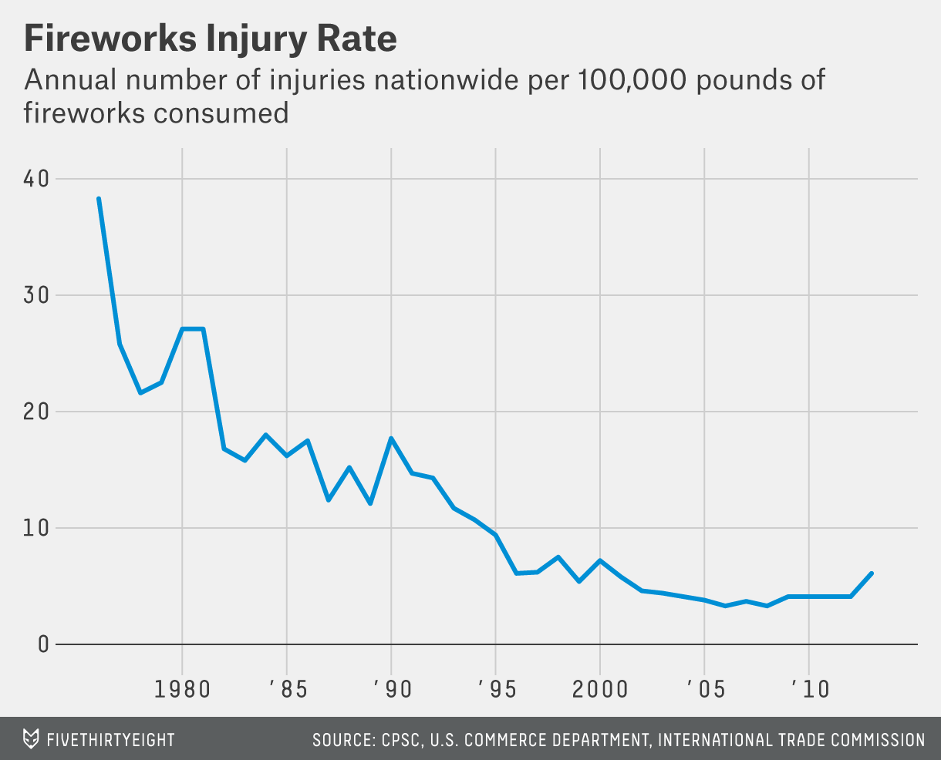
WHAT IS TIME SERIES DATA?
This plot of fireworks injury rates has an overall trend of fewer injuries with no seasonal pattern.

Slide 15
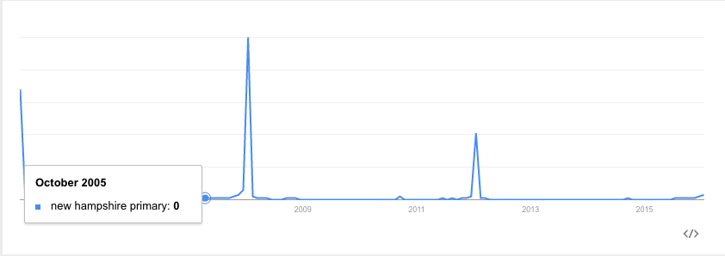
WHAT IS TIME SERIES DATA?
Meanwhile, the number of searches for the New Hampshire Primary has a clear seasonal component - it peaks every four years and on election years.

Slide 16
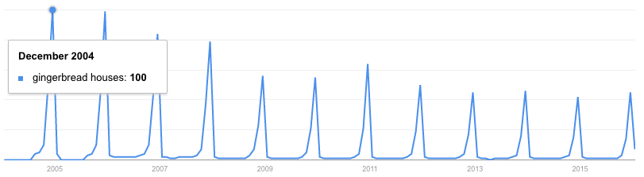
WHAT IS TIME SERIES DATA?
Similarly, searches for ‘gingerbread houses’ spike every year around the holiday season.
These spikes recur on a fixed time-scale, making them seasonal patterns.

Slide 17
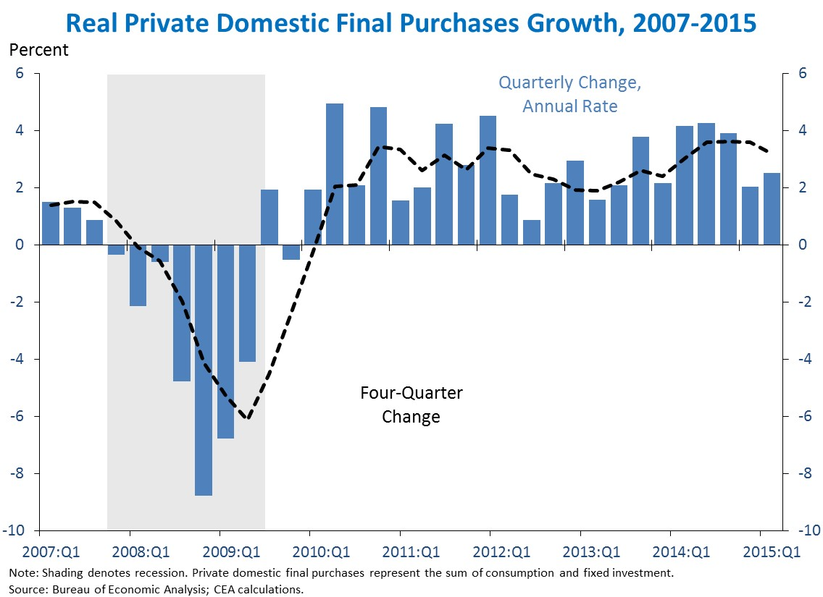
WHAT IS TIME SERIES DATA?
Many other types of regularly occurring up or down swings may occur without a fixed timescale or period (e.g. growth vs. recession for economic trends).

Slide 18
WHAT IS TIME SERIES DATA?
These aperiodic patterns are called cycles.
While identifying aperiodic cycles is important, they are often treated differently than seasonal effects. Seasonal effects are useful for their consistency, since prior data is useful as a predictor.

Slide 19
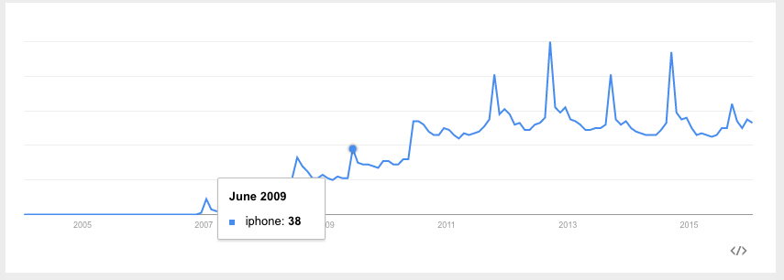
WHAT IS TIME SERIES DATA?
Searches for “iphone” have both a general trend upwards (indicating more popularity for the phone) as well as a seasonal spike in September (which is when Apple typically announces new versions).

Slide 20
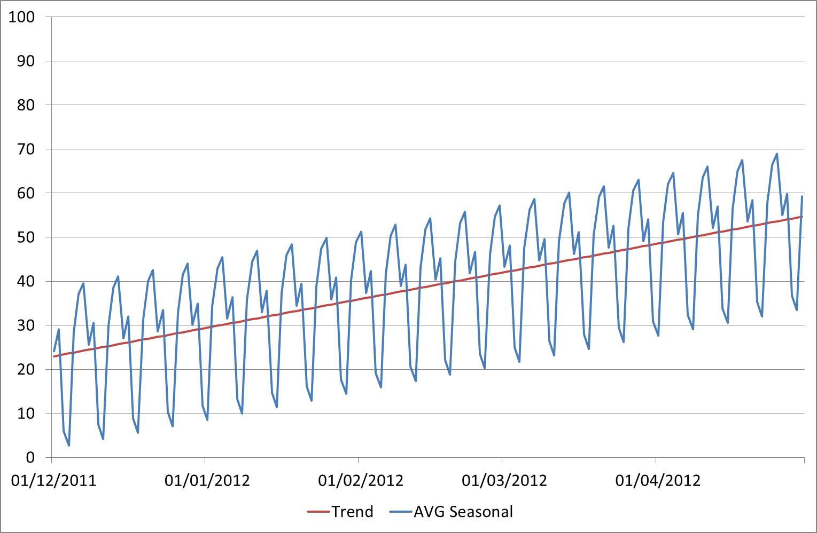
WHAT IS TIME SERIES DATA?
Most often, we’re interested in studying the trend and not the seasonal fluctuations.
Therefore it is important to identify whether we think a change is due to an ongoing trend or seasonal change.

Slide 21
ACTIVITY: KNOWLEDGE CHECK
ANSWER THE FOLLOWING QUESTIONS
EXERCISE
Discuss one or two more time series examples from Google Trends.
Identify relevant trends and seasonal patterns.
DELIVERABLE
Answers to the above questions

Slide 22
INTRODUCTION
COMMON ANALYSIS FOR TIME SERIES DATA

Slide 23
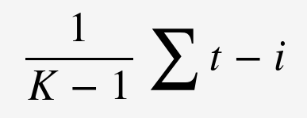
MOVING AVERAGES
A moving average replaces each data point with an average of k consecutive data points in time.
Typically, this is k/2 data points prior to and following a given time point, but it could also be the k preceding points.
These are often referred to as the “rolling” average.
The measure of average could be mean or median.
The formula for the rolling mean is
Notes:
Note: K = sum of timepoints, i = timepoints in mean from 0, t = timepoint

Slide 24
ACTIVITY: KNOWLEDGE CHECK
ANSWER THE FOLLOWING QUESTIONS
EXERCISE
What would a moving (rolling) mean indicate vs. a moving (rolling) median?
DELIVERABLE
Answer to the above question

Slide 25
MOVING AVERAGES
A rolling mean would average all values in the window, but can be skewed by outliers (extremely small or large values).
This may be useful if we are looking to identify atypical periods or we want to evaluate these odd periods.
For example, this would be useful if we are trying to identify particularly successful or unsuccessful sales days.
The rolling median would provide the 50 percentile value for the period and would possibly be more representative of a “typical” day.

Slide 26
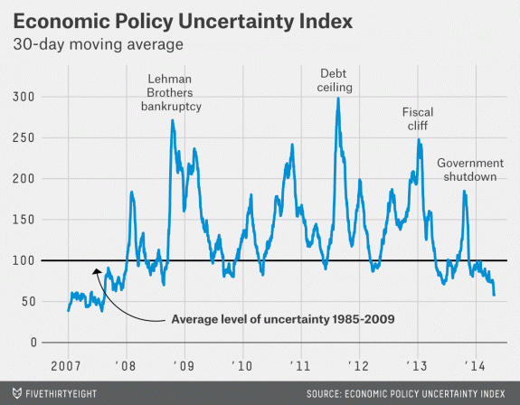
WHAT IS TIME SERIES DATA?
This plot shows the 30-day moving average of the Economic Uncertainty Index.
Plotting the moving average allows us to more easily visualize trends by smoothing out random fluctuations and removing outliers.

Slide 27
MOVING AVERAGES
While this statistic weights all data evenly, it may make sense to weight data closer to our date of interest higher.
We do this by taking a weighted moving average, where we assign particular weights to certain time points.
Various formulas or schemes can be used to weight the data points.

Slide 28
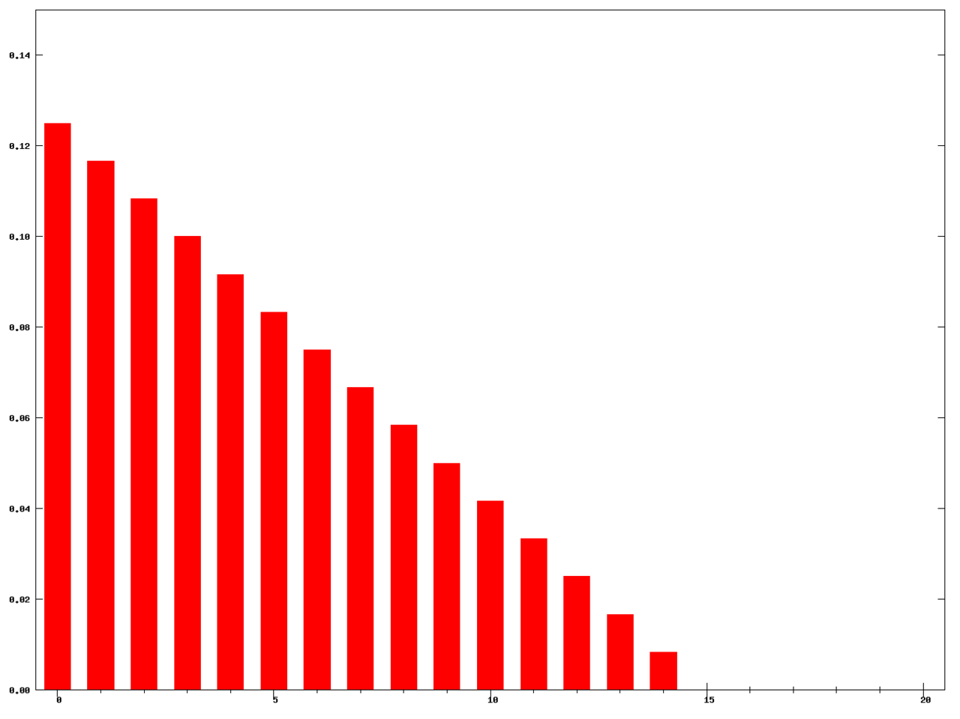
MOVING AVERAGES
A Weighted moving average where the decay is equal to the number of time points in the series (k = 15)
THANKS WIKI!

Slide 29
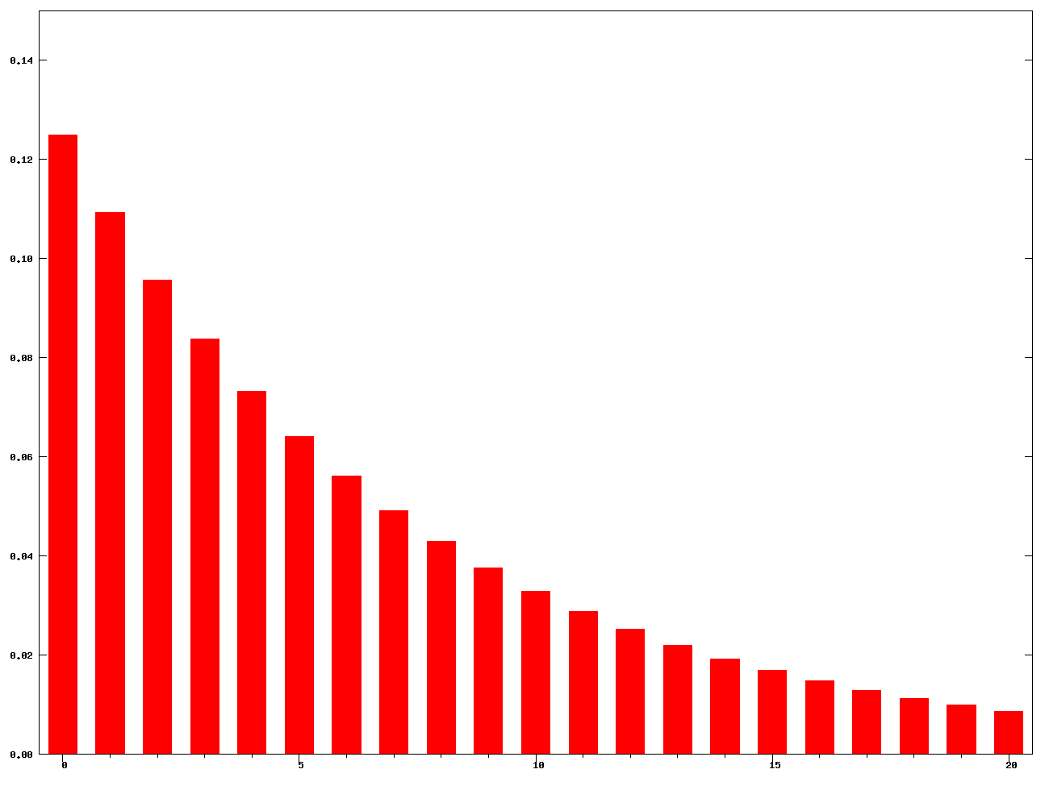
MOVING AVERAGES
The weights for an exponential weighted moving average with k = 15.
THANKS WIKI!

Slide 30
AUTOCORRELATION
In previous classes, we have been concerned with how two variables are correlated (e.g. height and weight, education and salary).
Autocorrelation is how correlated a variable is with itself. Specifically, how related are variables earlier in time with variables later in time.

Slide 31
AUTOCORRELATION
To compute autocorrelation, we fix a “lag” k. This is how many time points earlier we should use to compute the correlation.
A lag of 1 computes how correlated a value is with the prior one. A lag of 10 computes how correlated a value is with one 10 time points earlier.

Slide 32
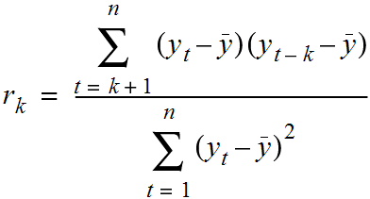
AUTOCORRELATION
The following formula can be used to calculate autocorrelation.

Slide 33
BREAK TIME
TIME FOR A BREAK

Slide 34
DEMO
EXPLORING ROSSMANN DRUGSTORE SALES DATA

Slide 35
EXPLORING ROSSMANN DRUGSTORE SALES DATA
We will be using data made available by a German drugstore, Rossmann.
This data contains the daily sales made at the drugstore as well as whether there was a sale or holiday affecting the sales data.
Follow along using the starter code (starter-code-15) available in the class repo.

Slide 36
LOADING THE DATA
As always, use Pandas to load our data.
import pandas as pd data = pd.read_csv('../../assets/dataset/rossmann.csv', skipinitialspace=True, low_memory=False)

Slide 37
LOADING THE DATA
Because we are most interested in the Date column, we can process it as a DateTime type and set it as the index of our dataframe.
data['Date'] = pd.to_datetime(data['Date']) data.set_index('Date', inplace=True) data['Year'] = data.index.year data['Month'] = data.index.month

Slide 38
LOADING THE DATA
This allows us to easily filter by date. For example, to a particular year:
data['2014']
We can also filter to a particular month:
data['2015-05']

Slide 39
LOADING THE DATA
There are over a million sales data points in this dataset, so for some analysis we will focus on just one store.
store1_data = data[data.Store == 1]

Slide 40
PLOTTING THE SALES DATA
As we begin to study the sales from this drug store, we will also want to know both the time dependent elements of sales as wells as whether promotions or holidays affected sales.
To start, we can simply compare the average sales on those events.
To compare sales on holidays, we can compare the sales using box plots. This allows us to compare the distribution of sales on holidays against all other days.

Slide 41
PLOTTING THE SALES DATA
On state holidays the store is closed (so there should be 0 sales).
On school holidays, the sales are relatively similar.
sb.factorplot( col='Open', x='SchoolHoliday', y='Sales', data=store1_data, kind='box' )

Slide 42
ACTIVITY: KNOWLEDGE CHECK
ANSWER THE FOLLOWING QUESTIONS
EXERCISE
Check if there is a difference affecting sales on promotion days.
DELIVERABLE
Plot answering the question

Slide 43
PLOTTING THE SALES DATA
We can see there is a difference in sales on promotion days.
sb.factorplot( col='Open', x='Promo', y='Sales', data=store1_data, kind='box' )
Why is it important to separate out days where the store is closed?

Slide 44
PLOTTING THE SALES DATA
Because there aren’t any promotions on those days either, so including them will bias your sales data on days without promotions.
Let’s compare sales across days of the week.
sb.factorplot( col='Open', x='DayOfWeek', y='Sales', data=store1_data, kind='box', )

Slide 45
PLOTTING THE SALES DATA
Lastly, we want to identify larger scale trends in our data.
How did sales change from 2014 to 2015? Were any particularly interesting outliers in terms of sales or customer visits?
To plot the sales over time:
# Filter to days store 1 was open store1_open_data = store1_data[store1_data.Open==1] store1_open_data[['Sales']].plot()

Slide 46
PLOTTING THE SALES DATA
To plot customer visits over time over time:
store1_open_data[['Customers']].plot()
We can see that there are large spikes of sales and customers towards the end of 2013 and 2014 leading into the first quarter of 2014 and 2015.

Slide 47
ACTIVITY: KNOWLEDGE CHECK
ANSWER THE FOLLOWING QUESTIONS
EXERCISE
Use the index filtering to filter to just 2015. Zoom in on changes over time.
Is it easier to identify the holiday sales bump?
DELIVERABLE
Plot answering the question

Slide 48
PLOTTING THE SALES DATA
To filter to the 2015 data:
store1_data_2015 = store1_data['2015'] store1_data_2015[store1_data_2015.Open==1][['Sales']].plot()

Slide 49
COMPUTING AUTOCORRELATION
To measure how much the sales are correlated with each other, we want to compute the autocorrelation of the “Sales” column.
In Pandas, we do this with the autocorr function. autocorr takes one argument, lag. This is how many points prior should be used to compute the correlation.
data['Sales'].resample('D', how='mean').autocorr(lag=1)
As with correlation between different variables, as this number moves closer to 1, the data is more correlated.

Slide 50
ACTIVITY: KNOWLEDGE CHECK
ANSWER THE FOLLOWING QUESTIONS
EXERCISE
What do the autocorrelation values of “Sales” and “Customers” imply about our data?
DELIVERABLE
Answer to the above question

Slide 51
AGGREGATES OF SALES OVER TIME
If we want to investigate trends over time in sales, we will start by computing simple aggregations. What were the mean and median sales in each year and each month?
In Pandas, this is performed using the resample function, which is very similar to the groupby function. It allows us to group over different time periods.

Slide 52
AGGREGATES OF SALES OVER TIME
We can use data.resample and provide the following arguments.
A level on which to roll up to: ‘D’ for day, ‘W’ for week, ‘M’ for month, ‘A’ for year.
The aggregation to perform: ‘mean’, ‘median’, ‘sum’, etc.

Slide 53
AGGREGATES OF SALES OVER TIME
data[['Sales']].resample('A', how=['median', 'mean']) data[['Sales']].resample('M', how=['median', 'mean'])
Here we see that December 2013 and 2014 were the highest average sales months.

Slide 54
AGGREGATES OF SALES OVER TIME
While identifying the monthly averages are useful, we often want to compare the sales data of a date to a smaller window.
To understand holidays’ sales, we want to compare the sales data of late December to a few days surrounding it.
We can do this using rolling averages.

Slide 55
AGGREGATES OF SALES OVER TIME
In Pandas, we can compute the rolling average using the pd.rolling_mean or pd.rolling_median functions.
pd.rolling_mean(data[['Sales']], window=3, center=True, freq='D')
This computes a rolling mean of sales using the sales on each day, the day preceding, and the day following (window=3 and center=True).

Slide 56
AGGREGATES OF SALES OVER TIME
rolling_mean (as well as rolling_median) takes the series to aggregate and three important parameters:
window - the number of days to include in the average
center - whether the window should be centered on the date or use data prior to that date
freq - what level to roll up the averages to (as used in resample); ‘D’ for day, ‘W’ for week, ‘M’ for month, ‘A’ for year

Slide 57
AGGREGATES OF SALES OVER TIME
We can use our index filtering to just look at 2015:
pd.rolling_mean(data[['Sales']], window=3, center=True, freq='D')['2015']
Instead of plotting the full time series, we can plot the rolling mean instead. This smooths random changes in sales as well as removing outliers, helping us identify larger trends.
pd.rolling_mean(data[['Sales']], window=10, center=True, freq='D').plot()

Slide 58
AGGREGATES OF SALES OVER TIME
As we discussed earlier, this averages all values in the window evenly. However we may want to weight closer values more.
For example, for a centered weighted average of 10 days, we want to put emphasis on +/- 1 day versus +/- 5 days.
One option to do that is the ewma function or the exponential weighted moving average function.
pd.ewma(data['Sales'], span=10)
OR
data['Sales'].resample('D').mean().ewm(span = 10).mean().plot()

Slide 59
ACTIVITY: KNOWLEDGE CHECK
ANSWER THE FOLLOWING QUESTIONS
EXERCISE
Discuss the differences between the plot of the 10-day moving average and the 10-day exponentially weighted moving average.
DELIVERABLE
Discussion

Slide 60
PANDAS WINDOW FUNCTIONS
Pandas rolling_mean and rolling_median are only two examples of Pandas window function capabilities.
Window functions operate on a set of N consecutive rows (a window) and produce output.
In addition, there are rolling_sum, rolling_min, rolling_max, and many more.

Slide 61
PANDAS WINDOW FUNCTIONS
Another common window function is diff, which takes the difference over time.
pd.diff takes one argument, periods, which is how many rows prior to use for the difference.
For example, if we want to compute the difference in sales, day by day:
data['Sales'].diff(periods=1)

Slide 62
PANDAS WINDOW FUNCTIONS
However, if we wanted to compare the same day in the prior week, we could set periods=7.
data['Sales'].diff(periods=7)
This would compute the difference in sales, from every day to the same day in the previous week.

Slide 63
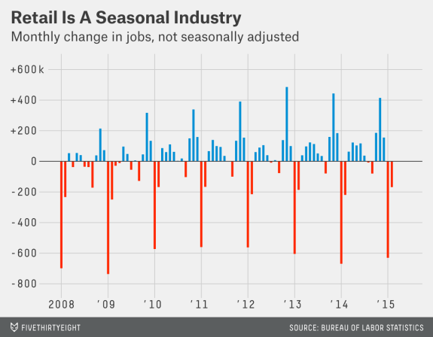
WHAT IS TIME SERIES DATA?
Difference functions allow us to identify seasonal changes as we see repeated up or down swings.
This plot of the month to month change (diff) in retail jobs helps identify the seasonal component of the number of retail jobs.

Slide 64
PANDAS EXPANDING FUNCTIONS
In addition to the set of “rolling” functions, Pandas also provides a similar set of “expanding” functions.
Instead of using a window of N values, “expanding” functions use all values up until that time.

Slide 65
PANDAS EXPANDING FUNCTIONS
We can compute the average sales from the first date until the date specified.
pd.expanding_mean(data['Sales'], freq='d')
We can also compute the sum of average sales per store up until that date.
pd.expanding_sum(data['Sales'], freq='d')

Slide 66
INDEPENDENT PRACTICE
TIME SERIES EXERCISES

Slide 67
ACTIVITY: TIME SERIES EXERCISES
DIRECTIONS (35 minutes)
EXERCISE
Plot the distribution of sales by month and compare the effect of promotions.
Are sales more correlated with the prior date, a similar date last year, or a similar date last month?
Plot the 15 day rolling mean of customers in the stores.
Identify the date with largest drop in sales from the same date in the previous month.
Compute the total sales up until Dec. 2014.
When were the largest differences between 15-day moving/rolling averages? HINT: Using rolling_mean and diff
DELIVERABLE
Plots and answers to the above questions

Slide 68
INDEPENDENT PRACTICE REVIEW
TIME SERIES EXERCISES

Slide 69
TIME SERIES EXERCISES REVIEW
Plot the distribution of sales by month and compare the effect of promotions.
sb.factorplot( col='Open', hue='Promo', x='Month', y='Sales', data=store1_data, kind='box' )

Slide 70
TIME SERIES EXERCISES REVIEW
Are sales more correlated with the prior date, a similar date last year, or a similar date last month?
# Compare the following: average_daily_sales = data[['Sales', 'Open']].resample('D', how='mean') average_daily_sales['Sales'].autocorr(lag=1) average_daily_sales['Sales'].autocorr(lag=30) average_daily_sales['Sales'].autocorr(lag=365)

Slide 71
TIME SERIES EXERCISES REVIEW
Plot the 15 day rolling mean of customers in the stores.
pd.rolling_mean(data[['Sales']], window=15, freq='D').plot()

Slide 72
TIME SERIES EXERCISES REVIEW
Identify the date with largest drop in sales from the same date in the previous month.
average_daily_sales = data[['Sales', 'Open']].resample('D', how='mean') average_daily_sales['DiffVsLastWeek'] = average_daily_sales[['Sales']].diff(periods=7) average_daily_sales.sort(['DiffVsLastWeek']).head
Unsurprisingly this day is December 25th and 26th in 2014 and 2015, when the store is closed and there were many sales in the preceding week.

Slide 73
TIME SERIES EXERCISES REVIEW
Compute the total sales up until Dec. 2014.
total_daily_sales = data[['Sales']].resample('D', how='sum') pd.expanding_sum(total_daily_sales)['2014-12']
Note that this is NOT
pd.expanding_sum(data['Sales'], freq='D')
We don’t want to average over stores first!

Slide 74
TIME SERIES EXERCISES REVIEW
When were the largest differences between 15-day moving/rolling averages? HINT: Using rolling_mean and diff
pd.rolling_mean(data[['Sales']], window=15, freq='D').diff(1).sort('Sales')
Unsurprisingly, they occur at the beginning of every year after the holiday season.

Slide 75
CONCLUSION
TOPIC REVIEW

Slide 76
CONCLUSION
We use time series analysis to identify changes in values over time.
We want to identify whether changes are true trends or seasonal changes.
Rolling means give us a local statistic of an average in time, smoothing out random fluctuations and removing outliers.
Autocorrelations are a measure of how much a data point is dependent on previous data points.

Slide 77
COURSE
BEFORE NEXT CLASS

Slide 78
DUE DATE
BEFORE NEXT CLASS
Project: Final Project, Part 3

Slide 79
LESSON
CREDITS

Slide 80
CITATIONS
THANKS FOR THE FOLLOWING
Title, Author: link
Title, Author: link
Title, Author: link

Slide 81
LESSON
Q & A

Slide 82
LESSON
EXIT TICKET
DON’T FORGET TO FILL OUT YOUR EXIT TICKET

Slide 83
THANKS!
NAME
Body Level One
Body Level Two
Body Level Three
Body Level Four
Body Level Five
Body Level One
Body Level Two
Body Level Three
Body Level Four
Body Level Five
Optional Information:
Email?
Website?
Twitter?

