Slide 1
EVALUATING MODEL FIT

Slide 2
LEARNING OBJECTIVES
EVALUATING MODEL FIT
Define regularization, bias, and error metrics for regression problems
Evaluate model fit using loss functions
Select regression methods based on fit and complexity

Slide 3
COURSE
PRE-WORK

Slide 4
PRE-WORK REVIEW
Understand goodness of fit (r-squared - tonight!)
Measure statistical significance of features
Recall what a residual is
Implement a sklearn estimator to predict a target variable

Slide 5
OPENING
R-SQUARES AND RESIDUALS

Slide 6
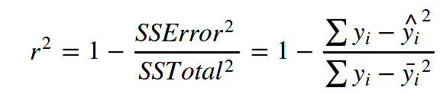
WHAT IS r²? WHAT IS A RESIDUAL?
r², the central metric introduced for linear regression
Which model performed better, one with an r-squared of 0.79 or 0.81?
r² is a measure of how well the model (line) explained the variance
R² = 1? R² = 0? R² = Negative value?
Doesn’t tell us how far the points were from the model.
We’ll explore loss functions and find ways to refine our model.

Slide 7
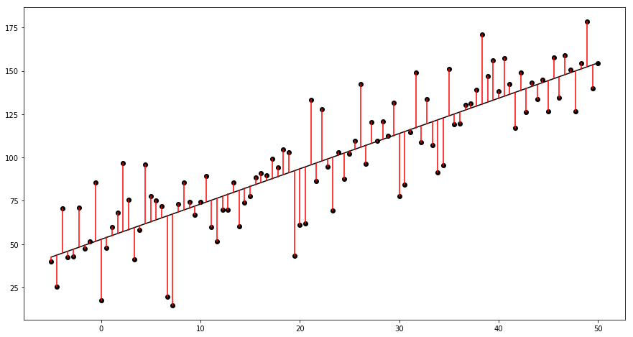
IT ALL STARTS WITH RESIDUALS

Slide 8
INTRODUCTION
LINEAR MODELS AND ERROR

Slide 9
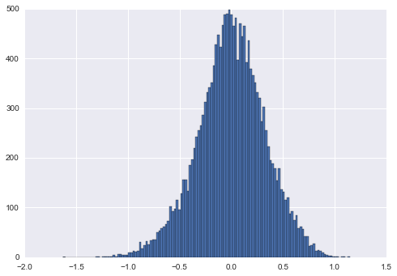
RECALL: WHAT’S RESIDUAL ERROR?
In linear models, residual error must be normal with a median close to zero.
Individual residuals are useful to see the error of specific points, but it doesn’t provide an overall picture for optimization.
We need a metric to summarize the error in our model into one value.
Mean square error: the mean residual error in our model

Slide 10
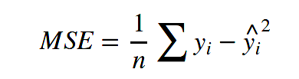
MEAN SQUARED ERROR (MSE)
To calculate MSE:
Calculate the difference between each target y and the model’s predicted value y-hat (i.e. the residual)
Square each residual.
Take the mean of the squared residual errors.

Slide 11
MEAN SQUARED ERROR (MSE)
sklearn’s metrics module includes a mean_squared_error function.
from sklearn import metrics metrics.mean_squared_error(y, model.predict(X))

Slide 12
MEAN SQUARED ERROR (MSE)
For example, two arrays of the same values would have an MSE of 0.
from sklearn import metrics metrics.mean_squared_error([1, 2, 3, 4, 5], [1, 2, 3, 4, 5])
0.0

Slide 13
MEAN SQUARED ERROR (MSE)
Two arrays with different values would have a positive MSE.
from sklearn import metrics metrics.mean_squared_error([1, 2, 3, 4, 5], [5, 4, 3, 2, 1]) # (4^2 + 2^2 + 0^2 + 2^2 + 4^2) / 5
8.0

Slide 14
LET’S COMPARE TWO RANDOM MODELS
import numpy as np import pandas as pd from sklearn import linear_model df = pd.DataFrame({'x': range(100), 'y': range(100)}) biased_df = df.copy() biased_df.loc[:20, 'x'] = 1 biased_df.loc[:20, 'y'] = 1 def append_jitter(series): jitter = np.random.random_sample(size=100) return series + jitter

Slide 15
LET’S COMPARE TWO RANDOM MODELS
df['x'] = append_jitter(df.x) df['y'] = append_jitter(df.y) biased_df['x'] = append_jitter(biased_df.x) biased_df['y'] = append_jitter(biased_df.y) - Fit: lm = linear_model.LinearRegression().fit(df[['x']], df['y']) print metrics.mean_squared_error(df['y'], lm.predict(df[['x']])) - Biased fit: lm = linear_model.LinearRegression().fit(biased_df[['x']], biased_df['y']) print metrics.mean_squared_error(df['y'], lm.predict(df[['x']]))

Slide 16
HOW DO WE MINIMIZE ERROR?
Model the data more effectively
Transforms
Polynomial (power) terms
Add more predictors
Different model types (eg. SVMs, Ensembles, KMeans etc)

Slide 17
A FORMULA FOR ERROR
Sources of error in our models can be due to one of three factors:
Error = bias² + variance + irreducible error

Slide 18
BIAS VARIANCE TRADEOFF
When our error is biased, it means the model’s prediction is consistently far away from the actual value.
This could be a sign of poor sampling and poor data.
One objective of a biased model is to trade bias error for generalized error. We prefer the error to be more evenly distributed across the model.
This is called error due to variance.
We want our model to generalize to data it hasn’t seen even if doesn’t perform as well on data it has already seen.

Slide 19
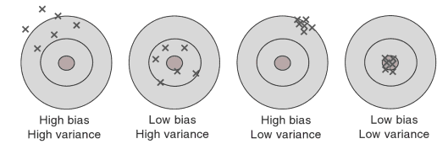
BIAS VS. VARIANCE

Slide 20
BIAS VARIANCE TRADEOFF
In short -
Bias: How far a model’s predictions are from the observed values
Variance: How a model performs on unseen data
These are the basis of underfitting (inadequate modelling of the data) and overfitting (overadequate modelling of the data).
Underfitting: High bias, low variance
Overfitting: Low bias, high variance

Slide 21
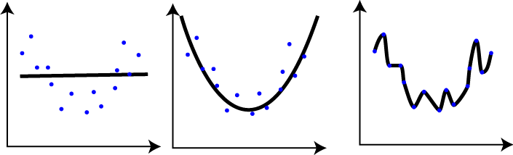
BIAS VARIANCE TRADEOFF

Slide 22
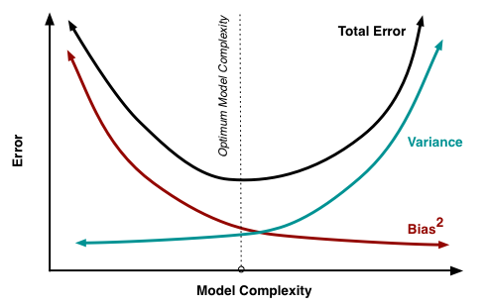
BIAS VARIANCE TRADEOFF

Slide 23

ACTIVITY: KNOWLEDGE CHECK
ANSWER THE FOLLOWING QUESTIONS (5 minutes)
EXERCISE
Which of the following scenarios would be better for a weatherman?
Knowing that I can very accurately "predict" the temperature outside from previous days perfectly, but be 20-30 degrees off for future days
Knowing that I can accurately predict the general trend of the temperate outside from previous days, and therefore am at most only 10 degrees off on future days
DELIVERABLE
Answers to the above questions

Slide 24
DEMO
CROSS VALIDATION

Slide 25
CROSS VALIDATION
Cross validation can help determine if the model is under / overfitting.
The idea is to
Generate several models on different cross sections of the data
Measure the performance of each (MSE, r², something else)
Take the mean performance

Slide 26
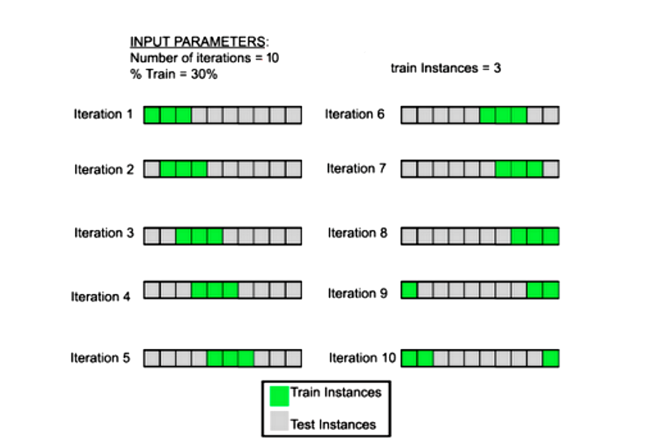
CROSS VALIDATION

Slide 27
K-FOLD CROSS VALIDATION
k-fold cross validation
Split the data into k group
Train the model on all segments except one
Test model performance on the remaining set
If k = 5, split the data into five segments and generate five models.

Slide 28
USING K-FOLD CROSS VALIDATION WITH MSE
Import the appropriate packages and load data.
from sklearn import cross_validation wd = '../../datasets/' bikeshare = pd.read_csv(wd + 'bikeshare/bikeshare.csv') weather = pd.get_dummies(bikeshare.weathersit, prefix='weather') modeldata = bikeshare[['temp', 'hum']].join(weather[['weather_1', 'weather_2', 'weather_3']]) y = bikeshare.casual

Slide 29
USING K-FOLD CROSS VALIDATION WITH MSE
Build models on subsets of the data and calculate the average score.
kf = cross_validation.KFold(len(modeldata), n_folds=5, shuffle=True) scores = [] for train_index, test_index in kf: lm = linear_model.LinearRegression().fit(modeldata.iloc[train_index], y.iloc[train_index]) scores.append(metrics.mean_squared_error(y.iloc[test_index], lm.predict(modeldata.iloc[test_index])))
print np.mean(scores)

Slide 30
USING K-FOLD CROSS VALIDATION WITH MSE
This can be compared to the model built on all of the data.
- This score will be lower, but we're trading off bias error for generalized error: lm = linear_model.LinearRegression().fit(modeldata, y) print metrics.mean_squared_error(y, lm.predict(modeldata))
Which approach would predict new data more accurately?

Slide 31
GUIDED PRACTICE
CROSS VALIDATION WITH LINEAR REGRESSION

Slide 32
ACTIVITY: CROSS VALIDATION WITH LINEAR REGRESSION
DIRECTIONS (20 minutes)
EXERCISE
If we were to continue increasing the number of folds in cross validation, would error increase or decrease?
Using the previous code example, perform k-fold cross validation for all even numbers between 2 and 50.
Answer the following questions:
What does shuffle=True do?
At what point does cross validation no longer seem to help the model?
Hint: range(2, 51, 2) produces a list of even numbers from 2 to 50
DELIVERABLE
Answers to questions

Slide 33
INTRODUCTION
REGULARIZATION AND CROSS VALIDATION

Slide 34
WHAT IS REGULARIZATION? AND WHY DO WE USE IT?
Regularization is an additive approach to protect models against overfitting (not generalizing well / fitting to noise / fitting to variance etc).
Regularization becomes an additional weight to betas, shrinking them closer to zero.
L1 (Lasso Regression) adds the extra weight to betas.
L2 (Ridge Regression) adds the square of the extra weight to betas.
Both methods are good for P >> n (more variables than observations)
Can also be used to combat multicolinearity (use with caution).

Slide 35
WHICH ONE AND WHEN?
L1 (Lasso):
Small changes in alpha make shrinkage more aggressive
May zero betas (Feature Selection)
Not useful when variables are correlated
Will keep one variable and shrink the rest
L2 (Ridge)
Shrinkage more gradual - “roll off”
Does not zero betas
Fine to use on colinear data

Slide 36
WHAT IS OVERFITTING?
The first model poorly explains the data.
The second model explains the general curve of the data.
The third model drastically overfits the model, bending to every point.
Regularization helps prevent the third model.

Slide 37
WHERE REGULARIZATION MAKES SENSE
What happens to MSE if use Lasso or Ridge Regression directly?
lm = linear_model.LinearRegression().fit(modeldata, y) print metrics.mean_squared_error(y, lm.predict(modeldata)) lm = linear_model.Lasso().fit(modeldata, y) print metrics.mean_squared_error(y, lm.predict(modeldata)) lm = linear_model.Ridge().fit(modeldata, y) print metrics.mean_squared_error(y, lm.predict(modeldata))
1672.58110765 # OLS 1725.41581608 # L1 1672.60490113 # L2

Slide 38
WHERE REGULARIZATION MAKES SENSE
It doesn’t seem to help. Why is that?
We need to optimize the regularization weight parameter (called alpha) through cross validation.

Slide 39
ACTIVITY: KNOWLEDGE CHECK
ANSWER THE FOLLOWING QUESTIONS (5 minutes)
EXERCISE
Why is regularization important?
What does it protect against and how?
DELIVERABLE
Answers to the above questions

Slide 40
DEMO
UNDERSTANDING REGULARIZATION EFFECTS

Slide 41
QUICK CHECK
We are working with the bikeshare data to predict riders over hours/days with a few features.
Does it make sense to use a ridge regression or a lasso regression?
Why?

Slide 42
UNDERSTANDING REGULARIZATION EFFECTS
Let’s test a variety of alpha weights for Ridge Regression on the bikeshare data.
alphas = np.logspace(-10, 10, 21) for a in alphas: print 'Alpha:', a lm = linear_model.Ridge(alpha=a) lm.fit(modeldata, y) print lm.coef_ print metrics.mean_squared_error(y, lm.predict(modeldata))
What happens to the weights of the coefficients as alpha increases? What happens to the error as alpha increases?

Slide 43
WE CAN MAKE THIS EASIER WITH GRID SEARCH!
Grid search exhaustively searches through all given options to find the best solution. Grid search will try all combos given in param_grid.
param_ grid = { 'intercept': [True, False], 'alpha': [1, 2, 3], }

Slide 44
WE CAN MAKE THIS EASIER WITH GRID SEARCH!
This param grid has six different options:
intercept True, alpha 1
intercept True, alpha 2
intercept True, alpha 3
intercept False, alpha 1
intercept False, alpha 2
intercept False, alpha 3
param_ grid = { 'intercept': [True, False], 'alpha': [1, 2, 3], }

Slide 45
WE CAN MAKE THIS EASIER WITH GRID SEARCH!
This is an incredibly powerful, automated machine learning tool!
from sklearn import grid_search alphas = np.logspace(-10, 10, 21) gs = grid_search.GridSearchCV( estimator=linear_model.Ridge(), param_grid={'alpha': alphas}, scoring='mean_squared_error')

Slide 46
WE CAN MAKE THIS EASIER WITH GRID SEARCH!
gs.fit(modeldata, y) print -gs.best_score_ # mean squared error here comes in negative, so let's make it positive. print gs.best_estimator_ # explains which grid_search setup worked best print gs.grid_scores_ # shows all the grid pairings and their performances.

Slide 47
GUIDED PRACTICE
GRID SEARCH CV, SOLVING FOR ALPHA

Slide 48
ACTIVITY: GRID SEARCH CV, SOLVING FOR ALPHA
DIRECTIONS (25 minutes)
EXERCISE
Modify the previous code to do the following:
Introduce cross validation into the grid search. This is accessible from the cv argument.
Add fit_intercept = True and False to the param_grid dictionary.
Re-investigate the best score, best estimator, and grid score attributes as a result of the grid search.
DELIVERABLE
New code and output that meets above requirements

Slide 49
INTRODUCTION
MINIMIZING LOSS THROUGH GRADIENT DESCENT

Slide 50
GRADIENT DESCENT
Gradient Descent can also help us minimize error.
How Gradient Descent works:
A random linear solution is provided as a starting point
The solver attempts to find a next “step”: take a step in any direction and measure the performance.
If the solver finds a better solution (i.e. lower MSE), this is the new starting point.
Repeat these steps until the performance is optimized and no “next steps” perform better. The size of steps will shrink over time.

Slide 51
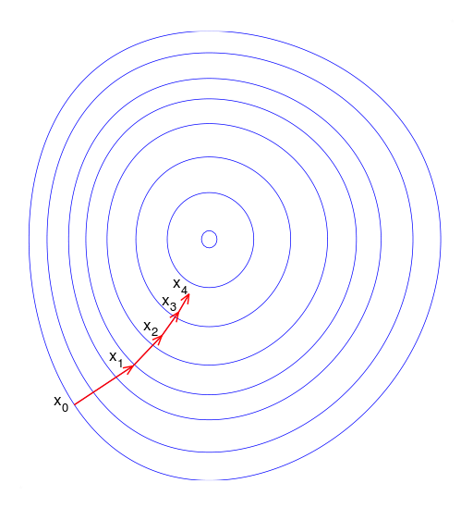
GRADIENT DESCENT

Slide 52
A CODE EXAMPLE OF GRADIENT DESCENT
num_to_approach, start, steps, optimized = 6.2, 0., [-1, 1], False while not optimized: current_distance = num_to_approach - start got_better = False next_steps = [start + i for i in steps] for n in next_steps: distance = np.abs(num_to_approach - n) if distance < current_distance: got_better = True print distance, 'is better than', current_distance current_distance = distance start = n

Slide 53
A CODE EXAMPLE OF GRADIENT DESCENT
if got_better: print 'found better solution! using', current_distance a += 1 else: optimized = True print start, 'is closest to', num_to_approach
What is the code doing? What could go wrong?

Slide 54
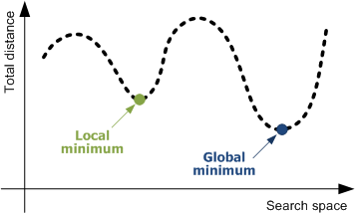
GLOBAL VS LOCAL MINIMUMS
Gradient Descent could solve for a local minimum instead of a global minimum.
A local minimum is confined to a very specific subset of solutions. The global minimum considers all solutions. These could be equal, but that’s not always true.

Slide 55
DEMO
APPLICATION OF GRADIENT DESCENT

Slide 56
APPLICATION OF GRADIENT DESCENT
Gradient Descent works best when:
We are working with a large dataset.
Otherwise just use OLS.
Data is cleaned up and normalized.

Slide 57
APPLICATION OF GRADIENT DESCENT
We can easily run a Gradient Descent regression.
Note: The verbose argument can be set to 1 to see the optimization steps.
lm = linear_model.SGDRegressor() lm.fit(modeldata, y) print lm.score(modeldata, y) print metrics.mean_squared_error(y, lm.predict(modeldata))
Untuned, how well did gradient descent perform compared to OLS?

Slide 58
APPLICATION OF GRADIENT DESCENT
Gradient Descent can be tuned with
the learning rate: how aggressively we solve the problem
epsilon: at what point do we say the error margin is acceptable
iterations: when should be we stop no matter what

Slide 59
INDEPENDENT PRACTICE
ON YOUR OWN

Slide 60
ACTIVITY: ON YOUR OWN
DIRECTIONS (30 minutes)
EXERCISE
There are tons of ways to approach a regression problem.
Implement the Gradient Descent approach to our bikeshare modeling problem.
Show how Gradient Descent solves and optimizes the solution.
Demonstrate the grid_search module.
Use a model you evaluated last class or the simpler one from today. Implement param_grid in grid search to answer the following questions:
With a set of values between 10^-10 and 10^-1, how does MSE change?
Our data suggests we use L1 regularization. Using a grid search with l1_ratios between 0 and 1, increasing every 0.05, does this statement hold true? If not, did gradient descent have enough iterations to work properly?
How do these results change when you alter the learning rate?
DELIVERABLE
Gradient Descent approach and answered questions

Slide 61
ACTIVITY: ON YOUR OWN
Starter Code
params = {} # put your gradient descent parameters here gs = grid_search.GridSearchCV( estimator=linear_model.SGDRegressor(), cv=cross_validation.KFold(len(modeldata), n_folds=5, shuffle=True), param_grid=params, scoring='mean_squared_error', ) gs.fit(modeldata, y) print 'BEST ESTIMATOR' print -gs.best_score_ print gs.best_estimator_ print 'ALL ESTIMATORS' print gs.grid_scores_
EXERCISE

Slide 62
CONCLUSION
TOPIC REVIEW

Slide 63
LESSON REVIEW
What's the (typical) range of r-squared?
What's the range of mean squared error?
How would changing the scale or interpretation of y (your target variable) effect mean squared error?
What's cross validation, and why do we use it in machine learning?
What is error due to bias? What is error due to variance? Which is better for a model to have, if it had to have one?
How does gradient descent try a different approach to minimizing error?

Slide 64
COURSE
BEFORE NEXT CLASS

Slide 65
DUE DATE
BEFORE NEXT CLASS
Homework:
Project: Final Project, Deliverable 1

Slide 66
LESSON
CREDITS

Slide 67
CITATIONS
THANKS FOR THE FOLLOWING
Title, Author: link
Title, Author: link
Title, Author: link

Slide 68
LESSON
Q & A

Slide 69
LESSON
EXIT TICKET
DON’T FORGET TO FILL OUT YOUR EXIT TICKET

Slide 70
THANKS!
NAME
Body Level One
Body Level Two
Body Level Three
Body Level Four
Body Level Five
Body Level One
Body Level Two
Body Level Three
Body Level Four
Body Level Five
Optional Information:
Email?
Website?
Twitter?

