Slide 1
INTRODUCTION TO LOGISTIC REGRESSION
(and welcome back!)

Slide 2
LEARNING OBJECTIVES
INTRODUCTION TO LOGISTIC REGRESSION
Build a Logistic regression classification model using the statsmodels library
Describe a sigmoid function, odds, and the odds ratio as well as how they relate to logistic regression
Evaluate a model using metrics such as classification accuracy/error, confusion matrix, ROC/AUC curves, and loss functions

Slide 3
COURSE
PRE-WORK

Slide 4
PRE-WORK REVIEW
Implement a linear model (LinearRegression) with sklearn
Understand what a coefficient is
Recall metrics such as accuracy and misclassification
Recall the differences between L1 and L2 regularization

Slide 5
OPENING
INTRODUCTION TO LOGISTIC REGRESSION

Slide 6

INTRODUCTION TO LOGISTIC REGRESSION
ANSWER THE FOLLOWING QUESTIONS
EXERCISE
Read through the following questions and brainstorm answers for each:
What are the main differences between linear and KNN models? What is different about how they approach solving the problem?
For example, what is interpretable about OLS compared to what's interpretable in KNN?
What would be the advantage of using a linear model like OLS to solve a classification problem, compared to KNN?
What are some challenges for using OLS to solve a classification problem (say, if the values were either 1 or 0)?
DELIVERABLE
Answers to the above questions

Slide 7
INTRODUCTION
LOGISTIC REGRESSION

Slide 8
LOGISTIC REGRESSION
Logistic regression is a linear approach to solving a classification problem.
The decision boundary between classes is linear (eg. a line in 2d’s)
That is, we can use a linear model, similar to Linear regression, in order to solve if an item belongs or does not belong to a class label.

Slide 9
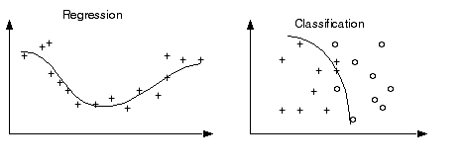
CHALLENGE! LINEAR REGRESSION RESULTS FOR CLASSIFICATION
Regression results can have a value range from -∞ to ∞.
Classification is used when predicted values (i.e. class labels) are not greater than or less than each other.

Slide 10
CHALLENGE! LINEAR REGRESSION RESULTS FOR CLASSIFICATION
But, since most classification problems are binary (0 or 1) and 1 is greater than 0, does it make sense to apply the concept of regression to solve classification?
How might we contain those bounds?
Let’s review some approaches to make classification with regression feasible.

Slide 11
INTRODUCTION
WORKING FROM THE END TO THE BEGINNING

Slide 12
FIX 1: PROBABILITY
One approach is predicting the probability that an observation belongs to a certain class.
We could assume the prior probability (the bias) of a class is the class distribution.

Slide 13
FIX 1: PROBABILITY
For example, suppose we know that roughly 700 of 2200 people from the Titanic survived. Without knowing anything about the passengers or crew, the probability of survival would be ~0.32 (32%).
700 / 2200 = ~0.32
However, we still need a way to use a linear function to either increase or decrease the probability of an observation given the data about it.

Slide 14
ACTIVITY: KNOWLEDGE CHECK
ANSWER THE FOLLOWING QUESTIONS
EXERCISE
Recall the ordinary least squares formula (intercept + slope | B0 + B1)
The prior probability is most similar to which value in the ordinary least squares formula?
DELIVERABLE
Answers to the above questions

Slide 15
FIX 2: LINK FUNCTIONS AND THE SIGMOID FUNCTION
Another advantage to OLS is that it allows for generalized models using a link function.
Link functions allows us to build a relationship between a linear function and the mean of a distribution.
We can now form a specific relationship between our linear predictors and the response variable.

Slide 16
FIX 2: LINK FUNCTIONS AND THE SIGMOID FUNCTION
For classification, we need a distribution associated with categories: given all events, what is the probability of a given event?
The link function that best allows for this is the logit function, which is the inverse of the sigmoid function.

Slide 17
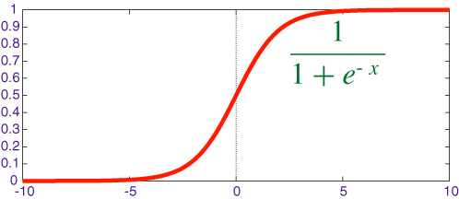

FIX 2: LINK FUNCTIONS AND THE SIGMOID FUNCTION
A sigmoid function is a function that visually looks like an s.
Mathematically, it is defined as

Slide 18
FIX 2: LINK FUNCTIONS AND THE SIGMOID FUNCTION
Recall that e is the inverse of the natural log.
As x increases, the results is closer to 1. As x decreases, the result is closer to 0.
When x = 0, the result is 0.5.

Slide 19
FIX 2: LINK FUNCTIONS AND THE SIGMOID FUNCTION
Since x decides how to much to increase or decrease the value away from 0.5, x can be interpreted as something like a coefficient.
However, we still need to change its form to make it more useful.

Slide 20
DEMO
PLOTTING A SIGMOID FUNCTION

Slide 21
PLOTTING A SIGMOID FUNCTION
Use the sigmoid function definition with values of x between -6 and 6 to plot it on a graph.
Do this by hand or write Python code to evaluate it.
Recall that e = 2.71.
Do we get an the “S” shape we expect?

Slide 22
INTRODUCTION
LOGISTIC REGRESSION

Slide 23
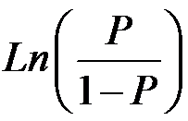
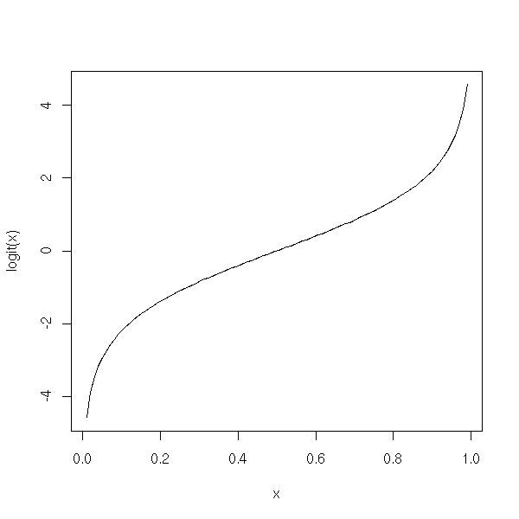
FIX 3: ODDS AND LOG-ODDS
The logit function is the inverse of the sigmoid function.
This will act as our link function for logistic regression.
Mathematically, the logit function is defined as

Slide 24
FIX 3: ODDS AND LOG-ODDS
The value within the natural log, p / (1-p) represents the odds. Taking the natural log of odds generates log odds.

Slide 25
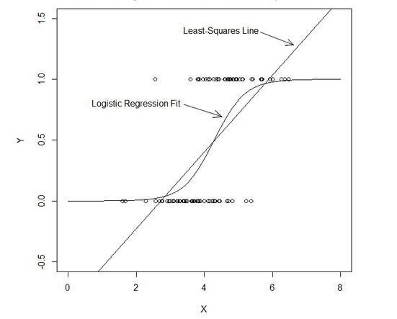
FIX 3: ODDS AND LOG-ODDS
The logit function allows for values on the x axis between -∞ and ∞, but provides us probabilities between 0 and 1.

Slide 26
ACTIVITY: KNOWLEDGE CHECK
ANSWER THE FOLLOWING QUESTIONS
EXERCISE
Why is it important to take values between -∞ and ∞, but provide probabilities between 0 and 1?
What does this remind us of?
DELIVERABLE
Answers to the above questions

Slide 27
FIX 3: ODDS AND LOG-ODDS
For example, the logit value (log odds) of 0.2 (or odds of ~1.2:1):
0.2 = ln(p / (1-p) )
With a mean probability of 0.5, the adjusted probability would be ~0.55.
1 / (1 + e^{-0.2})
To calculate this in python, we could use the following.
1 / (1 + numpy.exp(-0.2) )
or
1 / (1 + math.e ** -0.2)

Slide 28
FIX 3: ODDS AND LOG-ODDS
The logit value represents the coefficients in the logistic function.
Few people think in log odds.
Fewer people would be able to understand the explanation in the real world...
So how do we communicate the results (after all, linear models are meant to be easy to communicate yeah)?
Convert to odds (e^Bn), now everything similar to linear regression:
For every unit increase in x, the odds of being a 1 vs. a 0 increases / decreases by odds - 1%.

Slide 29
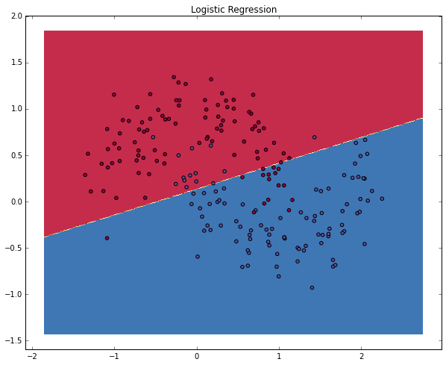
FIX 3: ODDS AND LOG-ODDS
With these coefficients, we get our overall probability: the logistic regression draws a linear decision line which divides the classes.

Slide 30
Eh?
Steps to logistic regression glory:
Fit a logit (log odds) function to the data using iterative method (eg. gradient descent) to minimise error.
Convert log odds (l0) to odds ratio (or)
or = e ^{lo}
Convert or to probability (p)
p = or / (1 + or)
2 + 3 together:
p = 1/(1 + e^{-lo})
And we decide:
p > 0.5 = 1, else 0.

Slide 31
GUIDED PRACTICE
WAGER THOSE ODDS!

Slide 32
ACTIVITY: WAGER THOSE ODDS!
DIRECTIONS (15 minutes)
EXERCISE
Given the odds below for some football games, use the logit function and the sigmoid function to solve for the probability that the “better” team would win.
Stanford : Iowa, 5:1
Alabama : Michigan State, 20:1
Clemson : Oklahoma, 1.1:1
Houston : Florida State, 1.8:1
Ohio State : Notre Dame, 1.6:1
DELIVERABLE
The desired probabilities

Slide 33
ACTIVITY: WAGER THOSE ODDS!
STARTER CODE
EXERCISE
def logit_func(odds): # uses a float (odds) and returns back the log odds (logit) return None def sigmoid_func(logit): # uses a float (logit) and returns back the probability return None
DELIVERABLE
The desired probabilities

Slide 34
INDEPENDENT PRACTICE
LOGISTIC REGRESSION IMPLEMENTATION

Slide 35
ACTIVITY: LOGISTIC REGRESSION IMPLEMENTATION
DIRECTIONS (15 minutes)
EXERCISE
Use the data collegeadmissions.csv and the LogisticRegression estimator in sklearn to predict the target variable admit.
What is the bias, or prior probability, of the dataset?
Build a simple model with one feature and explore the coef_ value. Does this represent the odds or logit (log odds)?
Build a more complicated model using multiple features. Interpreting the odds, which features have the most impact on admission rate? Which features have the least?
What is the accuracy of your model?
DELIVERABLE
Answers to the above questions

Slide 36
INTRODUCTION
ADVANCED CLASSIFICATION METRICS

Slide 37
ADVANCED CLASSIFICATION METRICS
Accuracy is only one of several metrics used when solving a classification problem.
Accuracy = total predicted correct / total observations in dataset
Accuracy alone doesn’t always give us a full picture.
If we know a model is 75% accurate, it doesn’t provide any insight into why the 25% was wrong.

Slide 38
ADVANCED CLASSIFICATION METRICS
Was it wrong across all labels?
Did it just guess one class label for all predictions?
It’s important to look at other metrics to fully understand the problem.

Slide 39
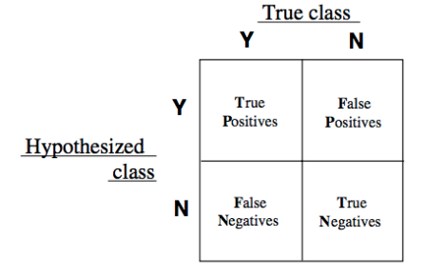
ADVANCED CLASSIFICATION METRICS
We can split up the accuracy of each label by using the true positive rate and the false positive rate.
For each label, we can put it into the category of a true positive, false positive, true negative, or false negative.

Slide 40
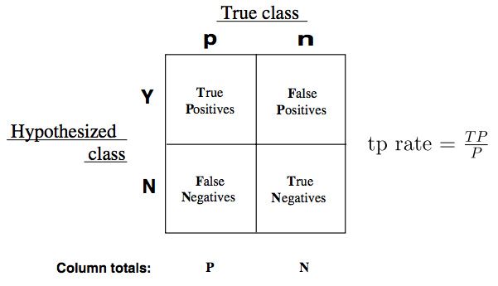
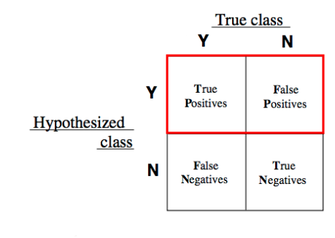
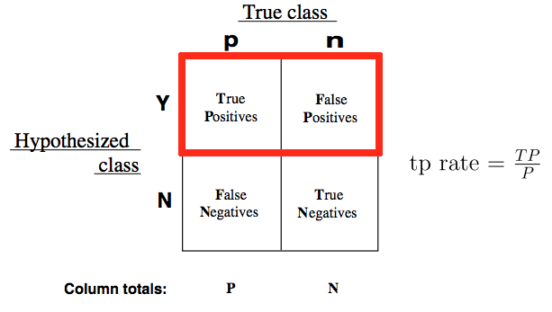
ADVANCED CLASSIFICATION METRICS
True Positive Rate (TPR) asks, “Out of all of the target class labels, how many were accurately predicted to belong to that class?”
For example, given a medical exam that tests for cancer, how often does it correctly identify patients with cancer?

Slide 41
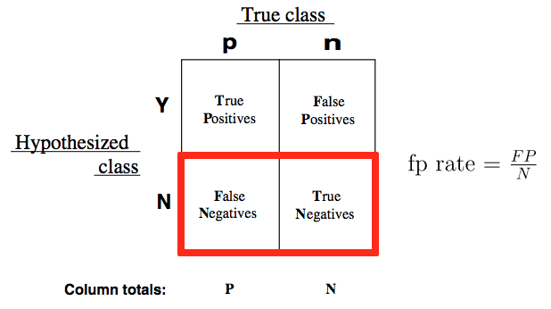
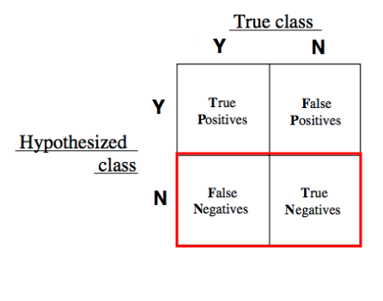
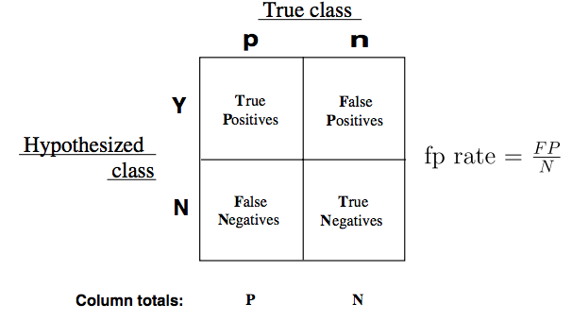
ADVANCED CLASSIFICATION METRICS
False Positive Rate (FPR) asks, “Out of all items not belonging to a class label, how many were predicted as belonging to that target class label?”
For example, given a medical exam that tests for cancer, how often does it trigger a “false alarm” by incorrectly saying a patient has cancer?

Slide 42
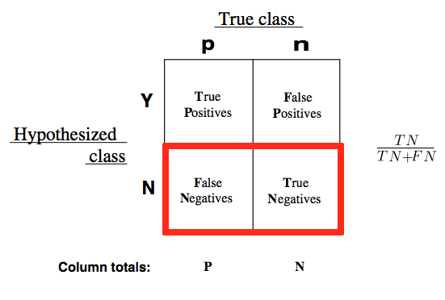
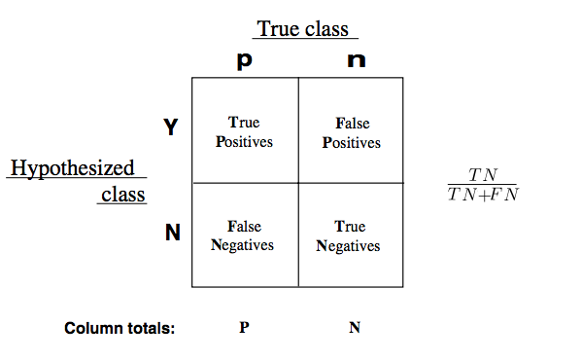
ADVANCED CLASSIFICATION METRICS
These can also be inverted.
How often does a test correctly identify patients without cancer?

Slide 43
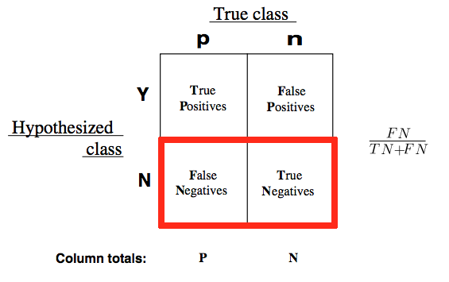
ADVANCED CLASSIFICATION METRICS
How often does a test incorrectly identify patient as cancer-free?

Slide 44
ADVANCED CLASSIFICATION METRICS
The true positive and false positive rates gives us a much clearer pictures of where predictions begin to fall apart.
This allows us to adjust our models accordingly.

Slide 45
ADVANCED CLASSIFICATION METRICS
A good classifier would have a true positive rate approaching 1 and a false positive rate approaching 0.
In our smoking problem, this model would accurately predict all of the smokers as smokers and not accidentally predict any of the nonsmokers as smokers.

Slide 46
ADVANCED CLASSIFICATION METRICS
We can vary the classification threshold for our model to get different predictions. But how do we know if a model is better overall than other model?
We can compare the FPR and TPR of the models, but it can often be difficult to optimize two numbers at once.
Logically, we like a single number for optimization.
Can you think of any ways to combine our two metrics?

Slide 47
ADVANCED CLASSIFICATION METRICS
This is where the Receiver Operation Characteristic (ROC) curve comes in handy.
The curve is created by plotting the true positive rate against the false positive rate at various model threshold settings.
Area Under the Curve (AUC) summarizes the impact of TPR and FPR in one single value.

Slide 48
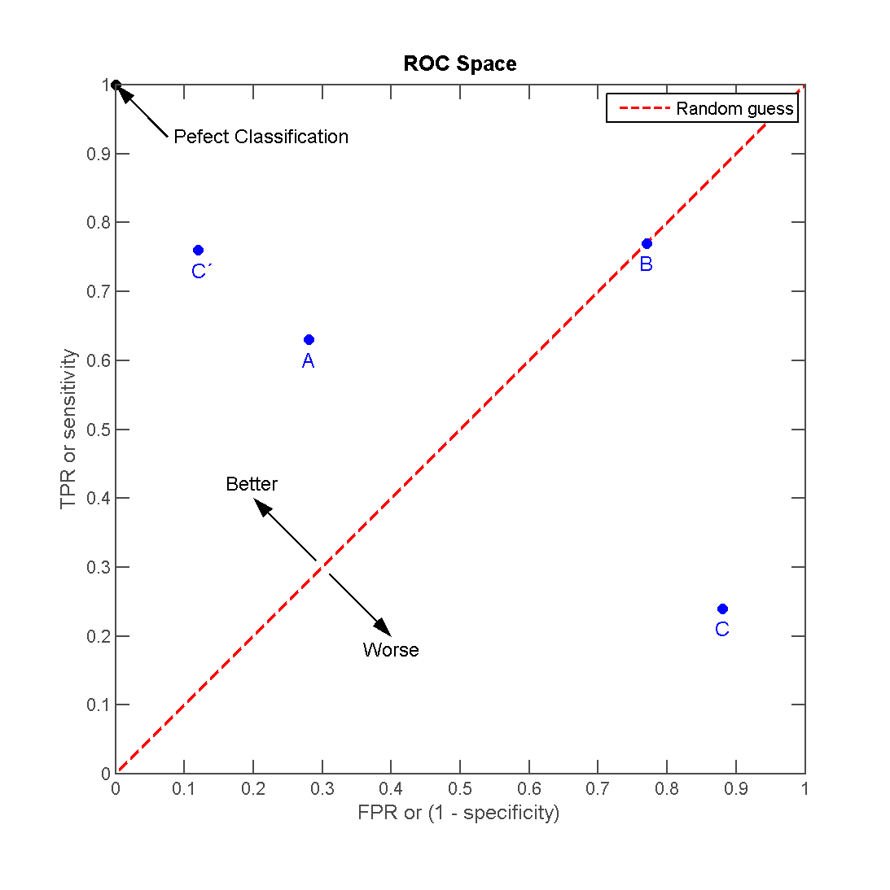
ADVANCED CLASSIFICATION METRICS
There can be a variety of points on an ROC curve.

Slide 49
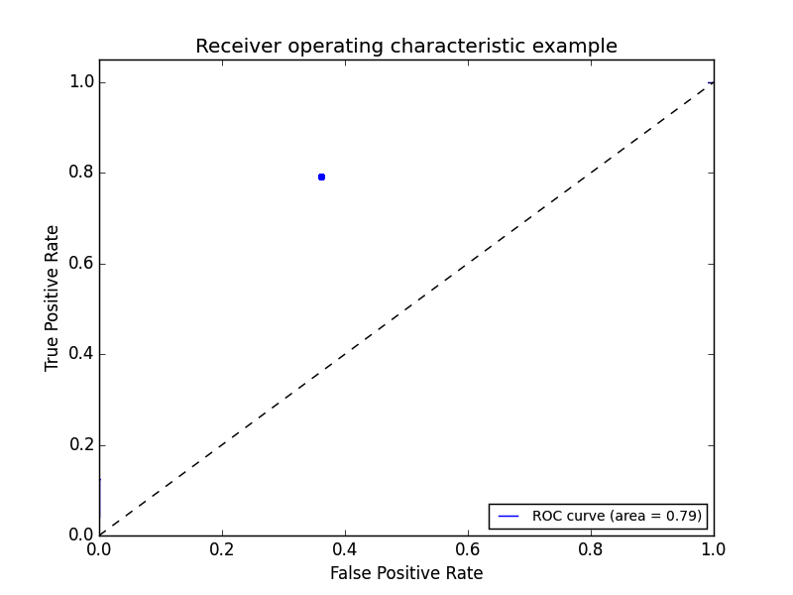
ADVANCED CLASSIFICATION METRICS
We can begin by plotting an individual TPR/FPR pair for one threshold.

Slide 50
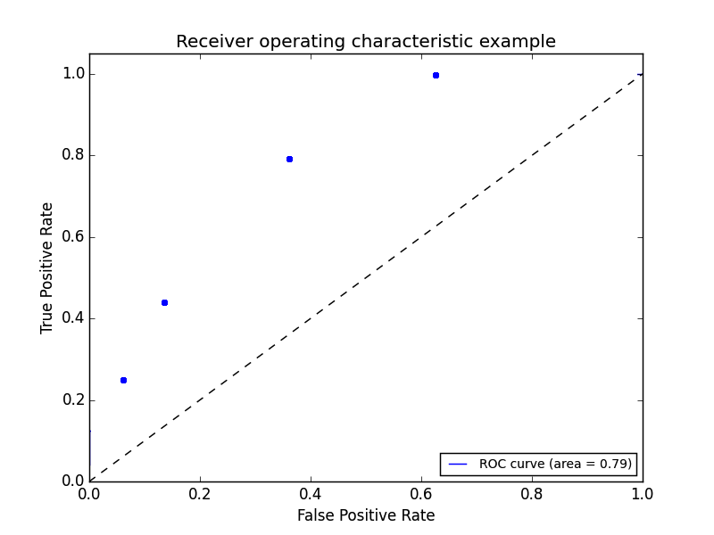
ADVANCED CLASSIFICATION METRICS
We can continue adding pairs for different thresholds

Slide 51
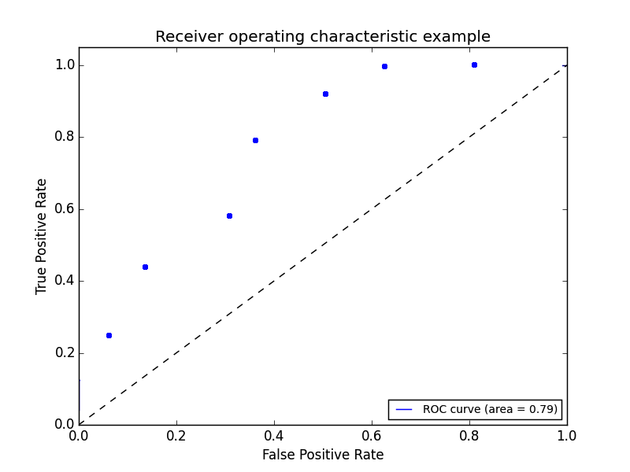
ADVANCED CLASSIFICATION METRICS
We can continue adding pairs for different thresholds

Slide 52
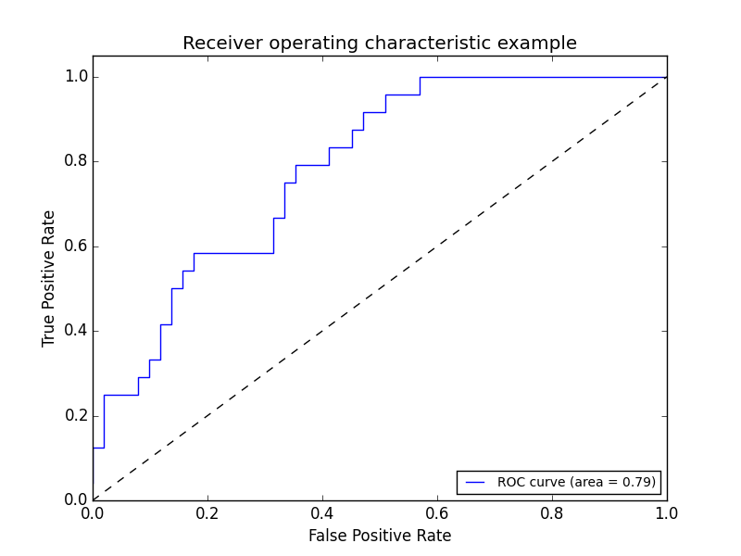
ADVANCED CLASSIFICATION METRICS
Finally, we create a full curve that is described by TPR and FPR.

Slide 53
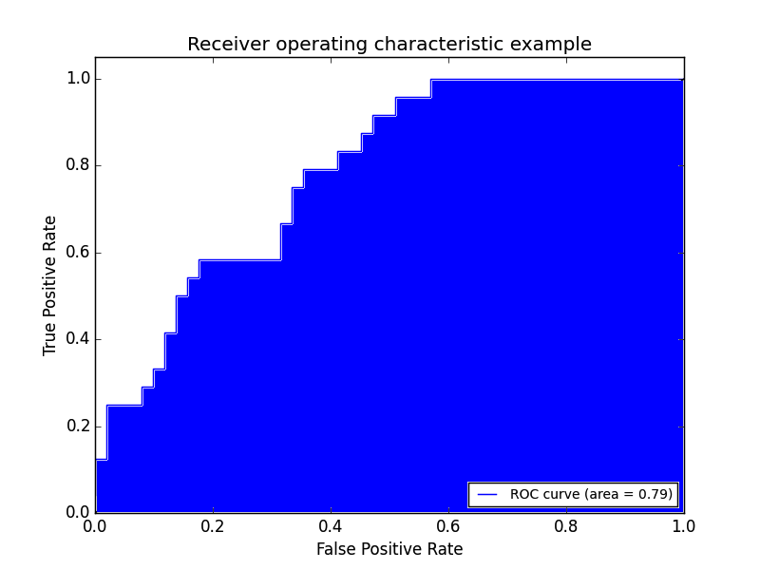
ADVANCED CLASSIFICATION METRICS
With this curve, we can find the Area Under the Curve (AUC).

Slide 54
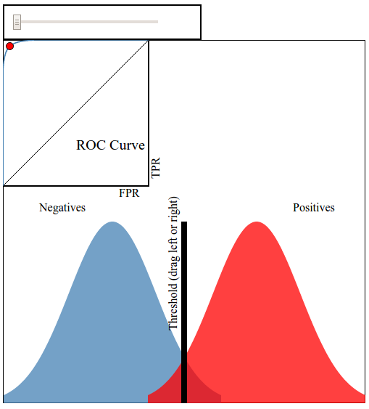
ADVANCED CLASSIFICATION METRICS
This interactive visualization can help practice visualizing ROC curves.

Slide 55
ADVANCED CLASSIFICATION METRICS
If we have a TPR of 1 (all positives are marked positive) and FPR of 0 (all negatives are not marked positive), we’d have an AUC of 1. This means everything was accurately predicted.
If we have a TPR of 0 (all positives are not marked positive) and an FPR of 1 (all negatives are marked positive), we’d have an AUC of 0. This means nothing was predicted accurately.
An AUC of 0.5 would suggest randomness (somewhat) and is an excellent benchmark to use for comparing predictions (i.e. is my AUC above 0.5?).

Slide 56
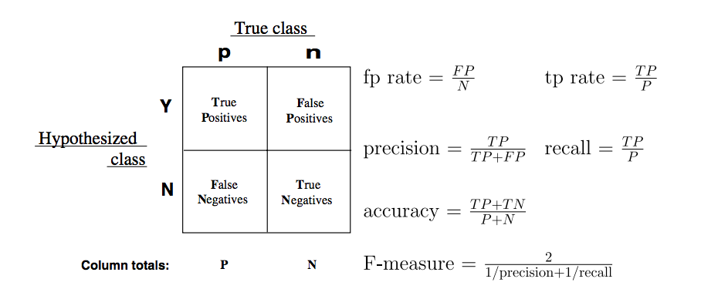
ADVANCED CLASSIFICATION METRICS
There are several other common metrics that are similar to TPR and FPR.
Sklearn has all of the metrics located on one convenient page.

Slide 57
GUIDED PRACTICE
WHICH METRIC SHOULD I USE?

Slide 58
ACTIVITY: WHICH METRIC SHOULD I USE?
DIRECTIONS (15 minutes)
EXERCISE
While AUC seems like a “golden standard”, it could be further improved depending upon your problem. There will be instances where error in positive or negative matches will be very important. For each of the following examples:
Write a confusion matrix: true positive, false positive, true negative, false negative. Then decide what each square represents for that specific example.
Define the benefit of a true positive and true negative.
Define the cost of a false positive and false negative.
Determine at what point does the cost of a failure outweigh the benefit of a success? This would help you decide how to optimize TPR, FPR, and AUC.
DELIVERABLE
Answers for each example

Slide 59
ACTIVITY: WHICH METRIC SHOULD I USE?
DIRECTIONS (15 minutes)
EXERCISE
Examples:
A test is developed for determining if a patient has cancer or not.
A newspaper company is targeting a marketing campaign for "at risk" users that may stop paying for the product soon.
You build a spam classifier for your email system.
DELIVERABLE
Answers for each example

Slide 60
INDEPENDENT PRACTICE
EVALUATING LOGISTIC REGRESSION WITH ALTERNATIVE METRICS

Slide 61
ACTIVITY: EVALUATING LOGISTIC REGRESSION
DIRECTIONS (35 minutes)
EXERCISE
Kaggle’s common online exercise is exploring survival data from the Titanic.
Spend a few minutes determining which data would be most important to use in the prediction problem. You may need to create new features based on the data available. Consider using a feature selection aide in sklearn. For a worst case scenario, identify one or two strong features that would be useful to include in this model.
DELIVERABLE
Answers to the above question and a Logistic model on the Titanic data

Slide 62
ACTIVITY: EVALUATING LOGISTIC REGRESSION
DIRECTIONS (35 minutes)
EXERCISE
Spend 1-2 minutes considering which metric makes the most sense to optimize. Accuracy? FPR or TPR? AUC? Given the business problem of understanding survival rate aboard the Titanic, why should you use this metric?
Build a tuned Logistic model. Be prepared to explain your design (including regularization), metric, and feature set in predicting survival using any tools necessary (such as a fit chart). Use the starter code to get you going.
DELIVERABLE
Answers to the above question and a Logistic model on the Titanic data

Slide 63
CONCLUSION
TOPIC REVIEW

Slide 64
REVIEW QUESTIONS
What’s the link function used in logistic regression?
What kind of machine learning problems does logistic regression address?
What do the coefficients in a logistic regression represent? How does the interpretation differ from ordinary least squares? How is it similar?

Slide 65
REVIEW QUESTIONS
How does True Positive Rate and False Positive Rate help explain accuracy?
What would an AUC of 0.5 represent for a model? What about an AUC of 0.9?
Why might one classification metric be more important to tune than another? Give an example of a business problem or project where this would be the case.

Slide 66
COURSE
BEFORE NEXT CLASS

Slide 67
DUE DATE
BEFORE NEXT CLASS
Unit Project 2: Next lesson (Wednesday @ 23:59….)

Slide 68
LESSON
CREDITS

Slide 69
CITATIONS
THANKS FOR THE FOLLOWING
Title, Author: link
Title, Author: link
Title, Author: link

Slide 70
LESSON
Q & A

Slide 71
LESSON
EXIT TICKET
DON’T FORGET TO FILL OUT YOUR EXIT TICKET

Slide 72
THANKS!
NAME
Body Level One
Body Level Two
Body Level Three
Body Level Four
Body Level Five
Body Level One
Body Level Two
Body Level Three
Body Level Four
Body Level Five
Optional Information:
Email?
Website?
Twitter?

