Slide 1
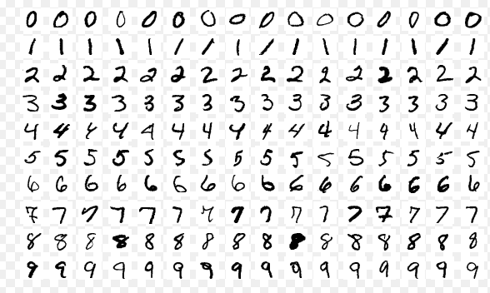
A project of developing a classifier for hand-written character recognition
Mnist data set:
a publicly available training and test data set for developing a classifier for hand-written character recognition.
it is one of the most widely used data set in machine learning.

Slide 2
It consists of two data sets: a training and a test data set.
training set: 60,000 examples
test set: 10,000 examples
They are of the same format.
an example is formed by a label and an image.
a label: 1 line which has a class index in the range from 0 to 9.
an image: 28 lines. Each line has 28 integers indicating gray scale (0 ~ 255) of a pixel.

Slide 3
A description of the task to do
Language to use: C or C++
A sample program was given in the lecture material and discussed in the class.
you can make use of this one.
Please use the MS visual studio which gives C, C++ program development environment.
Task to do:
the main task of this project is to find the values of the hyper parameters to allows the best model.
hyper parameters of interest in this project: learning rate, SZ1 and SZ2 (number of units of layer 1 and 2).
you have to run the training process for 6 different combinations of the hyper parameters.
you also need to find the number of epochs required to obtain the highest performance
you can stop the system when it looks like that more epochs may not lead to better accuracy.
What to submit:
a table showing the performance for each combination of parameters.

