Slide 1
Head.S 분석자료
16기 A조

Slide 2
Head.s @0 stext
X0
DTB (PHY ADDRERSS)
X1
00000000_00000000
X16
X2
00000000_00000000
X17
X3
00000000_00000000
X18
X4
X19
X5
X20
X6
X21
X7
X22
X8
X23
X9
X24
X10
X25
X11
X26
X12
X27
X13
X28
X14
X29
FP
X15
X30
LR
PC
00000088_11120000

Slide 3
Head.s @1 stext
X0
DTB (PHY ADDRERSS)
X1
00000000_00000000
X16
bl preserve_boot_args
X2
00000000_00000000
X17
X3
00000000_00000000
X18
X4
X19
X5
X20
X6
X21
X7
X22
X8
X23
X9
X24
X10
X25
X11
X26
X12
X27
X13
X28
X14
X29
FP
X15
X30
stext+4
LR

Slide 4
Head.s @2 preserve_boot_args
X0
DTB (PHY ADDRERSS)
X1
00000000_00000000
X16
X2
00000000_00000000
X17
X3
00000000_00000000
X18
X4
X19
X5
X20
mov x21, x0
X6
X21
DTB (PHY ADDRERSS)
X7
X22
X8
X23
X9
X24
X10
X25
X11
X26
X12
X27
X13
X28
X14
X29
FP
X15
X30
stext+4
LR

Slide 5
Head.s @3 preserve_boot_args
X0
00000088_11286000
X1
00000000_00000000
X16
X2
00000000_00000000
X17
X3
00000000_00000000
X18
X4
X19
X5
X20
adr_l x0, boot_args
u64 __cacheline_aligned boot_args[4];
(= ffff000011286000 )
+-4 GBiM 가 유효 함.
PC + boot_args = 0x88_11286000
X6
X21
DTB (PHY ADDRERSS)
X7
X22
X8
X23
X9
X24
X10
X25
X11
X26
X12
X27
X13
X28
X14
X29
FP
X15
X30
stext+4
LR

Slide 6
Head.s @4 preserve_boot_args
X0
00000088_11286000
X1
00000000_00000000
X16
X2
00000000_00000000
X17
X3
00000000_00000000
X18
X4
X19
X5
X20
stp x21, x1, [x0]
stp x2, x3, [x0, #16]
u64 __cacheline_aligned boot_args[4];
boot_args[0] = x21; // DTB
boot_args[1] = x1; // 0
boot_args[2] = x2; // 0
boot_args[3] = x3; // 0
X6
X21
DTB (PHY ADDRERSS)
X7
X22
X8
X23
X9
X24
X10
X25
X11
X26
X12
X27
X13
X28
X14
X29
FP
X15
X30
stext+4
LR

Slide 7
Head.s @5 preserve_boot_args
X0
00000088_11286000
X1
00000000_00000000
X16
dmb sy
DMB
Data Memory Barrier.
SY
Full system barrier operation. This is the default and can be omitted.
X2
00000000_00000000
X17
X3
00000000_00000000
X18
X4
X19
X5
X20
X6
X21
DTB (PHY ADDRERSS)
X7
X22
X8
X23
X9
X24
X10
X25
X11
X26
X12
X27
X13
X28
boot_arg[]를 저장한 명령어가
Chche clear 명령어에 영향을
받지 않도록 Barrier를 사용한다.
(메모리 오더링 이슈는 1 core에서도 발생한다)
X14
X29
FP
X15
X30
stext+4
LR

Slide 8
Head.s @6 preserve_boot_args
X0
00000088_11286000
X1
00000000_00000020
X16
mov x1, #0x20
4 x 8 = 32 = 0x20
X2
00000000_00000000
X17
X3
00000000_00000000
X18
X4
X19
X5
X20
X6
X21
DTB (PHY ADDRERSS)
X7
X22
X8
X23
X9
X24
X10
X25
X11
X26
X12
X27
X13
X28
X14
X29
FP
X15
X30
stext+4
LR

Slide 9
Head.s @7 preserve_boot_args
X0
00000088_11286000
X1
00000000_00000020
X16
b __inval_dcache_area
__inval_dcache_area(void *addr, size_t len);
X0 – addr
X1 – len
Ensure that any D-cache lines are invalidated.
X2
00000000_00000000
X17
X3
00000000_00000000
X18
X4
X19
X5
X20
X6
X21
DTB (PHY ADDRERSS)
X7
X22
X8
X23
X9
X24
X10
X25
X11
X26
X12
X27
X13
X28
X14
X29
FP
X15
X30
stext+4
LR

Slide 10
Head.s @8 stext
X0
00000088_11286000
X1
00000000_00000020
X16
bl el2_setup
X2
00000000_00000000
X17
X3
00000000_00000000
X18
X4
X19
X5
X20
X6
X21
DTB (PHY ADDRERSS)
X7
X22
X8
X23
X9
X24
X10
X25
X11
X26
X12
X27
X13
X28
X14
X29
FP
X15
X30
stext+8
LR

Slide 11
Head.s @9 el2_setup
X0
00000088_11286000
X1
00000000_00000020
X16
msr SPsel, #1
X2
00000000_00000000
X17
X3
00000000_00000000
X18
X4
X19
X5
X20
X6
X21
DTB (PHY ADDRERSS)
X7
X22
X8
X23
X9
X24
X10
X25
X11
X26
X12
X27
X13
X28
X14
X29
FP
X15
X30
stext+8
LR
SPSEL
00000000_00000001

Slide 12
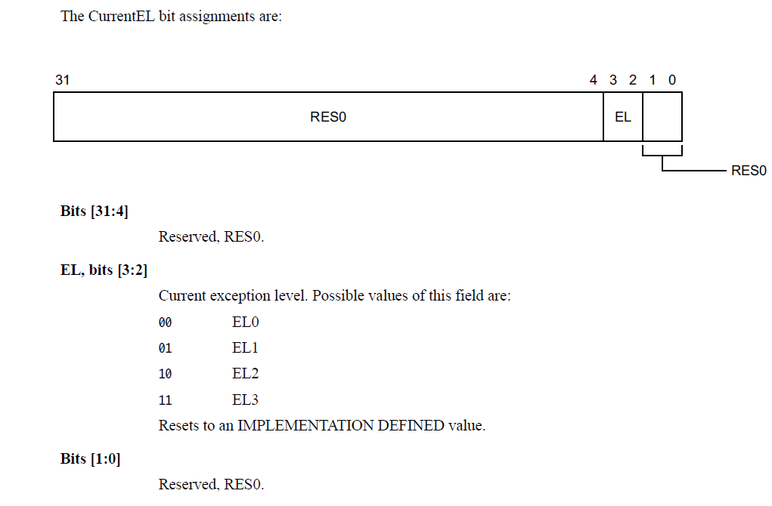
Head.s @10 el2_setup
X0
00000000_00000004
X1
00000000_00000020
X16
mrs x0, CurrentEL
X2
00000000_00000000
X17
X3
00000000_00000000
X18
X4
X19
X5
X20
X6
X21
DTB (PHY ADDRERSS)
System이 EL1 모드로
부팅했다고 가정함
X7
X22
X8
X23
X9
X24
X10
X25
X11
X26
X12
X27
X13
X28
X14
X29
FP
X15
X30
stext+8
LR
SPSEL
00000000_00000001

Slide 13
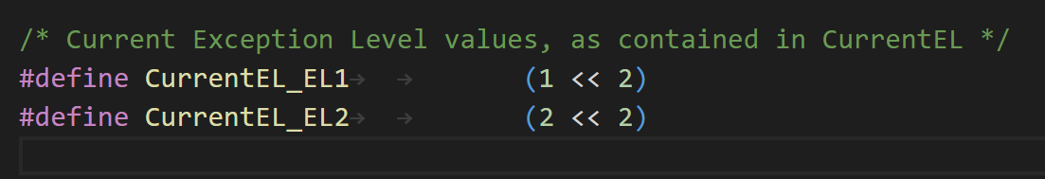
Head.s @11 el2_setup
X0
00000000_00000004
X1
00000000_00000020
X16
cmp x0, #CurrentEL_EL2 (=8)
X2
00000000_00000000
X17
X3
00000000_00000000
X18
X4
X19
X5
X20
X6
X21
DTB (PHY ADDRERSS)
X7
X22
X8
X23
X9
X24
X10
X25
X11
X26
X12
X27
X13
X28
X14
X29
FP
X15
X30
stext+8
LR
SPSEL
00000000_00000001

Slide 14
Head.s @12 el2_setup
X0
00000000_00000004
X1
00000000_00000020
X16
b.eq 1f
같지 않으므로 skip
X2
00000000_00000000
X17
X3
00000000_00000000
X18
X4
X19
X5
X20
X6
X21
DTB (PHY ADDRERSS)
X7
X22
X8
X23
X9
X24
X10
X25
X11
X26
X12
X27
X13
X28
X14
X29
FP
X15
X30
stext+8
LR
SPSEL
00000000_00000001

Slide 15
Head.s @13 el2_setup
X0
00000000_30500800
X1
00000000_00000020
X16
mov_q x0, (SCTLR_EL1_RES1 | ENDIAN_SET_EL1)
(SCTLR_EL1_RES1 | ENDIAN_SET_EL1) -> 0x30500800
X2
00000000_00000000
X17
X3
00000000_00000000
X18
X4
X19
X5
X20
X6
X21
DTB (PHY ADDRERSS)
X7
X22
X8
X23
X9
X24
X10
X25
X11
X26
X12
X27
X13
X28
X14
X29
FP
X15
X30
stext+8
LR
SPSEL
00000000_00000001

Slide 16
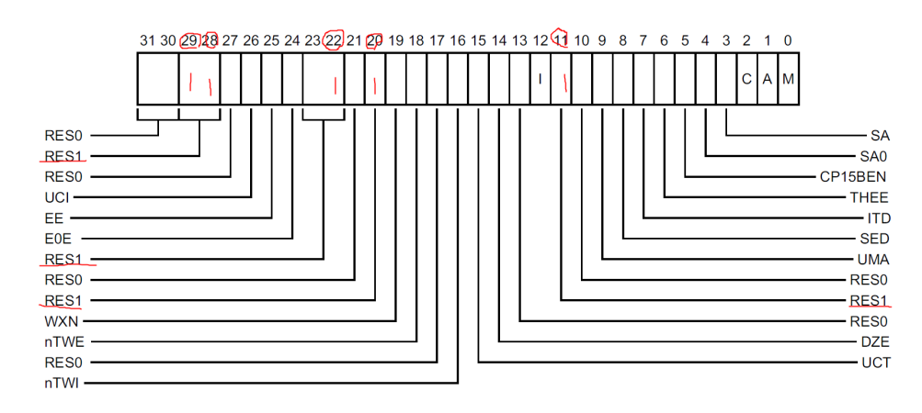
Head.s @14 el2_setup
X0
00000000_30500800
X1
00000000_00000020
X16
msr sctlr_el1, x0
Reserved 된 값을 1로 채움
왜 하는지는 정확히 모름
X2
00000000_00000000
X17
X3
00000000_00000000
X18
X4
X19
X5
X20
X6
X21
DTB (PHY ADDRERSS)
X7
X22
X8
X23
X9
X24
X10
X25
X11
X26
X12
X27
X13
X28
X14
X29
FP
X15
X30
stext+8
LR
SPSEL
SCTLR_EL1
00000000_00000001
00000000_30500800

Slide 17
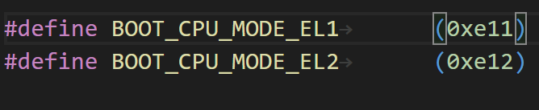
Head.s @15 el2_setup
X0
00000000_00000E11
X1
00000000_00000020
X16
mov w0, #BOOT_CPU_MODE_EL1 (=0xe11)
X2
00000000_00000000
X17
X3
00000000_00000000
X18
X4
X19
X5
X20
X6
X21
DTB (PHY ADDRERSS)
X7
X22
X8
X23
X9
X24
X10
X25
X11
X26
X12
X27
X13
X28
X14
X29
FP
X15
X30
stext+8
LR
SPSEL
SCTLR_EL1
00000000_00000001
00000000_30500800

Slide 18
Head.s @16 el2_setup
X0
00000000_00000E11
X1
00000000_00000020
X16
ret
X2
00000000_00000000
X17
X3
00000000_00000000
X18
X4
X19
X5
X20
X6
X21
DTB (PHY ADDRERSS)
X7
X22
Stext+8 로 return 함
X8
X23
X9
X24
X10
X25
X11
X26
X12
X27
X13
X28
X14
X29
FP
X15
X30
stext+8
LR
SPSEL
SCTLR_EL1
00000000_00000001
00000000_30500800

Slide 19
Head.s @17 stext
X0
00000000_00000E11
X1
00000000_00000020
X16
adrp x23, __PHYS_OFFSET
#define __PHYS_OFFSET (KERNEL_START - TEXT_OFFSET)
KERNEL_START = ffff000010080000
TEXT_OFFSET = 0x80000
__PHYS_OFFSET = ffff000010000000
ADRP 명령어는 32 Bit만 유효함
PC + 32Bit = 0x88_10000000
X2
00000000_00000000
X17
X3
00000000_00000000
X18
X4
X19
X5
X20
X6
X21
DTB (PHY ADDRERSS)
X7
X22
X8
X23
00000088_10000000
X9
X24
X10
X25
X11
X26
X12
X27
X13
X28
X14
X29
FP
X15
X30
stext+8
LR
SPSEL
SCTLR_EL1
00000000_00000001
00000000_30500800

Slide 20
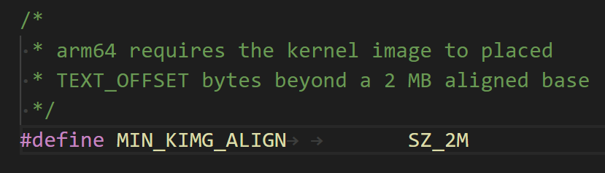
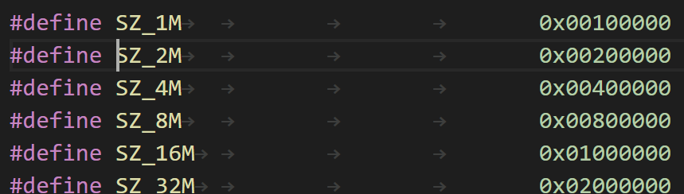
Head.s @18 stext
X0
00000000_00000E11
X1
00000000_00000020
X16
and x23, x23, MIN_KIMG_ALIGN – 1
X2
00000000_00000000
X17
X3
00000000_00000000
X18
X4
X19
X5
X20
X6
X21
DTB (PHY ADDRERSS)
X7
X22
X8
X23
00000000_00000000
X9
X24
X10
X25
X11
X26
X12
X27
X13
X28
X14
X29
FP
X15
X30
stext+8
LR
SPSEL
SCTLR_EL1
00000000_00000001
00000000_30500800

Slide 21
Head.s @19 stext
X0
00000000_00000E11
X1
00000000_00000020
X16
bl set_cpu_boot_mode_flag
X2
00000000_00000000
X17
X3
00000000_00000000
X18
X4
X19
X5
X20
X6
X21
DTB (PHY ADDRERSS)
X7
X22
X8
X23
00000000_00000000
X9
X24
X10
X25
X11
X26
X12
X27
X13
X28
X14
X29
FP
X15
X30
stext+20
LR
SPSEL
SCTLR_EL1
00000000_00000001
00000000_30500800

Slide 22
Head.s @20 set_cpu_boot_mode_flag
X0
00000000_00000E11
X1
00000088_1142C000
X16
adr_l x1, __boot_cpu_mode
extern u32 __boot_cpu_mode[2];
(= ffff00001142c000)
PC + 32Bit = 0x88 1142c000
X2
00000000_00000000
X17
X3
00000000_00000000
X18
X4
X19
X5
X20
X6
X21
DTB (PHY ADDRERSS)
X7
X22
X8
X23
00000000_00000000
X9
X24
X10
X25
X11
X26
X12
X27
X13
X28
X14
X29
FP
X15
X30
stext+20
LR
SPSEL
SCTLR_EL1
00000000_00000001
00000000_30500800

Slide 23
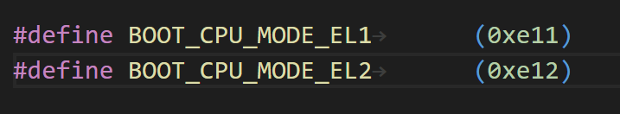
Head.s @21 set_cpu_boot_mode_flag
X0
00000000_00000E11
X1
00000088_1142C000
X16
cmp w0, #BOOT_CPU_MODE_EL2
X2
00000000_00000000
X17
X3
00000000_00000000
X18
X4
X19
X5
X20
X6
X21
DTB (PHY ADDRERSS)
X7
X22
X8
X23
00000000_00000000
X9
X24
X10
X25
X11
X26
X12
X27
X13
X28
X14
X29
FP
X15
X30
stext+20
LR
SPSEL
SCTLR_EL1
00000000_00000001
00000000_30500800

Slide 24
Head.s @22 set_cpu_boot_mode_flag
X0
00000000_00000E11
X1
00000088_1142C000
X16
b.ne 1f
X2
00000000_00000000
X17
X3
00000000_00000000
X18
X4
X19
0xE11 != 0xE12 -> b 1f
X5
X20
X6
X21
DTB (PHY ADDRERSS)
X7
X22
X8
X23
00000000_00000000
X9
X24
X10
X25
X11
X26
X12
X27
X13
X28
X14
X29
FP
X15
X30
stext+20
LR
SPSEL
SCTLR_EL1
00000000_00000001
00000000_30500800

Slide 25
Head.s @23 set_cpu_boot_mode_flag
X0
00000000_00000E11
X1
00000088_1142C000
X16
str w0, [x1]
*x1 = w0;
__boot_cpu_mode = 0x00000E11
X2
00000000_00000000
X17
X3
00000000_00000000
X18
X4
X19
X5
X20
X6
X21
DTB (PHY ADDRERSS)
X7
X22
X8
X23
00000000_00000000
X9
X24
X10
X25
X11
X26
X12
X27
X13
X28
X14
X29
FP
X15
X30
stext+20
LR
SPSEL
SCTLR_EL1
00000000_00000001
00000000_30500800

Slide 26
Head.s @24 set_cpu_boot_mode_flag
X0
00000000_00000E11
X1
00000088_1142C000
X16
dmb sy
dc ivac, x1
ret
__boot_cpu_mode에 값을 저장하고 코어내의 boot_cpu_mode 데이터 캐시 라인(PoC 관점) 을 무효화 시킨다.
(stext+16)으로 return 한다.
X2
00000000_00000000
X17
X3
00000000_00000000
X18
X4
X19
X5
X20
X6
X21
DTB (PHY ADDRERSS)
X7
X22
X8
X23
00000000_00000000
X9
X24
X10
X25
X11
X26
X12
X27
DC IVAC Invalidate by Virtual Address, to Point of Coherency
X13
X28
X14
X29
FP
X15
X30
stext+20
LR
SPSEL
SCTLR_EL1
00000000_00000001
00000000_30500800

Slide 27
Head.s @25 stext
X0
00000000_00000E11
X1
00000088_1142C000
X16
bl __create_page_tables
X2
00000000_00000000
X17
X3
00000000_00000000
X18
X4
X19
X5
X20
X6
X21
DTB (PHY ADDRERSS)
X7
X22
X8
X23
00000000_00000000
X9
X24
X10
X25
X11
X26
X12
X27
X13
X28
X14
X29
FP
X15
X30
stext+24
LR
SPSEL
SCTLR_EL1
00000000_00000001
00000000_30500800

Slide 28
Head.s @26 __create_page_tables
X0
00000000_00000E11
X1
00000000_413FC800
X16
mov x28, lr
X2
00000000_00000040
X17
X3
00000000_0000003F
X18
X4
X19
X5
X20
X6
X21
00000000_48000000
X7
X22
X8
X23
00000000_00000000
X9
X24
X10
X25
X11
X26
X12
X27
X13
0x16
X28
stext+24
X14
X29
FP
X15
X30
stext+24
LR
SPSEL
SCTLR_EL1
00000000_00000001
00000000_30500800

Slide 29
Head.s @27 __create_page_tables
&init_pg_dir
X0
00000000_4146E000
&init_pg_end
X1
00000000_41471000
X16
adrp x0, init_pg_dir
adrp x1, init_pg_end
init_pg_dir (= ffff00001149d000) -> 0x4146e000
init_pg_end (= ffff0000114a0000) -> 0x41471000
X2
00000000_00000040
X17
X3
00000000_00000000
X18
X4
X19
X5
X20
X6
X21
DTB (PHY ADDRERSS)
X7
X22
X8
X23
00000000_00000000
X9
X24
X10
X25
X11
X26
X12
X27
X13
X28
stext+24
X14
X29
FP
X15
X30
stext+24
LR
SPSEL
SCTLR_EL1
00000000_00000001
00000000_30500800

Slide 30
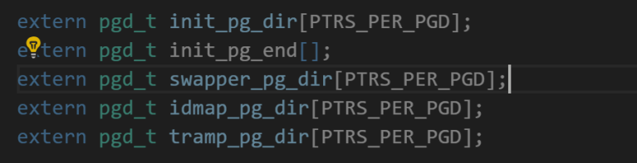
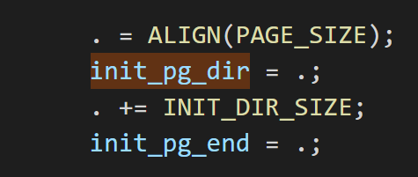
Head.s @28 __create_page_tables
X0
00000000_4146E000
X1
00000000_00003000
X16
sub x1, x1, x0
init_pg_dir ~ init_pg_end 까지 크기
X2
00000000_00000040
X17
X3
00000000_00000000
X18
X4
X19
X5
X20
X6
X21
DTB (PHY ADDRERSS)
X7
X22
X8
X23
00000000_00000000
X9
X24
X10
X25
X11
X26
X12
X27
X13
X28
stext+24
X14
X29
FP
X15
X30
stext+24
LR
SPSEL
SCTLR_EL1
00000000_00000001
00000000_30500800

Slide 31
Head.s @29 __create_page_tables
X0
00000000_4146E000
X1
00000000_00003000
X16
bl __inval_dcache_area
X2
00000000_00000000
X17
X3
00000000_00000000
X18
X4
X19
X5
X20
X6
X21
DTB (PHY ADDRERSS)
Init_pg_dir 부터 INIT_DIR_SIZE 만큼
데이터 캐시를 무효화 시킨다.
X7
X22
X8
X23
00000000_00000000
X9
X24
X10
X25
X11
X26
X12
X27
X13
X28
stext+24
X14
X29
FP
X15
X30
@29 + 8
LR
SPSEL
SCTLR_EL1
00000000_00000001
00000000_30500800

Slide 32
Head.s @32 __create_page_tables
X0
00000000_41471000
X1
00000000_00000000
X16
adrp x0, init_pg_dir
adrp x1, init_pg_end
sub x1, x1, x0
stp xzr, xzr, [x0], #16
stp xzr, xzr, [x0], #16
stp xzr, xzr, [x0], #16
stp xzr, xzr, [x0], #16
subs x1, x1, #64
b.ne 1b
16 * 4 = 64 bytes
memset(init_pg_dir, 0, 64)
Init_pg_dir 부터 64byte 씩 0으로 초기화 한다.
X2
00000000_00000040
X17
X3
00000000_0000003F
X18
X4
00000000_40080000
X19
X5
X20
X6
X21
00000000_48000000
X7
X22
X8
X23
00000000_00000000
X9
X24
stp xzr, xzr, [x0, #16] preindex
x0 += 16
*(x0 ) = xzr
*(x0 + 8) = xzr
stp xzr, xzr, [x0], #16 postindex
*(x0 ) = xzr
*(x0 + 8) = xzr
x0 += 16
X10
X25
X11
X26
X12
X27
X13
00000000_00000016
X28
stext+24
X14
X29
FP
X15
X30
@29 + 8
LR
SPSEL
SCTLR_EL1
00000000_00000001
00000000_30500800

Slide 33
Head.s @34 __create_page_tables
X0
00000000_41471000
X1
00000000_00000000
X16
mov x7, SWAPPER_MM_MMUFLAGS
#define SWAPPER_MM_MMUFLAGS
(PMD_ATTRINDX(MT_NORMAL) | SWAPPER_PMD_FLAGS)
#define MT_NORMAL 4
#define PMD_ATTRINDX(t) (_AT(pmdval_t, (t)) << 2)
#define SWAPPER_PMD_FLAGS
(PMD_TYPE_SECT | PMD_SECT_AF | PMD_SECT_S)
PMD_ATTRINDX(MT_NORMAL) : (4 << 2)
PMD_TYPE_SECT : (1 << 0)
PMD_SECT_AF : (1 << 10)
PMD_SECT_S : (3 << 8)
SWAPPER_MM_MMUFLAGS
= (4 << 2) | ((1 << 0) | (1 << 10) | (3 << 8)))
= 0x711
X2
00000000_00000040
X17
X3
00000000_0000003F
X18
X4
00000000_40080000
X19
X5
X20
X6
X21
00000000_48000000
X7
00000000_00000711
X22
X8
X23
00000000_00000000
X9
X24
X10
X25
X11
X26
X12
X27
X13
00000000_00000016
X28
stext+24
X14
X29
FP
X15
X30
@29 + 8
LR
SPSEL
SCTLR_EL1
00000000_00000001
00000000_30500800

Slide 34
Head.s @35 __create_page_tables
adrp x0, idmap_pg_dir
SPSEL
SCTLR_EL1
00000000_00000001
00000000_30500800

Slide 35
Head.s @36 __create_page_tables
adrp x3, __idmap_text_start
SPSEL
SCTLR_EL1
00000000_00000001
00000000_30500800

Slide 36
Head.s @37 __create_page_tables
mov x5, #VA_BITS
VA_BITS 48
SPSEL
SCTLR_EL1
00000000_00000001
00000000_30500800

Slide 37
Head.s @37 __create_page_tables
mov x5, #VA_BITS
VA_BITS 48
SPSEL
SCTLR_EL1
00000000_00000001
00000000_30500800

Slide 38
Head.s @38 __create_page_tables
X0
00000000_410E6000
X1
00000000_00000000
X16
adr_l x6, vabits_user
str x5, [x6]
dmb sy
dc ivac, x6
u64 vabits_user;
adr_l x6, vabits_user
str x5, [x6]
vabits_user = 0x30;
dmb sy
dc ivac, x6
vabits_user 에 값을 저장하고 코어내의 vabits_user 데이터 캐시 라인(PoC 관점) 을 무효화 시킨다.
X2
00000000_00000040
X17
X3
00000000_40B65000
X18
X4
00000000_40080000
X19
X5
00000000_00000030
X20
X6
00000000_4108D7C0
X21
00000000_48000000
X7
00000000_00000711
X22
X8
X23
00000000_00000000
X9
X24
X10
X25
X11
X26
X12
X27
X13
00000000_00000016
X28
stext+24
X14
X29
FP
X15
X30
@29 + 8
LR
SPSEL
SCTLR_EL1
00000000_00000001
00000000_30500800

Slide 39
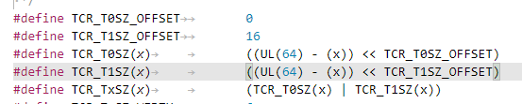
Head.s @39 __create_page_tables
X0
00000000_410E6000
X1
00000000_00000000
X16
adrp x5, __idmap_text_end
( =00000000_40B65000)
clz x5, x5
(=00000000_00000021)
cmp x5, TCR_T0SZ(VA_BITS) <= 16
b.ge 1f
X5 __idmap_text_end symbol 로딩
값은 ffff000010b8d658
CLZ X5 X5 -> 0으로 최종 저장 됨
__idmap_text_end ffff000010b8d658
TCR_T0SZ(VA_BITS) ((UL(64) – 48) << 0) = 16
b.ge 1f ( f : forward, b : backward)
@40 으로 감.
X2
00000000_00000040
X17
X3
00000000_40B65000
X18
X4
00000000_40080000
X19
X5
00000000_00000021
X20
X6
00000000_4108D7C0
X21
00000000_48000000
X7
00000000_00000711
X22
X8
X23
00000000_00000000
X9
X24
X10
X25
X11
X26
X12
X27
X13
00000000_00000016
X28
stext+24
X14
X29
FP
X15
X30
@29 + 8
LR
SPSEL
SCTLR_EL1
00000000_00000001
00000000_30500800

Slide 40
Head.s @40 __create_page_tables
adr_l x6, idmap_t0sz
str x5, [x6]
dmb sy
dc ivac, x6
*(&idmap_t0sz) = 0;
idmap_t0sz 에 값을 저장하고 코어내의 idmap_t0sz 데이터 캐시 라인(PoC 관점) 을 무효화 시킨다.
SPSEL
SCTLR_EL1
00000000_00000001
00000000_30500800

Slide 41
Head.s @41 __create_page_tables
mov x4, #1 << (PHYS_MASK_SHIFT - PGDIR_SHIFT)
str_l x4, idmap_ptrs_per_pgd, x5
#define PHYS_MASK_SHIFT (48)
#define CONFIG_PGTABLE_LEVELS 4
#define PGDIR_SHIFT ARM64_HW_PGTABLE_LEVEL_SHIFT(4 - CONFIG_PGTABLE_LEVELS)
#define ARM64_HW_PGTABLE_LEVEL_SHIFT(n) ((PAGE_SHIFT - 3) * (4 - (n)) + 3)
#define PAGE_SHIFT 12
#define ARM64_HW_PGTABLE_LEVEL_SHIFT(n) ((PAGE_SHIFT - 3) * (4 - (n)) + 3)
(PHYS_MASK_SHIFT - PGDIR_SHIFT) = 39
*(&idmap_ptrs_per_pgd) = 00000080_00000000
SPSEL
SCTLR_EL1
00000000_00000001
00000000_30500800

Slide 42
Head.s @42 __create_page_tables
X0
00000000_410E6000
X1
00000000_00000000
X16
ldr_l x4, idmap_ptrs_per_pgd
mov x5, x3
adr_l x6, __idmap_text_end
X2
00000000_00000040
X17
X3
00000000_40B65000
X18
X4
00000000_00000200
X19
X5
00000000_40B65000
X20
X6
00000000_40B65658
X21
00000000_48000000
X7
00000000_00000711
X22
X8
X23
00000000_00000000
X9
X24
X10
X25
X11
X26
X12
X27
X13
00000000_00000016
X28
stext+24
X14
X29
FP
X15
X30
@29 + 8
LR
SPSEL
SCTLR_EL1
00000000_00000001
00000000_30500800

Slide 43
Head.s @43 __create_page_tables
tbl
X0
00000000_410E6000
rtbl
X1
00000000_00000000
X16
map_memory x0, x1, x3, x6, x7, x3, x4, x10, x11, x12, x13, x14
* Map memory for specified virtual address range. Each level of page table needed supports
* multiple entries. If a level requires n entries the next page table level is assumed to be
* formed from n pages.
*
* tbl: location of page table
* rtbl: address to be used for first level page table entry (typically tbl + PAGE_SIZE)
* vstart: start address to map
* vend: end address to map - we map [vstart, vend]
* flags: flags to use to map last level entries
* phys: physical address corresponding to vstart - physical memory is contiguous
* pgds: the number of pgd entries
*
* Temporaries: istart, iend, tmp, count, sv - these need to be different registers
* Preserves: vstart, vend, flags
* Corrupts: tbl, rtbl, istart, iend, tmp, count, sv
.macro map_memory, tbl, rtbl, vstart, vend, flags, phys, pgds, istart, iend, tmp, count, sv
X2
00000000_00000040
X17
phys
vstart
X3
00000000_40B65000
X18
pgds
X4
00000000_00000200
X19
X5
00000000_40B65000
X20
vend
X6
00000000_40B65658
X21
00000000_48000000
flags
X7
00000000_00000711
X22
X8
X23
00000000_00000000
X9
X24
istart
X10
X25
iend
X11
X26
tmp
X12
X27
count
X13
00000000_00000016
X28
stext+24
sv
X14
X29
FP
X15
X30
@29 + 8
LR
SPSEL
SCTLR_EL1
00000000_00000001
00000000_30500800

Slide 44
Head.s @43.1 map_memory
tbl
X0
00000000_410E6000
rtbl
X1
00000000_410E7000
X16
add \rtbl, \tbl, #PAGE_SIZE
mov \sv, \rtbl
mov \count, #0
PAGE_SIZE (1 << 12)
#tbl – X0
#rtbl – X1
#sv – X14
#count – X13
X2
00000000_00000040
X17
phys
vstart
X3
00000000_40B65000
X18
pgds
X4
00000000_00000200
X19
X5
00000000_40B65000
X20
vend
X6
00000000_40B65658
X21
00000000_48000000
flags
X7
00000000_00000711
X22
X8
X23
00000000_00000000
X9
X24
istart
X10
X25
iend
X11
X26
tmp
X12
X27
count
X13
00000000_00000000
X28
stext+24
sv
X14
00000000_410E7000
X29
FP
X15
X30
@29 + 8
LR
SPSEL
SCTLR_EL1
00000000_00000001
00000000_30500800

Slide 45
Head.s @43.2 map_memory
X0
00000000_410E6000
X1
00000000_410E7000
X16
compute_indices \vstart, \vend, #PGDIR_SHIFT, \pgds, \istart, \iend, \count
#shift - 39
X2
00000000_00000040
X17
vstart
X3
00000000_40B65000
X18
ptrs
X4
00000000_00000200
X19
X5
00000000_40B65000
X20
vend
X6
00000000_40B65658
X21
00000000_48000000
X7
00000000_00000711
X22
X8
X23
00000000_00000000
X9
X24
istart
X10
X25
iend
X11
X26
X12
X27
count
X13
00000000_00000000
X28
stext+24
/*
* Compute indices of table entries from virtual address range. If multiple entries
* were needed in the previous page table level then the next page table level is assumed
* to be composed of multiple pages. (This effectively scales the end index).
*
* vstart: virtual address of start of range
* vend: virtual address of end of range
* shift: shift used to transform virtual address into index
* ptrs: number of entries in page table
* istart: index in table corresponding to vstart
* iend: index in table corresponding to vend
* count: On entry: how many extra entries were required in previous level, scales
* our end index.
* On exit: returns how many extra entries required for next page table level
*
* Preserves: vstart, vend, shift, ptrs
* Returns: istart, iend, count
*/
.macro compute_indices, vstart, vend, shift, ptrs, istart, iend, count
X14
00000000_410E7000
X29
FP
X15
X30
@29 + 8
LR
SPSEL
SCTLR_EL1
00000000_00000001
00000000_30500800

Slide 46
Head.s @43.2.1 compute_indices
X0
00000000_410E6000
X1
00000000_410E7000
X16
lsr \iend, \vend, \shift
(= 00000000_00000000)
mov \istart, \ptrs
(=00000000_00000200)
sub \istart, \istart, #1
and \iend, \iend, \istart
// iend = (vend >> shift) & (ptrs - 1)
mov \istart, \ptrs
mul \istart, \istart, \count
add \iend, \iend, \istart
// iend += (count - 1) * ptrs
// our entries span multiple tables
lsr \istart, \vstart, \shift
mov \count, \ptrs
sub \count, \count, #1
and \istart, \istart, \count
sub \count, \iend, \istart
#shift – 39
#vend – X6
#iend – X11
#ptrs – X4
#istart – X10
#vstart – X3
X2
00000000_00000040
X17
vstart
X3
00000000_40B65000
X18
ptrs
X4
00000000_00000200
X19
X5
00000000_40B65000
X20
vend
X6
00000000_40B65658
X21
00000000_48000000
X7
00000000_00000711
X22
X8
X23
00000000_00000000
X9
X24
istart
X10
00000000_00000000
X25
iend
X11
00000000_00000000
X26
X12
X27
count
X13
00000000_00000000
X28
stext+24
X14
00000000_410E7000
X29
FP
X15
X30
@29 + 8
LR
SPSEL
SCTLR_EL1
00000000_00000001
00000000_30500800

Slide 47
Head.s @43.3 create_page_tables
tbl
X0
00000000_410E6000
rtbl
X1
00000000_410E7000
X16
populate_entries \tbl, \rtbl, \istart, \iend, #PMD_TYPE_TABLE, #PAGE_SIZE, \tmp
Flags (= #PMD_TYPE_TABLE = 0x3)
Inc ( = #PAGE_SIZE = 0x1000 )
* Macro to populate page table entries, these entries can be pointers to the next level
* or last level entries pointing to physical memory.
*
* tbl: page table address
* rtbl: pointer to page table or physical memory
* index: start index to write
* eindex: end index to write - [index, eindex] written to
* flags: flags for pagetable entry to or in
* inc: increment to rtbl between each entry
* tmp1: temporary variable
*
* Preserves: tbl, eindex, flags, inc
* Corrupts: index, tmp1
Returns: rtbl
.macro populate_entries, tbl, rtbl, index, eindex, flags, inc, tmp1
X2
00000000_00000040
X17
X3
00000000_40B65000
X18
X4
00000000_00000200
X19
X5
00000000_40B65000
X20
X6
00000000_40B65658
X21
00000000_48000000
X7
00000000_00000711
X22
X8
X23
00000000_00000000
X9
X24
index
X10
00000000_00000000
X25
eindex
X11
00000000_00000000
X26
tmp1
X12
X27
X13
00000000_00000000
X28
stext+24
X14
00000000_410E7000
X29
FP
X15
X30
@29 + 8
LR
SPSEL
SCTLR_EL1
00000000_00000001
00000000_30500800

Slide 48
Head.s @43.3.1 populate_entries
tbl
X0
00000000_410E6000
rtbl
X1
00000000_410E8000
X16
.Lpe\@: phys_to_pte \tmp1, \rtbl
orr \tmp1, \tmp1, \flags // tmp1 = table entry
str \tmp1, [\tbl, \index, lsl #3]
add \rtbl, \rtbl, \inc // rtbl = pa next level
add \index, \index, #1
cmp \index, \eindex
b.ls .Lpe\@
Flags (= #PMD_TYPE_TABLE = 0x3)
Inc ( = #PAGE_SIZE = 0x1000 )
Pg_table[1+0] = 410E7003
X2
00000000_00000040
X17
X3
00000000_40B65000
X18
X4
00000000_00000200
X19
X5
00000000_40B65000
X20
X6
00000000_40B65658
X21
00000000_48000000
X7
00000000_00000711
X22
X8
X23
00000000_00000000
X9
X24
index
X10
00000000_00000001
X25
eindex
X11
00000000_00000000
X26
tmp1
X12
00000000_410E7003
X27
X13
00000000_00000000
X28
stext+24
X14
00000000_410E7000
X29
FP
X15
X30
@29 + 8
LR
SPSEL
SCTLR_EL1
00000000_00000001
00000000_30500800

Slide 49
Head.s @43.4 create_page_tables
tbl
X0
00000000_410E7000
rtbl
X1
00000000_410E8000
X16
mov \tbl, \sv
mov \sv, \rtbl
X2
00000000_00000040
X17
phys
vstart
X3
00000000_40B65000
X18
pgds
X4
00000000_00000200
X19
X5
00000000_40B65000
X20
vend
X6
00000000_40B65658
X21
00000000_48000000
flags
X7
00000000_00000711
X22
X8
X23
00000000_00000000
X9
X24
istart
X10
00000000_00000001
X25
iend
X11
00000000_00000000
X26
tmp
X12
00000000_410E7003
X27
count
X13
00000000_00000000
X28
stext+24
sv
X14
00000000_410E8000
X29
FP
X15
X30
@29 + 8
LR
SPSEL
SCTLR_EL1
00000000_00000001
00000000_30500800

Slide 50
Head.s @43.4 create_page_tables
X0
00000000_410E7000
X1
00000000_410E8000
X16
compute_indices \vstart, \vend, #SWAPPER_TABLE_SHIFT, #PTRS_PER_PMD, \istart, \iend, \count
#SWAPPER_TABLE_SHIFT = 30
# PTRS_PER_PMD = 512 = 0x200
#shift – 30
#Ptrs – 0x200
X2
00000000_00000040
X17
vstart
X3
00000000_40B65000
X18
ptrs
X4
00000000_00000200
X19
X5
00000000_40B65000
X20
vend
X6
00000000_40B65658
X21
00000000_48000000
X7
00000000_00000711
X22
X8
X23
00000000_00000000
X9
X24
istart
X10
00000000_00000000
X25
iend
X11
00000000_00000000
X26
X12
00000000_410E7003
X27
count
X13
00000000_00000000
X28
stext+24
/*
* Compute indices of table entries from virtual address range. If multiple entries
* were needed in the previous page table level then the next page table level is assumed
* to be composed of multiple pages. (This effectively scales the end index).
*
* vstart: virtual address of start of range
* vend: virtual address of end of range
* shift: shift used to transform virtual address into index
* ptrs: number of entries in page table
* istart: index in table corresponding to vstart
* iend: index in table corresponding to vend
* count: On entry: how many extra entries were required in previous level, scales
* our end index.
* On exit: returns how many extra entries required for next page table level
*
* Preserves: vstart, vend, shift, ptrs
* Returns: istart, iend, count
*/
.macro compute_indices, vstart, vend, shift, ptrs, istart, iend, count
X14
00000000_410E8000
X29
FP
X15
X30
@29 + 8
LR
SPSEL
SCTLR_EL1
00000000_00000001
00000000_30500800

Slide 51
Head.s @43.5 create_page_tables
tbl
X0
00000000_410E7000
rtbl
X1
00000000_410E9000
X16
populate_entries \tbl, \rtbl, \istart, \iend, #PMD_TYPE_TABLE, #PAGE_SIZE, \tmp
Flags (= #PMD_TYPE_TABLE = 0x3)
Inc ( = #PAGE_SIZE = 0x1000 )
Pg_table[1+0] = 410E7003 (PG DIR)
Pg_table[2+0] = 410E8003 (PUD)
X2
00000000_00000040
X17
X3
00000000_40B65000
X18
X4
00000000_00000200
X19
X5
00000000_40B65000
X20
X6
00000000_40B65658
X21
00000000_48000000
X7
00000000_00000711
X22
X8
X23
00000000_00000000
X9
X24
index
X10
00000000_00000001
X25
eindex
X11
00000000_00000000
X26
tmp1
X12
00000000_410E8003
X27
X13
00000000_00000000
X28
stext+24
X14
00000000_410E8000
X29
FP
X15
X30
@29 + 8
LR
SPSEL
SCTLR_EL1
00000000_00000001
00000000_30500800

Slide 52
Head.s @43.6 create_page_tables
tbl
X0
00000000_410E8000
mov \tbl, \sv
rtbl
X1
00000000_410E9000
X16
X2
00000000_00000040
X17
phys
vstart
X3
00000000_40B65000
X18
pgds
X4
00000000_00000200
X19
X5
00000000_40B65000
X20
vend
X6
00000000_40B65658
X21
00000000_48000000
flags
X7
00000000_00000711
X22
X8
X23
00000000_00000000
X9
X24
istart
X10
00000000_00000001
X25
iend
X11
00000000_00000000
X26
tmp
X12
00000000_410E8003
X27
count
X13
00000000_00000000
X28
stext+24
sv
X14
00000000_410E8000
X29
FP
X15
X30
@29 + 8
LR
SPSEL
SCTLR_EL1
00000000_00000001
00000000_30500800

Slide 53
Head.s @43.7 create_page_tables
X0
00000000_410E8000
compute_indices \vstart, \vend, #SWAPPER_BLOCK_SHIFT, #PTRS_PER_PTE, \istart, \iend, \count
# SWAPPER_BLOCK_SHIFT = 21
# PTRS_PER_PTE = 512 = 0x200
#shift – 21
#Ptrs – 0x200
X1
00000000_410E9000
X16
X2
00000000_00000040
X17
vstart
X3
00000000_40B65000
X18
ptrs
X4
00000000_00000200
X19
X5
00000000_40B65000
X20
vend
X6
00000000_40B65658
X21
00000000_48000000
X7
00000000_00000711
X22
X8
X23
00000000_00000000
X9
X24
istart
X10
00000000_00000000
X25
iend
X11
00000000_00000000
X26
X12
00000000_410E8003
X27
count
X13
00000000_00000000
X28
stext+24
/*
* Compute indices of table entries from virtual address range. If multiple entries
* were needed in the previous page table level then the next page table level is assumed
* to be composed of multiple pages. (This effectively scales the end index).
*
* vstart: virtual address of start of range
* vend: virtual address of end of range
* shift: shift used to transform virtual address into index
* ptrs: number of entries in page table
* istart: index in table corresponding to vstart
* iend: index in table corresponding to vend
* count: On entry: how many extra entries were required in previous level, scales
* our end index.
* On exit: returns how many extra entries required for next page table level
*
* Preserves: vstart, vend, shift, ptrs
* Returns: istart, iend, count
*/
.macro compute_indices, vstart, vend, shift, ptrs, istart, iend, count
X14
00000000_410E8000
X29
FP
X15
X30
@29 + 8
LR
SPSEL
SCTLR_EL1
00000000_00000001
00000000_30500800

Slide 54
Head.s @43.8 create_page_tables
tbl
X0
00000000_410E8000
bic \count, \phys, #SWAPPER_BLOCK_SIZE - 1
# SWAPPER_BLOCK_SHIFT = (1 << 21)
Bic X13, X3, 1FFFFF
rtbl
X1
00000000_410E9000
X16
X2
00000000_00000040
X17
phys
vstart
X3
00000000_40B65000
X18
pgds
X4
00000000_00000200
X19
X5
00000000_40B65000
X20
vend
X6
00000000_40B65658
X21
00000000_48000000
flags
X7
00000000_00000711
X22
X8
X23
00000000_00000000
X9
X24
istart
X10
00000000_00000000
X25
iend
X11
00000000_00000000
X26
tmp
X12
00000000_410E8003
X27
count
X13
00000000_40A00000
X28
stext+24
sv
X14
00000000_410E8000
X29
FP
X15
X30
@29 + 8
LR
SPSEL
SCTLR_EL1
00000000_00000001
00000000_30500800

Slide 55
Head.s @43.9 create_page_tables
tbl
X0
00000000_410E8000
X1
00000000_410E9000
X16
populate_entries \tbl, \rtbl, \istart, \iend, #PMD_TYPE_TABLE, #PAGE_SIZE, \tmp
populate_entries \tbl, \count, \istart, \iend, \flags, #SWAPPER_BLOCK_SIZE, \tmp
#Inc= SWAPPER_BLOCK_SIZE = (1<<21)
Flags (= #PMD_TYPE_TABLE = 0x3)
Inc ( = #PAGE_SIZE = 0x1000 )
*pg_table == 00000000_410E6000
Pg_table[1+0] = 410E7003 (PG DIR)
Pg_table[2+0] = 410E8003 (PUD)
Pg_table[2+0] = 40A00711 (PTE)
=
.macro populate_entries, tbl, rtbl, index, eindex, flags, inc, tmp1
X2
00000000_00000040
X17
X3
00000000_40B65000
X18
X4
00000000_00000200
X19
X5
00000000_40B65000
X20
X6
00000000_40B65658
X21
00000000_48000000
flags
X7
00000000_00000711
X22
X8
X23
00000000_00000000
X9
X24
index
X10
00000000_00000000
X25
eindex
X11
00000000_00000000
X26
tmp1
X12
00000000_40A00711
X27
rtbl
X13
00000000_40A00000
X28
stext+24
X14
00000000_410E8000
X29
FP
X15
X30
@29 + 8
LR
SPSEL
SCTLR_EL1
00000000_00000001
00000000_30500800

Slide 56
/*
* Compute indices of table entries from virtual address range. If multiple entries
* were needed in the previous page table level then the next page table level is assumed
* to be composed of multiple pages. (This effectively scales the end index).
*
* vstart: virtual address of start of range
* vend: virtual address of end of range
* shift: shift used to transform virtual address into index
* ptrs: number of entries in page table
* istart: index in table corresponding to vstart
* iend: index in table corresponding to vend
* count: On entry: how many extra entries were required in previous level, scales
* our end index.
* On exit: returns how many extra entries required for next page table level
*
* Preserves: vstart, vend, shift, ptrs
* Returns: istart, iend, count
*/
.macro compute_indices, vstart, vend, shift, ptrs, istart, iend, count

