Slide 1
Head.S 분석자료
16기 A조

Slide 2
Head.s @0 stext
X0
DTB (PHY ADDRERSS)
X1
00000000_00000000
X16
X2
00000000_00000000
X17
X3
00000000_00000000
X18
X4
X19
X5
X20
X6
X21
X7
X22
X8
X23
X9
X24
X10
X25
X11
X26
X12
X27
X13
X28
X14
X29
FP
X15
X30
LR

Slide 3
Head.s @1 stext
X0
DTB (PHY ADDRERSS)
X1
00000000_00000000
X16
bl preserve_boot_args
X2
00000000_00000000
X17
X3
00000000_00000000
X18
X4
X19
X5
X20
X6
X21
X7
X22
X8
X23
X9
X24
X10
X25
X11
X26
X12
X27
X13
X28
X14
X29
FP
X15
X30
stext+8
LR

Slide 4
Head.s @2 preserve_boot_args
X0
DTB (PHY ADDRERSS)
X1
00000000_00000000
X16
X2
00000000_00000000
X17
X3
00000000_00000000
X18
X4
X19
X5
X20
mov x21, x0
X6
X21
DTB (PHY ADDRERSS)
X7
X22
X8
X23
X9
X24
X10
X25
X11
X26
X12
X27
X13
X28
X14
X29
FP
X15
X30
stext+8
LR

Slide 5
Head.s @3 preserve_boot_args
X0
&boot_args
X1
00000000_00000000
X16
X2
00000000_00000000
X17
X3
00000000_00000000
X18
X4
X19
X5
X20
adr_l x0, boot_args
u64 __cacheline_aligned boot_args[4];
X6
X21
DTB (PHY ADDRERSS)
X7
X22
X8
X23
X9
X24
X10
X25
X11
X26
X12
X27
X13
X28
X14
X29
FP
X15
X30
stext+8
LR

Slide 6
Head.s @4 preserve_boot_args
X0
&boot_args
X1
00000000_00000000
X16
X2
00000000_00000000
X17
X3
00000000_00000000
X18
X4
X19
X5
X20
stp x21, x1, [x0]
stp x2, x3, [x0, #16]
u64 __cacheline_aligned boot_args[4];
boot_args[0] = x21; // DTB
boot_args[1] = x1; // 0
boot_args[2] = x2; // 0
boot_args[3] = x3; // 0
X6
X21
DTB (PHY ADDRERSS)
X7
X22
X8
X23
X9
X24
X10
X25
X11
X26
X12
X27
X13
X28
X14
X29
FP
X15
X30
stext+8
LR

Slide 7
Head.s @5 preserve_boot_args
X0
&boot_args
X1
00000000_00000000
X16
dmb sy
DMB
Data Memory Barrier.
SY
Full system barrier operation. This is the default and can be omitted.
X2
00000000_00000000
X17
X3
00000000_00000000
X18
X4
X19
X5
X20
X6
X21
DTB (PHY ADDRERSS)
X7
X22
X8
X23
X9
X24
X10
X25
X11
X26
X12
X27
X13
X28
boot_arg[]를 저장한 명령어가
Chche clear 명령어에 영향을
받지 않도록 Barrier를 사용한다.
(메모리 오더링 이슈는 1 core에서도 발생한다)
X14
X29
FP
X15
X30
stext+8
LR

Slide 8
Head.s @6 preserve_boot_args
X0
&boot_args
X1
00000000_00000020
X16
mov x1, #0x20
4 x 8 = 32 = 0x20
X2
00000000_00000000
X17
X3
00000000_00000000
X18
X4
X19
X5
X20
X6
X21
DTB (PHY ADDRERSS)
X7
X22
X8
X23
X9
X24
X10
X25
X11
X26
X12
X27
X13
X28
X14
X29
FP
X15
X30
stext+8
LR

Slide 9
Head.s @7 preserve_boot_args
X0
&boot_args
X1
00000000_00000020
X16
b __inval_dcache_area
__inval_dcache_area(void *addr, size_t len);
X0 – addr
X1 – len
Ensure that any D-cache lines are invalidated.
X2
00000000_00000000
X17
X3
00000000_00000000
X18
X4
X19
X5
X20
X6
X21
DTB (PHY ADDRERSS)
X7
X22
X8
X23
X9
X24
X10
X25
X11
X26
X12
X27
X13
X28
X14
X29
FP
X15
X30
stext+8
LR

Slide 10
Head.s @8 stext
X0
&boot_args
X1
00000000_00000020
X16
bl el2_setup
X2
00000000_00000000
X17
X3
00000000_00000000
X18
X4
X19
X5
X20
X6
X21
DTB (PHY ADDRERSS)
X7
X22
X8
X23
X9
X24
X10
X25
X11
X26
X12
X27
X13
X28
X14
X29
FP
X15
X30
stext+16
LR

Slide 11
Head.s @9 el2_setup
X0
&boot_args
X1
00000000_00000020
X16
msr SPsel, #1
X2
00000000_00000000
X17
X3
00000000_00000000
X18
X4
X19
X5
X20
X6
X21
DTB (PHY ADDRERSS)
X7
X22
X8
X23
X9
X24
X10
X25
X11
X26
X12
X27
X13
X28
X14
X29
FP
X15
X30
stext+16
LR
SPSEL
00000000_00000001

Slide 12
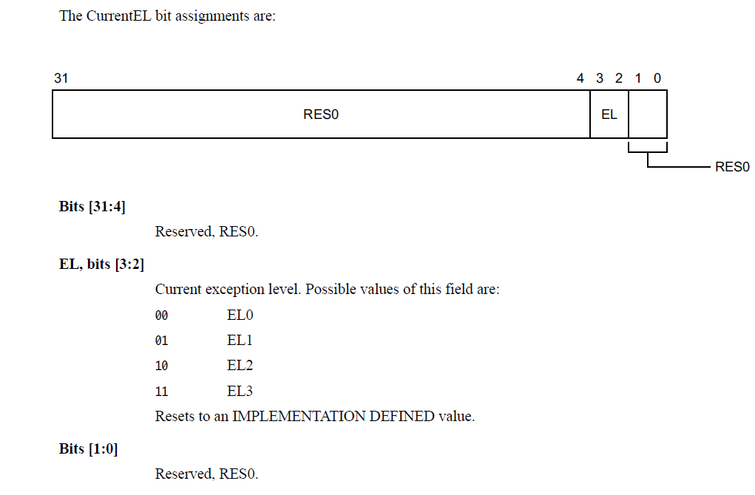
Head.s @10 el2_setup
X0
00000000_00000004
X1
00000000_00000020
X16
mrs x0, CurrentEL
X2
00000000_00000000
X17
X3
00000000_00000000
X18
X4
X19
X5
X20
X6
X21
DTB (PHY ADDRERSS)
System이 EL1 모드로
부팅했다고 가정함
X7
X22
X8
X23
X9
X24
X10
X25
X11
X26
X12
X27
X13
X28
X14
X29
FP
X15
X30
stext+16
LR
SPSEL
00000000_00000001

Slide 13
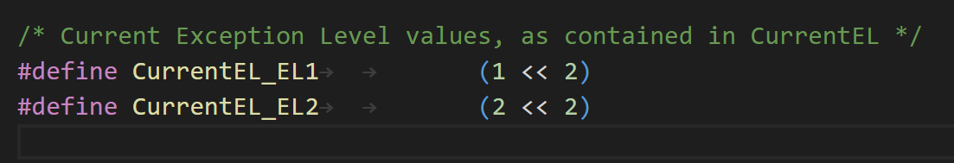
Head.s @11 el2_setup
X0
00000000_00000004
X1
00000000_00000020
X16
cmp x0, #CurrentEL_EL2 (=8)
X2
00000000_00000000
X17
X3
00000000_00000000
X18
X4
X19
X5
X20
X6
X21
DTB (PHY ADDRERSS)
X7
X22
X8
X23
X9
X24
X10
X25
X11
X26
X12
X27
X13
X28
X14
X29
FP
X15
X30
stext+16
LR
SPSEL
00000000_00000001

Slide 14
Head.s @12 el2_setup
X0
00000000_00000004
X1
00000000_00000020
X16
b.eq 1f
같지 않으므로 skip
X2
00000000_00000000
X17
X3
00000000_00000000
X18
X4
X19
X5
X20
X6
X21
DTB (PHY ADDRERSS)
X7
X22
X8
X23
X9
X24
X10
X25
X11
X26
X12
X27
X13
X28
X14
X29
FP
X15
X30
stext+16
LR
SPSEL
00000000_00000001

Slide 15
Head.s @13 el2_setup
X0
00000000_30500800
X1
00000000_00000020
X16
mov_q x0, (SCTLR_EL1_RES1 | ENDIAN_SET_EL1)
(SCTLR_EL1_RES1 | ENDIAN_SET_EL1) -> 0x30500800
X2
00000000_00000000
X17
X3
00000000_00000000
X18
X4
X19
X5
X20
X6
X21
DTB (PHY ADDRERSS)
X7
X22
X8
X23
X9
X24
X10
X25
X11
X26
X12
X27
X13
X28
X14
X29
FP
X15
X30
stext+16
LR
SPSEL
00000000_00000001

Slide 16
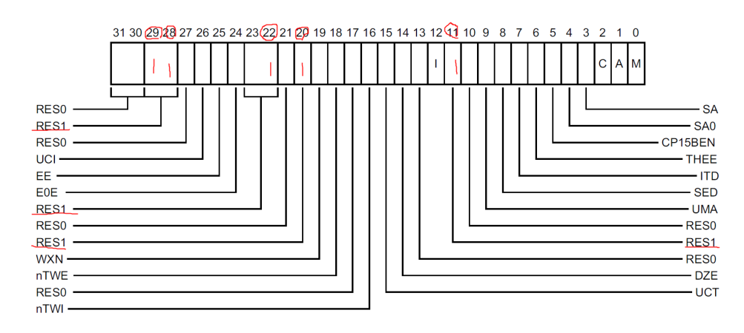
Head.s @14 el2_setup
X0
00000000_30500800
X1
00000000_00000020
X16
msr sctlr_el1, x0
Reserved 된 값을 1로 채움
왜 하는지는 정확히 모름
X2
00000000_00000000
X17
X3
00000000_00000000
X18
X4
X19
X5
X20
X6
X21
DTB (PHY ADDRERSS)
X7
X22
X8
X23
X9
X24
X10
X25
X11
X26
X12
X27
X13
X28
X14
X29
FP
X15
X30
stext+16
LR
SPSEL
SCTLR_EL1
00000000_00000001
00000000_30500800

Slide 17
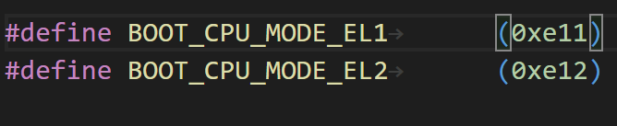
Head.s @15 el2_setup
X0
00000000_00000E11
X1
00000000_00000020
X16
mov w0, #BOOT_CPU_MODE_EL1 (=0xe11)
X2
00000000_00000000
X17
X3
00000000_00000000
X18
X4
X19
X5
X20
X6
X21
DTB (PHY ADDRERSS)
X7
X22
X8
X23
X9
X24
X10
X25
X11
X26
X12
X27
X13
X28
X14
X29
FP
X15
X30
stext+16
LR
SPSEL
SCTLR_EL1
00000000_00000001
00000000_30500800

Slide 18
Head.s @16 el2_setup
X0
00000000_00000E11
X1
00000000_00000020
X16
ret
X2
00000000_00000000
X17
X3
00000000_00000000
X18
X4
X19
X5
X20
X6
X21
DTB (PHY ADDRERSS)
X7
X22
stext로 return 함
X8
X23
X9
X24
X10
X25
X11
X26
X12
X27
X13
X28
X14
X29
FP
X15
X30
stext+16
LR
SPSEL
SCTLR_EL1
00000000_00000001
00000000_30500800

Slide 19
Head.s @17 stext
X0
00000000_00000E11
X1
00000000_00000020
X16
adrp x23, __PHYS_OFFSET
KERNEL_START = ffff000010080000
TEXT_OFFSET = 0x80000
__PHYS_OFFSET = ffff000010000000
#define __PHYS_OFFSET (KERNEL_START - TEXT_OFFSET)
X2
00000000_00000000
X17
X3
00000000_00000000
X18
X4
X19
X5
X20
X6
X21
DTB (PHY ADDRERSS)
X7
X22
X8
X23
FFFF0000_10000000
X9
X24
X10
X25
X11
X26
X12
X27
X13
X28
X14
X29
FP
X15
X30
stext+16
LR
SPSEL
SCTLR_EL1
00000000_00000001
00000000_30500800

Slide 20
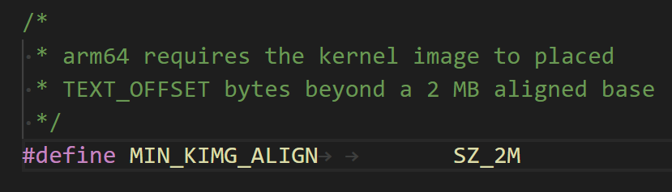
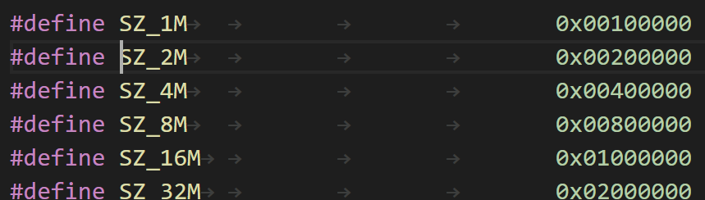
Head.s @18 stext
X0
00000000_00000E11
X1
00000000_00000020
X16
and x23, x23, MIN_KIMG_ALIGN – 1
X2
00000000_00000000
X17
X3
00000000_00000000
X18
X4
X19
X5
X20
X6
X21
DTB (PHY ADDRERSS)
X7
X22
X8
X23
00000000_00000000
X9
X24
X10
X25
X11
X26
X12
X27
X13
X28
X14
X29
FP
X15
X30
stext+16
LR
SPSEL
SCTLR_EL1
00000000_00000001
00000000_30500800

Slide 21
Head.s @19 stext
X0
00000000_00000E11
X1
00000000_00000020
X16
bl set_cpu_boot_mode_flag
X2
00000000_00000000
X17
X3
00000000_00000000
X18
X4
X19
X5
X20
X6
X21
DTB (PHY ADDRERSS)
X7
X22
X8
X23
00000000_00000000
X9
X24
X10
X25
X11
X26
X12
X27
X13
X28
X14
X29
FP
X15
X30
stext+40
LR
SPSEL
SCTLR_EL1
00000000_00000001
00000000_30500800

Slide 22
Head.s @20 set_cpu_boot_mode_flag
X0
00000000_00000E11
X1
& __boot_cpu_mode
X16
adr_l x1, __boot_cpu_mode
X2
00000000_00000000
X17
X3
00000000_00000000
X18
X4
X19
X5
X20
X6
X21
DTB (PHY ADDRERSS)
X7
X22
X8
X23
00000000_00000000
X9
X24
X10
X25
X11
X26
X12
X27
X13
X28
X14
X29
FP
X15
X30
stext+40
LR
SPSEL
SCTLR_EL1
00000000_00000001
00000000_30500800

Slide 23
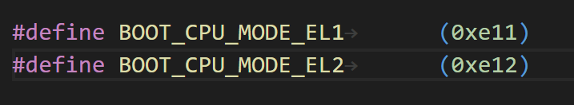
Head.s @21 set_cpu_boot_mode_flag
X0
00000000_00000E11
X1
& __boot_cpu_mode
X16
cmp w0, #BOOT_CPU_MODE_EL2
X2
00000000_00000000
X17
X3
00000000_00000000
X18
X4
X19
X5
X20
X6
X21
DTB (PHY ADDRERSS)
X7
X22
X8
X23
00000000_00000000
X9
X24
X10
X25
X11
X26
X12
X27
X13
X28
X14
X29
FP
X15
X30
stext+40
LR
SPSEL
SCTLR_EL1
00000000_00000001
00000000_30500800

Slide 24
Head.s @22 set_cpu_boot_mode_flag
X0
00000000_00000E11
X1
& __boot_cpu_mode
X16
b.ne 1f
X2
00000000_00000000
X17
X3
00000000_00000000
X18
X4
X19
0xE11 != 0xE12 -> b 1f
X5
X20
X6
X21
DTB (PHY ADDRERSS)
X7
X22
X8
X23
00000000_00000000
X9
X24
X10
X25
X11
X26
X12
X27
X13
X28
X14
X29
FP
X15
X30
stext+40
LR
SPSEL
SCTLR_EL1
00000000_00000001
00000000_30500800

Slide 25
Head.s @23 set_cpu_boot_mode_flag
X0
00000000_00000E11
X1
& __boot_cpu_mode
X16
str w0, [x1]
*x1 = w0;
__boot_cpu_mode = 0x00000E11
X2
00000000_00000000
X17
X3
00000000_00000000
X18
X4
X19
X5
X20
X6
X21
DTB (PHY ADDRERSS)
X7
X22
X8
X23
00000000_00000000
X9
X24
X10
X25
X11
X26
X12
X27
X13
X28
X14
X29
FP
X15
X30
stext+40
LR
SPSEL
SCTLR_EL1
00000000_00000001
00000000_30500800

Slide 26
Head.s @24 set_cpu_boot_mode_flag
X0
00000000_00000E11
X1
& __boot_cpu_mode
X16
dmb sy
dc ivac, x1
__boot_cpu_mode에 값을 저장하고 코어내의 boot_cpu_mode 데이터 캐시 라인(PoC 관점) 을 무효화 시킨다.
X2
00000000_00000000
X17
X3
00000000_00000000
X18
X4
X19
X5
X20
X6
X21
DTB (PHY ADDRERSS)
X7
X22
X8
X23
00000000_00000000
X9
X24
X10
X25
X11
X26
X12
X27
DC IVAC Invalidate by Virtual Address, to Point of Coherency
X13
X28
X14
X29
FP
X15
X30
stext+40
LR
SPSEL
SCTLR_EL1
00000000_00000001
00000000_30500800

Slide 27
Head.s @25 stext
X0
00000000_00000E11
X1
& __boot_cpu_mode
X16
bl __create_page_tables
X2
00000000_00000000
X17
X3
00000000_00000000
X18
X4
X19
X5
X20
X6
X21
DTB (PHY ADDRERSS)
X7
X22
X8
X23
00000000_00000000
X9
X24
X10
X25
X11
X26
X12
X27
X13
X28
X14
X29
FP
X15
X30
stext+24
LR
SPSEL
SCTLR_EL1
00000000_00000001
00000000_30500800

Slide 28
Head.s @26 __create_page_tables
X0
00000000_00000E11
X1
& __boot_cpu_mode
X16
mov x28, lr
X2
00000000_00000000
X17
X3
00000000_00000000
X18
X4
X19
X5
X20
X6
X21
DTB (PHY ADDRERSS)
X7
X22
X8
X23
00000000_00000000
X9
X24
X10
X25
X11
X26
X12
X27
X13
X28
stext+24
X14
X29
FP
X15
X30
stext+24
LR
SPSEL
SCTLR_EL1
00000000_00000001
00000000_30500800

Slide 29
Head.s @27 __create_page_tables
X0
& init_pg_dir
X1
& init_pg_end
X16
adrp x0, init_pg_dir
adrp x1, init_pg_end
X2
00000000_00000000
X17
X3
00000000_00000000
X18
X4
X19
X5
X20
X6
X21
DTB (PHY ADDRERSS)
X7
X22
X8
X23
00000000_00000000
X9
X24
X10
X25
X11
X26
X12
X27
X13
X28
stext+24
X14
X29
FP
X15
X30
stext+24
LR
SPSEL
SCTLR_EL1
00000000_00000001
00000000_30500800

Slide 30
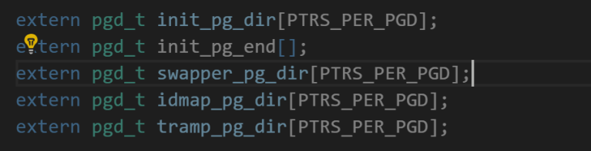
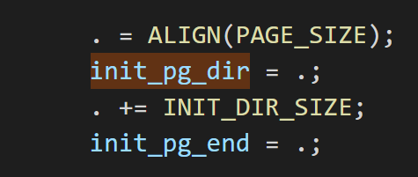
Head.s @28 __create_page_tables
X0
& init_pg_dir
X1
INIT_DIR_SIZE
X16
sub x1, x1, x0
init_pg_dir ~ init_pg_end 까지 크기
X2
00000000_00000000
X17
X3
00000000_00000000
X18
X4
X19
X5
X20
X6
X21
DTB (PHY ADDRERSS)
X7
X22
X8
X23
00000000_00000000
X9
X24
X10
X25
X11
X26
X12
X27
X13
X28
stext+24
X14
X29
FP
X15
X30
stext+24
LR
SPSEL
SCTLR_EL1
00000000_00000001
00000000_30500800

Slide 31
Head.s @29 __create_page_tables
X0
& init_pg_dir
X1
INIT_DIR_SIZE
X16
bl __inval_dcache_area
X2
00000000_00000000
X17
X3
00000000_00000000
X18
X4
X19
X5
X20
X6
X21
DTB (PHY ADDRERSS)
Init_pg_dir 부터 INIT_DIR_SIZE 만큼
데이터 캐시를 무효화 시킨다.
X7
X22
X8
X23
00000000_00000000
X9
X24
X10
X25
X11
X26
X12
X27
X13
X28
stext+24
X14
X29
FP
X15
X30
@29 + 8
LR
SPSEL
SCTLR_EL1
00000000_00000001
00000000_30500800

Slide 32
Head.s @30 __create_page_tables
X0
& init_pg_dir
X1
& init_pg_end
X16
adrp x0, init_pg_dir
adrp x1, init_pg_end
X2
00000000_00000000
X17
X3
00000000_00000000
X18
X4
X19
X5
X20
X6
X21
DTB (PHY ADDRERSS)
X7
X22
X8
X23
00000000_00000000
X9
X24
X10
X25
X11
X26
X12
X27
X13
X28
stext+24
X14
X29
FP
X15
X30
@29 + 8
LR
SPSEL
SCTLR_EL1
00000000_00000001
00000000_30500800

Slide 33
Head.s @31 __create_page_tables
X0
& init_pg_dir
X1
INIT_DIR_SIZE
X16
sub x1, x1, x0
init_pg_dir ~ init_pg_end 까지 크기
X2
00000000_00000000
X17
X3
00000000_00000000
X18
X4
X19
X5
X20
X6
X21
DTB (PHY ADDRERSS)
X7
X22
X8
X23
00000000_00000000
X9
X24
X10
X25
X11
X26
X12
X27
X13
X28
stext+24
X14
X29
FP
X15
X30
@29 + 8
LR
SPSEL
SCTLR_EL1
00000000_00000001
00000000_30500800

Slide 34
Head.s @32 __create_page_tables
X0
& init_pg_dir + 64
X1
INIT_DIR_SIZE
X16
stp xzr, xzr, [x0], #16
stp xzr, xzr, [x0], #16
stp xzr, xzr, [x0], #16
stp xzr, xzr, [x0], #16
16 * 4 = 64 bytes
memset(init_pg_dir, 0, 64)
Init_pg_dir 부터 64byte 씩 0으로 초기화 한다.
X2
00000000_00000000
X17
X3
00000000_00000000
X18
X4
X19
X5
X20
X6
X21
DTB (PHY ADDRERSS)
X7
X22
X8
X23
00000000_00000000
X9
X24
stp xzr, xzr, [x0, #16] preindex
x0 += 16
*(x0 ) = xzr
*(x0 + 8) = xzr
stp xzr, xzr, [x0], #16 postindex
*(x0 ) = xzr
*(x0 + 8) = xzr
x0 += 16
X10
X25
X11
X26
X12
X27
X13
X28
stext+24
X14
X29
FP
X15
X30
@29 + 8
LR
SPSEL
SCTLR_EL1
00000000_00000001
00000000_30500800

Slide 35
Head.s @33 __create_page_tables
X0
& init_pg_dir + 64
X1
INIT_DIR_SIZE - 64
X16
subs x1, x1, #64
b.ne 1b
X1 값이 0이 아니면 레이블 1(@32)로 분기
X1 값이 0이면 다음 라인(@34) 실행
X2
00000000_00000000
X17
X3
00000000_00000000
X18
X4
X19
X5
X20
X6
X21
DTB (PHY ADDRERSS)
X7
X22
X8
X23
00000000_00000000
X9
X24
X10
X25
X11
X26
X12
X27
X13
X28
stext+24
X14
X29
FP
X15
X30
@29 + 8
LR
SPSEL
SCTLR_EL1
00000000_00000001
00000000_30500800

Slide 36
Head.s @34 __create_page_tables
X0
& init_pg_dir + 64
X1
0
X16
mov x7, SWAPPER_MM_MMUFLAGS
#define SWAPPER_MM_MMUFLAGS
(PMD_ATTRINDX(MT_NORMAL) | SWAPPER_PMD_FLAGS)
#define MT_NORMAL 4
#define PMD_ATTRINDX(t) (_AT(pmdval_t, (t)) << 2)
#define SWAPPER_PMD_FLAGS
(PMD_TYPE_SECT | PMD_SECT_AF | PMD_SECT_S)
PMD_ATTRINDX(MT_NORMAL) : (4 << 2)
PMD_TYPE_SECT : (1 << 0)
PMD_SECT_AF : (1 << 10)
PMD_SECT_S : (3 << 8)
SWAPPER_MM_MMUFLAGS
= (4 << 2) | ((1 << 0) | (1 << 10) | (3 << 8)))
= 0x711
X2
00000000_00000000
X17
X3
00000000_00000000
X18
X4
X19
X5
X20
X6
X21
DTB (PHY ADDRERSS)
X7
00000000_00000711
X22
X8
X23
00000000_00000000
X9
X24
X10
X25
X11
X26
X12
X27
X13
X28
stext+24
X14
X29
FP
X15
X30
@29 + 8
LR
SPSEL
SCTLR_EL1
00000000_00000001
00000000_30500800

Slide 37
Head.s @35 __create_page_tables
X0
& idmap_pg_dir
X1
0
X16
adrp x0, idmap_pg_dir
X2
00000000_00000000
X17
X3
00000000_00000000
X18
X4
X19
X5
X20
X6
X21
DTB (PHY ADDRERSS)
X7
00000000_00000711
X22
X8
X23
00000000_00000000
X9
X24
X10
X25
X11
X26
X12
X27
X13
X28
stext+24
X14
X29
FP
X15
X30
@29 + 8
LR
SPSEL
SCTLR_EL1
00000000_00000001
00000000_30500800

Slide 38
Head.s @36 __create_page_tables
X0
& idmap_pg_dir
X1
0
X16
adrp x3, __idmap_text_start
X2
00000000_00000000
X17
X3
&__idmap_test_start
X18
X4
X19
X5
X20
X6
X21
DTB (PHY ADDRERSS)
X7
00000000_00000711
X22
X8
X23
00000000_00000000
X9
X24
X10
X25
X11
X26
X12
X27
X13
X28
stext+24
X14
X29
FP
X15
X30
@29 + 8
LR
SPSEL
SCTLR_EL1
00000000_00000001
00000000_30500800

Slide 39
Head.s @37 __create_page_tables
X0
& idmap_pg_dir
X1
0
X16
mov x5, #VA_BITS
VA_BITS 48
X2
00000000_00000000
X17
X3
&__idmap_test_start
X18
X4
X19
X5
00000000_00000030
X20
X6
X21
DTB (PHY ADDRERSS)
X7
00000000_00000711
X22
X8
X23
00000000_00000000
X9
X24
X10
X25
X11
X26
X12
X27
X13
X28
stext+24
X14
X29
FP
X15
X30
@29 + 8
LR
SPSEL
SCTLR_EL1
00000000_00000001
00000000_30500800

Slide 40
Head.s @37 __create_page_tables
X0
& idmap_pg_dir
X1
0
X16
mov x5, #VA_BITS
VA_BITS 48
X2
00000000_00000000
X17
X3
&__idmap_test_start
X18
X4
X19
X5
00000000_00000030
X20
X6
X21
DTB (PHY ADDRERSS)
X7
00000000_00000711
X22
X8
X23
00000000_00000000
X9
X24
X10
X25
X11
X26
X12
X27
X13
X28
stext+24
X14
X29
FP
X15
X30
@29 + 8
LR
SPSEL
SCTLR_EL1
00000000_00000001
00000000_30500800

Slide 41
Head.s @38 __create_page_tables
X0
& idmap_pg_dir
X1
0
X16
adr_l x6, vabits_user
str x5, [x6]
dmb sy
dc ivac, x6
u64 vabits_user;
adr_l x6, vabits_user
str x5, [x6]
vabits_user = 0x30;
dmb sy
dc ivac, x6
vabits_user 에 값을 저장하고 코어내의 vabits_user 데이터 캐시 라인(PoC 관점) 을 무효화 시킨다.
X2
00000000_00000000
X17
X3
&__idmap_test_start
X18
X4
X19
X5
00000000_00000030
X20
X6
&vabits_user
X21
DTB (PHY ADDRERSS)
X7
00000000_00000711
X22
X8
X23
00000000_00000000
X9
X24
X10
X25
X11
X26
X12
X27
X13
X28
stext+24
X14
X29
FP
X15
X30
@29 + 8
LR
SPSEL
SCTLR_EL1
00000000_00000001
00000000_30500800

Slide 42
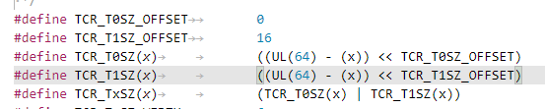
Head.s @39 __create_page_tables
X0
& idmap_pg_dir
X1
0
X16
adrp x5, __idmap_text_end
clz x5, x5
cmp x5, TCR_T0SZ(VA_BITS) <= 16
b.ge 1f
X5 __idmap_text_end symbol 로딩
값은 ffff000010b8d658
CLZ X5 X5 -> 0으로 최종 저장 됨
__idmap_text_end ffff000010b8d658
TCR_T0SZ(VA_BITS) ((UL(64) – 48) << 0) = 16
b.ge 1f ( f : forward, b : backward)
@40 으로 감.
X2
00000000_00000000
X17
X3
&__idmap_test_start
X18
X4
X19
X5
0
X20
X6
&vabits_user
X21
DTB (PHY ADDRERSS)
X7
00000000_00000711
X22
X8
X23
00000000_00000000
X9
X24
X10
X25
X11
X26
X12
X27
X13
X28
stext+24
X14
X29
FP
X15
X30
@29 + 8
LR
SPSEL
SCTLR_EL1
00000000_00000001
00000000_30500800

Slide 43
Head.s @40 __create_page_tables
X0
& idmap_pg_dir
X1
0
X16
adr_l x6, idmap_t0sz
str x5, [x6]
dmb sy
dc ivac, x6
*(&idmap_t0sz) = 0;
idmap_t0sz 에 값을 저장하고 코어내의 idmap_t0sz 데이터 캐시 라인(PoC 관점) 을 무효화 시킨다.
X2
00000000_00000000
X17
X3
&__idmap_test_start
X18
X4
X19
X5
0
X20
X6
&idmap_t0sz
X21
DTB (PHY ADDRERSS)
X7
00000000_00000711
X22
X8
X23
00000000_00000000
X9
X24
X10
X25
X11
X26
X12
X27
X13
X28
stext+24
X14
X29
FP
X15
X30
@29 + 8
LR
SPSEL
SCTLR_EL1
00000000_00000001
00000000_30500800

Slide 44
Head.s @41 __create_page_tables
X0
& idmap_pg_dir
X1
0
X16
mov x4, #1 << (PHYS_MASK_SHIFT - PGDIR_SHIFT)
str_l x4, idmap_ptrs_per_pgd, x5
#define PHYS_MASK_SHIFT (48)
#define CONFIG_PGTABLE_LEVELS 4
#define PGDIR_SHIFT ARM64_HW_PGTABLE_LEVEL_SHIFT(4 - CONFIG_PGTABLE_LEVELS)
#define ARM64_HW_PGTABLE_LEVEL_SHIFT(n) ((PAGE_SHIFT - 3) * (4 - (n)) + 3)
#define PAGE_SHIFT 12
#define ARM64_HW_PGTABLE_LEVEL_SHIFT(n) ((PAGE_SHIFT - 3) * (4 - (n)) + 3)
(PHYS_MASK_SHIFT - PGDIR_SHIFT) = 39
*(&idmap_ptrs_per_pgd) = 00000080_00000000
X2
00000000_00000000
X17
X3
&__idmap_test_start
X18
X4
00000080_00000000
X19
X5
& idmap_ptrs_per_pgd
X20
X6
&idmap_t0sz
X21
DTB (PHY ADDRERSS)
X7
00000000_00000711
X22
X8
X23
00000000_00000000
X9
X24
X10
X25
X11
X26
X12
X27
X13
X28
stext+24
X14
X29
FP
X15
X30
@29 + 8
LR
SPSEL
SCTLR_EL1
00000000_00000001
00000000_30500800

Slide 45
Head.s @42 __create_page_tables
X0
& idmap_pg_dir
X1
0
X16
ldr_l x4, idmap_ptrs_per_pgd
mov x5, x3
adr_l x6, __idmap_text_end
X2
00000000_00000000
X17
X3
&__idmap_test_start
X18
X4
& idmap_ptrs_per_pgd
X19
X5
&__idmap_test_start
X20
X6
& __idmap_text_end
X21
DTB (PHY ADDRERSS)
X7
00000000_00000711
X22
X8
X23
00000000_00000000
X9
X24
X10
X25
X11
X26
X12
X27
X13
X28
stext+24
X14
X29
FP
X15
X30
@29 + 8
LR
SPSEL
SCTLR_EL1
00000000_00000001
00000000_30500800

Slide 46
Head.s @43 __create_page_tables
tbl
X0
& idmap_pg_dir
rtbl
X1
0
X16
map_memory x0, x1, x3, x6, x7, x3, x4, x10, x11, x12, x13, x14
* Map memory for specified virtual address range. Each level of page table needed supports
* multiple entries. If a level requires n entries the next page table level is assumed to be
* formed from n pages.
*
* tbl: location of page table
* rtbl: address to be used for first level page table entry (typically tbl + PAGE_SIZE)
* vstart: start address to map
* vend: end address to map - we map [vstart, vend]
* flags: flags to use to map last level entries
* phys: physical address corresponding to vstart - physical memory is contiguous
* pgds: the number of pgd entries
*
* Temporaries: istart, iend, tmp, count, sv - these need to be different registers
* Preserves: vstart, vend, flags
* Corrupts: tbl, rtbl, istart, iend, tmp, count, sv
.macro map_memory, tbl, rtbl, vstart, vend, flags, phys, pgds, istart, iend, tmp, count, sv
X2
00000000_00000000
X17
phys
vstart
X3
&__idmap_text_start
X18
pgds
X4
& idmap_ptrs_per_pgd
X19
X5
&__idmap_text_start
X20
vend
X6
& __idmap_text_end
X21
DTB (PHY ADDRERSS)
flags
X7
00000000_00000711
X22
X8
X23
00000000_00000000
X9
X24
istart
X10
X25
iend
X11
X26
tmp
X12
X27
count
X13
X28
stext+24
sv
X14
X29
FP
X15
X30
@29 + 8
LR
SPSEL
SCTLR_EL1
00000000_00000001
00000000_30500800

Slide 47
Head.s @44 __create_page_tables
tbl
X0
& init_pg_dir
rtbl
X1
0
X16
adrp x0, init_pg_dir
mov_q x5, KIMAGE_VADDR + TEXT_OFFSET // compile time __va(_text)
add x5, x5, x23 // add KASLR displacement
mov x4, PTRS_PER_PGD
adrp x6, _end // runtime __pa(_end)
adrp x3, _text // runtime __pa(_text)
sub x6, x6, x3 // _end - _text
add x6, x6, x5 // runtime __va(_end)
map_memory x0, x1, x5, x6, x7, x3, x4, x10, x11, x12, x13, x14
#define PTRS_PER_PGD (1 << (48- 39(@41))) = 512
X2
00000000_00000000
X17
phys
X3
&_text
X18
pgds
X4
00000000_00000200
X19
vstart
X5
&_text
X20
vend
X6
&_end
X21
DTB (PHY ADDRERSS)
flags
X7
00000000_00000711
X22
X8
X23
00000000_00000000
X9
X24
istart
X10
X25
iend
X11
X26
tmp
X12
X27
count
X13
X28
stext+24
sv
X14
X29
FP
X15
X30
@29 + 8
LR
SPSEL
SCTLR_EL1
00000000_00000001
00000000_30500800

Slide 48
Head.s @45 __create_page_tables
tbl
X0
& idmap_pg_dir
rtbl
X1
Sizeof(idmap_pg_dir +init_pg_dir)
X16
adrp x0, idmap_pg_dir
adrp x1, init_pg_end
sub x1, x1, x0
dmb sy
bl __inval_dcache_area
ret x28
__inval_dcache_area(void *addr, size_t len);
X0 – addr
X1 – len
Ensure that any D-cache lines are invalidated.
stext+24 주소로 return
X2
00000000_00000000
X17
phys
X3
&_text
X18
pgds
X4
00000000_00000200
X19
vstart
X5
&_text
X20
vend
X6
&_end
X21
DTB (PHY ADDRERSS)
flags
X7
00000000_00000711
X22
X8
X23
00000000_00000000
X9
X24
istart
X10
X25
iend
X11
X26
tmp
X12
X27
count
X13
X28
stext+24
sv
X14
X29
FP
X15
X30
&(ret x28)
LR
SPSEL
SCTLR_EL1
00000000_00000001
00000000_30500800

