Slide 1
Trivia & Quiz Night Manager
CPE 314 Software Design | Group 2 | Final design review
John Daevin S. Simbajon Clarence Philip A. Elegino Justine B. Cuizon
Joshua Neil G. Malaya Gebrielle P. Mirasol
Notes:
Introduce the project and the five members. Instructor: Richyll Son, University of Cebu, first semester S.Y. 2026-2027. Suggested time for the whole talk: about 15 to 20 minutes.

Slide 2
The problem we solve
Quiz hosts keep score on paper or in scattered spreadsheets.
Results are easy to lose and hard to compare from one night to the next.
One app: questions, scoring, saved history and charts, so groups can see who is improving and which categories are hardest.
8
database tables
116
JUnit test methods
2
charts: bar and line
Notes:
Quiz hosts keep score on paper or in spreadsheets, so results are lost and hard to compare. Our app keeps questions, scores and history in one place and shows them as charts. The three numbers come from the database schema (8 tables), the test suite (116 test methods) and the analytics screen (bar and line chart).

Slide 3
How a game night runs
A
B
C
D
Add players
Play a round
Scores saved
Review
The host adds players and sets the seconds per question
Timed, turn-based. Multiple choice or true/false, with undo
Every answer is stored in SQLite as it happens
Leaderboard and analytics charts from the saved data
Offline question bank
Open Trivia DB download
JSON file import
Notes:
Walk through one game: the host adds players, the game runs turn by turn with a timer, every answer is saved, and the results screens read the saved data. Questions come from three sources: the offline bank that ships with the app, a download from the Open Trivia Database, or a JSON file.

Slide 4
System architecture
JavaFX screens
Home, NewGameScreen, M2GameScreen, Players, Results, AnalyticsScreen, ImportScreen
Game logic
GameEngine, RoundRobinGame, Question classes, Category tree
Background work
FetchQuestionsTask, JsonImportTask, ScoreJsonImporter
Data and API
DAO classes on SQLite, OpenTdbClient, QuestionParser, QuestionBankService
Today the screens call the DAOs directly. A controller layer is planned (see Known issues).
Notes:
Four layers. The screens call the game logic and the DAOs. Slow work (downloads, imports, exports) runs in background tasks. Be upfront about the limitation in the footnote: today the screens create their DAOs directly, and a controller layer is planned. It is listed in KNOWN_ISSUES.md.

Slide 5
Object-oriented design
Question (abstract)
getPoints() | getChoices() | display()
The game code holds only a Question
Each subclass owns its points, choices and answer checking
A new question type is one subclass and one case in QuestionMapper
MultipleChoiceQuestion
TrueFalseQuestion
QuestionMapper builds the right subclass from a database row
Notes:
Question is an abstract class with three abstract methods: getPoints, display and getChoices. MultipleChoiceQuestion and TrueFalseQuestion extend it. The game engine and the screens only hold a Question, so each subclass decides its own points, choices and answer checking. That is polymorphism, and it is also single responsibility: the question classes only represent questions. A new type means one subclass and one case in QuestionMapper.

Slide 6
Data structures and recursion
A
Queue and stack in GameEngine
B
Recursive category tree
Question queue: the next question comes off the front
Undo history: the last answer comes off the top
Undo restores the score and puts the question back
Each category can have a parent, so categories form a tree
One search collects questions from a category and all its subcategories
A visited set stops loops from bad parent links
Deque<Question> Deque<AnswerHistory>
CategoryDao.getQuestionsRecursively
Notes:
GameEngine keeps two Deque objects: one is the queue of questions still to ask, the other is the undo history used as a stack. Undo restores the score and puts the question back. The category tree is stored with parent_id, and CategoryDao.getQuestionsRecursively walks the tree. The visited set protects against a bad parent link that would loop forever.

Slide 7
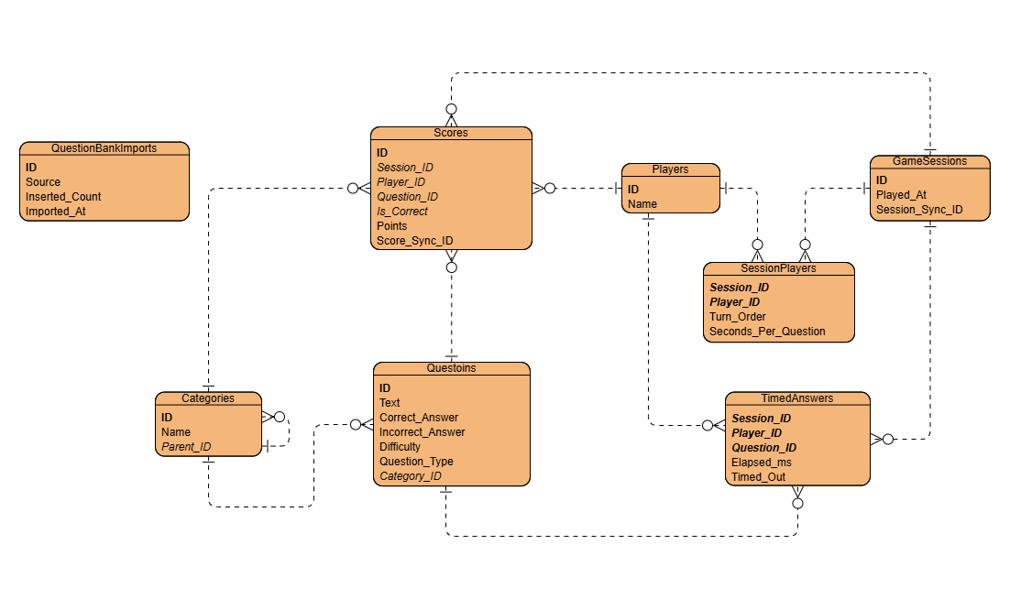
Database design
8 tables, foreign keys enforced
players and sessions are many-to-many, resolved by session_players
Categories reference themselves (parent_id)
Sync IDs make score re-imports duplicate-safe
Notes:
This is the team's finalized ER diagram from the design document (Figure 3). Eight tables. players and game_sessions are many-to-many, resolved by session_players. categories reference themselves through parent_id. The sync IDs on sessions and scores let a score file be imported twice without duplicates. NOTE: replace this picture with the final version of the diagram if the team updates it (for example after removing scores.category_id).

Slide 8
API integration
1
A screen starts FetchQuestionsTask
Request
2
OpenTdbClient sends the HTTP GET
opentdb.com/api.php?amount=10
&encode=url3986
3
QuestionParser checks response_code and decodes
difficulty and type added when chosen
Only response_code 0 is accepted
Timeouts: 12 s connect, 25 s request
4
QuestionBankService skips duplicates
5
DAOs save the questions to SQLite
6
Saved questions work offline
Notes:
The public API is the Open Trivia Database. The request always sends amount and encode=url3986, and adds difficulty and type when the user picks them. QuestionParser accepts only response_code 0. Timeouts are 12 seconds to connect and 25 seconds for the request. Questions are saved to SQLite, so the game still works offline.

Slide 9
Concurrency
Operation | Started from | How it runs
Download questions | Home, M2GameScreen | FetchQuestionsTask (JavaFX Task)
Import questions (JSON) | M2GameScreen | JsonImportTask (JavaFX Task)
Import scores | ImportScreen | CompletableFuture, single-thread executor
Export scores | ImportScreen | JavaFX Task on a daemon thread
UI updated only on the JavaFX thread
Buttons disabled while a task runs
Daemon threads never block exit
Notes:
Four operations run off the JavaFX thread. The two question operations and the score export use a JavaFX Task on a daemon thread. The score import uses a CompletableFuture on its own single-thread executor and returns to the UI with Platform.runLater. The UI is only touched on the JavaFX thread, and the buttons are disabled while a task runs. Known limitation: some database reads (for example the dashboard counts on Home) still run on the UI thread. It is in KNOWN_ISSUES.md.

Slide 10
Data mining and charts
Aggregation in SQL
Accuracy % = correct / total x 100, per category (COUNT, SUM, GROUP BY)
Why these charts
Bar: compare accuracy across categories
Line: see a player's points change from game to game
Worked example from our design document
Notes:
AnalyticsDao runs SQL aggregation (COUNT, SUM, AVG, GROUP BY) on the saved scores. Accuracy per category is correct answers divided by total answers. The chart on this slide uses the worked example from our design document: 8 of 10 correct answers is 80 percent, and after two more wrong answers it is 66.7 percent. It shows why the charts update when the data changes. The bar chart compares categories, and the line chart shows one player's points over sessions.

Slide 11
Testing
Edge cases we test
Submit on an empty queue returns false
Malformed or missing JSON is rejected
Concurrent imports never duplicate questions
Not covered yet
OpenTDB client
Background tasks
RoundRobinGame
JavaFX screens
116
test methods
16 test classes
JUnit 5 + Maven
Notes:
116 test methods in 16 test classes, written with JUnit 5 and run with mvn test. CONFIRM THE LIVE NUMBER before presenting: run mvn test and use the count Maven reports (the instructor's earlier run on Nov 10 showed 102 passing, and more tests were added on Nov 13). Edge cases: empty queue, malformed or missing JSON, concurrent imports. Gaps: no tests yet for OpenTdbClient, the background tasks, RoundRobinGame or the screens. They are listed in KNOWN_ISSUES.md.

Slide 12
Team and contributions
John Daevin S. Simbajon
Clarence Philip A. Elegino
Justine B. Cuizon
Joshua Neil G. Malaya
Gebrielle P. Mirasol
Team Lead, Integrator
Core OOP and Logic
Database and API
UI/UX, JavaFX
Analytics and QA
Home dashboard, lives tracking, design document, 17 merges
Question classes, GameEngine, RoundRobinGame, Category tree
Schema and DAOs, OpenTDB client and parser, sync IDs
Screens, import and export UI, styling
AnalyticsDao, score importer, sample data, tests
36 commits
46 commits
30 commits
30 commits
15 commits
Notes:
Each member can show their work in the git history of project/milestone-2. Commit counts are as of 14 Nov 2026 and exclude merge commits. John also made 17 merge commits, the most in the team, and owns the design document. Be ready to name files and commits for your own part: see Section 9 of the design document.

Slide 13
Known issues and next steps
Known issues
No controller layer: screens call DAOs directly
Two game screens, several entry points
Some database reads run on the UI thread
No tests for the API client and tasks
Planned
Add controllers; thin screens
One game screen, one entry point
Run reads in background tasks
Add API client and task tests
User accounts with host and player roles
Notes:
Be honest about what is not finished. The four known issues are the ones the instructor raised and that are still in the code: no controller layer, two game screens and several entry points, some database reads on the UI thread, and missing tests for the API client and background tasks. The full list with files and line numbers is in KNOWN_ISSUES.md. User accounts with host and player roles are planned, not built.

Slide 14
Questions?
Thank you
github.com/daevinsimbajon-web/cpe314-69167-capstone-team-02
Notes:
Open for questions. Repository: github.com/daevinsimbajon-web/cpe314-69167-capstone-team-02, branch project/milestone-2.

